Slide 1


Geography
Rainforests
Year One
Geography | Year 3 | Rainforests | Life in the Rainforest | Lesson 4

Slide 2
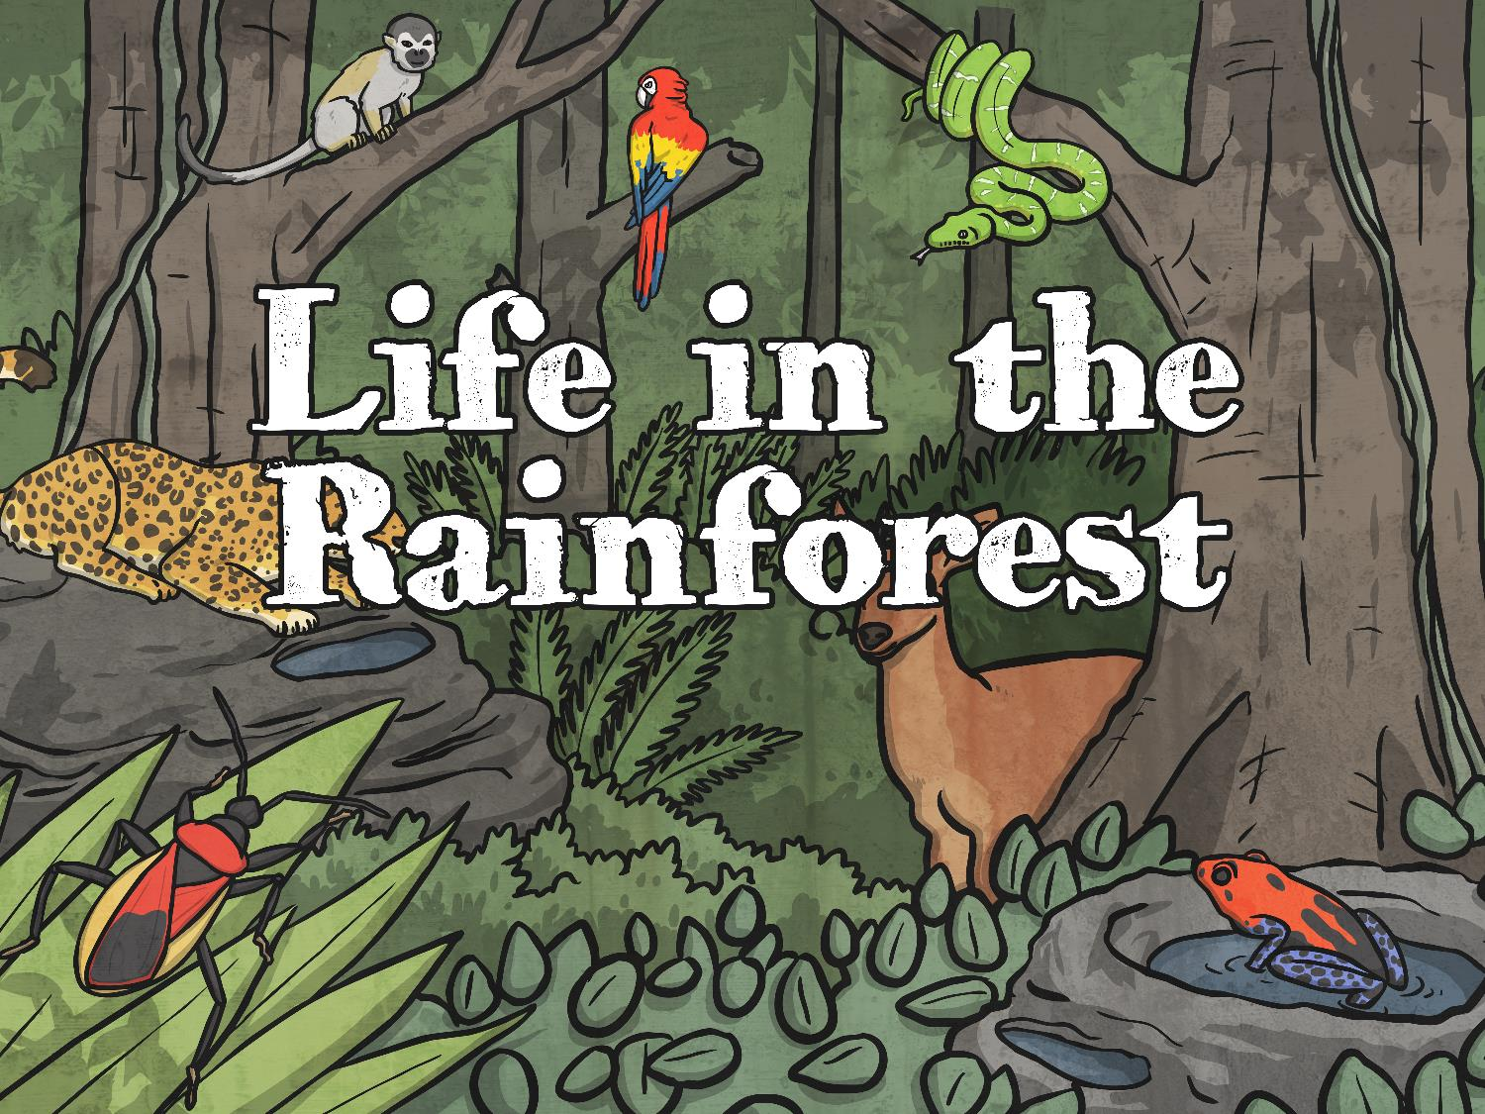


Slide 3
Aim
I can describe the animals and plants living in the rainforest.
Success Criteria
I can name some animals that live in each layer of the rainforest.
I can explain why different animals live in different layers.
I can tell you more about one animal living in a rainforest.

Slide 4

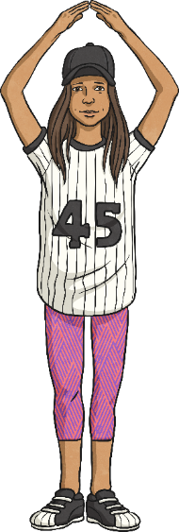
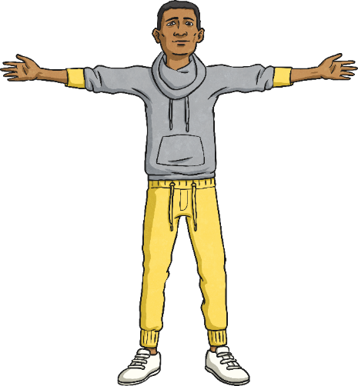
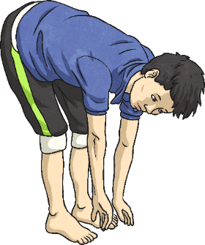
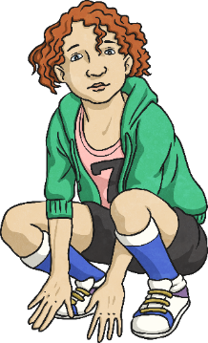
Which Layer?
Listen to the clue. Think about which layer of the rainforest the clue
relates to. Show what you think by doing one of the actions.
Emergent –
hands above head
Canopy –
arms out wide
Understory
– touch your toes
Forest floor – crouch down low

Slide 5
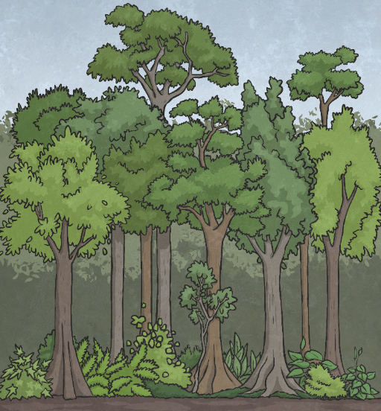
What Lives There?
Monkeys, bats and butterflies live here.
Snakes, toucans and tree frogs live here.
Many insects live here.
Gorillas, leopards and tigers live here.
Why do you think animals live in different layers of the rainforest?
They choose different habitats depending on their diet, how much water they need and how much shelter they need.

Slide 6

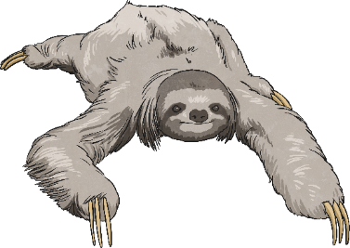
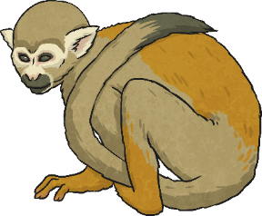
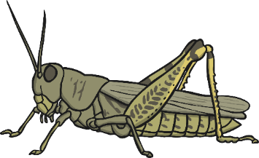
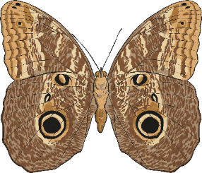
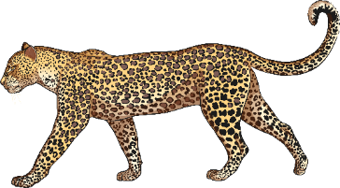
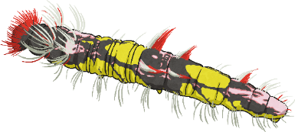
Where Do I Live?
Can you suggest where each of these animals might live?
Can you give a reason for your suggestion?
sloth
monkey
grasshopper
owl butterfly
blue morpho caterpillar
leopard

Slide 7

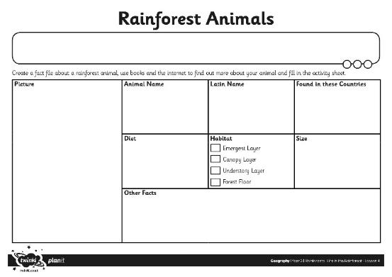
Rainforest Animals
Visit this website.
Choose one animal to research.
Fill in your Animal Fact File with what you have found out.
You could use information books to find out more.

Slide 8

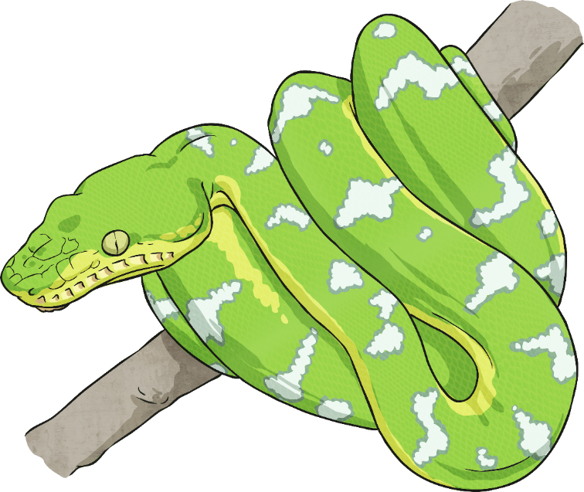
Where Does Your
Animal Belong?
Look at the habitat for your chosen animal.
Which layer of the rainforest would suit it best?
Be ready to share a fact about
your animal with
the class.

Slide 9

Aim
I can describe the animals and plants living in the rainforest.
Success Criteria
I can name some animals that live in each layer of the rainforest.
I can explain why different animals live in different layers.
I can tell you more about one animal living in a rainforest.

