Slide 1

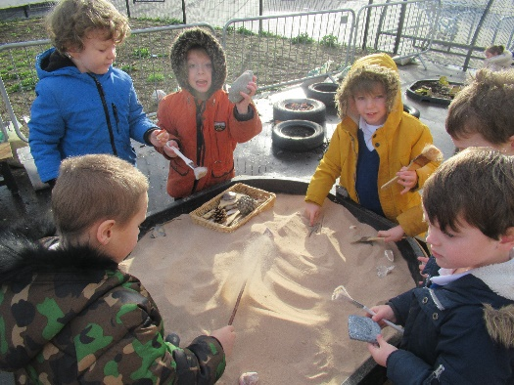
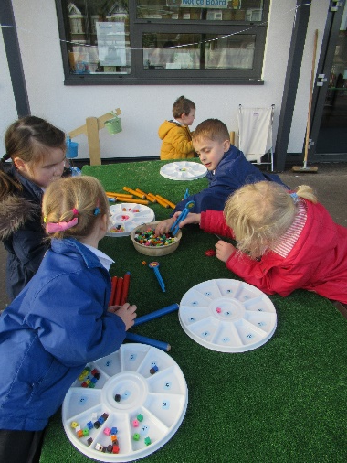

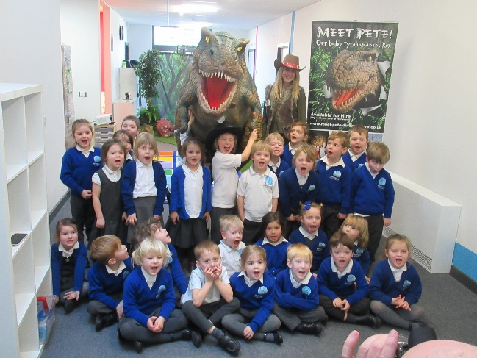

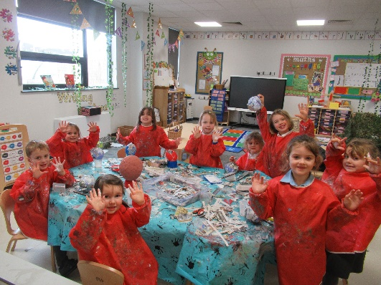
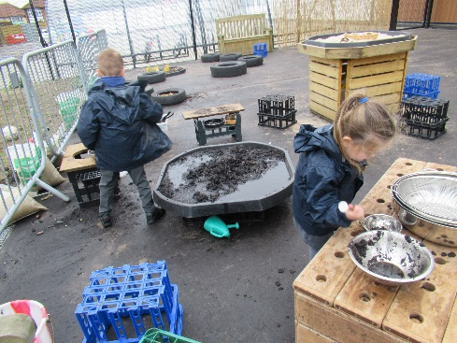
Welcome to
Year R
One Childhood, One Chance
Together we make a difference

Slide 2
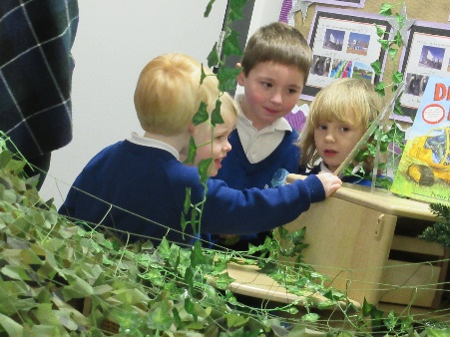
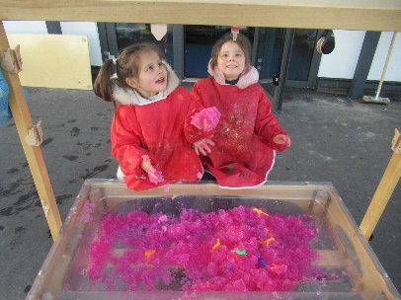
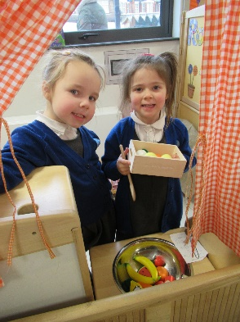
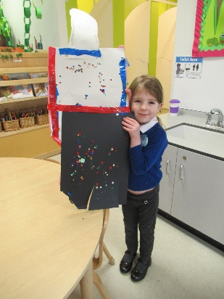
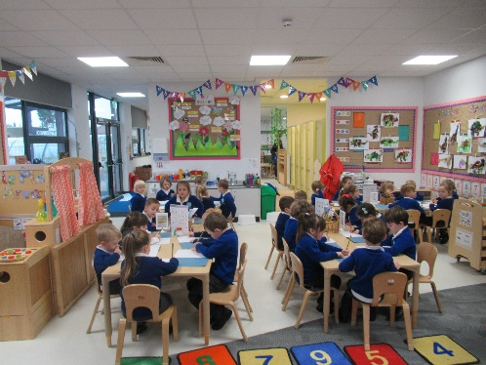
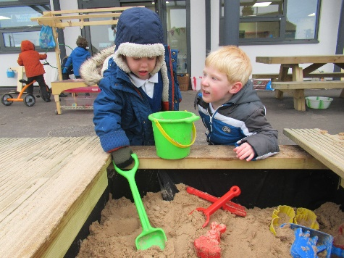
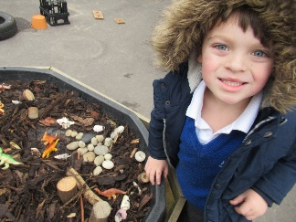
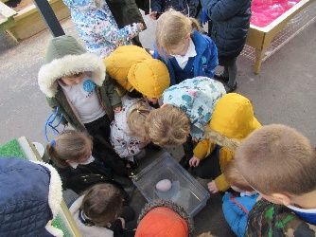
What we’ll cover:
The school day
Learning
Behaviour for learning
Home Learning
Other information
Questions

Slide 3

The School Day:
APPROXIMATE TIMES!
8:15 – doors open, activities on tables
8:30 – doors close, registration
9:00-9:15 RWI
9:15 - 9:35 – Smart Bodies and Snack
9:35 - 11.10 – Choosing Time (CIP)
11:10 - 11:30 – Maths
11:30 – 13:00 – Lunch
13:00-13:15- Peer Massage/Mindfulness
13:15-13:40 – Topic activities
13:40 – 14:40 – Choosing Time (CIP)
14:40 – 14:50 – Story Time
15:00 – End of the day

Slide 4
The School Day:
We are developing your child’s independence this term. Please encourage them to follow the visual steps for coming into the classroom in the morning (these are located in the cloakroom, by the book bags and sink area).
Please allow your child to try to do this on their own and we ask that parents/carers stay in the cloak room area.

Slide 5
Topics
Maths – recognising numbers, counting to 20 and beyond, counting fixed objects, ordering numbers, knowing what is 1 more and 1 less than a given number, shape recognition and addition and subtraction.
Topic/Writing –This is Me, Magical Winter, The World, Lets pretend, Growth, The Ocean and Writing sentences.
Please see our first curriculum letter on the website for full details.

Slide 6
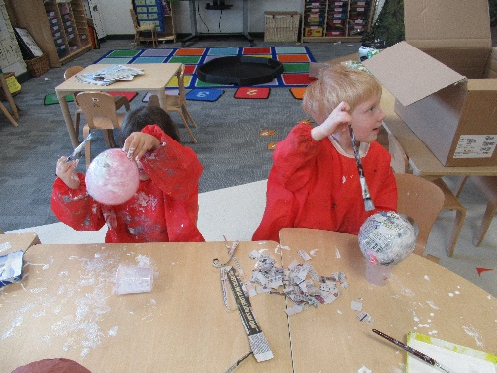
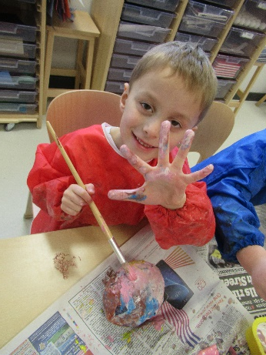
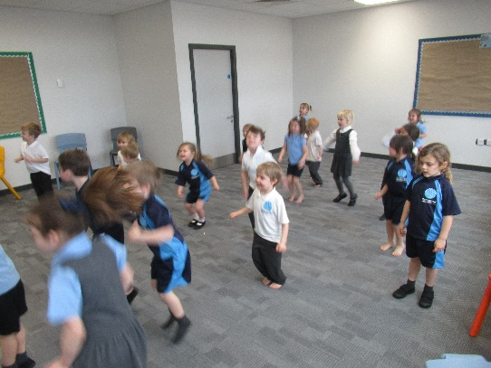
The School Day:
Music is on a Tuesday
Art is on a Tuesday
PE will be taught through the BEAM programme for the first two terms.
Drama is taught throughout the topics/ special occasions
We also have all of these areas covered through CIP daily.

Slide 7



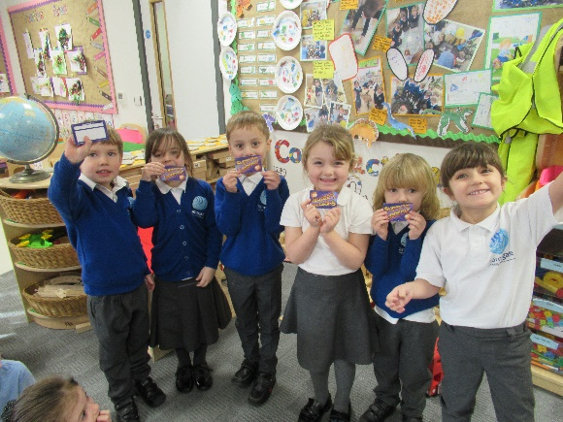
Behaviour
Smiley Cards – for good/expected behaviour each day (keeps you in the loop).
25 smiley cards brought back in will be exchanged for a certificate and reward.
Yellow and Red cards may lead to missing some of their choosing time or time out.
Superstar learner card
Table points
House points

Slide 8


Wow at Home Moments
Has y0ur child done/said something for the first time that you have never noticed before?
It could be anything from counting to 10, writing their name, riding a bike, putting their coat on independently, writing words/sentences, speaking, reading, playing with others, achievements in clubs etc.
This helps us to build up the child’s EYFS profile and get the whole picture of what your child can do.
These are located on the parent notice board.

Slide 9
Home Learning
Home learning will be every new topic and/or holiday. We let the children’s interests lead.
Please work together with your child on these tasks.
Please check the website/blog for new love to learn tasks. When it has a love to learn on it we will send it home too.
We will also put a copy of it on the notice board.
Sound books- Please complete weekly.

Slide 10
Reading at Home
Please read with your child daily if possible.
Your child will be able to choose and bring ‘book corner books’ home with them to read. When finished, please return to school and place in the reading basket.
Your child will receive a phonics book closer to Christmas when they have been exposed to the set 1 sounds.
Parent phonics workshop: Tuesday 2nd October 2:30pm

Slide 11
Other information
Wellies
PE kit
Water bottle
Home Basket, Lost Property Basket
Parent notice board and school website.
Class blog

Slide 12

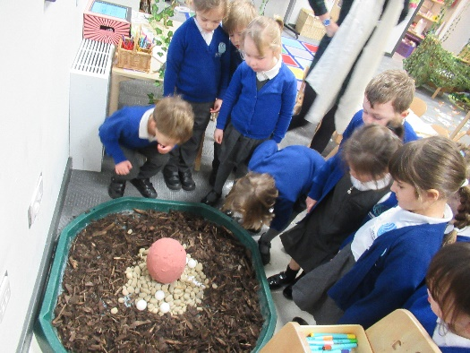

Any Questions?

