Slide 1


Geography
Rainforests
Year One
Geography | Year 3 | Rainforests | Protecting the Rainforests| Lesson 6

Slide 2
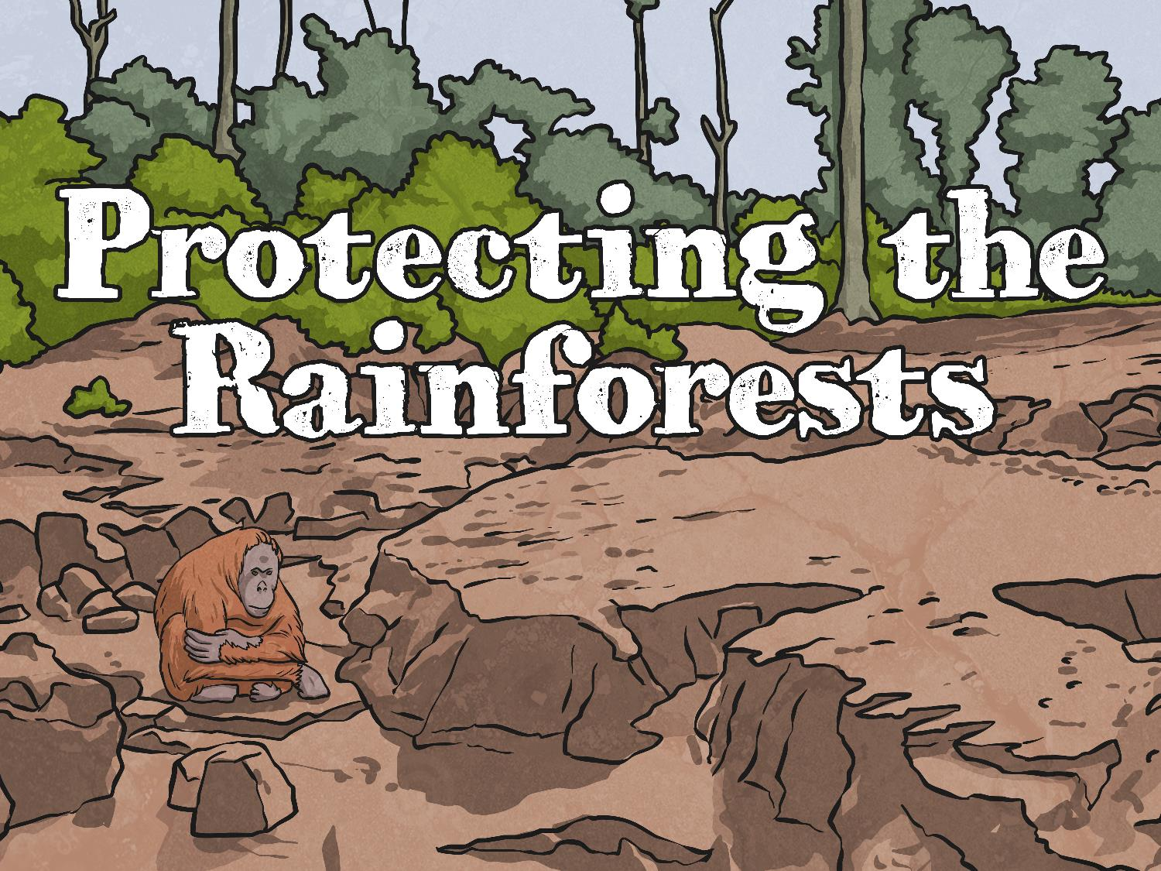


Slide 3
Aim
I can explain the effects humans are having on the rainforests.
Success Criteria
I can tell you what deforestation means.
I can tell you why deforestation is happening.
I can identify positive effects of deforestation.
I can identify negative effects of deforestation.
I can tell you some things I can do to help limit the impact of deforestation.

Slide 4

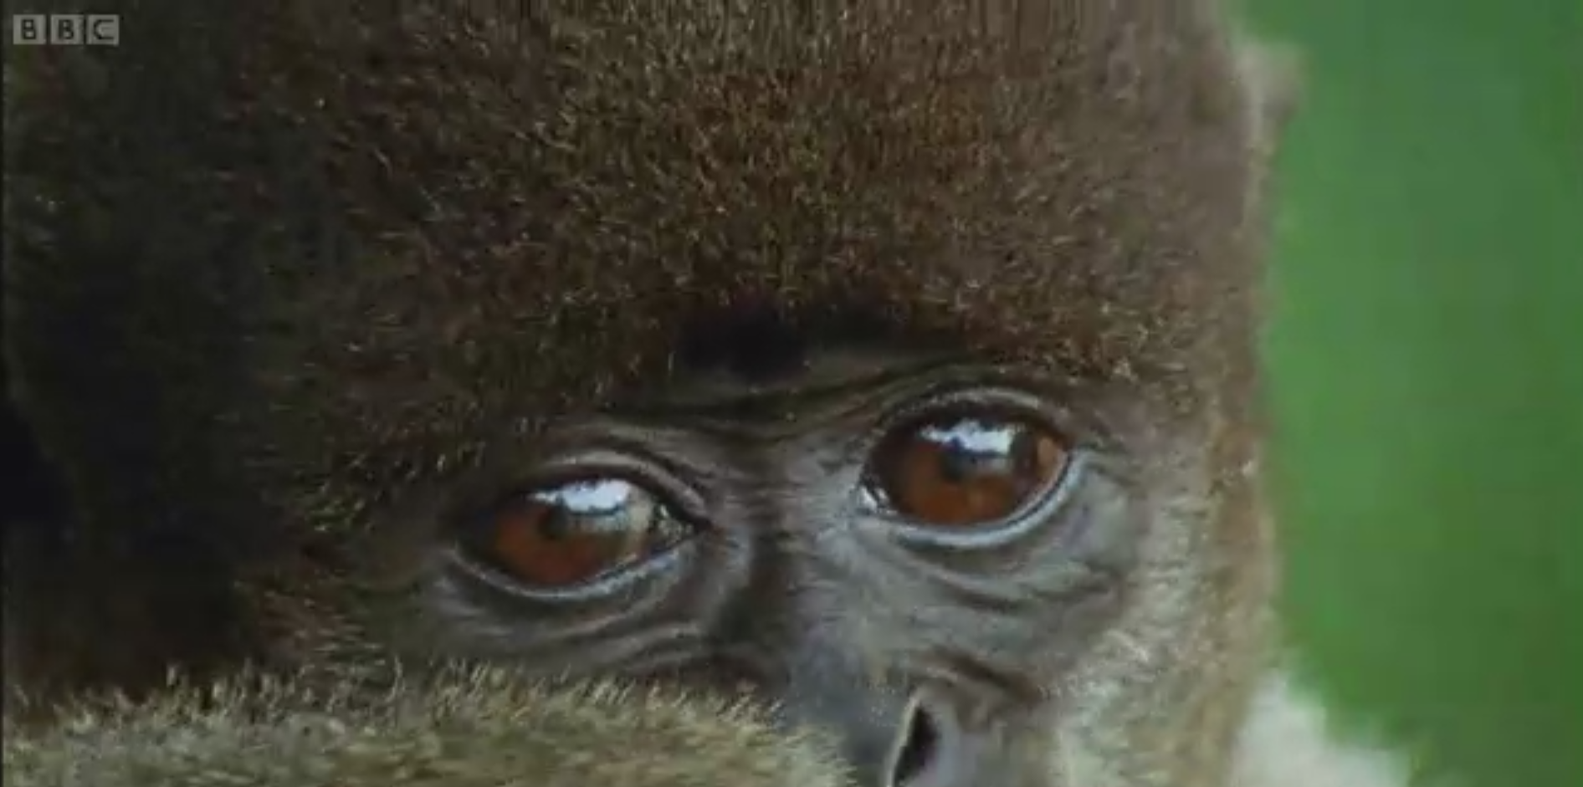

Why Does the
Rainforest Need Protecting?
Watch this video clip about the rainforest - Why might survival in the rainforest be so hard?

Slide 5
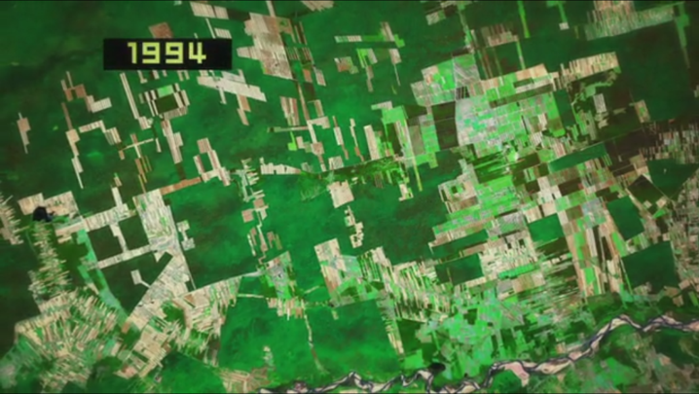

Why Does the
Rainforest Need Protecting?
This video shows the rate of deforestation in Bolivia.
Why do you think trees are being chopped down?
To create fields for farming cattle.
To create fields for growing crops.
To produce timber to make furniture.
To produce wood pulp to make paper.
To create space for housing.

Slide 6

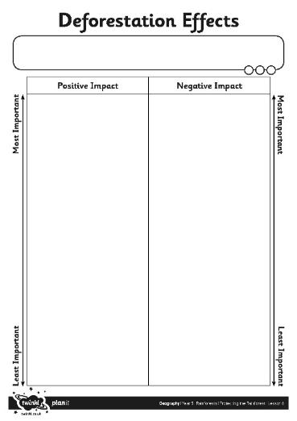
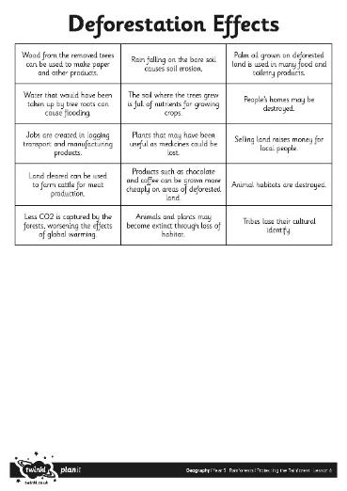
Positive or Negative Impact?
Work together in your groups.
First, sort out the effects of deforestation into those with positive impacts and those with negative impacts.
Next, look at each set. Sort out the ones that you think are most important. Which ones are least important?

Slide 7
What Did You Decide?
Which effects are positive? Which are negative? How did you choose which were important effects and which were less important? Click on the statements to see which are positive and which are negative.
Positive
Wood from the removed trees can be used to make paper and other products.
Negative
Water that would have been taken up by tree roots can cause flooding.
Positive
Jobs are created in logging transport and manufacturing products.
Positive
Land cleared can be used to farm cattle for meat production.
Negative
Less CO₂ is captured by the forests, worsening the effects of global warming.
Negative
Rain falling on the bare soil causes soil erosion.
Positive
The soil where the trees grew is full of nutrients for growing crops.
Negative
Plants that may have been useful as medicines could be lost.
Positive
Products such as chocolate and coffee can be grown more cheaply on areas of deforested land.
Negative
Animals and plants may become extinct through loss of habitat.
Positive
Palm oil grown on deforested land is used in many food and toiletry products.
Negative
People’s homes may be destroyed.
Positive
Selling land raises money for local people.
Negative
Animal habitats are destroyed.
Negative
Tribes lose their cultural identify.

Slide 8
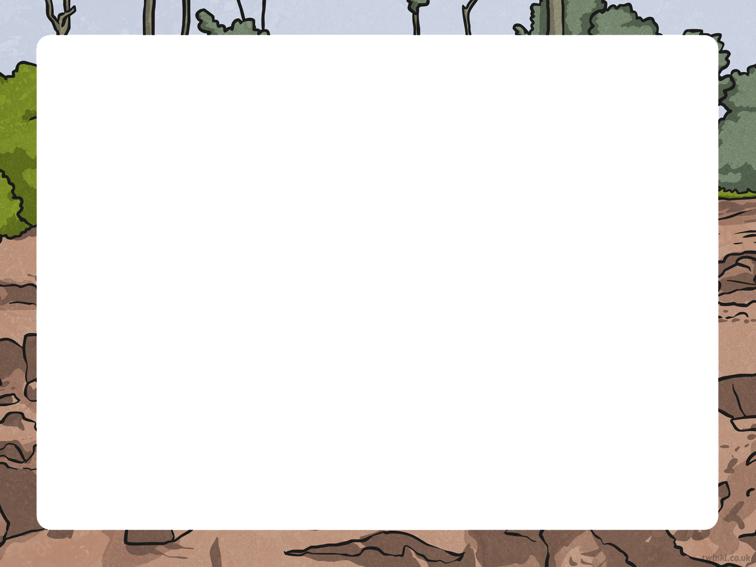

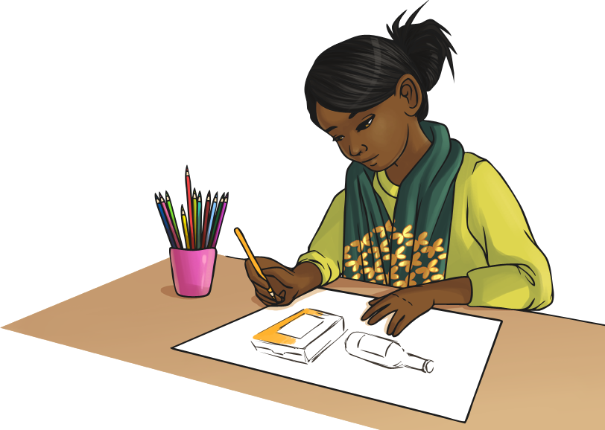
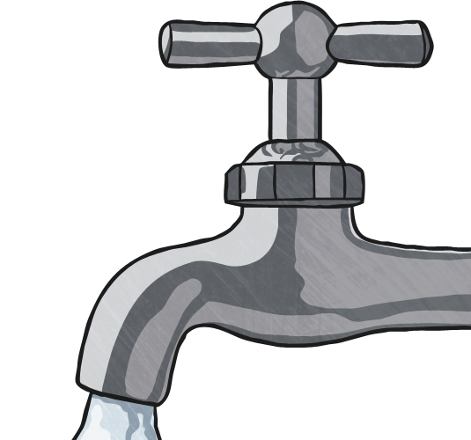

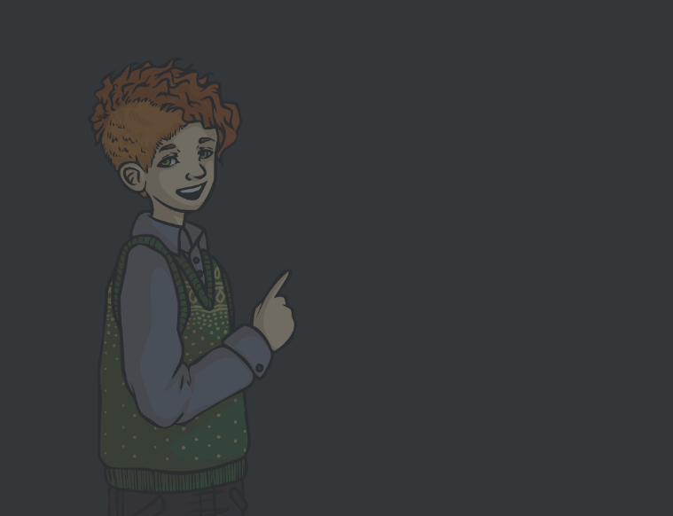


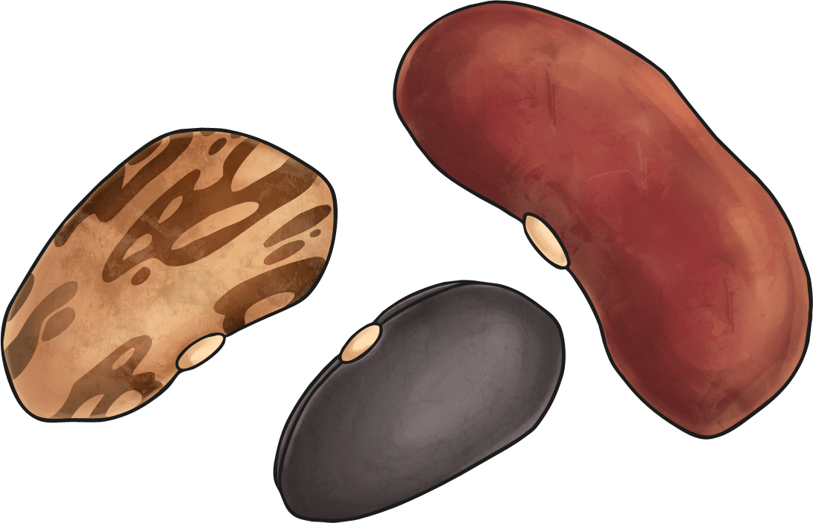


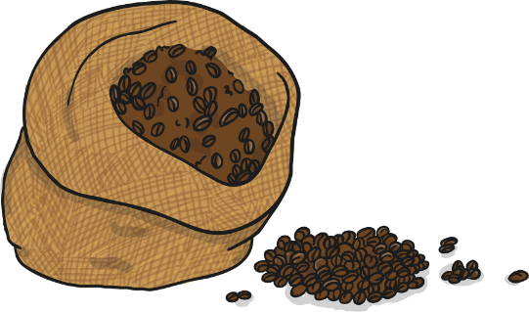
What Can Be Done?
Instead of eating meat, think of eating other sources of protein such as fish, soy, beans, whole-wheat,
and nuts.
Encourage your parents, relatives, and friends to buy furniture and wood that is FCS Certified.
Buy Fairtrade fruits, vegetables, chocolate and coffee.
Turn off lights and other electrical items when not in use to save electricity.
Turn off the tap when brushing your teeth to save water.
Use e-books, or a library, rather than buying new books.
Buy paper products made from recycled paper.
Use pencils until they are stubs!
Always use both sides of paper when writing, drawing, photocopying, etc.
What effect would adopting
each idea have?
Which negative impact would it
help to limit?

Slide 9

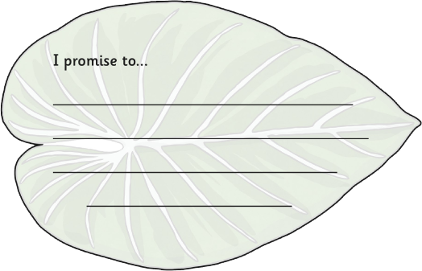
What Can I Do?
Which action could you adopt as your promise to protect the rainforests? Write down your promise.
Always use both sides of paper when writing, drawing, photocopying, etc.
Use e-books, or a library, rather than buying new books.
Buy paper products made from recycled paper.
Use pencils until they are stubs!
Encourage your parents, relatives, and friends to buy furniture and wood that is FSC Certified.
Instead of eating meat, think of eating other sources of protein such as fish, soy, beans, whole-wheat, and nuts.
Buy Fairtrade fruits, vegetables, chocolate and coffee.
Turn off lights and other electrical items when not in use to save electricity.
Turn off the tap when brushing your teeth to save water.

Slide 10

Aim
I can explain the effects humans are having on the rainforests.
Success Criteria
I can tell you what deforestation means.
I can tell you why deforestation is happening.
I can identify positive effects of deforestation.
I can identify negative effects of deforestation.
I can tell you some things I can do to help limit the impact of deforestation.

