Slide 1


Year 1 – Summer Block 5 – Money – Counting in Coins
About This Resource:
This PowerPoint has been designed to support your teaching of this small step. It includes a starter activity and an example of each question from the Varied Fluency and Reasoning and Problem Solving resources also provided in this pack. You can choose to work through all examples provided or a selection of them depending on the needs of your class.
National Curriculum Objectives:
Mathematics Year 1: (1M3) Recognise and know the value of different denominations of coins and notes
More Year 1 Money resources.
Did you like this resource? Don’t forget to review it on our website.
© Classroom Secrets Limited 2018

Slide 2
Year 1 – Summer Block 5 – Money
Step 3: Counting in Coins
© Classroom Secrets Limited 2018

Slide 3
Introduction
What comes next?
2, 4, 6, 8, ___ , ___ , ___
5, 10, 15, ___ , ___ , ___
30, 40, 50, ___ , ___ , ___
0, 5, ___ , ___ , ___ , 25
0, ___ , ___ , ___ , 8, 10
© Classroom Secrets Limited 2018

Slide 4
Introduction
What comes next?
2, 4, 6, 8, ___ , ___ , ___
5, 10, 15, ___ , ___ , ___
30, 40, 50, ___ , ___ , ___
0, 5, ___ , ___ , ___ , 25
0, ___ , ___ , ___ , 8, 10
10
12
14
20
25
30
60
70
80
10
15
20
2
4
6
© Classroom Secrets Limited 2018

Slide 5
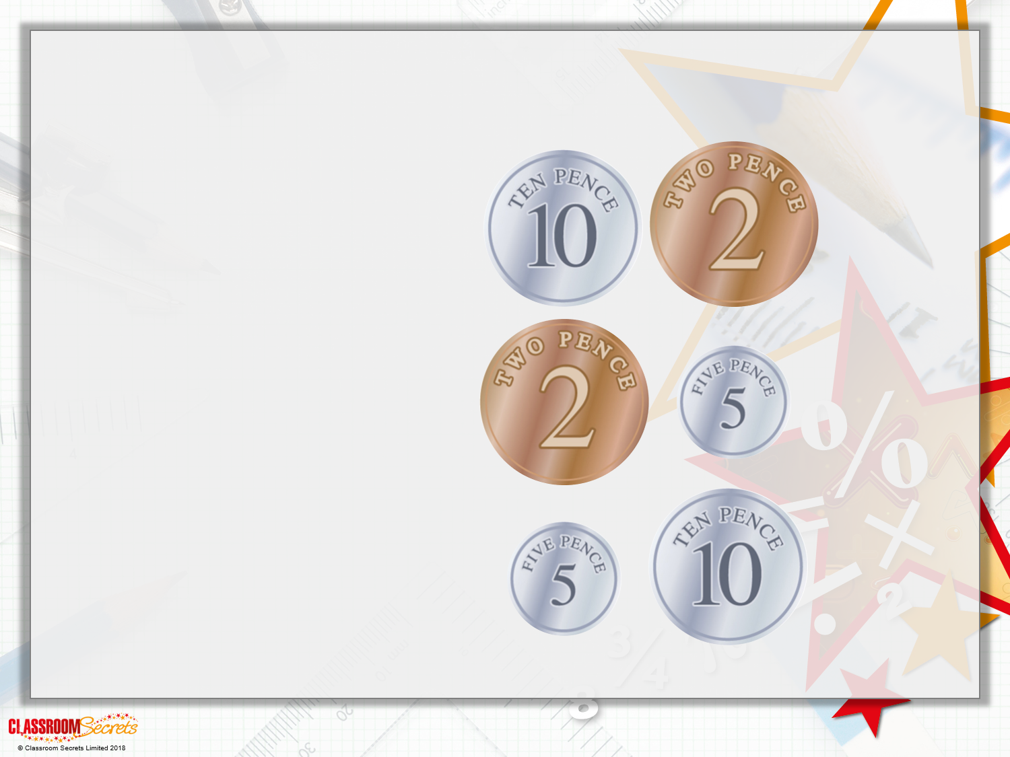
Varied Fluency 1
How much is there altogether?
 | =
 | =
 | =

Slide 6
Varied Fluency 1
How much is there altogether?
12p | =
7p | =
15p | =

Slide 7
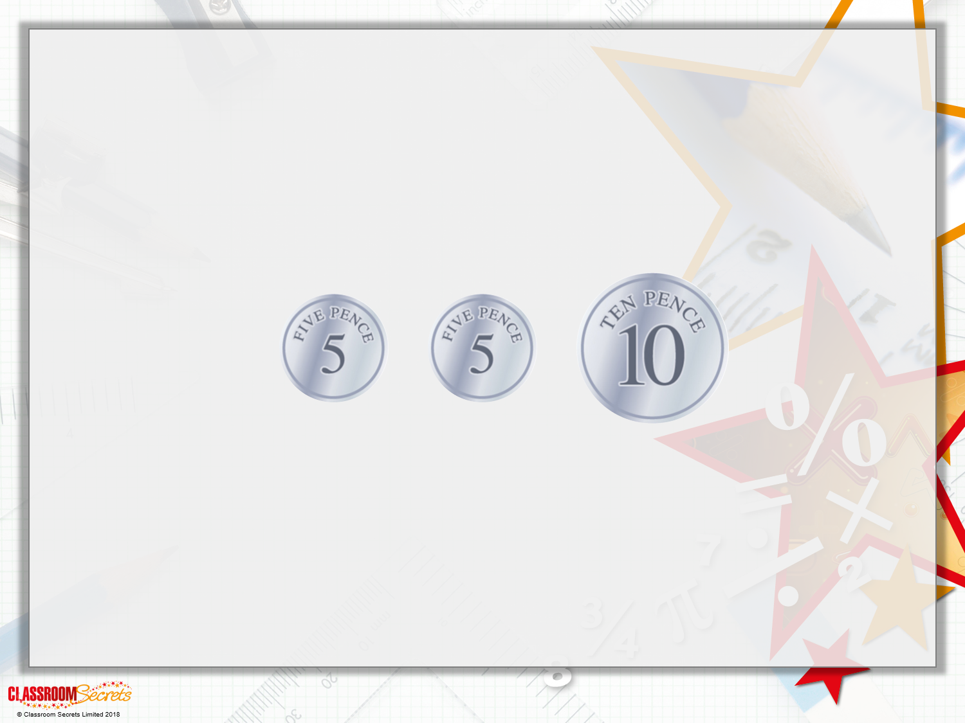
Varied Fluency 2
The amount is10p.
True or false?

Slide 8
Varied Fluency 2
The amount is10p.
True or false?
False
5p + 5p + 10p = 20p

Slide 9
Varied Fluency 3
Choose a word to make the statements correct.
5p is ________ than 10p
5p is ________ than 2p
Word Bank
more less
© Classroom Secrets Limited 2018

Slide 10
Varied Fluency 3
Choose a word to make the statements correct.
5p is ________ than 10p
5p is ________ than 2p
less
more
Word Bank
more less
© Classroom Secrets Limited 2018

Slide 11
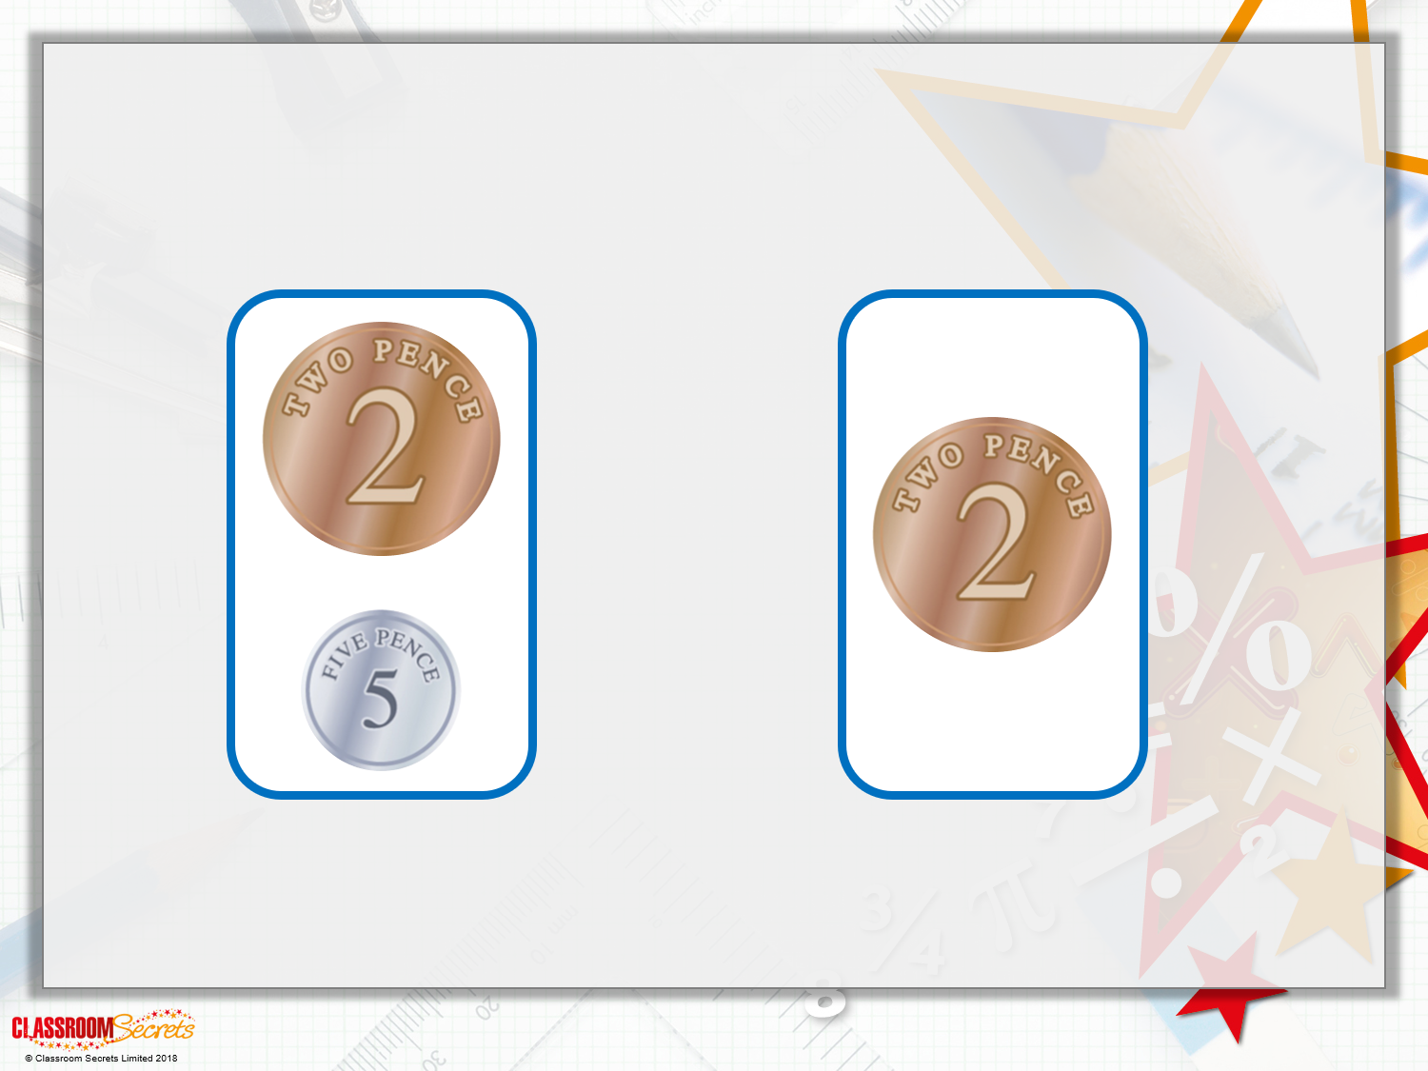
Varied Fluency 4
Which is the biggest amount?

Slide 12
Varied Fluency 4
Which is the biggest amount?
7p
2p

Slide 13
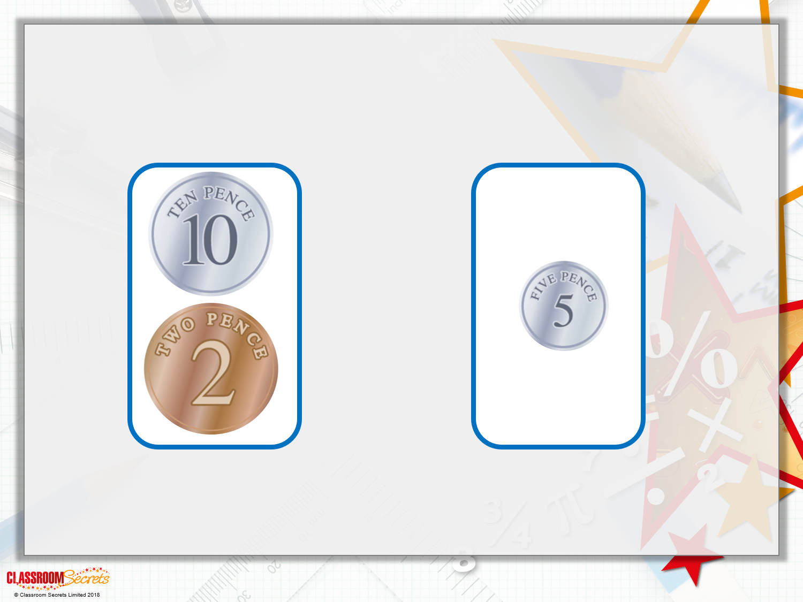
Varied Fluency 5
Which is the smallest amount?

Slide 14
Varied Fluency 5
Which is the smallest amount?
12p
5p

Slide 15
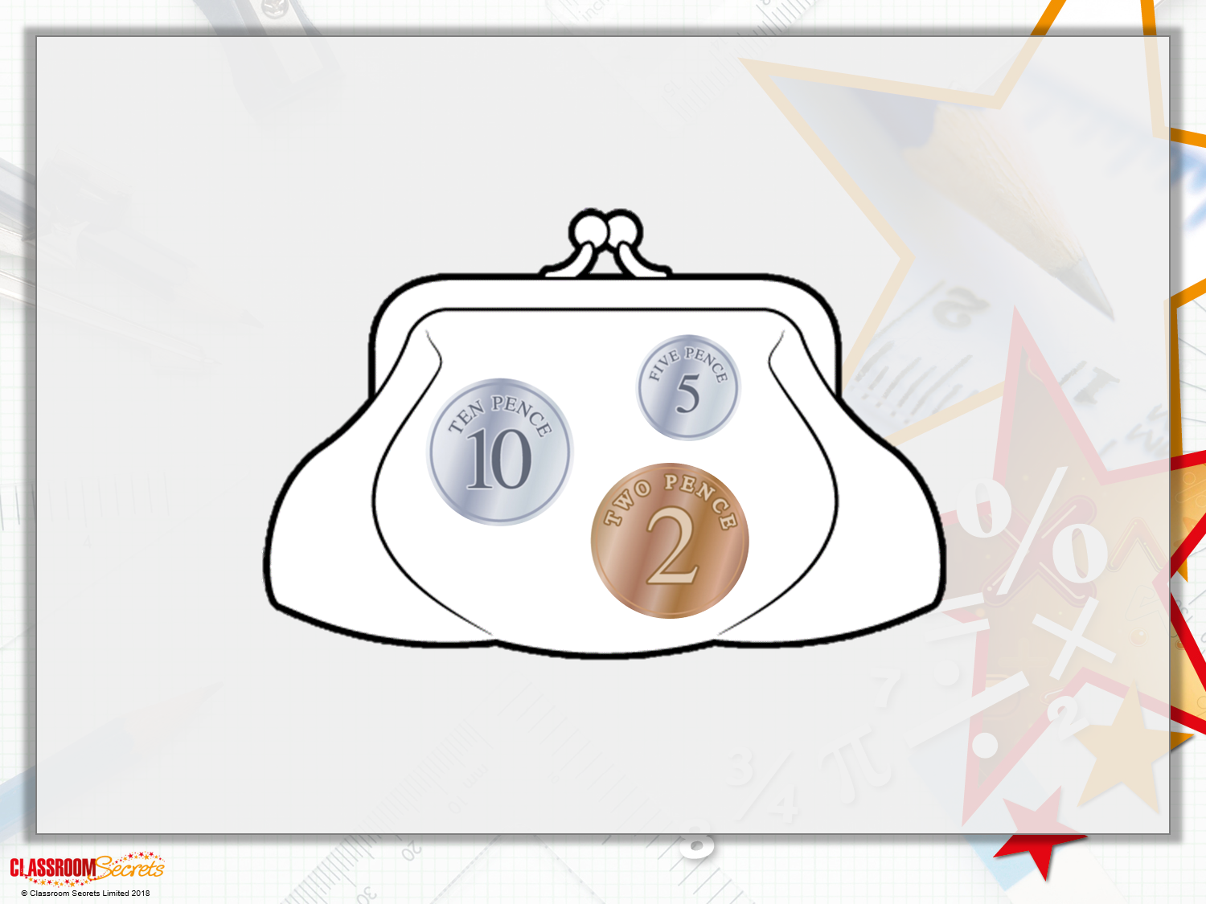
Reasoning 1
Lou thinks she has 17p in her purse. Is she correct? Prove it.

Slide 16
Reasoning 1
Lou thinks she has 17p in her purse. Is she correct? Prove it.
Lou is correct because...

Slide 17
Reasoning 1
Lou thinks she has 17p in her purse. Is she correct? Prove it.
Lou is correct because 2p + 5p + 10p = 17p.

Slide 18
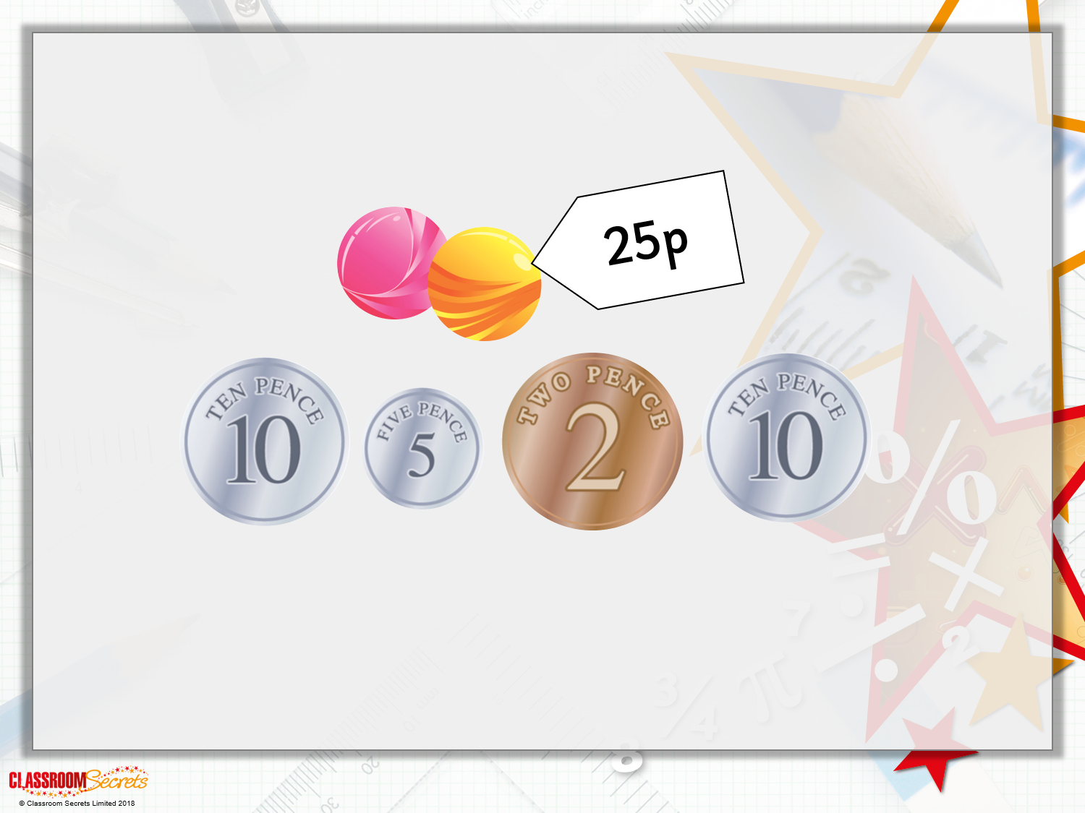
Problem Solving 1
Which coins are needed to buy the marbles?

Slide 19
Problem Solving 1
Which coins are needed to buy the marbles?
Possible answer: 10p, 10p, 5p

Slide 20
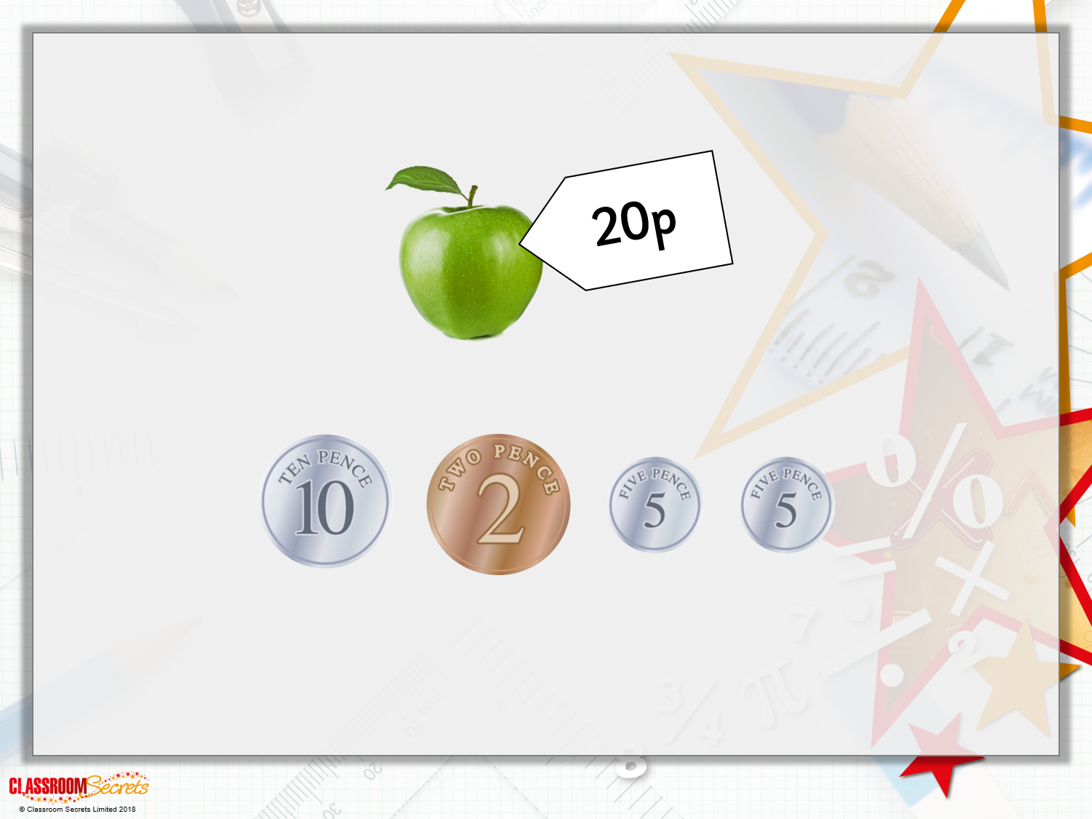
Reasoning 2
Emma wants to buy an apple.
Does she have enough money?
Explain your answer.

Slide 21
Reasoning 2
Emma wants to buy an apple.
Does she have enough money?
Explain your answer.
Emma has enough money because...

Slide 22
Reasoning 2
Emma wants to buy an apple.
Does she have enough money?
Explain your answer.
Emma has enough money because 10p + 5p + 5p = 20p. She would have 2p left over.

