Slide 1


Maths
Statistics
Year One
Maths | Year 5 | Statistics | Line Graphs | Lesson 1 of 5: Hot Drinks Line Graphs

Slide 2
Hot Drinks Line Graphs

Slide 3
Aim
I can answer questions about data presented in a line graph.
Success Criteria
I can…
I can identify the features of a line graph.
I can interpret data in tables and line graphs.
I can answer comparison, sum and difference questions about data presented in a line graph.

Slide 4


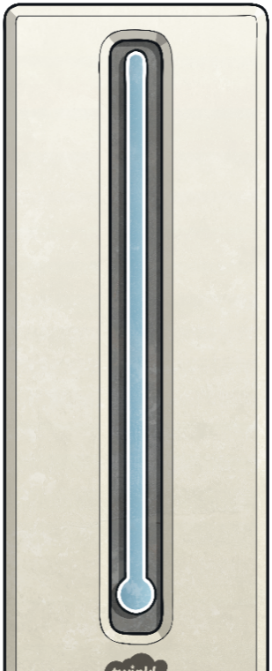
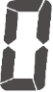

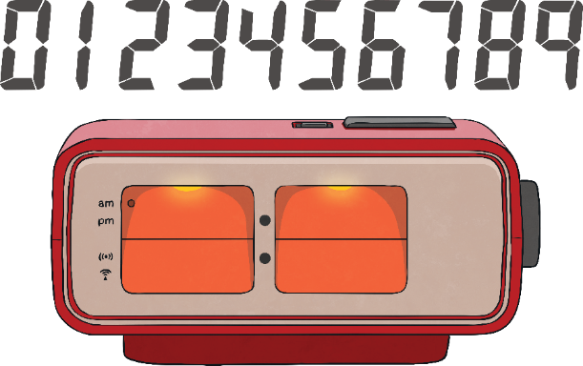




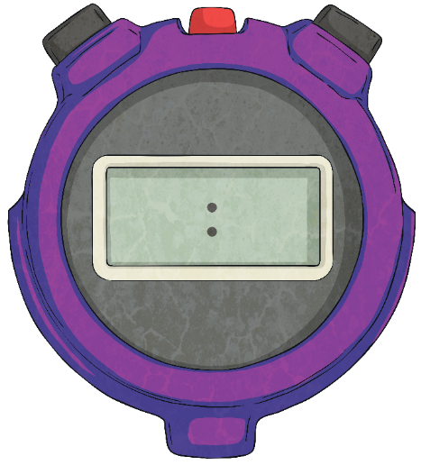
Temperature Investigation
In their science lesson, Class 5 are investigating how
the temperature of boiled water changes over time.
100
°C
90
80
Continuous
They are going to record the temperature of a cup of boiled water over twenty minutes.
Is the temperature of the water going to be discrete or continuous data?
70
60
50
Use the following slide to complete the results table of Class 5’s investigation.
40
30
20
10
0

Slide 5



Temperature Investigation
Complete the table showing the results of Class 5’s science investigation.
100
°C
90
Time in Minutes | Temperature in °C
80
70
0
100
60
50
5
50
40
10
30
30
15
25
20
10
20
20
0

Slide 6

Temperature Investigation
The children from Class 5 wrote four questions about their data.
Can you answer them?
By how many degrees
did the water cool from the fifth minute to the tenth minute?
By how many degrees
did the water cool from
the tenth minute to the fifteenth minute?
By how many degrees
did the water cool over the twenty minutes?
By how many degrees
did the water cool over
the first five minutes?
Time in Minutes | Temperature in °C
0 | 100
5 | 50
10 | 30
15 | 25
20 | 20
80°C
50°C
20°C
5°C

Slide 7


Temperature over Time
Class 5 repeat their investigation, but this time they record
the change in temperature of a cup of coffee over 20 minutes.
Time in Minutes | Temperature in °C
0 | 84
5 | 40
10 | 27
15 | 23
20 | 21
The time data is called the independent variable.
The temperature data is called the dependent variable.
How do you think this data could be shown as a graph?

Slide 8



Line Graphs
Class 5’s teacher, Mrs Chambers, explains to her class
that they can draw a line graph of the data.
In this investigation,
we have measured how
the temperature changed every five minutes.
Line graphs are
used to show changes to a measurement
over time.
Time in Minutes | Temperature in °C
0 | 84
5 | 40
10 | 27
15 | 23
20 | 21

Slide 9

Line Graphs
A line graph has a horizontal axis.
In this investigation, the horizontal axis is showing time in minutes.
A line graph also has a vertical axis.
In this investigation, the vertical axis is showing temperature in °C.
Data is plotted on to a line graph in the same way as a coordinate grid.
These data plots are then joined with straight lines.
We can see that the temperature of the coffee dropped more
quickly at the start of the twenty minutes than at the end.
Using the line graph, we can get approximate temperatures of the coffee
at any time over the 20 minutes, not just at five minute intervals.
A line graph can also be used to give us
data between the plotted measurements.
The line shows us visually how the temperature of the coffee changed.
A Line Graph to Show the Change in Temperature of a Cup of Coffee
85
80
75
After six and
a half minutes, the temperature of the coffee was approximately
36°C.
70
65
60
55
Temperature in °C
50
45
40
35
30
25
20
0
1
2
3
4
5
6
7
8
9
10
11
12
13
14
15
16
17
18
19
20
Time in Minutes

Slide 10

Line Graph Questions
At which minute of the investigation was
the temperature of the coffee 32°C?
During which minute of the investigation was
the temperature of the coffee 60°C?
What was the temperature of the coffee at minute 7 of the investigation?
What was the temperature of the coffee at minute 4 of the investigation?
A Line Graph to Show the Change in Temperature of a Cup of Coffee
85
80
75
70
65
60
35°C
48°C
Minute 8
Minute 2
55
Temperature in °C
50
45
40
35
30
25
20
0
1
2
3
4
5
6
7
8
9
10
11
12
13
14
15
16
17
18
19
20
Time in Minutes

Slide 11

Line Graph Challenge
Finally, Mrs Chambers shows the children a line graph which
shows the change in temperature of two different hot drinks.
A line graph that shows two sets of data can be used for comparison.
A key will show you which line represents which data.
Which drink had a higher temperature at minute 3?
What was the difference in temperature of the two hot drinks at minute 3?
A Line Graph to Show the Change in Temperature of a Cup of Coffee and a Cup of Lemon Tea
100
Key/Legend
= Coffee
= Lemon Tea
95
Lemon Tea
90
13°C
85
80
75
70
65
Temperature in °C
60
55
50
45
40
35
30
25
20
0
1
2
3
4
5
6
7
8
9
10
11
12
13
14
15
16
Time in Minutes

Slide 12


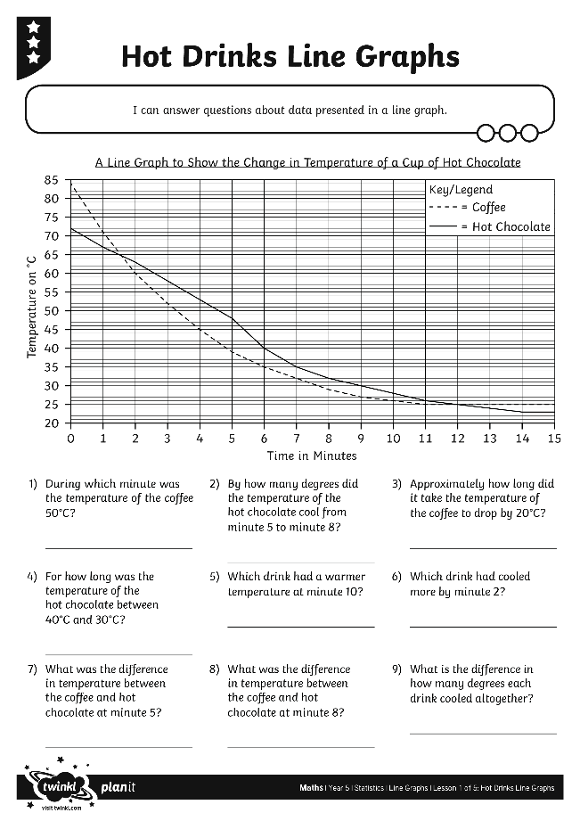
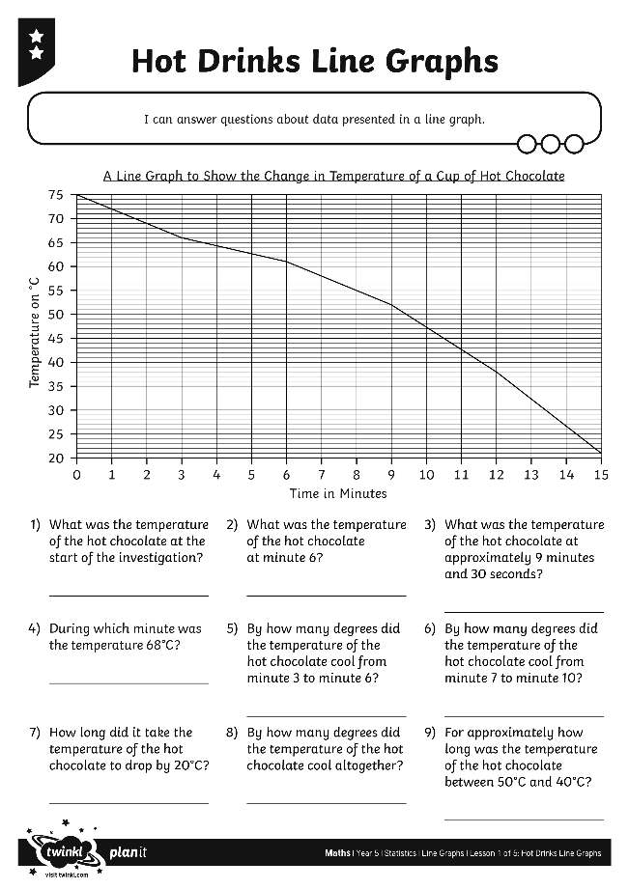
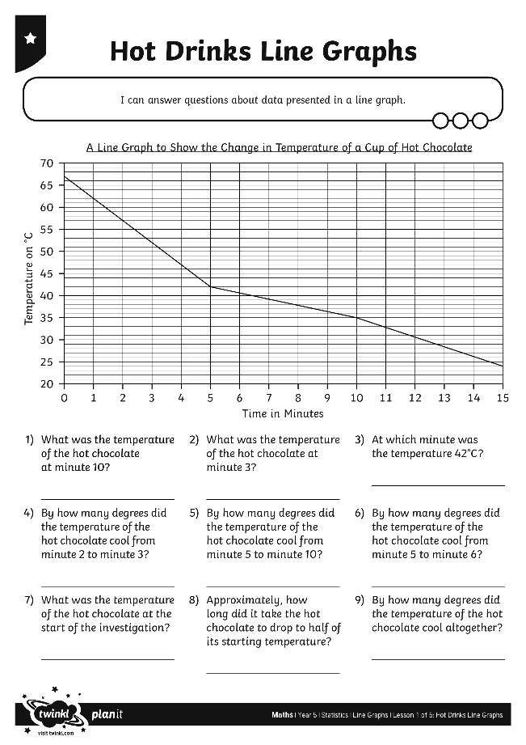
Hot Drinks Line Graphs
Use your marvellous maths skills to complete these activity sheets:

Slide 13


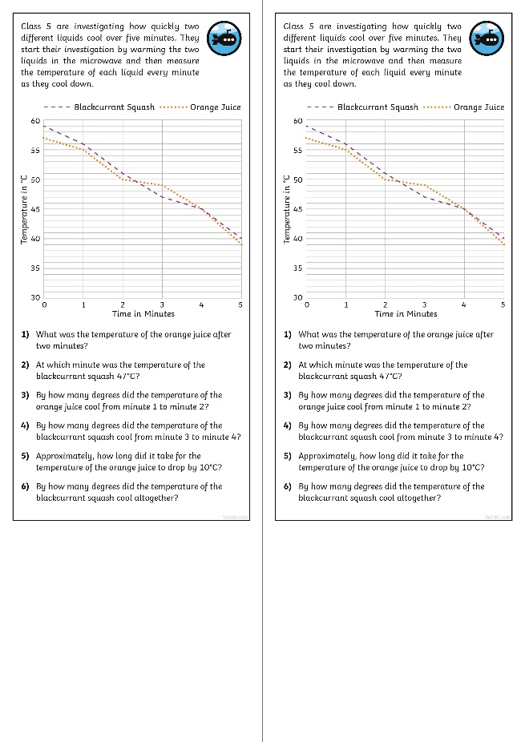
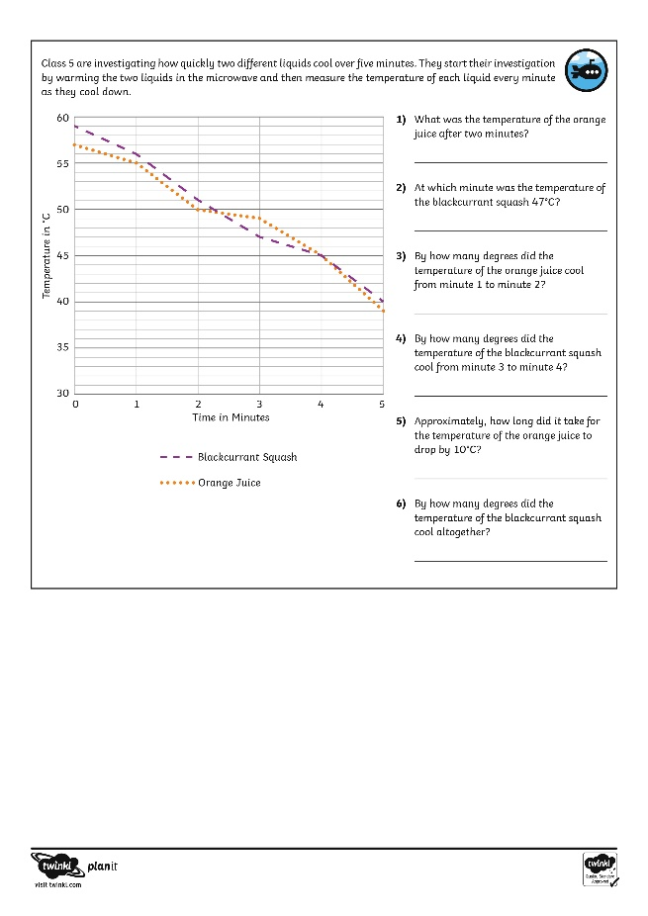
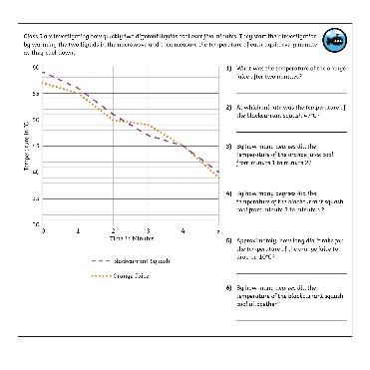
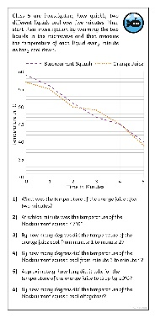
Diving into Mastery
Dive in by completing your own activity!

Slide 14
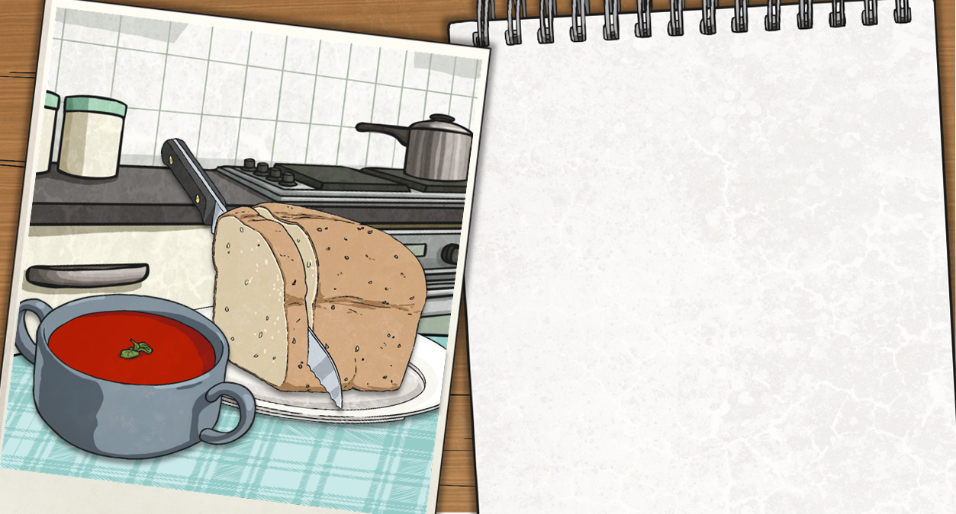
Soup Temperature Reveal
Choose a question to answer about the line graph. Click on the box
once to check your answer and then again to reveal a part of the picture!
65°C
What was the temperature at minute 10?
40°C
What was the temperature increase over ten minutes?
45°C
A Line Graph to Show the Change in
Temperature of a Saucepan of Soup
What was the temperature at minute 5?
70
20°C
What was the temperature increase over the first five minutes?
Minute 2
65
At what minute was the temperature 33°C?
4°C
What was the temperature increase over the final minute?
60
55
50
Minute 3
At what minute was the temperature 37°C?
Temperature in °C
49°C
45
What was the temperature at minute 6?
57°C
What was the temperature at minute 8?
40
35
Minute 8
30
At what minute was the temperature 57°C?
8°C
25
What was the temperature increase over the first two minutes?
29°C
What was the temperature at minute 1?
20
0
1
2
3
4
5
6
7
8
9
10
Time in Minutes

Slide 15

Aim
I can answer questions about data presented in a line graph.
Success Criteria
I can…
I can identify the features of a line graph.
I can interpret data in tables and line graphs.
I can answer comparison, sum and difference questions about data presented in a line graph.

