Slide 2
Aim
Solve comparison, sum and difference problems using information presented in a line graph.

Slide 3

Draw Line Graphs
Diving
Class 5 measures the height of a sunflower over seven weeks.
Here is the table of data that shows their results.
Week | Height (cm)
1 | 54
2 | 63
3 | 70
4 | 75
5 | 82
6 | 87
7 | 94
×
×
×
Which point has been plotted correctly to show the height of the sunflower in week 1?
Orange

Slide 4
Draw Line Graphs
Diving
Class 5 measures the height of a sunflower over seven weeks.
Here is the table of data that shows their results.
Week | Height (cm)
1 | 54
2 | 63
3 | 70
4 | 75
5 | 82
6 | 87
7 | 94
×
×
×
×
Which point has been plotted correctly to show the height of the sunflower in week 2?
Blue

Slide 5
Draw Line Graphs
Diving
Class 5 measures the height of a sunflower over seven weeks.
Here is the table of data that shows their results.
Week | Height (cm)
1 | 54
2 | 63
3 | 70
4 | 75
5 | 82
6 | 87
7 | 94
×
×
×
×
×
Which point has been plotted correctly to show the height of the sunflower in week 3?
Blue

Slide 6
Draw Line Graphs
Diving
Class 5 measures the height of a sunflower over seven weeks.
Here is the table of data that shows their results.
Week | Height (cm)
1 | 54
2 | 63
3 | 70
4 | 75
5 | 82
6 | 87
7 | 94
×
×
×
×
×
×
Which point has been plotted correctly to show the height of the sunflower in week 4?
Green

Slide 7
Draw Line Graphs
Diving
Class 5 measures the height of a sunflower over seven weeks.
Here is the table of data that shows their results.
×
Week | Height (cm)
1 | 54
2 | 63
3 | 70
4 | 75
5 | 82
6 | 87
7 | 94
×
×
×
×
×
×
Which point has been plotted correctly to show the height of the sunflower in week 5?
Green

Slide 8
Draw Line Graphs
Diving
Class 5 measures the height of a sunflower over seven weeks.
Here is the table of data that shows their results.
×
×
Week | Height (cm)
1 | 54
2 | 63
3 | 70
4 | 75
5 | 82
6 | 87
7 | 94
×
×
×
×
×
×
Which point has been plotted correctly to show the height of the sunflower in week 6?
Orange

Slide 9
Draw Line Graphs
Diving
Class 5 measures the height of a sunflower over seven weeks.
Here is the table of data that shows their results.
×
×
×
×
Week | Height (cm)
1 | 54
2 | 63
3 | 70
4 | 75
5 | 82
6 | 87
7 | 94
×
×
×
×
×
Which point has been plotted correctly to show the height of the sunflower in week 7?
Blue

Slide 10

Draw Line Graphs
Deeper
Class 5 measures the heights of two sunflowers over six weeks. Here is the table of data that shows their results:
Sunflower 1
Week | Sunflower 1 Height (cm) | Sunflower 2 Height (cm)
1 | 53 | 55
2 | 58 | 60
3 | 70 | 64
4 | 74 | 70
5 | 82 | 79
6 | 91 | 85
Sunflower 2
×
×
×
×
×
×
×
Olivia draws a graph of the data. However, she has made 8 mistakes. Can you spot all the mistakes and explain what she got wrong?
×
×
×
×
×
What advice would you give Olivia for drawing line graphs?
1
3
3
4
5
6
7

Slide 11

Draw Line Graphs
Deepest
Three children in Class 5 measure the heights of their sunflowers over four weeks. Use the clues and the partially completed table of information to complete the results of the investigation so that the children can draw line graphs of the data.
In week 1, Milo’s sunflower was 3cm shorter than Daisy’s.
The difference between Milo’s and Olivia’s sunflowers in week 2 was 6cm. Olivia’s sunflower was taller.
In week 3, Daisy’s sunflower was taller than Milo’s but shorter than Olivia’s. It measured an odd number of cm.
By week 4, both Daisy’s and Milo’s sunflowers had grown 19cm since week 1. Olivia’s had grown 3cm less than this.
Week | Daisy’s Sunflower - Height (cm) | Milo’s Sunflower - Height (cm) | Olivia’s Sunflower - Height (cm)
1 | 35 |  | 37
2 | 40 | 37
3 |  | 45 | 48
4
32
43
47
54
51
53

Slide 12
Draw Line Graphs
Deepest
Has Daisy drawn the correct line graph for her sunflower?
×
No. The point for week 3 has been plotted at 45cm instead of 47cm.
×
×
×
Week | Daisy’s Sunflower - Height (cm) | Milo’s Sunflower - Height (cm) | Olivia’s Sunflower - Height (cm)
1 | 35 | 32 | 37
2 | 40 | 37 | 43
3 | 47 | 45 | 48
4 | 54 | 51 | 53

Slide 13
Draw Line Graphs
Deepest
Has Milo drawn the correct line graph for his sunflower?
×
Yes.
×
×
×
Week | Daisy’s Sunflower - Height (cm) | Milo’s Sunflower - Height (cm) | Olivia’s Sunflower - Height (cm)
1 | 35 | 32 | 37
2 | 40 | 37 | 43
3 | 47 | 45 | 48
4 | 54 | 51 | 53

Slide 14
Draw Line Graphs
Deepest
How could Olivia improve the line graph for her sunflower?
×
She could draw her line graph more accurately by including the horizontal lines from the y-axis for all intervals, instead of just using them for intervals of five.
×
×
×
Week | Daisy’s Sunflower - Height (cm) | Milo’s Sunflower - Height (cm) | Olivia’s Sunflower - Height (cm)
1 | 35 | 32 | 37
2 | 40 | 37 | 43
3 | 47 | 45 | 48
4 | 54 | 51 | 53

Slide 15


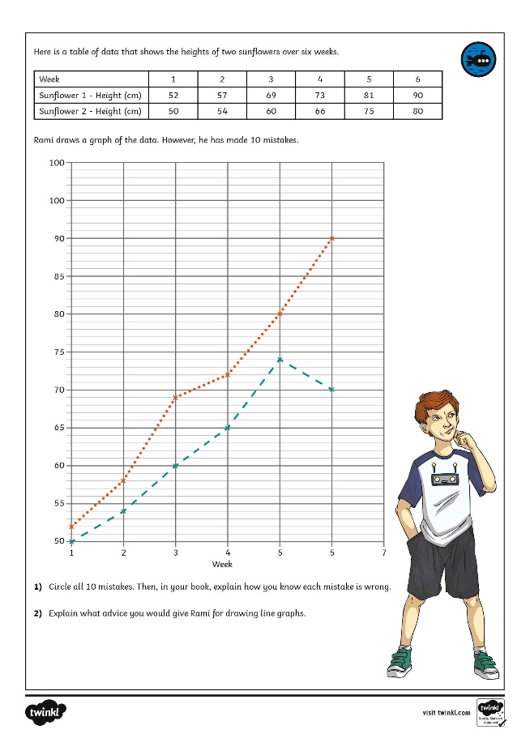
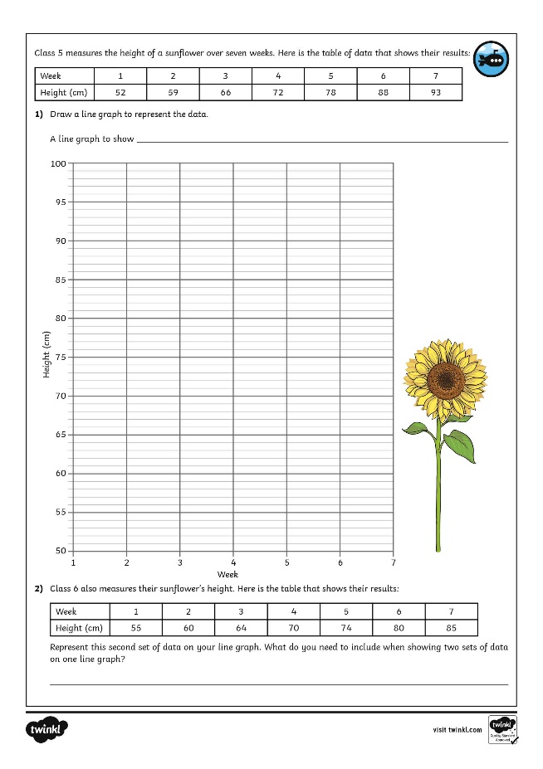
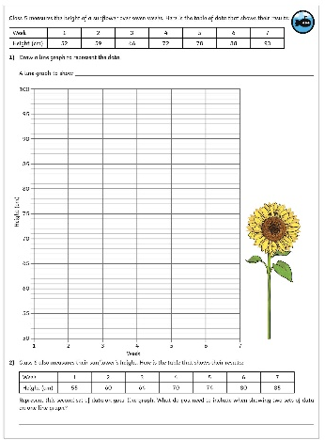
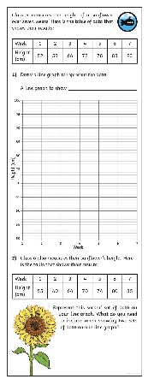
Draw Line Graphs
Dive in by completing your own activity!

