Slide 1

IALT: create a scene description based on a picture.
Notes:
NOTE:
To change the image on this slide, select the picture and delete it. Then click the Pictures icon in the placeholder to insert your own image.

Slide 2
IALT create a scene description based on a picture.
Steps to success:
Paragraphs
Adjectives and expanded noun phrases
Attention to detail
Challenge: Use personification

Slide 3
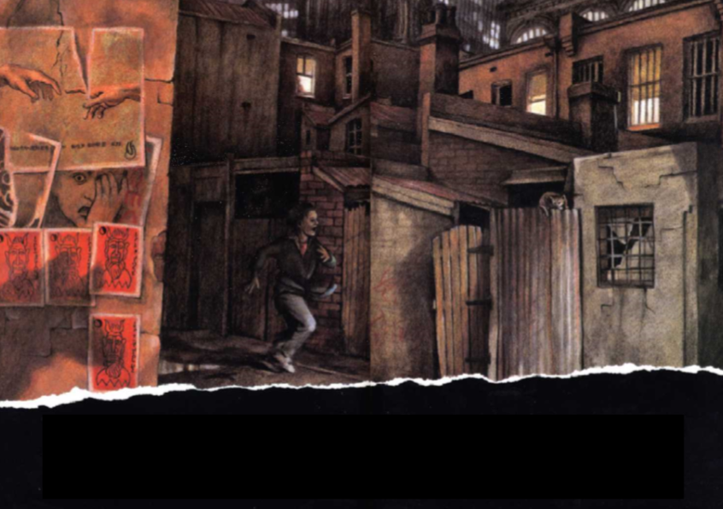

Slide 4
You are going to write your own paragraph based on the scene
Plan:
What can you see? What could you describe?
Boy
Cat
Darkness
What else?

Slide 5
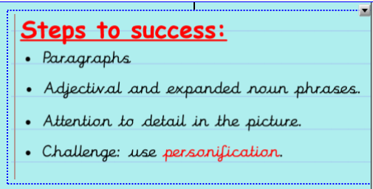
You are going to write in 1st person
My example
As I sprinted through the narrow, winding alleyways I could feel my heart thumping in my ears. In the distance, dogs barked and cars rumbled like thunder. Buildings towered over me, their yellow eyes staring down at me as I raced through the snaking backstreets. I barely saw the crumpled, rain-stained posters barely still stuck to the crumbling brick walls as I continued to charge ahead. Suddenly, I skidded to a halt. My scuffed trainers almost screeched as I came to an abrupt stop in front of a rotting, holey fence with a rusting gate adjacent. On the gate, was a cat. A sorry-looking, mournful cat…
Can you spot my expanded noun phrases and adjectives?
Have I included lots of detail? Give examples.
I used personification (where objects are described as people or animals). Can you spot it?

Slide 6
Your turn!
Write a description as if you were the boy running through the alleyways. Include what you see, can hear etc. Remember the success criteria.

