Slide 1

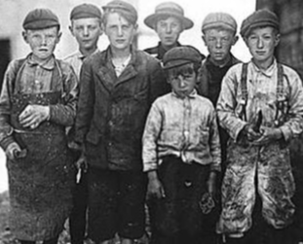
2019 1901
2019 1901

