Slide 1

Way Home
Read the first 3 pages
Guided Reading

Slide 3
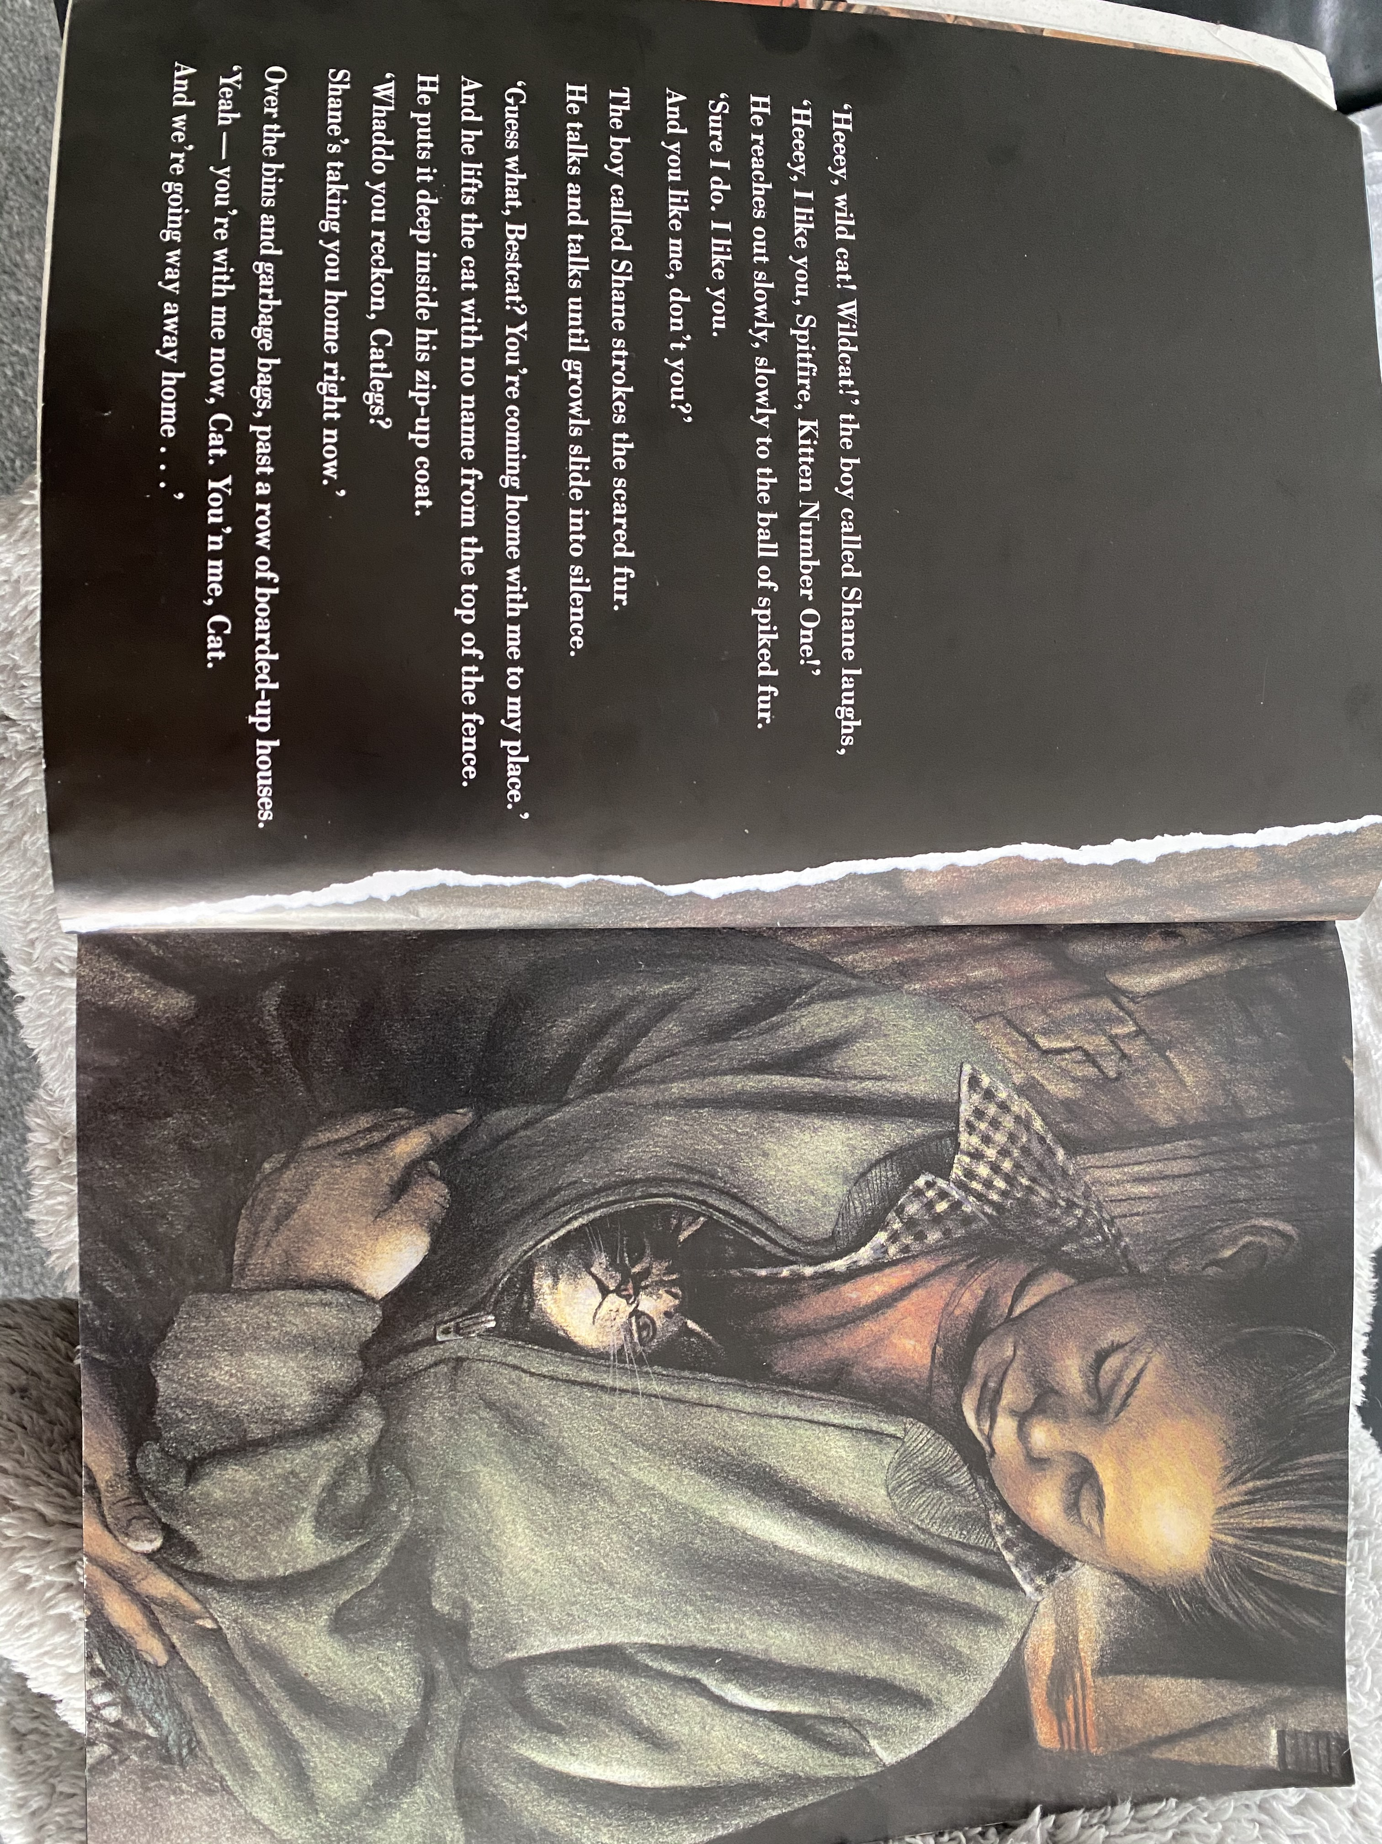

Slide 4
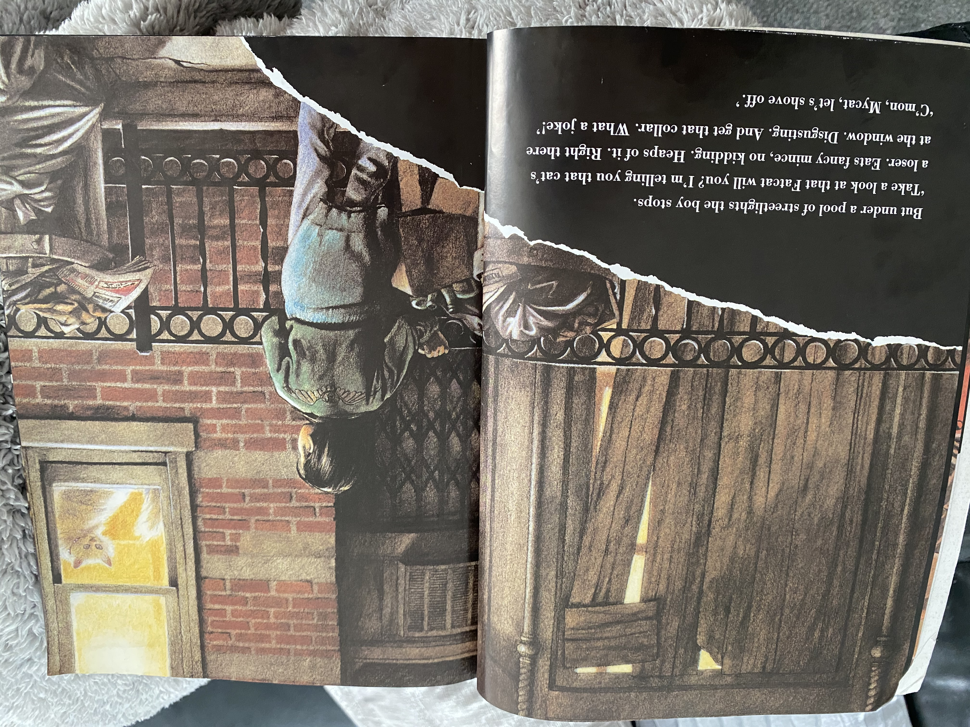

Slide 5
Answer these questions:
Why does the boy, Shane, reach out ‘slowly, slowly’?
What made the cat stop growling?
What sort of neighbourhood do you think Shane lives in? Use evidence from the text (2 marks)
Shane calls the cat he finds lots of nicknames. Find 3 of them (not including Spitfire Kitten Number One).
Why do you think he stops and makes fun of the cat in the window?

