Slide 1


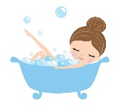



Parent Home Learning
You deserve it!
Love Miss R-B x
Relax and unwind from home school and have a relaxing bath. | Watch a film! | Read a book!
Sit down and have a beverage of your choice (tea, coffee or something stronger) | Smile to yourself you have done an AMAZING job for the past 10 weeks! | Go and take a walk

