Slide 1

Last week, we learned where chocolate is grown today. But where did it come from originally?

Slide 2
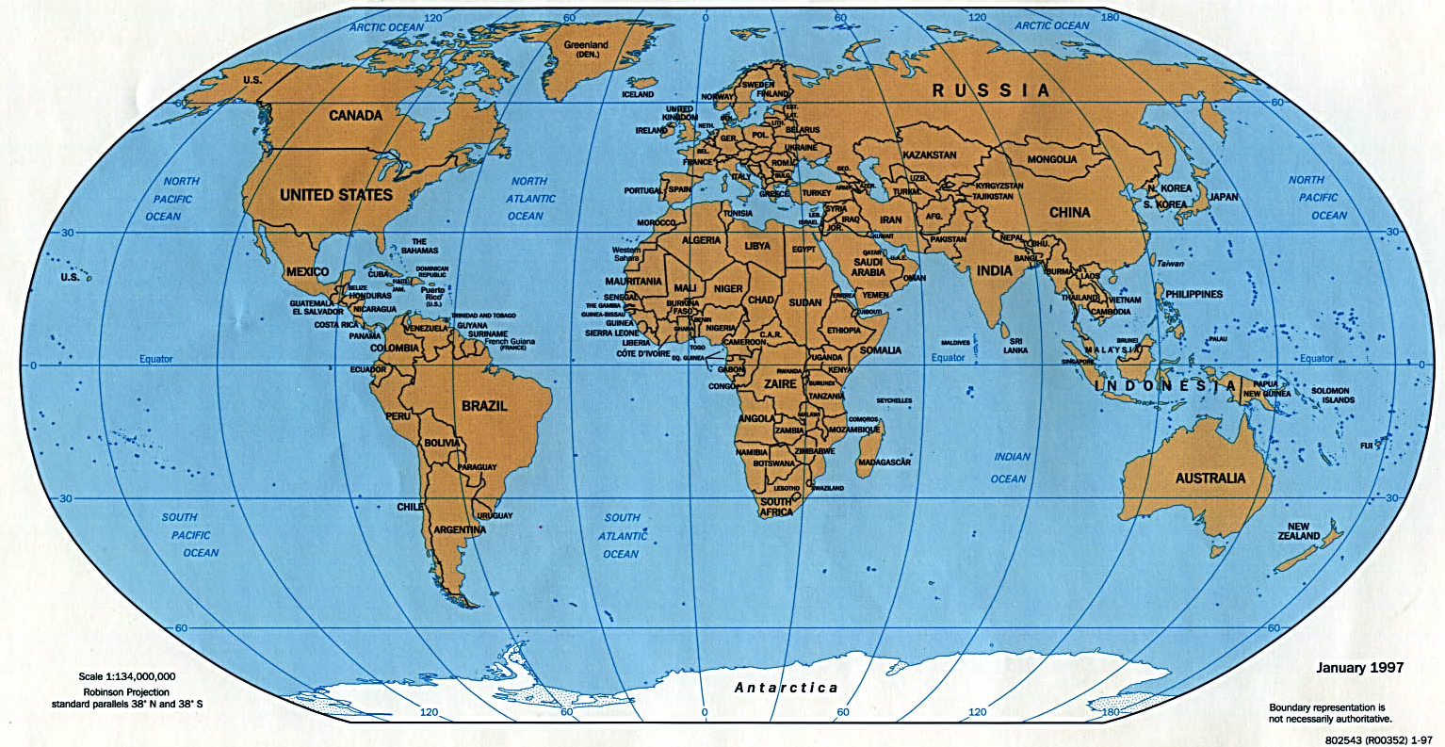
The history of chocolate starts in what we now call Mexico.
Can you find Britain on the map? Can you find Mexico?

Slide 3
A brief back story…
Watch this clip up until 2 minutes (you can watch the rest, but we won’t be looking at anything covered after the first 2 minutes)…
https://www.youtube.com/watch?v=ibjUpk9Iagk

Slide 4
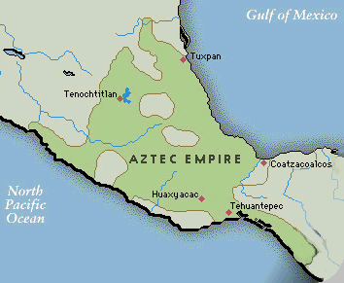
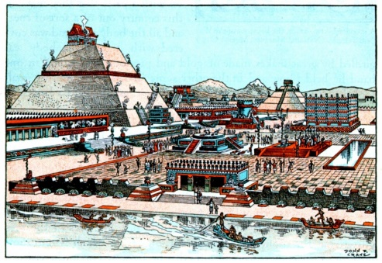
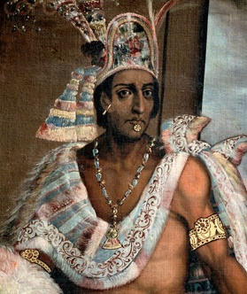
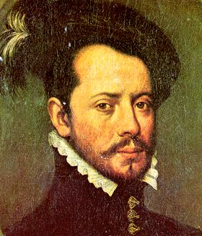
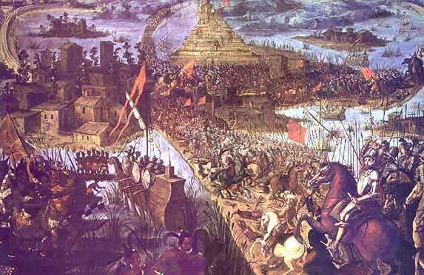
A timeline of events
Spanish explorers began to set off on voyages around the world in wooden sailing ships. Back in these times, little was known about what lands were out there beyond Europe! They landed in South and Central America.
1250
1325
1502
1519
1521
Tenochtitlan is destroyed by the Spanish.
The Aztecs arrive in Mexico.
The Aztecs build Tenochtitlan.
Hernando Cortez arrives in Mexico.
Montezuma II becomes ruler.

Slide 5
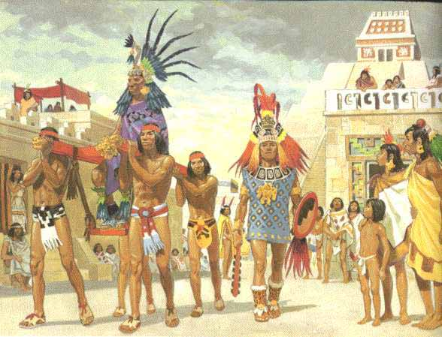
So what happened?
When the Spanish encountered the Aztecs, some of them wanted to take what they wanted, including land and gold!

Slide 6
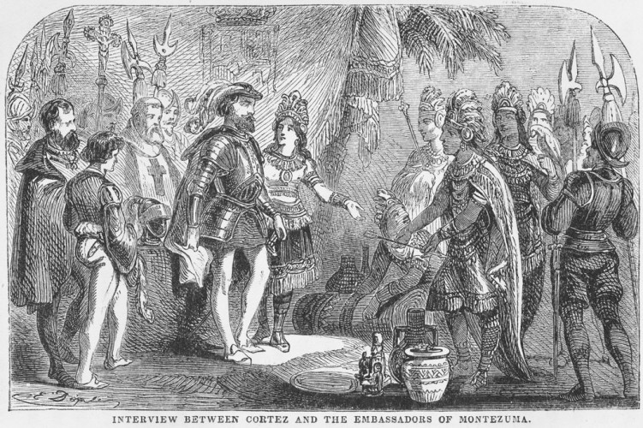
How did it happen? Let’s meet the key characters.
Priest
Hernan Cortez
Aztecs
gifts
Spanish soldiers
interpreter
Montezuma

Slide 7
Your city is amazing...We have not seen anything like it before... it is so clean!
Our Lord, you are weary. The journey has tired you, but now you have arrived on Earth. You have come to the city, Mexico. You have come here to sit on your throne.

Slide 8
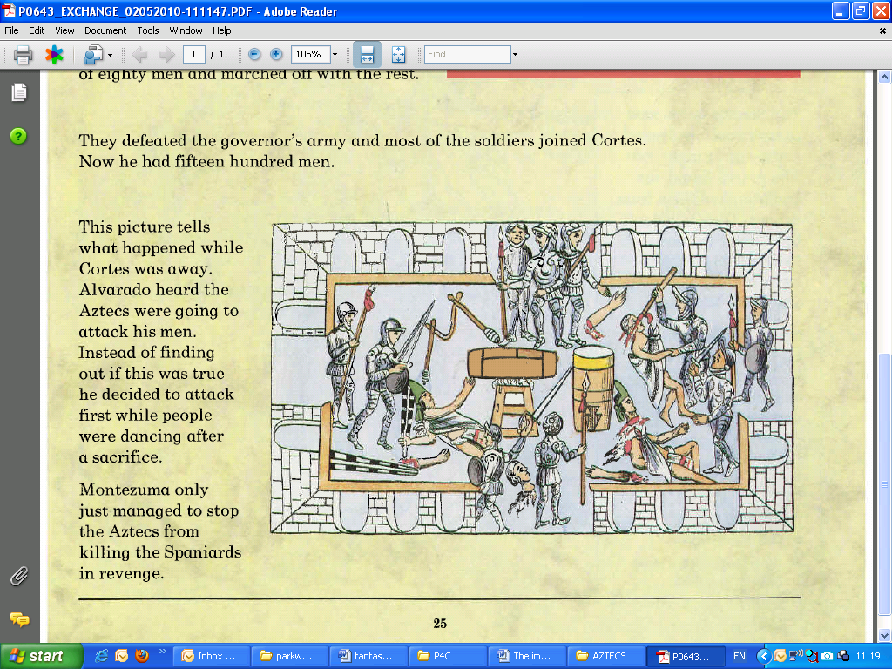
While Cortez is away, let’s attack the Aztecs while they are dancing!
While Hernan Cortez was away, the Spanish soldiers attacked the Aztecs.

Slide 9
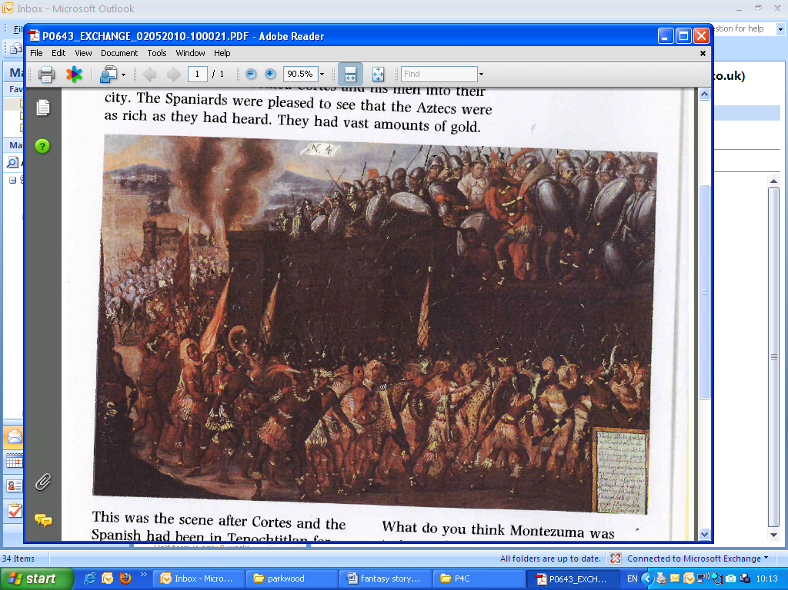
Listen to me... I am your Emperor.....Don’t Fight!
We want a new Emperor....Stone him!!
The Aztecs turned on the Spanish. Montezuma tried to persuade them to stop but they threw stones at him and killed him.

Slide 10
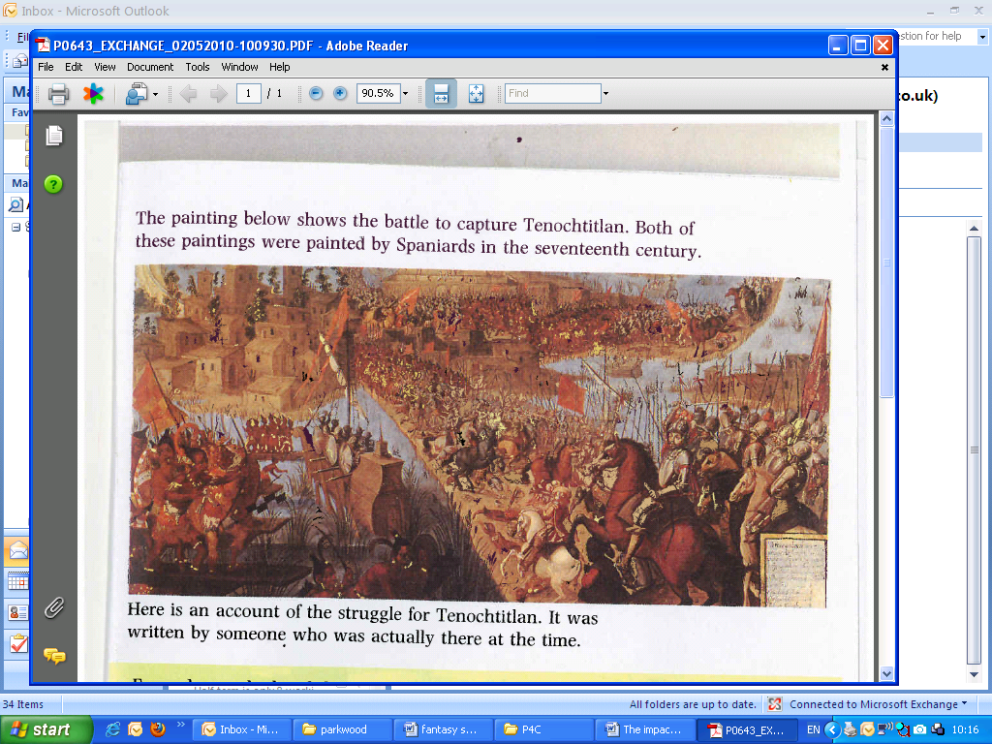
Every day, we fight tremendous battles... captured Spanish soldiers are used for human sacrifices!
The Spanish army defeated the Aztecs after a long fierce battle.

Slide 11
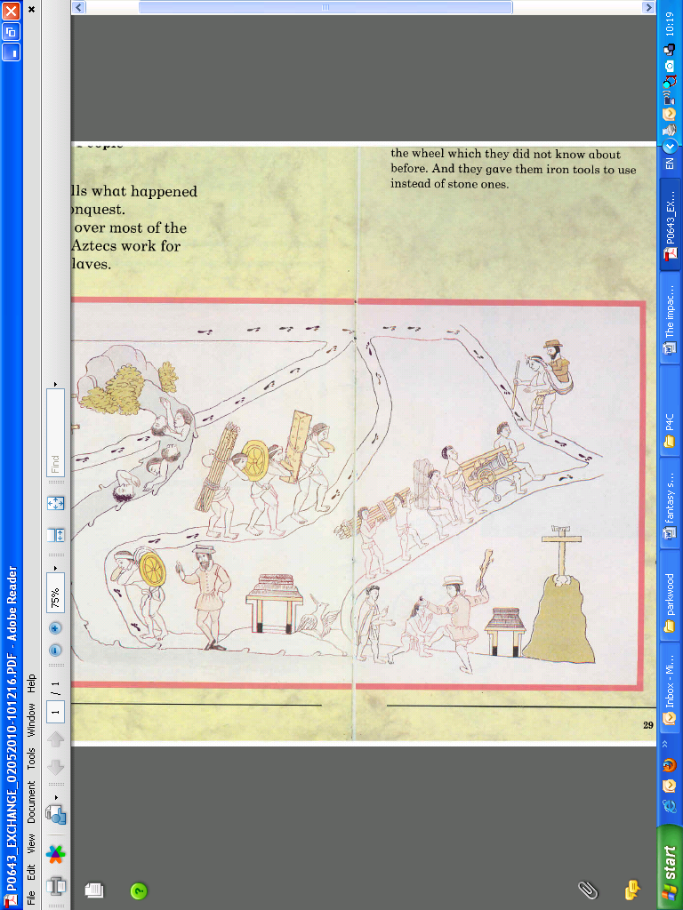
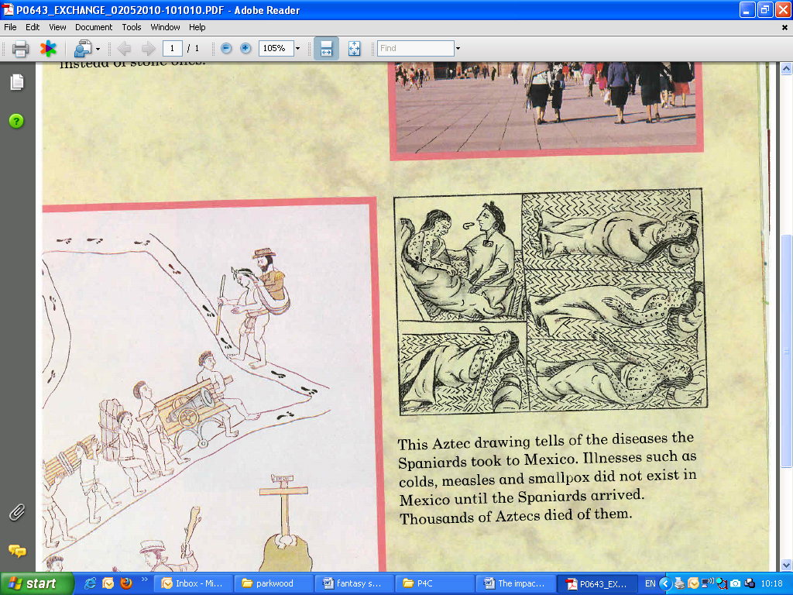
You are my slave now!
You have got a strange new disease.
The Spanish made the Aztecs their slaves. They did not treat them very well.
The Spanish gave the Aztecs diseases such as colds, measles and smallpox.

Slide 12
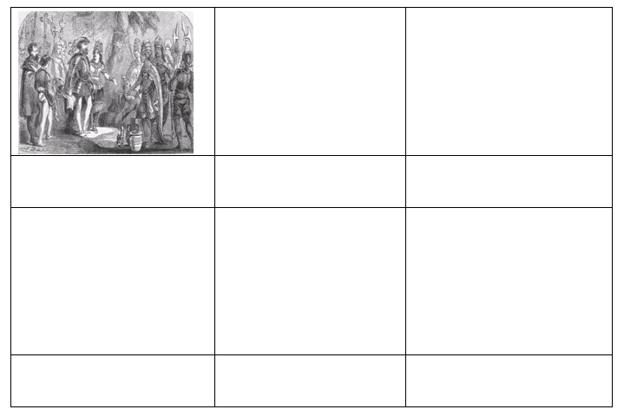
Task
Can you complete a story board of what happened when the Spanish arrived in Mexico?
What happened after Cortez met Montezuma?

