Slide 1
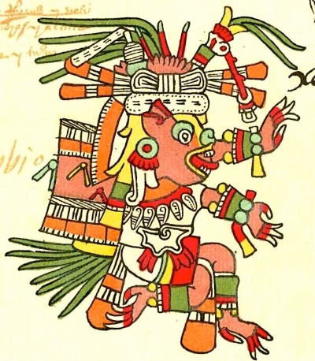
The Aztecs…

Slide 2
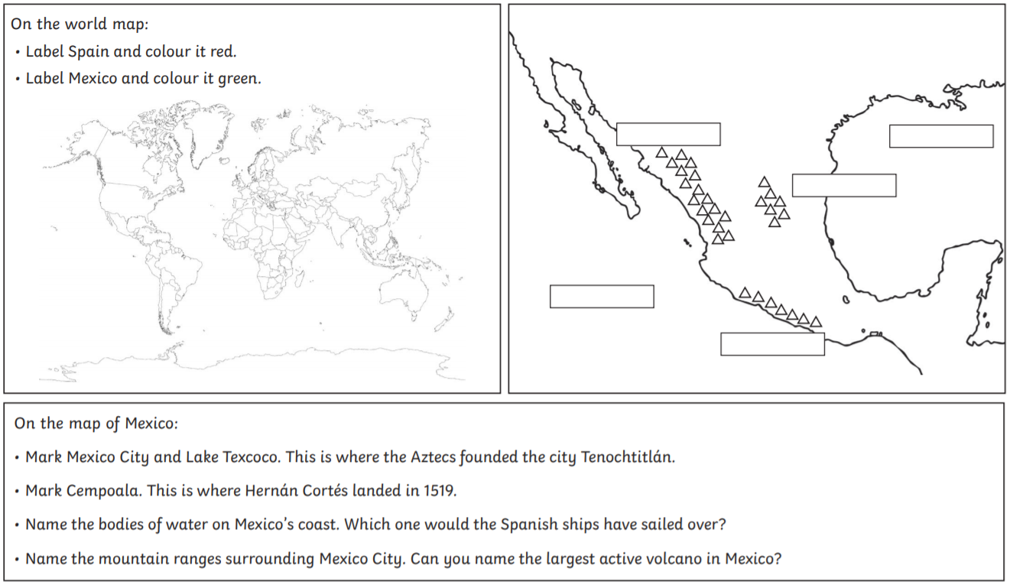
Let’s learn a little more about the Aztec people.
Grab an atlas or use an online search engine to help you complete this sheet. It is attached alongside this PowerPoint.

Slide 3
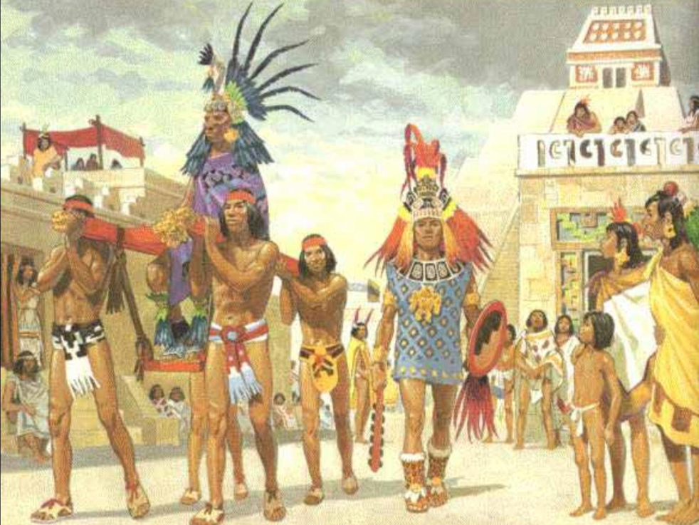
What was it like to live in Aztec society?

Slide 4
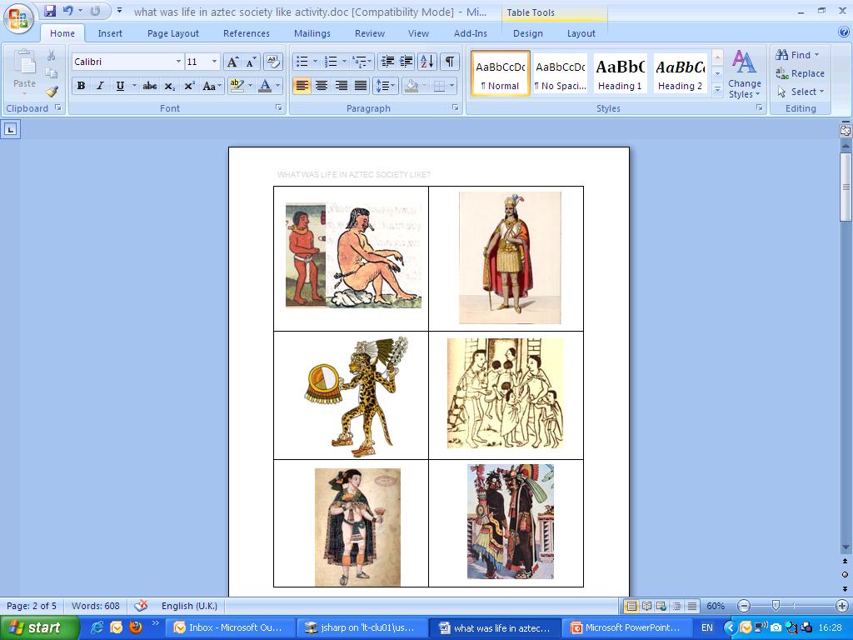
The ‘Who’s Who’ of Aztec society?
There were different groups of people that made up Aztec society.
commoners
slaves
nobles
priests
warriors
emperor
Can you match the six pictures with their headings?

Slide 5
The ‘Who’s Who’ of Aztec society
slaves
emperor
warriors
commoners
nobles
priests
How did you do?

Slide 6
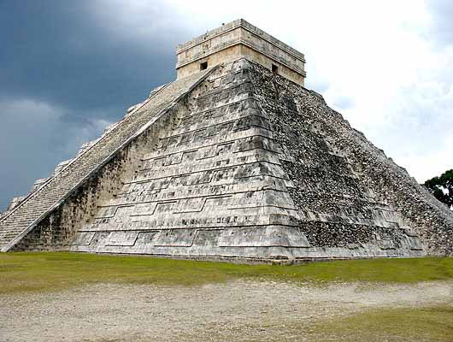
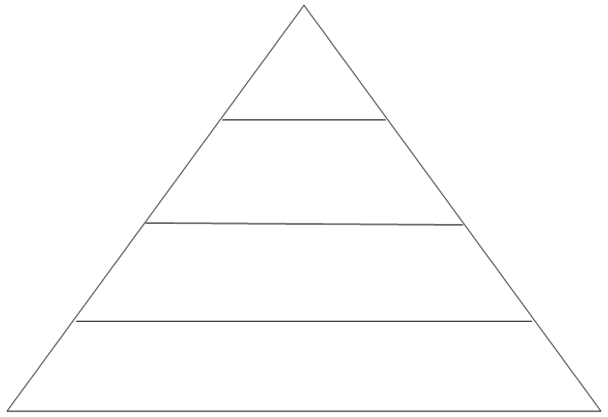
The pyramid of Aztec society
Like the Ancient Egyptians, the Aztecs were famous for building vast pyramids.
Aztec society can be seen like a pyramid, with the most powerful people at the top, ruler over those below. Also, there are fewer people nearer the top, but lots at the bottom!

Slide 7
The pyramid of Aztec society
Can you put the groups into their correct place on the pyramid? Hint: As there are SIX groups and only FOUR layers, some will have to share a layer!
Where did they all belong? Who was the most important? Who was the least important?

Slide 8
The pyramid of Aztec society
The answer… Go back and try first, before looking at the answer!
emperor
nobles
priests
warriors
commoners
slaves

Slide 9
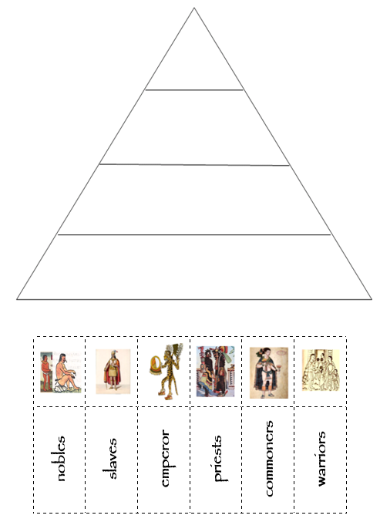
Aztec society task…
Use this PowerPoint to complete the second attached task. Cut out the labels and pictures and place them onto the pyramid. Or you could draw your own!

Slide 10
What was it like to live in Aztec society?
Why not continue learning about the Aztecs with one of the following:
Optional tasks:
Carry out your own research about the Aztecs and their way of life.
Try the attached ‘Design a Sunstone’ task.
Try the attached ‘Amazing Aztec Art’ task.
Try the attached ‘Make an Aztec headdress’ task.

