Slide 1
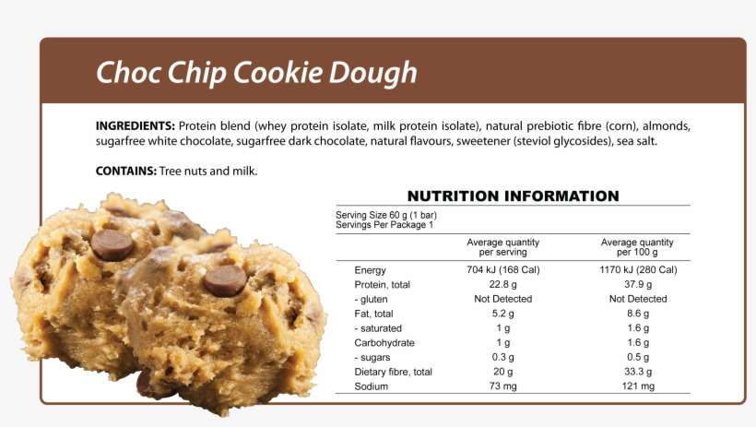
What goes into a chocolate bar?

Slide 2
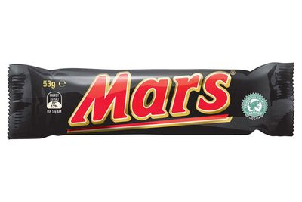
Is a chocolate bar good or bad for you?
If you are with someone else, have a chat with them. Is it good for you? Bad for you? Bit of both?
If may be that you had different thoughts. It may be good because it gives us energy or bad because it can lead to obesity.

Slide 3
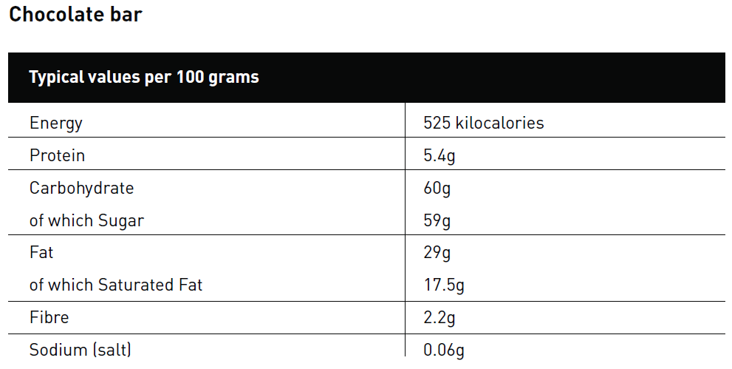
What is in a bar?
If you have a chocolate bar nearby, have a look at the wrapper and you will find something like this:
The main ingredients are sugar and fat.
Optional task 1:
Find out how the human body uses sugar and fat. How much sugar and fat does the human body need each day?

Slide 4

Energy!
A chocolate bar provides you with a lot of energy. If your body released this energy instantly, you would explode like a stick of dynamite! But it doesn’t happen because your body burns the energy off slowly, doing all the things it needs to do to keep you alive and working properly.
The amount of energy you need depends on many things, including how much exercise you do. Your body is using energy all the time – even when you are asleep. Obviously, some activities burn off more energy quickly such as playing football, dancing or doing gymnastics..

Slide 5
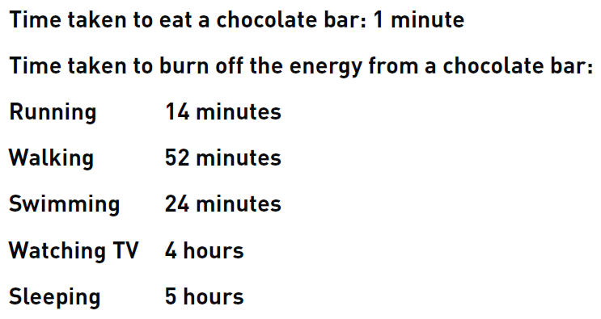
Burning off energy
Optional task 2:
Present this information as a bar chart. To make it easier for you, round ‘Running’ to 15 minutes (1/4 of an hour), ‘Walking’ to an hour and ‘Swimming’ to 30 minutes (1/2 an hour). There is a template attached.

Slide 6
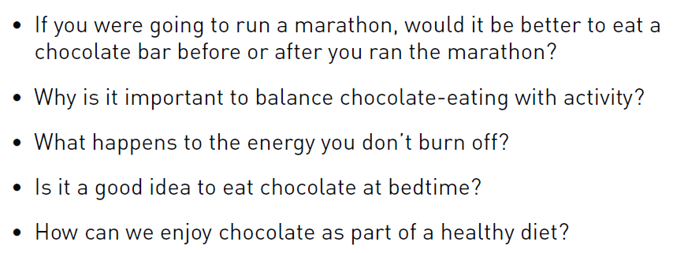
Final thoughts…
Optional task 3:
Try to answer these questions. You could do it verbally with a family member or friend, or instead you could write them in full sentences.

