Slide 1
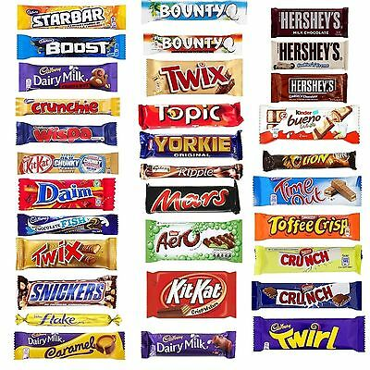
Eating chocolate!

Slide 2
Why do you eat chocolate?
As a snack between meals?
As a treat?
As part of a meal?
How often do you eat chocolate?
Every day?
A few times a week?
Special occasions?

Slide 3
Chocolate is often eaten as a snack
Many children will have some form of chocolate as a snack between meals. Is this really healthy though? Like most foods, chocolate is ok in moderation. Too much chocolate though can be bad for you!
Task 1:
On the following slide is a Venn diagram. Place the different snacks into the correct place on the diagram.

Slide 4
Sorting snacks
Healthy
Unhealthy
crisps
raisins
Fruit winders
apple
Chocolate bar
Cheese string
biscuit
sweets
bowl of cereal
carrot sticks
Sausage roll
nuts

Slide 5
Justify!
Task 2:
I would like you to EXPLAIN your choices. WHY have you put the different snacks where you did? You may need to do a little bit of research to find out what makes some of these snacks ‘healthy’ or ‘unhealthy’.
Here are some openers for you…
I believe that … is good for you because…
… is an unhealthy snack as …
… can be both heathy and unhealthy since …

Slide 6
Optional extra tasks:
Design a poster to promote healthy snacks.
Design a poster to highlight the dangers of unhealthy snacks.
Plan a healthy living snack timetable / planner.
Set yourself the challenge to try 3 new healthy snacks.
Write a poem about healthy snacks.

