Slide 1
Radio Adverts to Persuade

Slide 2
Contents
Radio Adverts
  The Cup
The Plan
Sonic Handwriter
Jet Skate ZX9
ClassX4000
Task- Radio Advert Vestibag
Task – Movie Advert Healthy

Slide 3
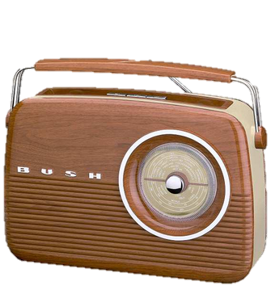
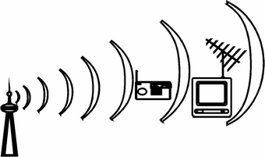

Adverts to Persuade
Radio (objects)

Slide 4
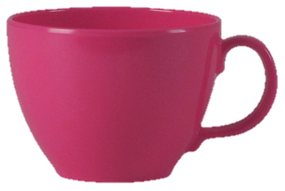


The Amazing Cup!
Are you bored with scooping water up in your hand? Do you find drinking water a pain?
Well worry no longer because Crocko have created the cup, just for you. (questions to draw us in)
The cup has taken 2000 years to develop and is made using space age technology. Its fantastic!
(company and how long it's taken)
The cup has many features to delight young and old. Along its side is an amazing loop called a handle. The handle will allow you to scoop up water without getting your hand wet. Truly superb. (features)
Find it hard to get a decent drink? The cup is the answer to all your problems. The cup, with its rounded smooth edges, will allow you to place your lips along its rim and empty the whole contents into your mouth. You'll be refreshed like never before! (what it does)
Your friends will be amazed when they see your cup. They will want one. Everyone will want one!
Don't think it's trendy enough? Well.. the cup comes in many shades of colour. And for those wild enough we have 'the cup plus' which has bold daring stripes down its side or even wild wacky spots. (what others think of it)
The cup has been tested in dishwashers for hundreds of washes and it came out clean time and time again. Yes, the cup is almost indestructible. It's the accessory of the decade. (what it's made of and how strong it is)
The cup is priced at just £2.99 or in a fantastic gift box of 6 for just £20. Don't wait for the weekly shop, get down NOW to your local supermarket and get one. It's a MUST-HAVE! (rush out, buy one, wow phrases - ONLY price)

Slide 5
Radio Advert Plan
1. Question to draw reader in
2. Explain what it does
3. Give peoples thoughts and opinions
4. What is it made of
5. Make them think they can't live without it

Slide 6
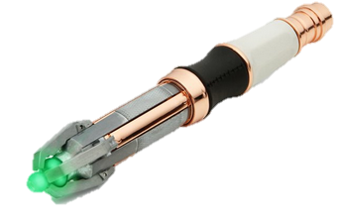
Sonic Handwriter Part 1
Are you bored with your old toys?
Do you wish you had something more exciting to do?
(questions to draw us in)
Well now you have.... because Matell have created the new Sonic Handwriter. The Sonic Handwriter has been in development for over 10 years, to make your life easier at school and to allow you to have some fun at the same time.
(company and how long it's taken)
Too much writing to do? Then get out the Sonic Handwriter, show it the title, tap in how many pages you want and in a few minutes your writing will be completed with beautiful handwriting. It's as easy as that!
(what it does)
However, that's not all! The Sonic Handwriter has been especially programmed to produce beautiful drawings too. You want a picture of horse, the Sonic Handwriter draws it. You want a picture of your favourite football star - your Sonic Handwriter sketches them out in perfect detail.
(what else it does)
1. Question to draw reader in
2. Explain what it does
3. Give peoples thoughts and opinions
4. What is it made of
5. Make them think they can't live without it
analysis
classic

Slide 7
Sonic Handwriter Part 2
Your friends will be amazed when they see what you can do
with the Sonic Handwriter. It's amazing!
(what others think of it)
The Sonic Handwriter has been 10 years in the making and is made from strong durable plastics. In recent tests the Sonic Handwriter was dropped from a tall building and it still wrote a perfect story when it reached the bottom. There wasn't even a scratch!
(what it's made of and how strong it is)
Don't wait for a birthday or Christmas, get down to the shops now and buy one! Parents will be amazed at the educational potential of the Sonic Handwriter and stunned at the incredible price of just £99.99. It's the gift of the year and a must-have for young and old!
(rush out, buy one, wow phrases - ONLY price)
*the pen requires 15 AAA batteries and is not guaranteed to write a story or draw a picture. The Sonic Handwriter must be used with adult supervision and must not be used by children under 18. Prices may vary.
(small print)
1. Question to draw reader in
2. Explain what it does
3. Give peoples thoughts and opinions
4. What is it made of
5. Make them think they can't live without it
analysis

Slide 8
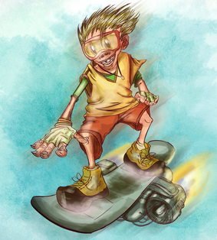
The Amazing Jet Skate ZX9 Part 1
Do you get bored of having to walk to school?
Do you feel your legs getting tired during PE?
(Questions to draw in the reader)
If the answer’s yes - Tomy will solve all your problems. The Jet Skate ZX9 has been in development for more than 5 years and has been thoroughly tested by Olympic athletes on the busiest of roads. As a result when you use the Jet Skaye ZX9 you will always arrive safely at school, on time and with minimal effort.
(Company and how long in the making)
Are you tired of walking to and from school? Are you sometimes late for class? Not any more with the 'Jet Skate ZX9'! Yes, the Jet Skate ZX9 will make sure that you will arrive at school, on time without breaking sweat. Not only that, you'll be the envy of all your friends as well! Yes, it really is that fantastic!
However, it doesn't stop there. Just simply programme in your required destination into the on-board computer and the Jet Skate ZX9 will take you there promptly and in style! Turn up to the end of year disco on your Jet Skate ZX9 or make an entrance at a friends birthday. The choices are unlimited.
Parents too. Imagine not having to drive your child around! Gone are the days of the school run or even waiting for a club to finish. Yes the Jet Skate ZX9 is truly life changing!
(What it does)
1. Question to draw reader in
2. Explain what it does
3. Give peoples thoughts and opinions
4. What is it made of
5. Make them think they can't live without it

Slide 9
The Amazing Jet Skate ZX9 Part 2
Experiments have been carried out by experts on the Jet skate ZX9 over a period of 5 years. The conclusions prove that the Jet Skate ZX9 is a revolutionary product that is about to change the way that children travel. Forever! Teachers believe that the Jet Skate ZX9 will result in the end of the late marks in the register and children being tired during lessons- imagine that!
(Peoples Opinions)
The Jet Skate ZX9 is made from the most technologically advanced materials which make it strong, safe and reliable. In a recent test, the Jet Skate ZX9 was run over by a test-lorry and survived without even a scratch. The lorry driver was so impressed by the Jet Skate ZX9 – he took it home. Unbelievable! (What is it made of)
Yes, this is the must have transportation system for every child! Don't wait for a birthday or even Christmas, go down to your local Supermarket and buy one today. You will never arrive late again and not only that you'll arrive in style. All this for the incredible price of just £49.99, yes £49.99! This makes it the must have gift of the year!
('Can't live without one' phrase and price)
*the jet skate ZX9 requires 15 AAA batteries and is not always guaranteed to arrive you at your destination on time. The Jet Skate ZX9 must be used with adult supervision and must not be used by children under 18. Prices may vary.
(small print)
1. Question to draw reader in
2. Explain what it does
3. Give peoples thoughts and opinions
4. What is it made of
5. Make them think they can't live without it

Slide 10
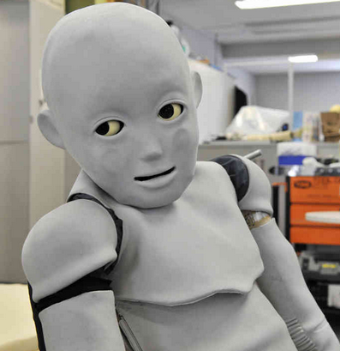
Class X4000 Part 1
Teachers! - Are you fed up with the same faces sat in your classroom?
Do you wish you had a brand new set of pupils? (Questions to draw in the reader)
Well now you can, because Classroom Removals has developed the new Class x4000.
The Class x4000 has been 3 years in development and is guaranteed to provide you
with a brand new set of attractive, interesting faces to share your exciting lessons.
(Company and how long in the making)
Class looking tired and fed up? Then contact Classroom removals and they take out your old class and replace it with a whole new room of children that are guaranteed to enjoy every single second of your lessons.
However, that's not all! Classroom Removals will dispose of your old class in a clean and environmentally way placing each bored and tired child in a large hole in the ground where they will rot away without polluting the water system or affecting nearby animals. (What it does)
Your colleagues will be stunned when they see your Class x4000 performing in difficult tests. Watch as they marvel at the way they zip through every single level of the Mental Maths Challenge - even Platinum Mixture! Observe their open mouths as they calculate the most difficult of problems.
(People’s Opinions)
1. Question to draw reader in
2. Explain what it does
3. Give peoples thoughts and opinions
4. What is it made of
5. Make them think they can't live without it

Slide 11
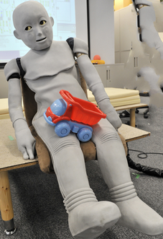
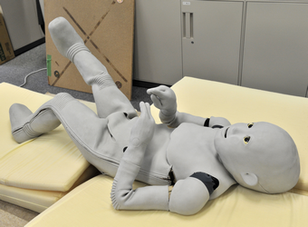
Class X4000 Part 2
1. Question to draw reader in
2. Explain what it does
3. Give peoples thoughts and opinions
4. What is it made of
5. Make them think they can't live without it
The Class x4000 is made from a bank of programmable androids programmed to answer your every question without bickering or argument. Their skin is made from strong durable rubber that will not tear, even during the most horrendous fall onto a hard tarmac playground. The Class X4000 was dropped from the top of a school roof and each child stood up quickly and walked away to make a daisy chain in the sun. Amazing! (What is it made of)
Don't wait for the end of the year to get rid of your old class - ditch them now. Get along to our new scientific laboratory where you can see your new class being created. You can even choose their facial features and hair colour! Parents will be amazed when they see a brand new likeable child return to their house instead of the boring, dull argumentative one that left earlier that morning. Watch as they come into school to thank you for making their lives more bearable. The new Class x4000 is not expensive. Each child can be bought for just £25 each and if you have a class of 30, you can have them for just £500. An absolute steal! (Can't live without one' phrase and price)
* The Class X4000 is not guaranteed to work at all. Some android children may malfunction and destroy the classroom others may be dull and lifeless. Skin may tear on contact with pencils or pens. Requires 3 posatronic batteries to work which need replacing after 30 minutes. (small print)

Slide 12

Task
Create a radio advert for the Vestibag

