Slide 2
Aim
Interpret and present discrete and continuous data using appropriate graphical methods, including bar charts and time graphs.

Slide 3

Introducing Line Graphs
Diving
How Far a Family Cycled over an Hour
3000
What information is missing from this graph?
2500
2000
1500
Title
Distance in metres
1000
Label
500
Label
0
10
20
30
40
50
60
Time in minutes

Slide 4
Introducing Line Graphs
Diving
How Far a Family Cycled over an Hour
3000
How far had the family cycled after 30 minutes?
2500
2000
1500 metres
1500
Distance in metres
After how long did they reach 2000 metres?
1000
500
45 minutes
0
10
20
30
40
50
60
Time in minutes

Slide 5

Introducing Line Graphs
Deeper
How Far a Family Cycled over an Hour
Use this line graph to answer these questions.
3000
Estimate how far the family had cycled after 25 minutes?
2500
2000
1500
1250 metres
Distance in metres
1000
One rider had to stop to change a tyre. When was this?
500
0
10
20
30
40
50
60
30-40 minutes in
Time in minutes

Slide 6
Introducing Line Graphs
Deeper
How Far a Family Cycled over an Hour
When did the family cycle most slowly?
3000
2500
Between 0 and 10 minutes and 50 and 60 minutes
2000
Distance in metres
How do you know?
1500
1000
We can see the line is less steep, meaning they travelled a shorter distance in the first and last 10 minutes.
500
0
10
20
30
40
50
60
Time in minutes

Slide 7

Introducing Line Graphs
Deepest
Can this graph tell us how many people were in the park at 10:30?
No. We can estimate the number of people to be between 15 and 16 but since we cannot have half a person we cannot say exactly how many were there at 10:30.

Slide 8


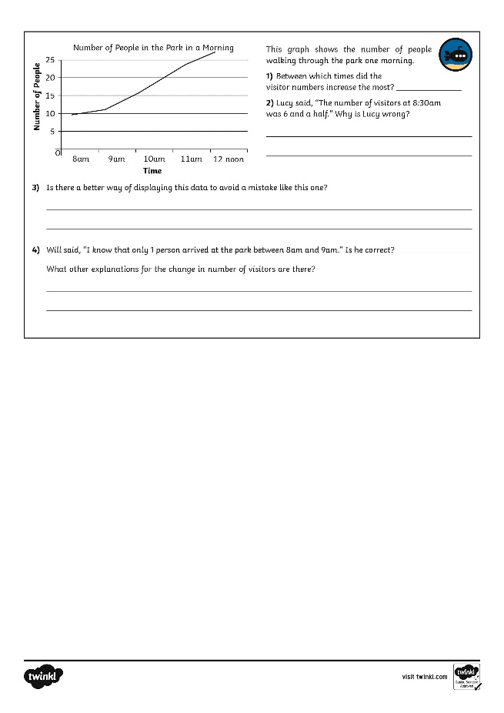
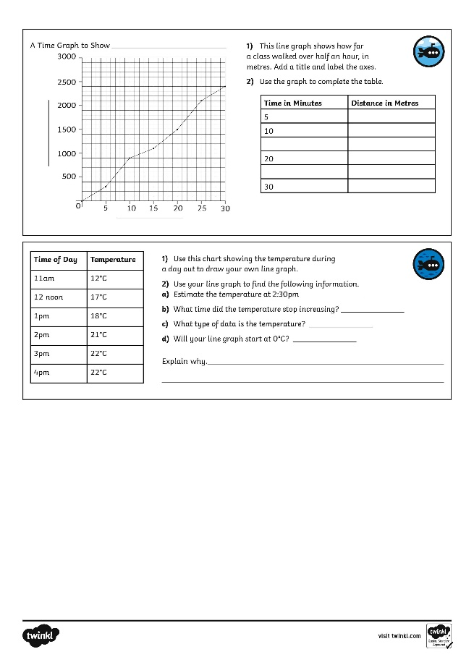
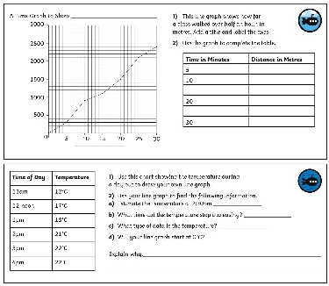
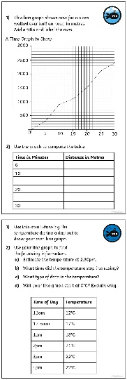
Introducing Line Graphs
Dive in by completing your own activity!

