Slide 1


Welcome to Year 6
Team Beraet-Williams
One Childhood, One Chance
Together we make a difference

Slide 2


What we’ll cover:
The Team
The School day
Learning
Core Values
Behaviour for learning
Home Learning
Home Reading
Mathletics
Social Media
Communication
Other information
Questions

Slide 3
The School Day
8:15 – doors open, early morning work *Register completed by 8:30am
8:30 – Star Spelling & PAG (Punctuation and Grammar)
9:00 – English
10:00 – Assembly
10:15 - Break
10:30 – Guided Reading
11:00 – Maths
12:00-1:00 – Lunch
1:00 – Topic
1:55 – Snack & Toilet
2:00 - Story
2:15 – Session One Arts curriculum
3:15 – Session Two Arts curriculum
4:15 - End of the day

Slide 4
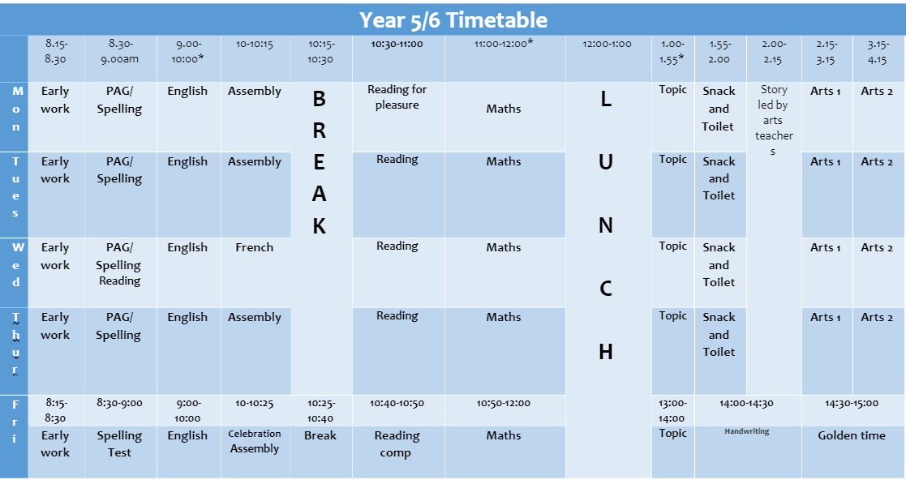
The School Day

Slide 5
Arts Curriculum
Term 1 (2:15-4:15pm):
*Year 6 children to come to school in PE kits on Wednesday and bring in swimming kit on Thursdays.
 | Monday |  | Tuesday |  | Wednesday |  | Thursday
Year 6 | Art | Art | Music | ICT | Drama | Dance* | Swimming | Swimming

Slide 6
What will we be learning?
Maths Term 1:
Website, blogs and newsletters will show termly updates
Number and Place Value | 4 Operations
Reading and writing numbers to 10 million Ordering and comparing numbers Rounding numbers Negative numbers Prime numbers Square and Cubed numbers | Formal methods for + and – + / - decimal numbers Solve + / - word problems Formal methods for multiplication Short Division (including remainders) Division with factor pairs Division with fact boxes Division using chunking BODMAS

Slide 7
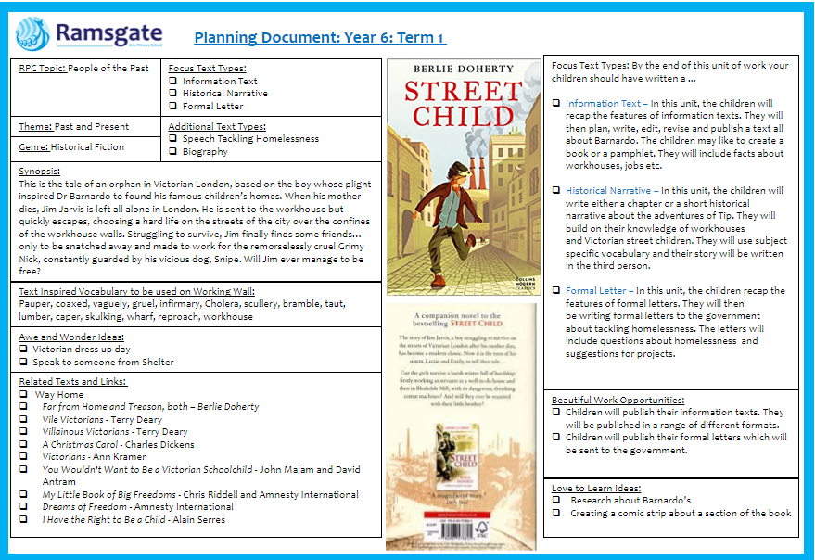
What will we be learning?
English
Term 1:
Website, blogs and curriculum letter will show termly updates

Slide 8
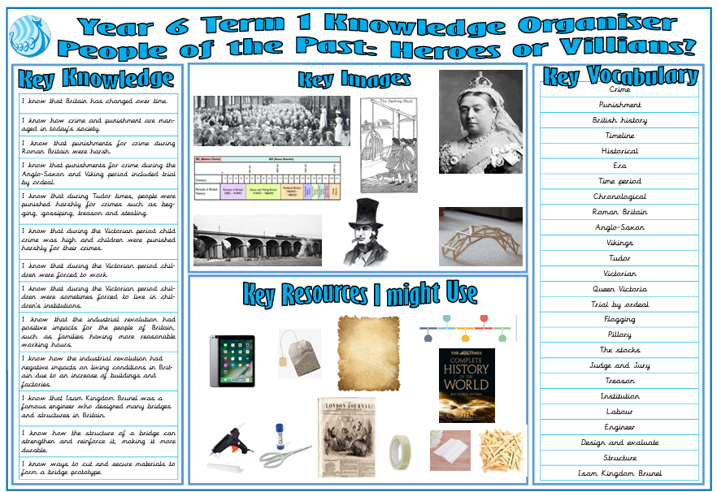
What will we be learning?
Topic
Term 1:
Website, blogs and newsletters will show termly updates

Slide 9
Our Core Values…
These are at the heart of everything we do at Ramsgate Arts Primary School.
Aspiration (this term)
Challenge
Collaboration
Autonomy
Engagement
Enquiry
Diversity

Slide 10
Behaviour for Learning
At RAPS, we want our children to be ready to learn.
Happy Safe Successful

Slide 11
What are RAPS Golden Rules?
Show good learning behaviours (SLANT)
Show respect (Be Kind)
Listen
Try your best!
Stay safe!
Expected Behaviour at RAPS

Slide 12

Hand Signal
3
4
2
5
1

Slide 13
Pupil Code of Conduct
Pupils are expected to:
Follow the school rules and safety & playground codes
Demonstrate school values in their behaviours, attitudes and interactions
Behave in an orderly and self-controlled way
Show respect to members of staff and each other
In class, make it possible for all pupils to learn
Move quietly around the school
Treat the school buildings and school property with respect
Respect the property of others
Wear the correct uniform at all times
Accept sanctions when given
Refrain from behaving in a way that brings the school into disrepute, including when outside school

Slide 14
Behaviour Points
Each child starts off with 5 points at the beginning of every day.
Possible total of 25 points a week. Expected to keep all 25 points!
The points will also be looked at on a 3 weekly basis. 25 x 3 = 75 points

Slide 15

Sanctions
If a child is:
talking
messing around
refusing to work
rude
disrupting the lesson etc…
a non-verbal warning, a verbal warning then a
yellow warning card gets placed on the desk in front of you. This will act as a reminder to the child that they have got to improve their behaviour.

Slide 16

If a child improves their behaviour, they can then earn the yellow card back. The yellow card can then be removed from the table and positive praise will be given.
If a child continues to misbehave the yellow card is changed to a red card.

Slide 17
If a child has a yellow card on their desk at the end of the lesson, they lose 1 point.
If a child has a red card on their desk at the end of the lesson, they lose 2 points.

Slide 18
Restorative Conversation
When unpicking behaviours after a yellow/red card is given, a conversation will take place based around a restorative approach:
What happened?
I’m wondering why you did that?
Who's been affected?
What needs to happen next to put things right?
What can we do next time?
I notice that… (WIN)
This conversation will ensure the child is in right place to continue their learning/day positively.

Slide 19
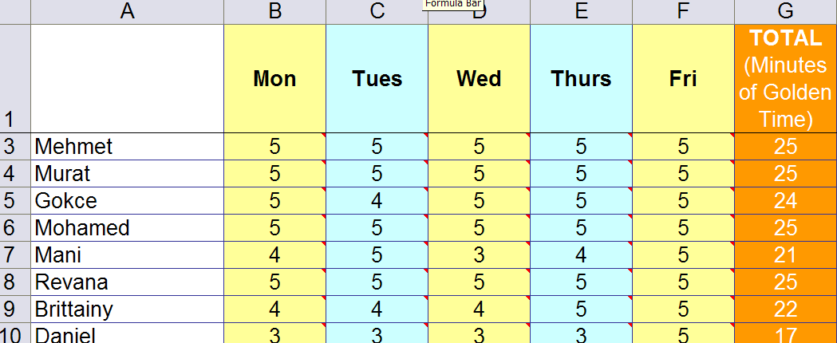
Behaviour Points

Slide 20

Daily Rewards
Verbal praise
Smiles
Superstar Learner cards (if a child has a Superstar learner card on their table at the end of the lesson, they can swap it for a house point as they leave).

Slide 21
Weekly Rewards
25 points= All golden time and text home.
22-24 points= All golden time.
11-22= Teacher to contact parents.
6-10 points= Mr Budge to send letter home to inform parents.
5 points or less= Mr Budge to have a meeting with parents.

Slide 22
Three-weekly Rewards
75 points= Letter home (emailed). Badge to wear.
3rd badge: RAPS lanyard
6th badge: silver behaviour badge
12th badge: Gold behaviour badge

Slide 23
Home Learning
Love 2 learn will be assigned most weeks – usually involving a short reading comprehension task.
Home reading should be happening regularly – preferably every night, but at least 4 times a week.
Spellings are set every week in KS2.
KS2 - Mathletics and TTRS optional – tables focus/reinforcing learning activity

Slide 24
Home Reading
This week, school reading books have been assigned to every pupil in the class. The band is based on a combination of word reading and comprehension. If you feel it is too easy or too difficult, please speak to a member of staff. Children are encouraged to change books themselves. If they are on RED, they can choose to read home books as well.
Bug Club – should be set up by the end of next week.

Slide 25
Times Tables Rockstars
Pupils will be given a TTRS log in this term.
You can download the app.
They can practise as they so wish.
We will practise in class.

Slide 26
Social Media
The minimum age to open an account on nearly every social media platform—TikTok, Instagram, Twitter, Pinterest, Kik, YouTube, Snapchat, Facebook, and more— is 13. WhatsApp is 16.
We ask that if using social media, such as ‘WhatsApp’, children behave appropriately using respectful language and refrain from sending images/videos of themselves or others.
Where parents’ social media groups are created for classes, refrain from discussing pupils, staff or other parents.
The school is not responsible for monitoring Parents’ WhatsApp groups and recommend they are only used for event and timetable reminders.

Slide 27
Communication
Website
Blog three times per week
Termly Newsletters
MCAS
Email via Office (to book a meeting/phone call)
Instagram
Parents' Evenings

Slide 28
Other information
Role models – House Captain, Young Leaders etc.
School Uniform expectations
PE kits (and swimming)
Open door policy - communicate through office – who will pass note or email on

Slide 29

Any Questions?

