Slide 1


Welcome to Year 4
Team Cialis and
Team Chamberlain
One Childhood, One Chance
Together we make a difference

Slide 2

What we’ll cover:
The Team
The School day
Learning
Core Values
Behaviour for learning
Home Learning
Home Reading
Mathletics
Social Media
Communication
Other information
Questions

Slide 3
The Team
Team Cialis: Mr Cialis and Miss Goode
Team Chamberlain: Mr Chamberlain and Mr Hearne
We are really lucky that Mrs Smart will also be supporting us across Year 4. She will be working with those who need more support as well as those that might need a push.

Slide 4
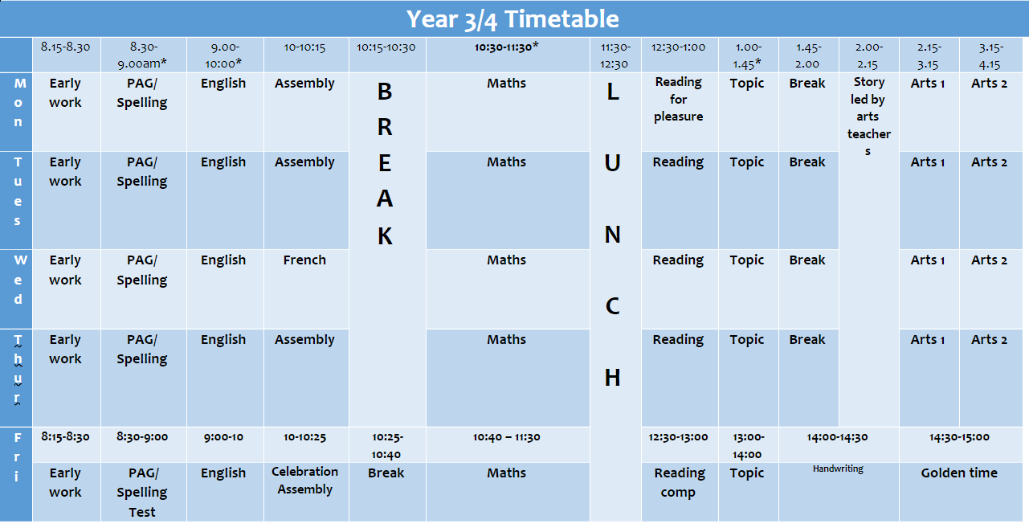
The School Day

Slide 5
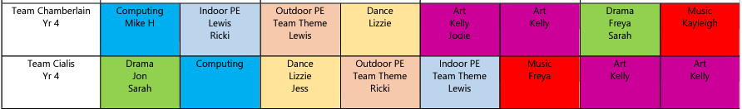
Arts Curriculum
Term 1 (2:15-4:15pm):
*Year 4 children to come to school in PE kits on

Slide 6

What will we be learning?
Topic
Term 1

Slide 7
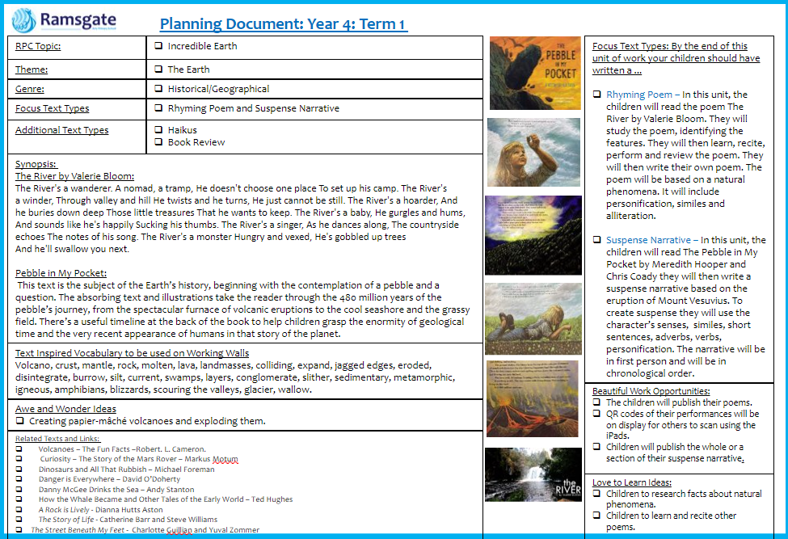
What will we be learning?
English
Term 1

Slide 8
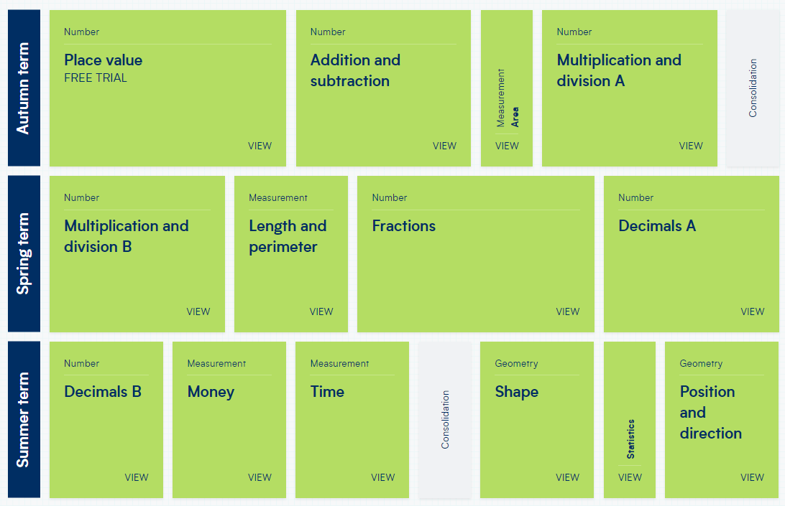
What will we be learning?
Maths Term 1
In the Summer Term Year 4s also take part in the gov’s MTC – start practise now.

Slide 9
Our Core Values…
These are at the heart of everything we do at Ramsgate Arts Primary School.
Aspiration
Challenge
Collaboration
Autonomy
Engagement
Enquiry
Diversity

Slide 10
Behaviour for Learning
At RAPS, we want our children to be ready to learn.
Happy Safe Successful

Slide 11
What are RAPS Golden Rules?
Show good learning behaviours (SLANT)
Show respect (Be Kind)
Listen
Try your best!
Stay safe!
Expected Behaviour at RAPS

Slide 12

Hand Signal
3
4
2
5
1

Slide 13
Pupil Code of Conduct
Pupils are expected to:
Follow the school rules and safety & playground codes
Demonstrate school values in their behaviours, attitudes and interactions
Behave in an orderly and self-controlled way
Show respect to members of staff and each other
In class, make it possible for all pupils to learn
Move quietly around the school
Treat the school buildings and school property with respect
Respect the property of others
Wear the correct uniform at all times
Accept sanctions when given
Refrain from behaving in a way that brings the school into disrepute, including when outside school

Slide 14
Behaviour Points
Each child starts off with 5 points at the beginning of every day.
Possible total of 25 points a week. Expected to keep all 25 points!
The points will also be looked at on a 3 weekly basis. 25 x 3 = 75 points

Slide 15

Sanctions
If a child is:
talking
messing around
refusing to work
rude
disrupting the lesson etc…
a non-verbal warning, a verbal warning then a
yellow warning card gets placed on the desk in front of you. This will act as a reminder to the child that they have got to improve their behaviour.

Slide 16

If a child improves their behaviour, they can then earn the yellow card back. The yellow card can then be removed from the table and positive praise will be given.
If a child continues to misbehave the yellow card is changed to a red card.

Slide 17
If a child has a yellow card on their desk at the end of the lesson, they lose 1 point.
If a child has a red card on their desk at the end of the lesson, they lose 2 points.

Slide 18
Restorative Conversation
When unpicking behaviours after a yellow/red card is given, a conversation will take place based around a restorative approach:
What happened?
I’m wondering why you did that?
Who's been affected?
What needs to happen next to put things right?
What can we do next time?
I notice that… (WIN)
This conversation will ensure the child is in right place to continue their learning/day positively.

Slide 19
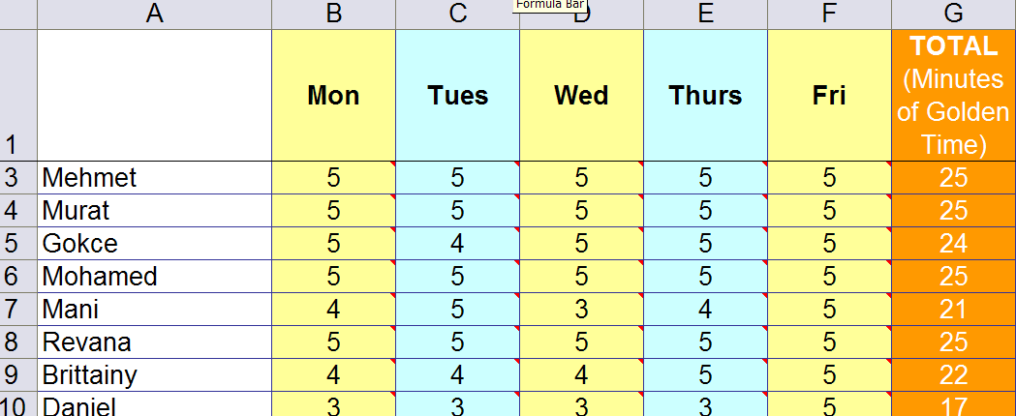
Behaviour Points

Slide 20

Daily Rewards
Verbal praise
Smiles
Superstar Learner cards (if a child has a Superstar learner card on their table at the end of the lesson, they can swap it for a house point as they leave).
Year 4 - 10 superstar learner cards will mean you get a reward.

Slide 21
Weekly Rewards
25 points= All golden time and text home.
22-24 points= All golden time.
11-22= Teacher to contact parents.
6-10 points= Mr Budge to send letter home to inform parents.
5 points or less= Mr Budge to have a meeting with parents.

Slide 22
Three-weekly Rewards
75 points= Letter home (emailed). Badge to wear.
3rd badge: RAPS lanyard
6th badge: silver behaviour badge
12th badge: Gold behaviour badge

Slide 23
Home Learning
Love 2 learn will be assigned every 3 weeks
Home reading should be happening regularly – preferably every night, but at least 4 times a week
Spellings every week in KS2
Times Tables – practice on TTRS or Maths Frame.

Slide 24
Home Reading
School reading books have been assigned to every pupil in the class. The band is based on a combination of word reading and comprehension. If you feel it is too easy or too difficult, please speak to a member of staff. Children are encouraged to change books themselves.

Slide 25
Times Tables Rockstars
Pupils will be given a TTRS log in this term.
You can download the app.
They can practise as they so wish.
We will practise in class.

Slide 26
Social Media
The minimum age to open an account on nearly every social media platform—TikTok, Instagram, Twitter, Pinterest, Kik, YouTube, Snapchat, Facebook, and more— is 13. WhatsApp is 16.
We ask that if using social media, such as ‘WhatsApp’, children behave appropriately using respectful language and refrain from sending images/videos of themselves or others
Where parents’ social media groups are created for classes, refrain from discussing pupils, staff or other parents
The school is not responsible for monitoring Parents’ WhatsApp groups and recommend they are only used for event and timetable reminders

Slide 27
Communication
Website
Blog three times per week
Termly Newsletters
MCAS
Email via Office (to book a meeting/phone call)
Instagram
Parents' Evenings

Slide 28
Other information
School Uniform expectations
PE kits
Reading books can be changed whenever your child has finished their book. They do not need to ask but they need to show an adult so it can be recorded.
Class blogs - 3 x weekly letting you know what is going on in classroom plus homework blog

Slide 29

Any Questions?

