Slide 1
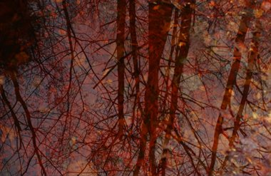
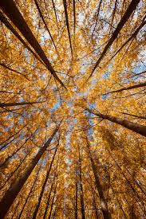
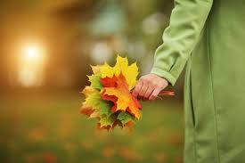
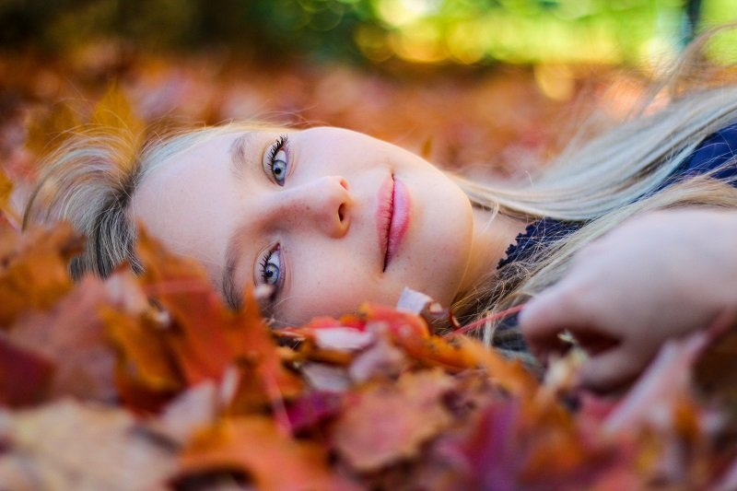
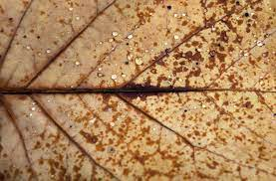
Term 1
Art Competition
'Autumn'

Slide 2
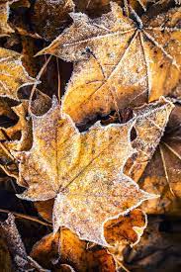
This term's art competition is: 'Autumn'.
Aim: Take a series of images that represent the word 'Autumn'.
Print 1 –10 images and display them in a creative way.
This competition is photography based but you can use other media to display your photographs - such as painting on top of images, collaging images etc (There will be workshops on this in art club).
Your photographs can be any size and as always if you need help with materials or printing, you just need to ask.

Slide 3
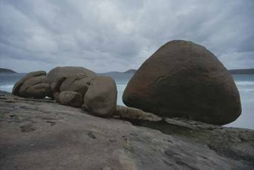
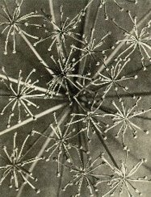
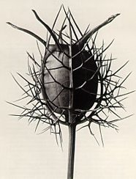
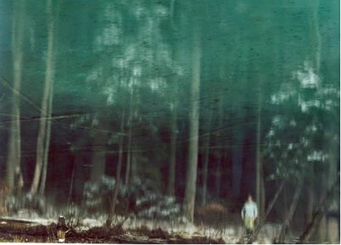
Ideas to help inspire you
Nature – go outside use the woods/ beaches.
Focus on the changes in your surroundings.
Focus on the weather.
Take close-up images of things like ferns and leaves.

Slide 4
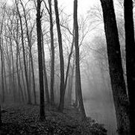
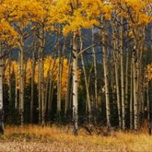
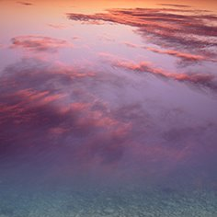
Take long distance images of the woods and skies.
Really look around you. In Autumn, we see the most dramatic seasonal change.
Focus on the reds, browns and oranges that you see.

Slide 5
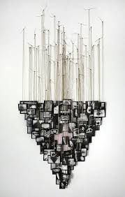
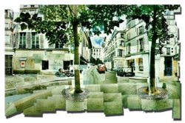
Could you present your work in an interesting way? For example, hanging your photographs or collaging them?

Slide 6
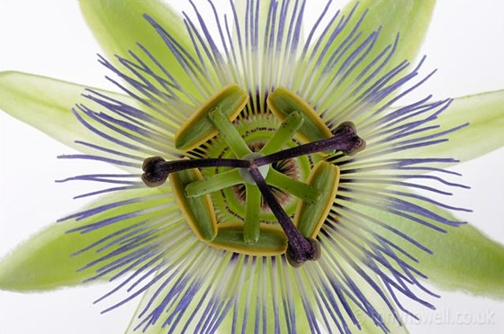
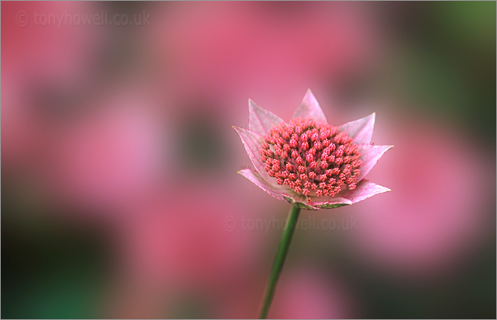
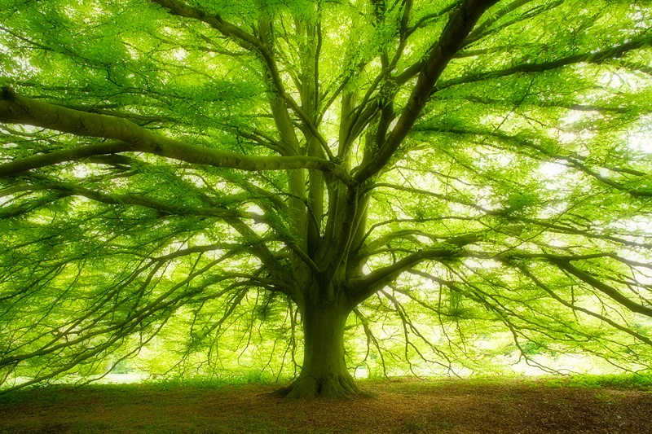
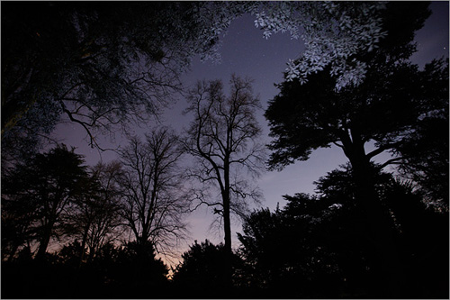
Tony Howell
Landscape Nature Depth of field Colour
Contemporary

Slide 7
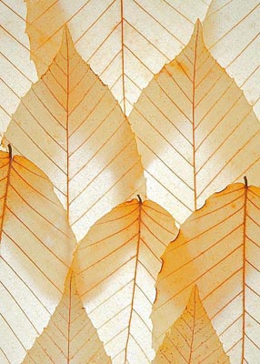
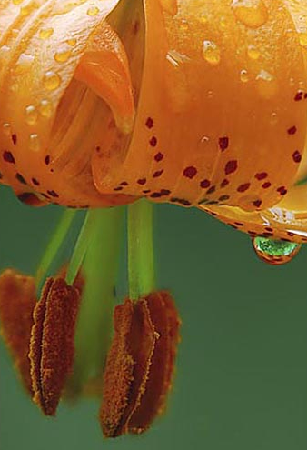
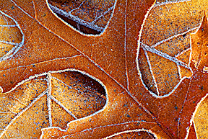
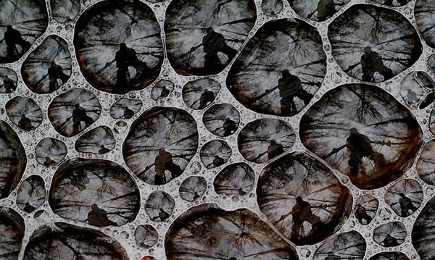
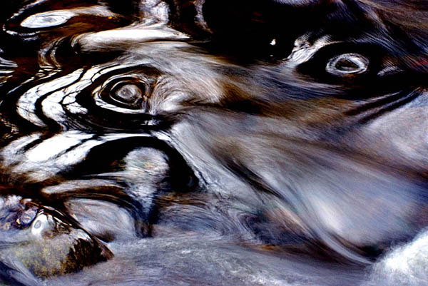
Mike Moats
Contemporary
Nature Texture Water
Reflection Close-up

Slide 8
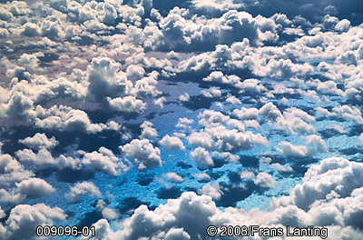
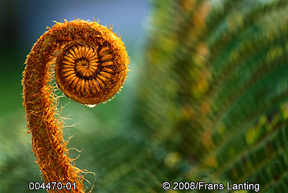
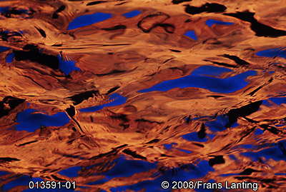
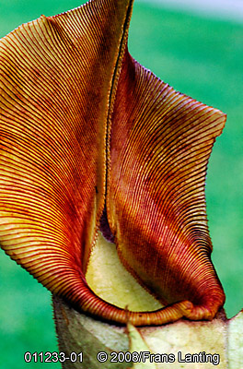
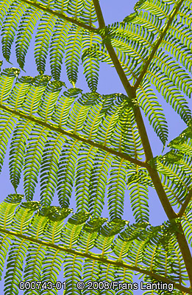
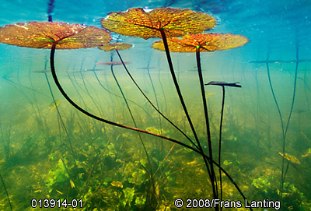
Frans Lanting
Pattern
Line
Texture
Nature
Contemporary
Water
Sky

Slide 9

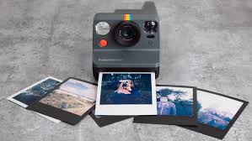
Resources you can use:
Cameras
iPads
Canvas/ boards
Phones/ parent's phones (with permission)
Pens
Paint
Collage
Pastels
Paper A2/A3

Slide 10
Rules
Keep your images appropriate- try not to include people
Be original
Try to think outside the box
Use the inspiration from the suggested artists and idea pages
Work must be submitted to Mr Brown or Mrs Smith by Tuesday 31st October after half term, with your full name, team name and age.
Workshops will be in the art room this term for the competition on Thursdays 12pm-1pm

Slide 11

Prizes
  There will be art-based prizes for 3 winners which will be announced at the beginning of next term.
  Good Luck!

