Slide 1

Welcome to RAPS SATs Awareness Meeting
18th April 2024

Slide 2
What are the SATs?
SATs tests are compulsory national tests for primary school pupils.
Children in England are required to take Standard Assessment Tests (SATs) at the age of 11 (school year 6) and do so on the same days throughout the country.
SATs measure how children achieve against the National Standard. They also assess the progress they have made during their time at school in comparison to other children across England.

Slide 3
Are the SATs used by secondary schools?
Some secondary schools use the SATS scores to put children into sets for Maths and English before they arrive; other schools re-test their Year 7 pupils in Maths and English when they arrive – they’ve had 6 weeks off over the summer.
All secondary schools have to use the SATs scores to determine targets for your child at GCSE – it’s called Progress 8. The higher the SATs score the higher a child’s GCSE target and the harder a school will push them to achieve.

Slide 4
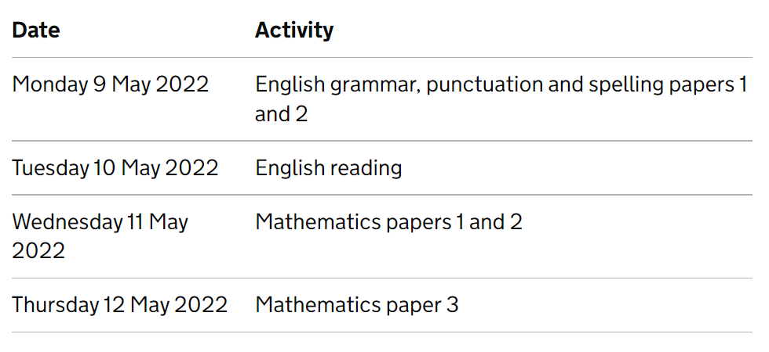
When are the SATs?
Monday 13th May 2024
Tuesday 14th May 2024
Wednesday 15th May 2024
Thursday 16th May 2024

Slide 5
Monday 13th May – Grammar, Punctuation and Spelling (SPAG)
The Grammar and Punctuation part of the test involves one paper worth 50 marks. Pupils have 45 minutes to complete this.
Questions vary in difficulty.
There is also a 20-word spelling test (untimed)

Slide 6
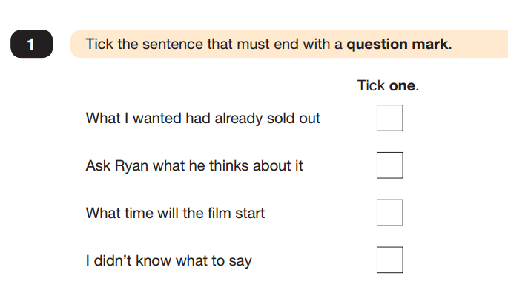
Monday 13th May – Grammar, Punctuation and Spelling (SPAG)

Slide 7
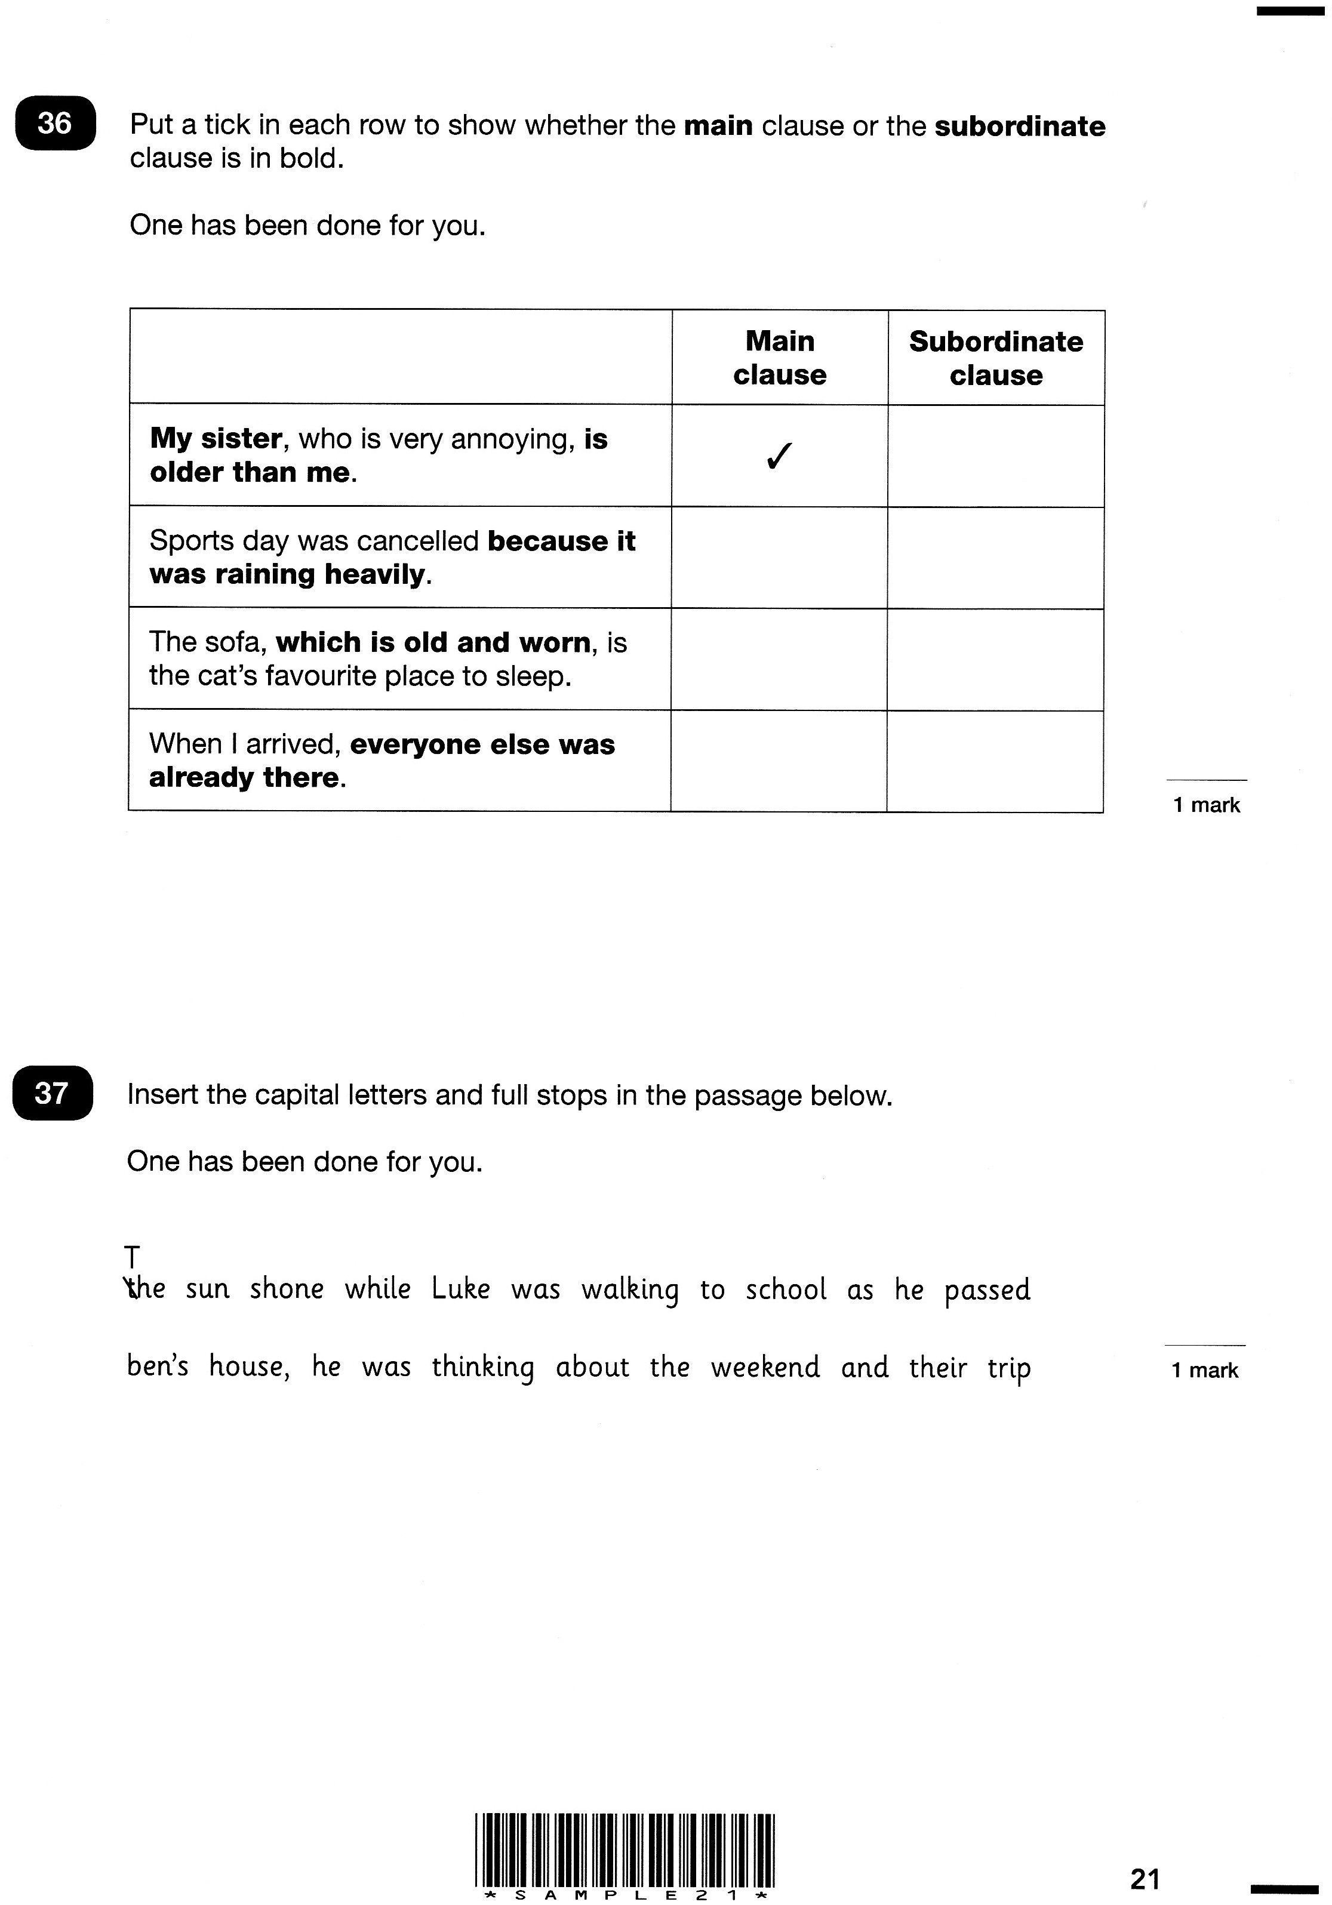
Monday 13th May– Grammar, Punctuation and Spelling (SPAG)

Slide 8
Monday 13th May – Grammar, Punctuation and Spelling (SPAG)
Circle all the determiners below.
Two apple trees screened the open windows on one side.

Slide 9
Monday 13th May–Spelling (SPAG)
Substance
Toughest
Bruise
Inspiring
Probable
Crumb
Nervous
Sensation
Straight
Likely
Operation
Sensibly
Violence
Disobeyed
Thorough
Monarch
Sympathetic
Originally
Percussion
Coarse

Slide 10
Tuesday 14th – Reading Comprehension
Pupils will have a total of 1 hour to read the 3 texts in the reading booklet and complete the questions at their own pace (total of 50 marks).
They can approach the test as they choose, but the best way is usually working through one text and answering the questions before moving on to the next.
The least-demanding text will come first, with the following texts increasing in level of difficulty.
The answer required can take different forms

Slide 11

Tuesday 14th – Reading Comprehension

Slide 12
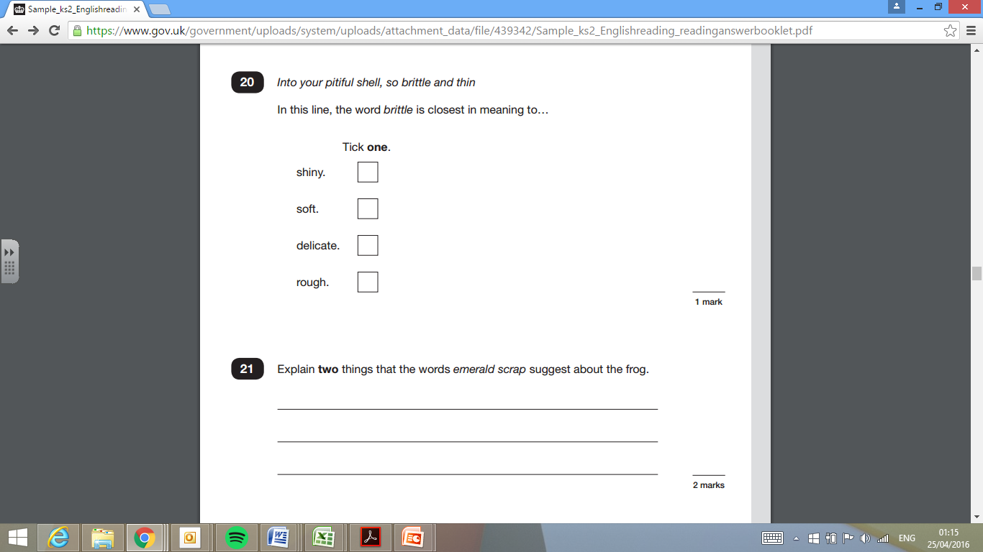

Slide 13
Wednesday 15th– Maths Papers 1&2
Maths Paper 1 is an arithmetic test. Pupils have to complete 36 questions in 30 minutes for a maximum of 40 marks.
Maths Paper 2 is a Reasoning test which pupils have 40 minutes to complete.

Slide 14
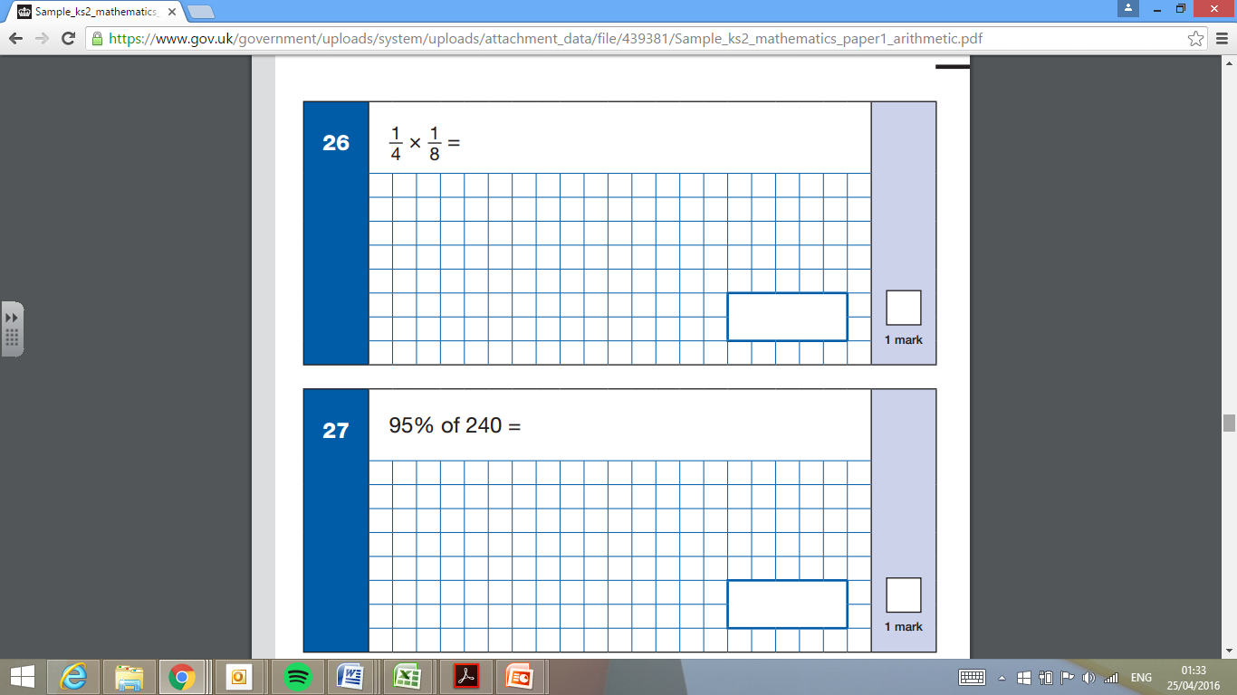
Thursday 11th– Maths Papers 1&2

Slide 15
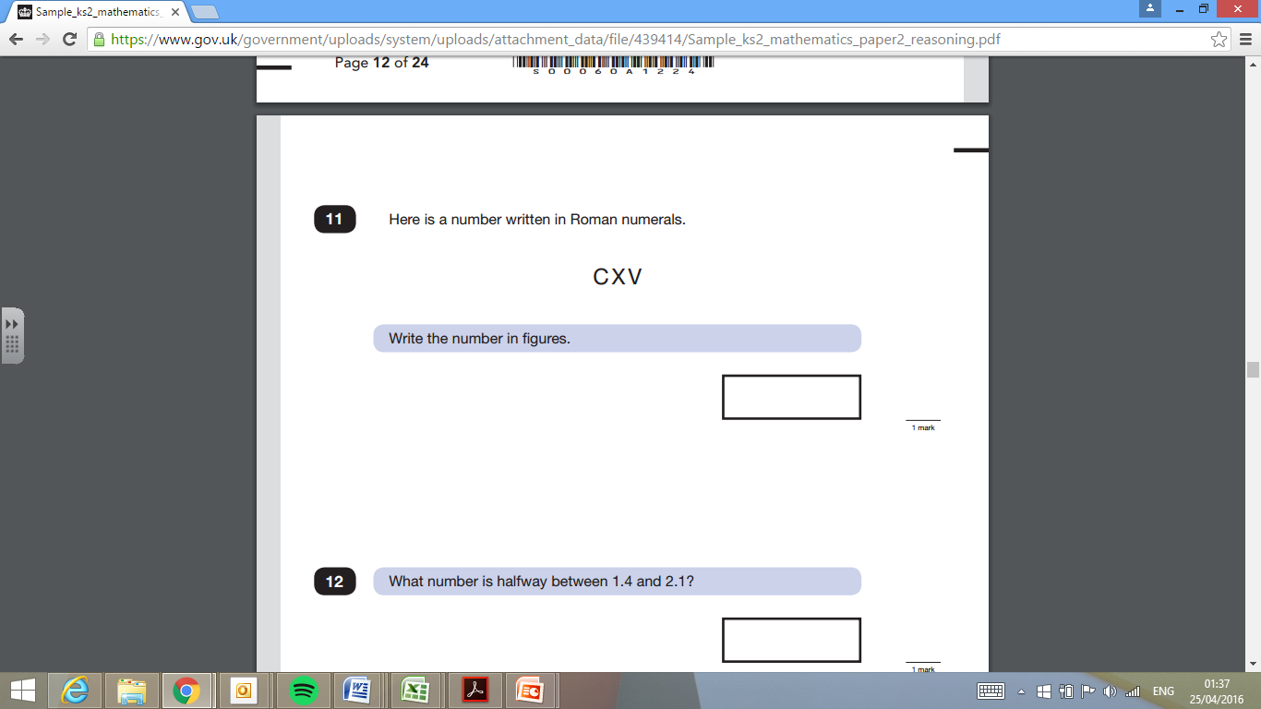
Wednesday 15th– Maths Papers 1&2

Slide 16
Thursday 16th– Maths Paper 3
Maths Paper 3 is also a Reasoning test which pupils have 40 minutes to complete

Slide 17
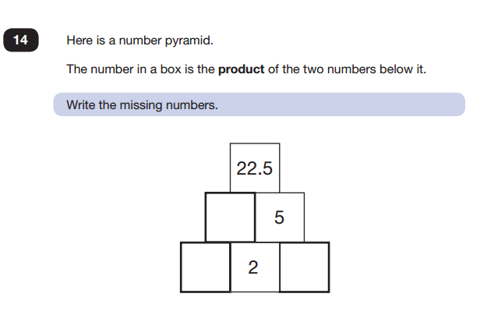
Thursday 16th– Maths Paper 3

Slide 18
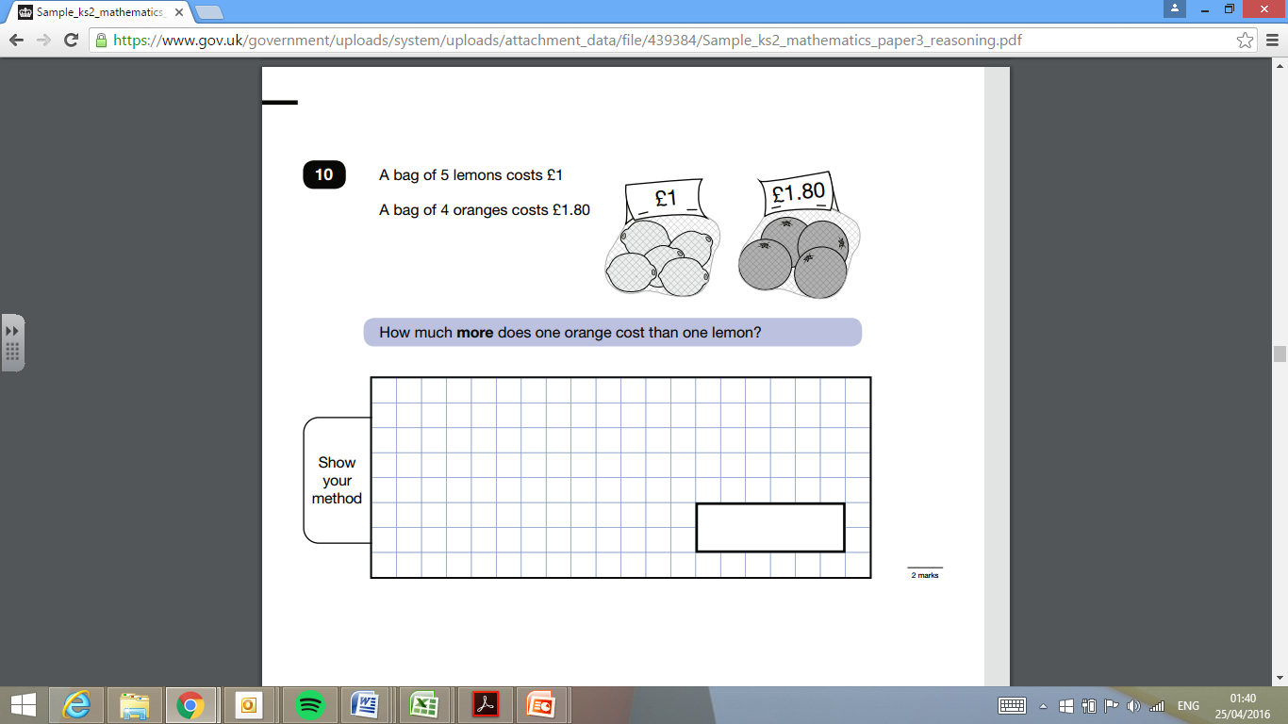
Thursday 16th– Maths Paper 3

Slide 19
Writing
Writing isn’t assessed through a test but is judged across the year.
Children’s books are taken to moderation or a moderator will come into the school to check teacher judgements.
Children will be assessed as either:
*working towards the expected standard
*working at the expected standard
*working in greater depth within the expected standard.

Slide 20
During SATs Week
We are offering free breakfast from 8.00am on Monday to Thursday during SATs week.
We will also provide water, bananas and mints for those who want them.
Testing will be finished by the end of Thursday unless a timetable variation is needed for a child who was absent.

Slide 21
How can Parents Help?
Make sure your child is at school!
Have them at school on time (8am)
Reassure the children. It’s nothing scary or new. The children are very familiar already with the type of papers so they will know what to do.
Keep everything calm. We want pupils to do as well as they can but not put themselves under unnecessary pressure.
Have a healthy week! Sensible bedtimes, plenty of fluids, take advantage of our breakfast offer!

