Slide 1
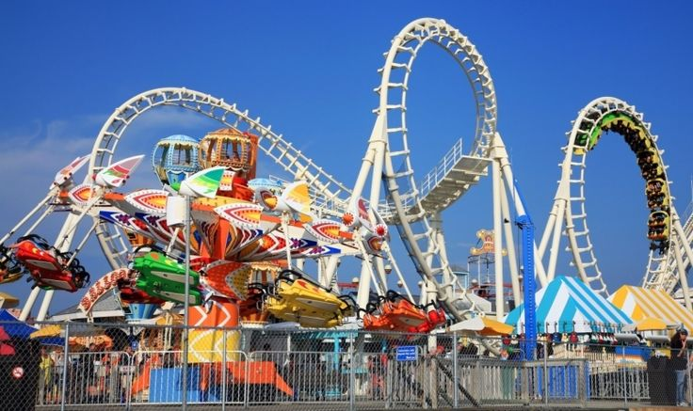
Term 6
Art Competition
Theme park ride design

Slide 2
https://www.youtube.com/watch?v=NxsAeRUS2V0

Slide 3
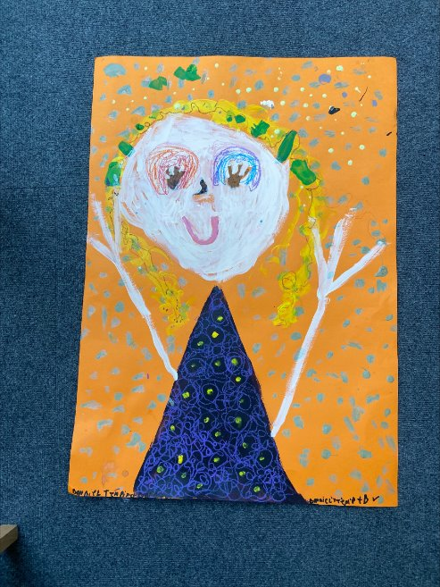
Winner KS1
Bonnie – Yr 1

Slide 4
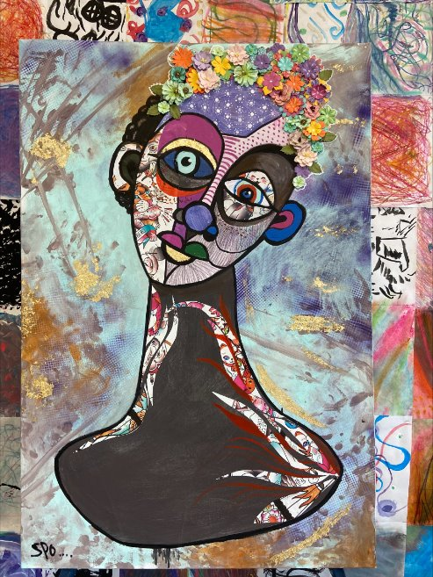
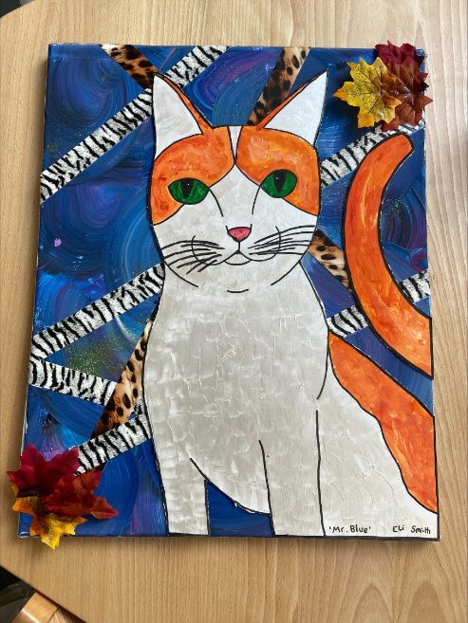
Winners KS2
Summer – Yr 6
Eli – Yr 4

Slide 5
This term's theme:
Create your own theme park ride.
Aim: Create your own theme park ride design to go into a theme park of your choice.
Could your ride go into Disney World, Thorpe Park or Chessington?
Have you ever gone to a theme park and thought, 'I wish there was [this] ride here'?
What about a vintage-themed ride to go into Dreamland?
What will you name your ride?
You can make/ paint/ draw your design and you need to explain what it is.

Slide 6

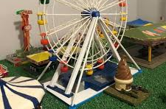
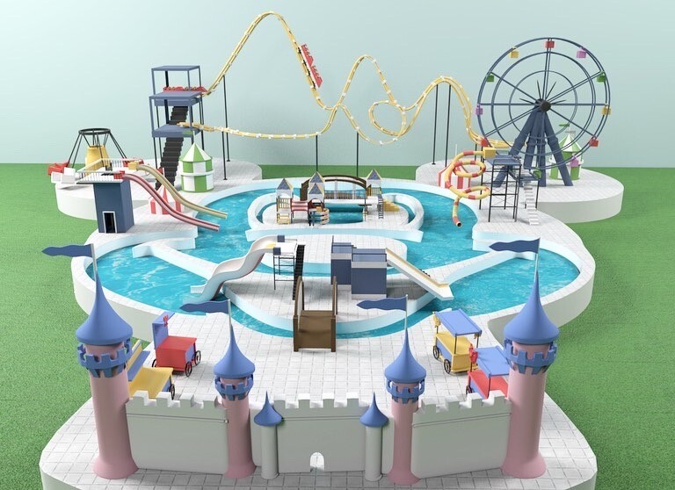
Resources you can use:
Model-making materials
Recycled materials: card, plastic, soft plastics, paper, newspaper
iPads- for inspiration
Canvas/ boards
Pens
Paint
Collage
Paper A2/A3
Card

Slide 7
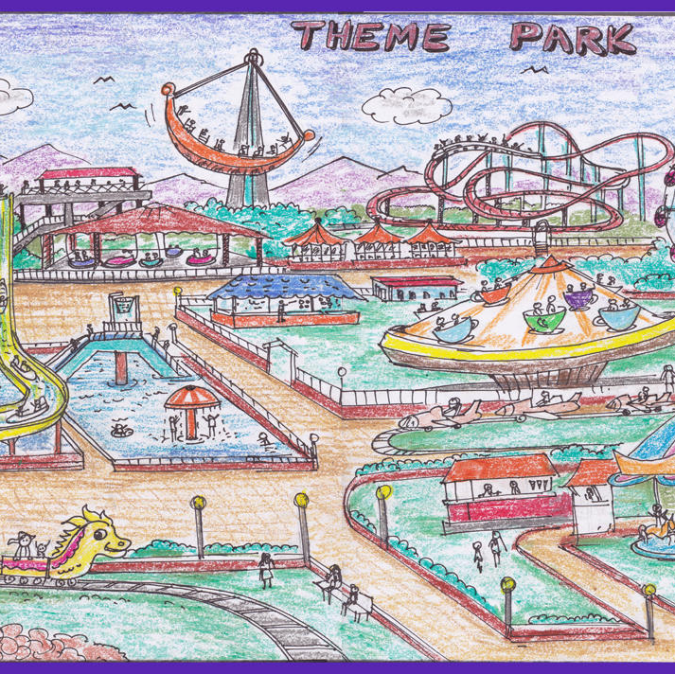
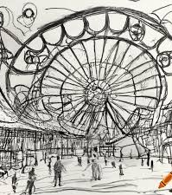
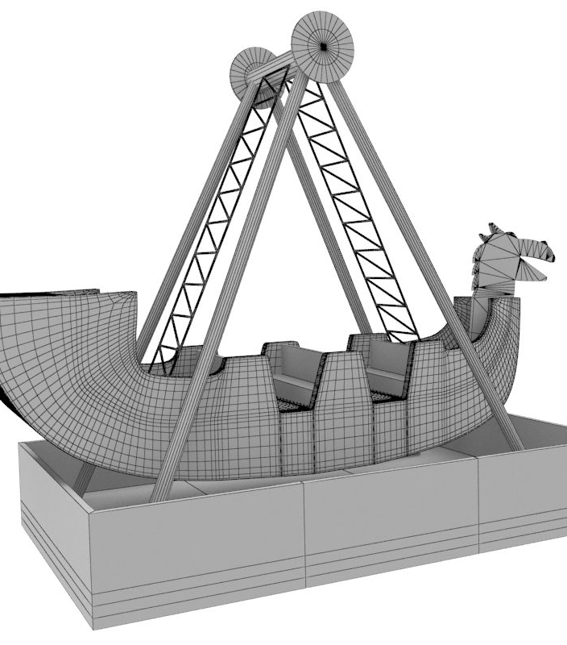
Ideas
Can you design a ride on your favourite video game or game?
What about your favourite toy?
What awesome name will you give your ride?
Could you design a whole theme park?

Slide 8
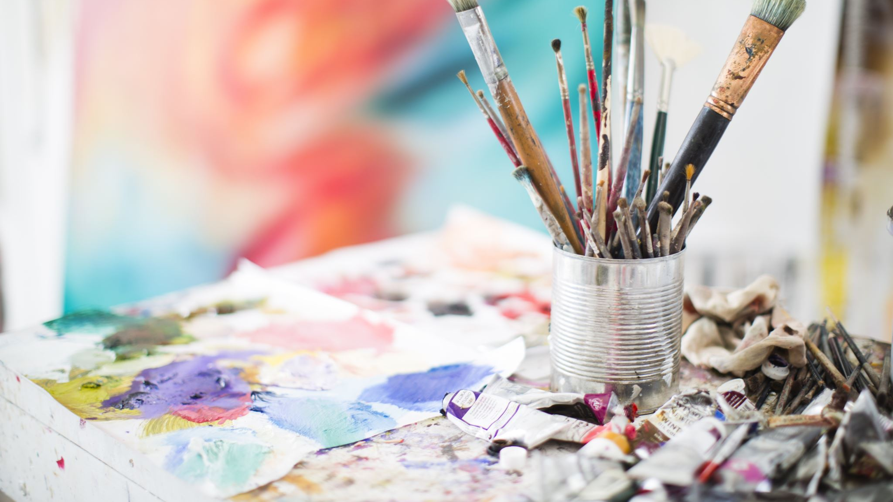
Rules
Keep your artwork appropriate and to the theme
Be original
Try to think outside the box
Use the inspiration from the idea pages
Work must be submitted to Mr Brown or Mrs Smith by Monday 15th July with your full name, team name and age.
Workshops will be in the art room this term for the competition on Thursdays 12pm-1pm

Slide 9

Prizes
  There will be art-based prizes for two winners which will be announced at the beginning of next term.
  Good Luck!

