Slide 1


Welcome to Year ?
Team CHANGE and
Team CHANGE
RAPS Open Classes 2024-2025
Welcome to Year 6
One Childhood, One Chance
Together we make a difference

Slide 2
We will cover:
The Team
The School day
Learning
Core Values
Behaviour for learning
Home Learning
Home Reading
TTRS
Social Media
Communication
Other information
Testing
Questions

Slide 3
The team
Mr Beraet
Mr Williams
Mrs Pilcher
Mrs Stephens
Teacher
Teacher
Teaching Assistant
Teaching assistant
Miss Dannell
Assistant Head for Phase

Slide 4

The School Day
8.15am- Doors open, early morning work *Register completed by 8:30am
8:15 – Early Morning Tasks
8.30-10am – English and Reading
10:00 – Assembly
10:15 - Break
10:30 – Maths
11:00-12:00 – SPaG
12:00-1:00 – Lunch
1:00 – Topic
1:55 – Story/snack
2:15 – Session One Arts curriculum
3:15 – Session Two Arts curriculum
4:15 - End of the day

Slide 5
Arts Curriculum
Term 1 (2:15-4:15pm):
Children to come to school in PE kits on PE days.
 | Monday |  | Tuesday |  | Wednesday |  | Thursday
Team Beraet | Art | Art | Music | Computing | Dance | Musical Theatre | Swimming | Swimming
Team Williams | Dance | Musical Theatre | PE | Drama | Art | Art | Music | Computing

Slide 6
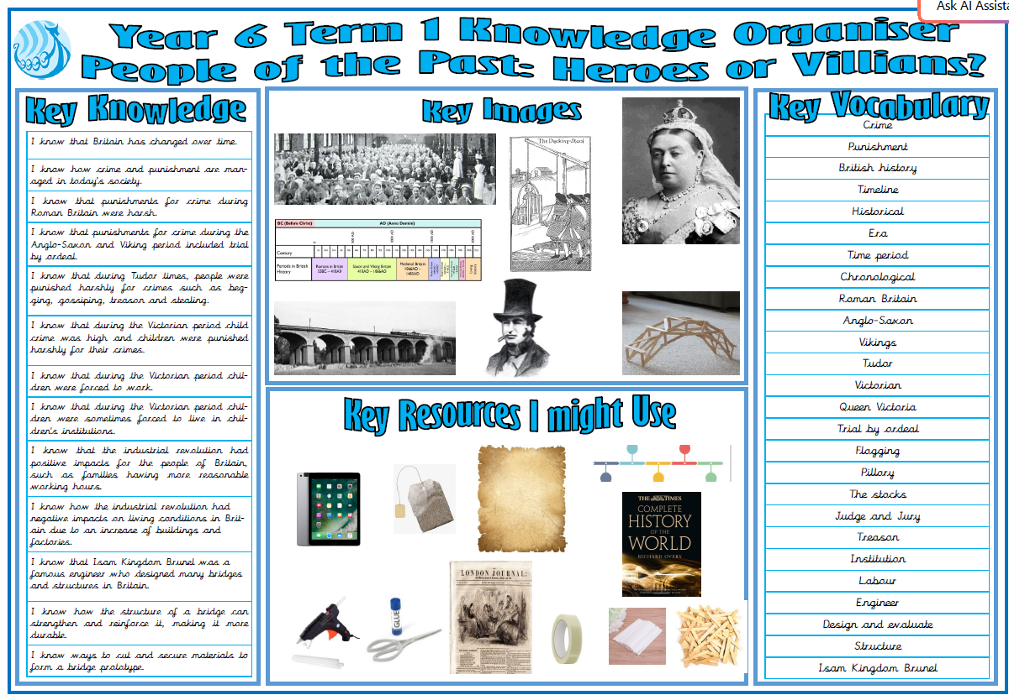
What will we be learning?
Topic- Term 1
Website, blogs and curriculum letters will show termly updates

Slide 8
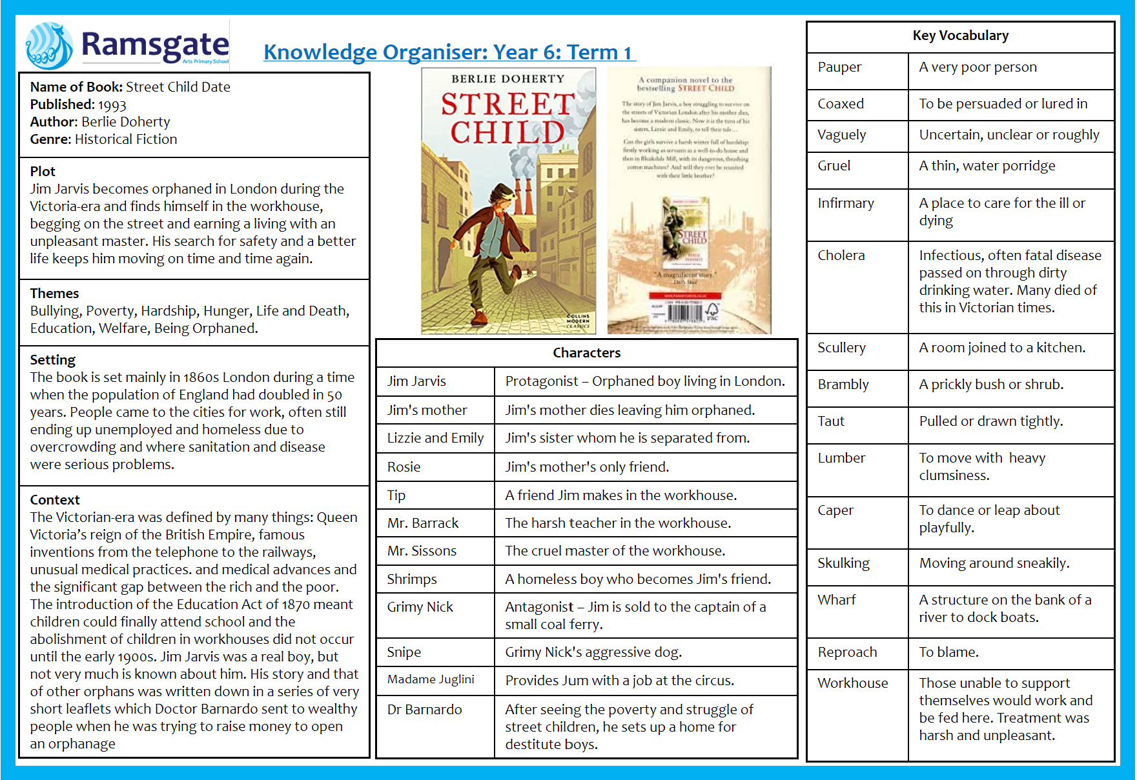
What will we be learning?
English- Term 1
Website, blogs and curriculum letter will show termly updates

Slide 9
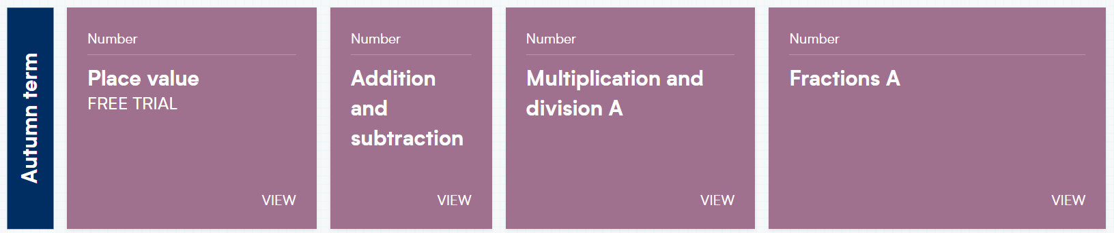
What will we be learning?
Maths- Term 1
Website, blogs and newsletters will show termly updates

Slide 10
Personal Development
Personal Development is taught in the first week of each term.
This includes learning about: our school values, oracy, citizenship, religious education, emotional literacy, British values and PSHE.
In PSHE, children learn about three main strands: Living in the Wider World, Relationships and Health.
The aim of these weeks is to develop children into well-rounded, kind and responsible members of our school and of society.
By devoting a whole week to personal development every term, the children get plenty of opportunities to have class discussions and learn how to be tolerant and respectful.

Slide 11
Our NEW Core Values…
These are at the heart of everything we do at Ramsgate Arts Primary School.
Kindness
Resilience
Collaboration
Creativity
Kindness, Resilience, Collaboration, Creativity

Slide 12
Why did we change them?
There were too many
They were hard to understand
They were not right for our children
The new values have been introduced to the children in personal development week and will be fundamental in everything we do.

Slide 13
Behaviour for Learning
At RAPS, we want our children to be ready to learn.
Our new golden rules:
Be Ready Be Respectful Be Safe
Kindness, Resilience, Collaboration, Creativity

Slide 14
Pupil Code of Conduct
Pupils are expected to:
Follow the school rules and safety & playground codes
Demonstrate school values in their behaviours, attitudes and interactions
Behave in an orderly and self-controlled way
Show respect to members of staff and each other
In class, make it possible for all pupils to learn
Move quietly around the school
Treat the school buildings and school property with respect
Respect the property of others
Wear the correct uniform at all times
Accept sanctions when given
Refrain from behaving in a way that brings the school into disrepute, including when outside school

Slide 15
Behaviour Points
Each child starts off with 5 points at the beginning of every day.
Possible total of 25 points a week. Expected to keep all 25 points!
If your child keeps all their points for the week, you will receive a text home and they will receive 'Golden Time' on Friday afternoon.

Slide 16

Sanctions
If a child is:
talking
messing around
refusing to work
rude
disrupting the lesson etc…
a non-verbal warning, a verbal warning then a yellow warning card gets placed on the desk in front of you. This will act as a reminder to the child that they have got to improve their behaviour.

Slide 17

If a child improves their behaviour, they can then earn the yellow card back. The yellow card can then be removed from the table and positive praise will be given.
If a child continues to misbehave the yellow card is changed to a red card.

Slide 18
If a child has a yellow card on their desk at the end of the lesson, they lose 1 point.
If a child has a red card on their desk at the end of the lesson, they lose 2 points.

Slide 19
Lunchtime
All lunch time incidents will be reported to the SLT member for the year group who will then log the cards, monitor and take appropriate action.
Warning letters will be sent to parents after being issued 1 and 2 red cards.
If 3 red cards are issued in a term at lunch, then the child will have playground privileges removed and social skills support in place for a term. A stage 3 letter will be sent to parents.

Slide 20
Restorative Conversation
When unpicking behaviours after a yellow/red card is given, a conversation will take place based around a restorative approach:
What happened?
I’m wondering why you did that?
Who's been affected?
What needs to happen next to put things right?
What can we do next time?
I notice that…
This conversation will ensure the child is in right place to continue their learning/day positively.

Slide 21

Daily Rewards
Verbal praise
Smiles
Superstar Learner cards (if a child has a Superstar learner card on their table at the end of the lesson, they can swap it for a house point as they leave)

Slide 22
Weekly Rewards
25 points= All golden time and text home.
“Your child has kept all of their behaviour points this week and have been rewarded with Golden Time.”
22-24 points= Some golden time will be missed to discuss behaviour with class teacher.
11-21 All golden time will be missed and SLT to contact parents.
6-10 points= Mr Budge to send letter home to inform parents.
5 points or less= Mr Budge to have a meeting with parents.

Slide 23
Termly Rewards
If children have kept all their behaviour points for the term, they will receive a behaviour badge.
After 4 behaviour badges, the fifth one is a silver badge.
If a child earns a badge every term, they will receive a gold one at the end of the year.

Slide 24
Home Learning
Love 2 learn will be assigned most weeks
Home reading should be happening regularly – preferably every night, but at least 4 times a week
Spellings every week in KS2 (set on a Friday, to be returned the following Friday).
Please continue to practise times tables at home.

Slide 25
Home Reading
School reading books have been assigned to every pupil in the class. The band is based on a combination of word reading and comprehension.
If you feel it is too easy or too difficult, please speak to a member of staff.
Children are encouraged to change books themselves.

Slide 26
Times Tables Rockstars
Pupils will be given a TTRS log in this term.
You can download the app.
They can practise as they so wish.
We will practise in class.

Slide 27
Social Media
The minimum age to open an account on nearly every social media platform—TikTok, Instagram, Twitter, Pinterest, Kik, YouTube, Snapchat, Facebook, and more— is 13. WhatsApp is 16.
We ask that if using social media, such as ‘WhatsApp’, children behave appropriately using respectful language and refrain from sending images/videos of themselves or others
Where parents’ social media groups are created for classes, refrain from discussing pupils, staff or other parents
The school is not responsible for monitoring parents’ WhatsApp groups and recommend they are only used for event and timetable reminders

Slide 28
Communication
School Website
Blog three times per week (for updates about learning)
Termly Curriculum letters on blog
MCAS (for info about dates, admin etc)
Email via Office enquiries@ramsgateartsprimaryschool.co.uk (to book a meeting/phone call or to discuss issues relating to children with class teacher/ SLT)
RAPS Instagram page
Parents' Evenings
End of year report
Teacher on the playground

Slide 29
Communication
A member of the Team will be on the door every morning
Or e-mail the class teacher at
enquiries@ramsgateartsprimaryschool.co.uk and the office will forward this on.
Each phase has a member of the senior leadership team-the SLT member for Year 6 is Miss Dannell.
If you wish to discuss anything related to your child, please email: enquiries@ramsgateartsprimaryschool.co.uk

Slide 30
Other information
School Uniform expectations
PE kits
Reading books can be changed whenever your child has finished their book.
Class blogs - 3 x weekly, letting you know what is going on in classroom plus homework blog
Find us on the playground

Slide 31
Testing
Kent Test will take place next Thursday.
SATS occur in Term 5 – there will be a meeting beforehand to discuss their structure, support etc.

Slide 32

Any Questions?

