Slide 1
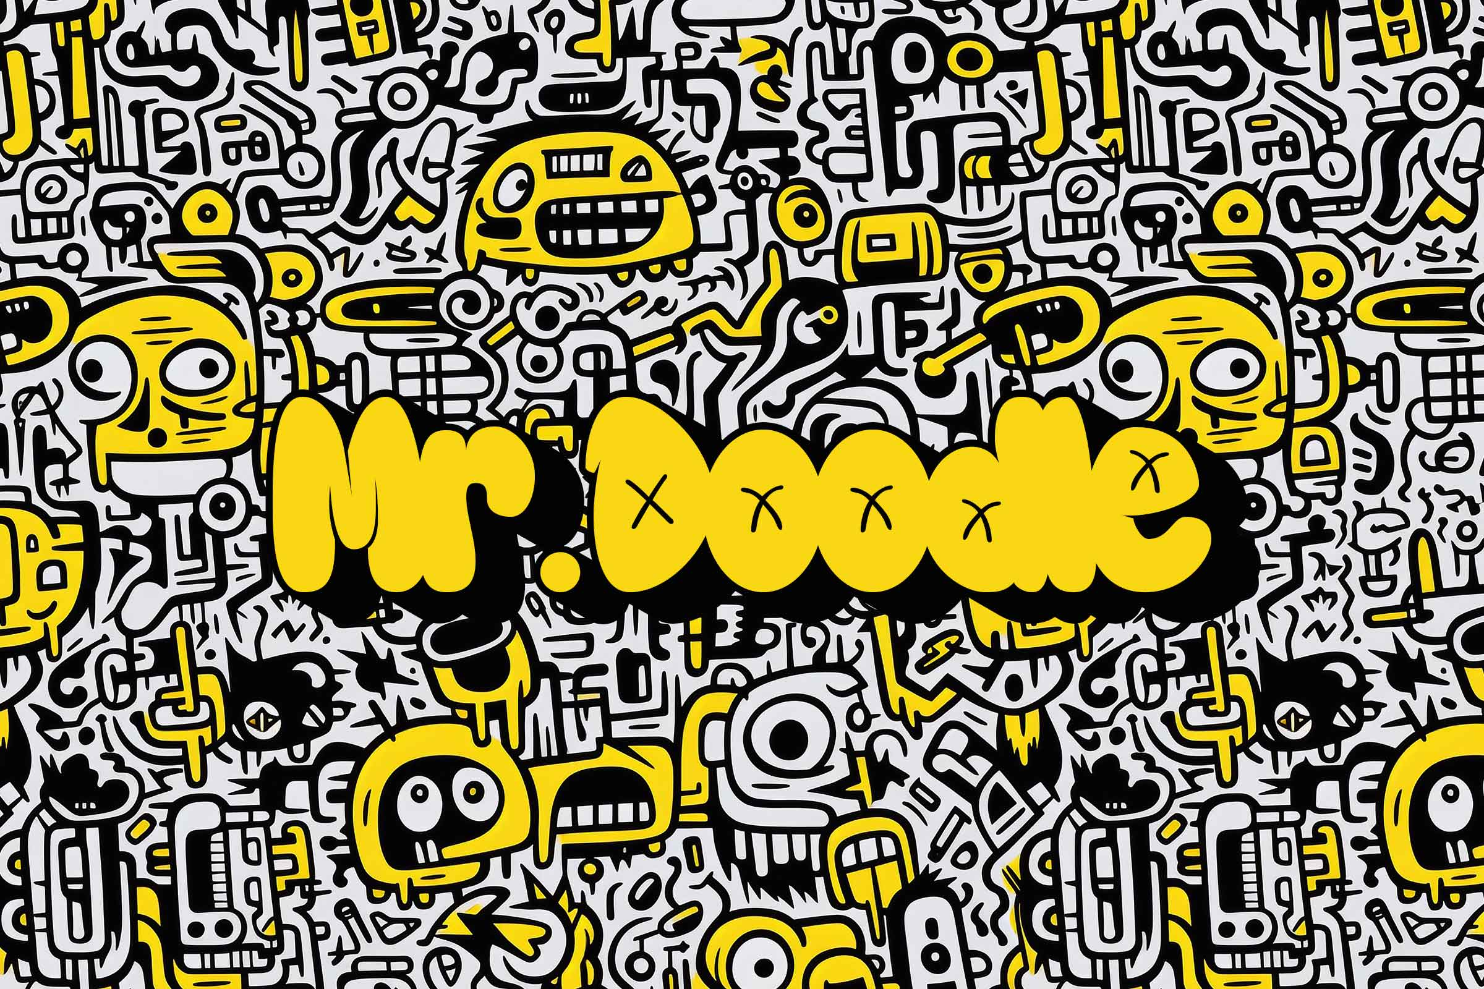
    Term 1
    Art Competition

Slide 2
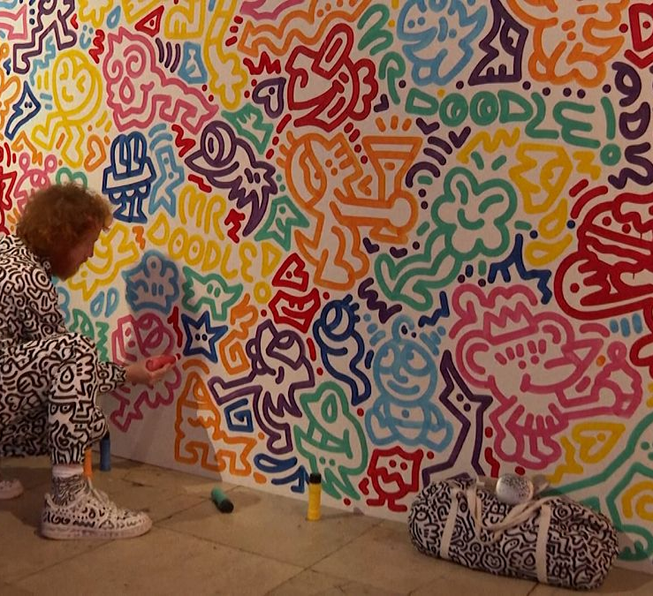
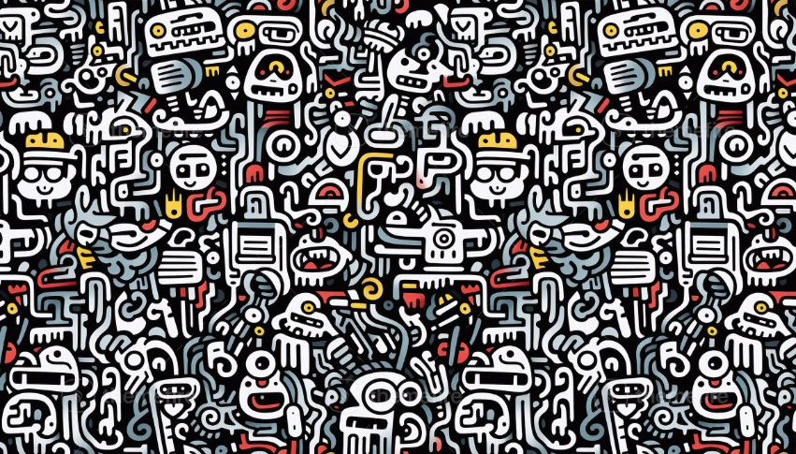
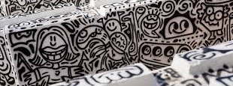

Slide 3
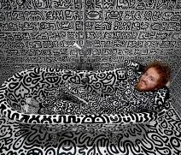
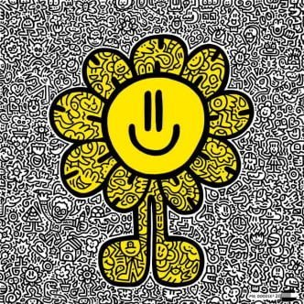
Who is Mr Doodle?
Sam Cox is better known as Mr Doodle.
He describes his drawing style as "OCD – Obsessive Compulsive Drawing" and "growing drawing virus."
Mr. Doodle's draws for clients including Adidas, MTV, and Cass Art.
Mr Doodle was born in Kent, England in 1994.

Slide 4
https://www.bbc.co.uk/news/av/uk-england-kent-51635511
https://www.bbc.co.uk/news/av/entertainment-arts-63118482

Slide 5
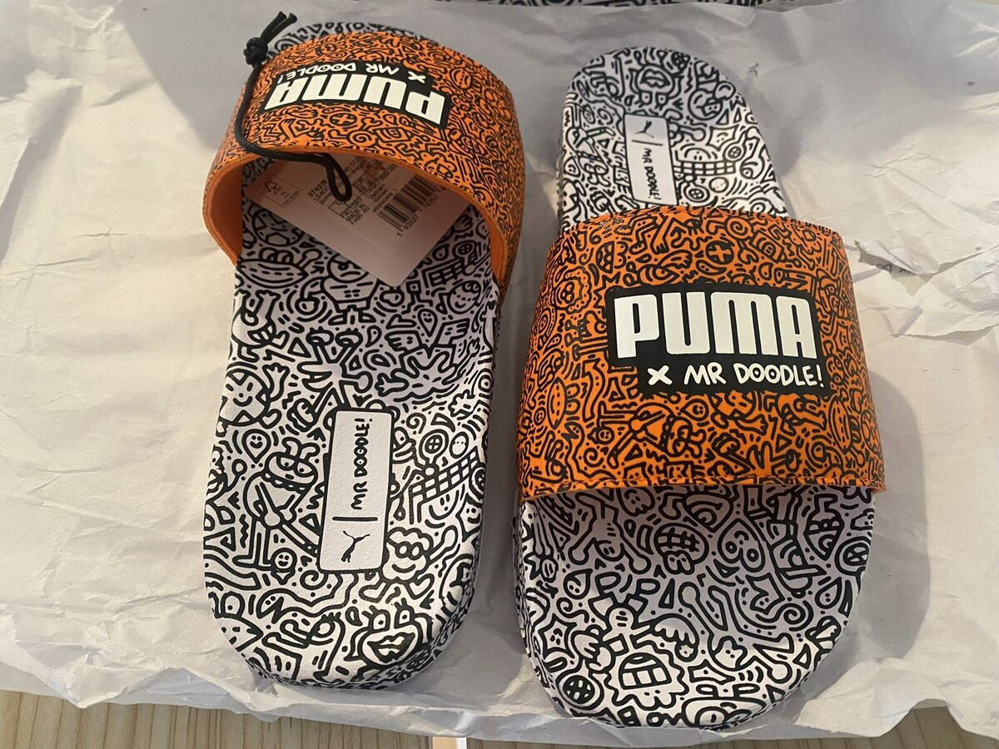
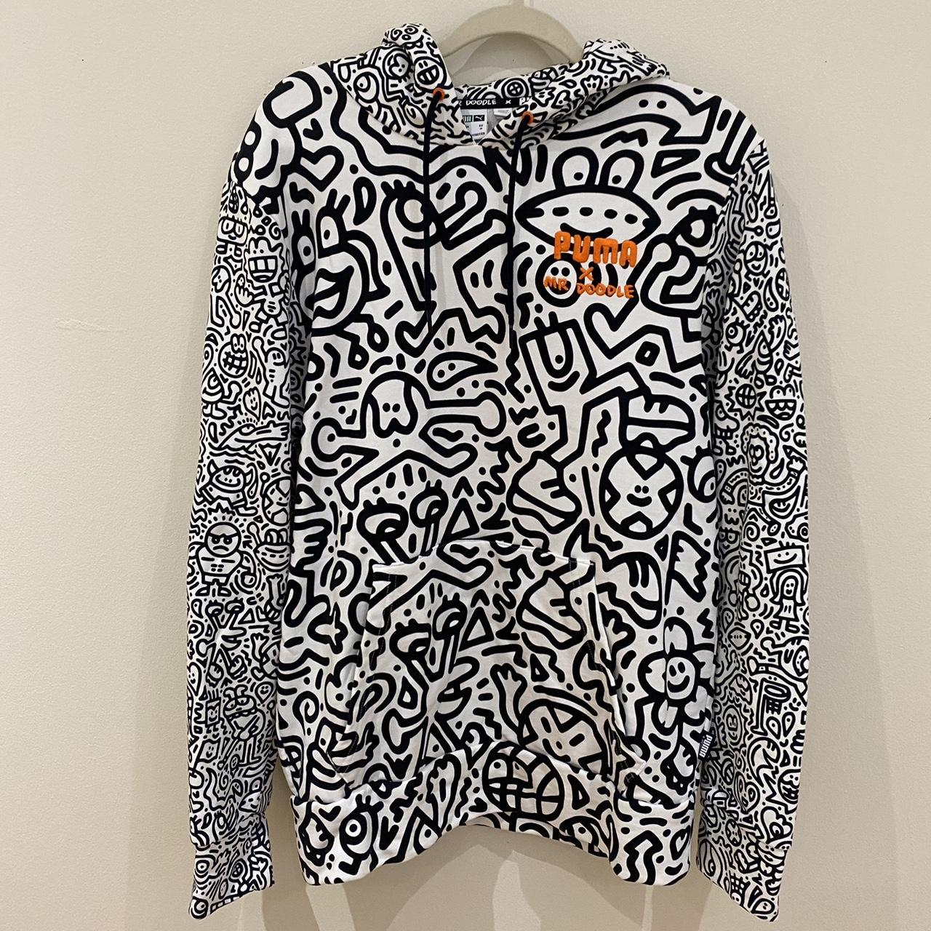
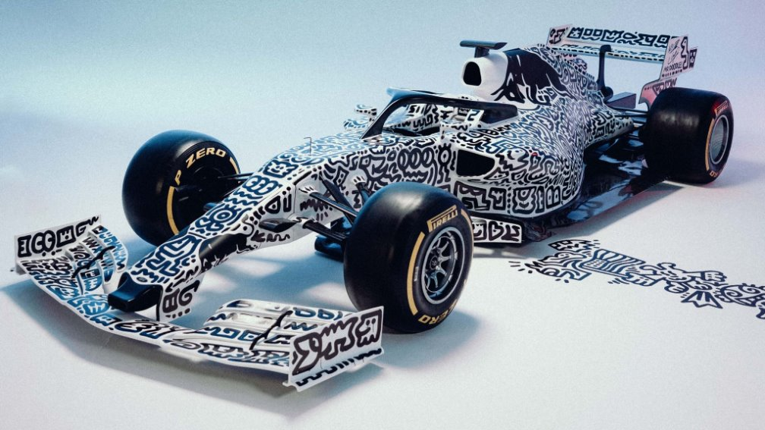
This term's theme: Mr Doodle
Aim: Create your own Mr Doodle inspired artwork!
You can create artwork on any sort of material such as clothes, shoes, toys, old household items, old technology – the possibilities are endless
You can create your doodles on any theme of life– food, sea life, animals, people, nature etc
You can use colour
Follow Mr Doodle on YouTube for more ideas. https://www.youtube.com/c/MrDoodle

Slide 6
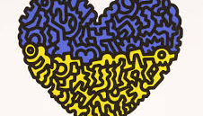
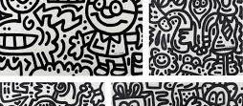
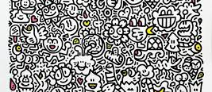
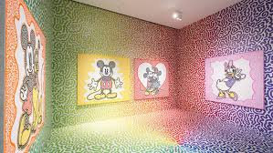

Slide 7
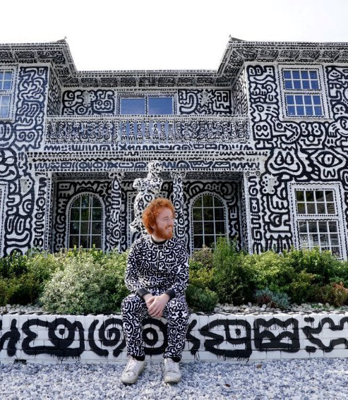
Resources you can use:
Pens – how you use pens creativity?
Recycled materials: card, plastic, something that is being thrown away like an old shelf or table, old shoes and clothes
iPads- for inspiration – YouTube Mr Doodle
Canvas/ boards
Pens - Sharpies, thin and thick felt tip pens, metallic
Paint
Fabric pens
Paper A2/A3
Card

Slide 8
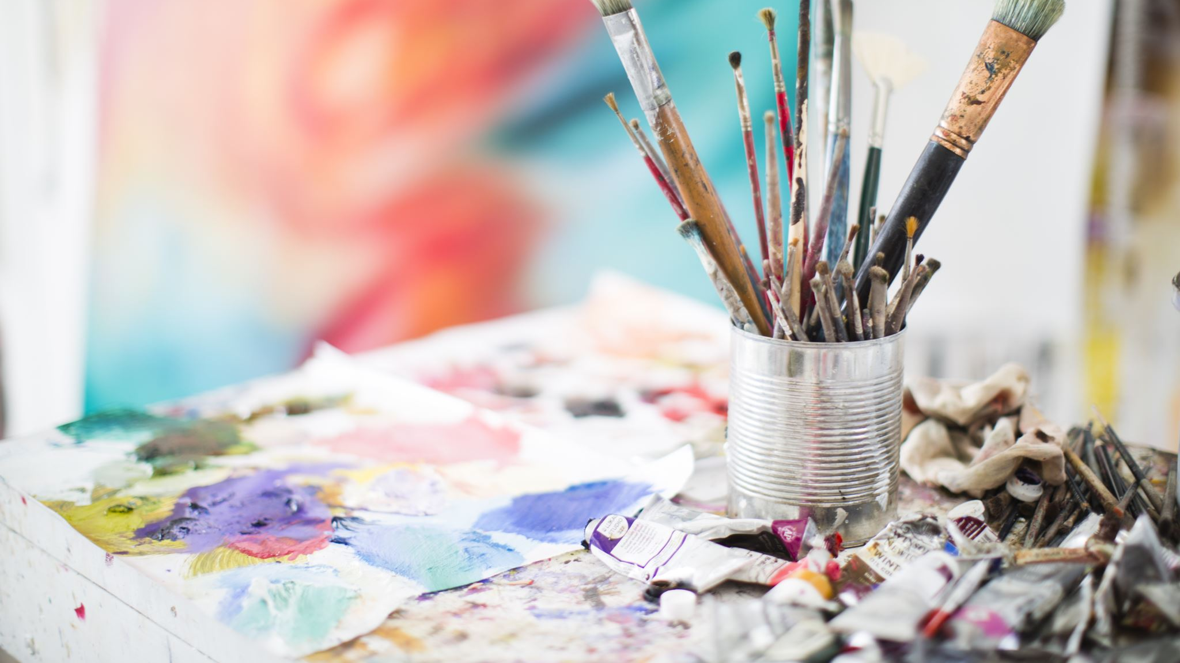
Rules
Keep your artwork appropriate and to the theme
DO NOT DOODLE ON ANYTHING YOU ARE NOT ALLOWED
Be original
Try to think outside the box
Use the inspiration from the idea pages/ YouTube
Work must be submitted to Mr Brown or Mrs Smith by Monday 21st October with your full name, team name and age.
Workshops will be in the art room this term for the competition on Thursdays 12pm-1pm – You may bring a pack lunch

Slide 9

Prizes
  There will be art-based prizes and house points for three winners which will be announced at the beginning of next term.
  Good Luck!

Slide 10
https://www.youtube.com/shorts/fSizsHGKFwQ

