Slide 1
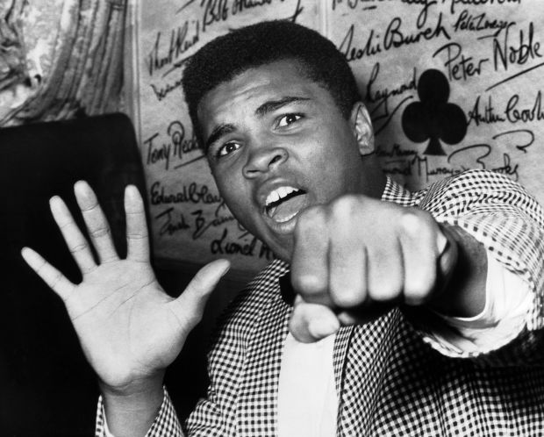


Welcome to Team Amin
Year 4
One Childhood, One Chance
Together we make a difference

Slide 2
What we’ll cover:
The School Day
Learning
Core values
Behaviour for Learning
Home Learning
Home reading
Other information
Questions

Slide 3
The School Day:
APPROXIMATE TIMES!
8:15 – Doors open, Early Morning work
8:35 –Guided Reading
9:00 – Assembly
9:25-10:25 – Maths
10:25-10:40 – Break
10:40-11:00 – Star spelling & PAG
11:00 – 12:00 – English
12:00-1:00 – Lunch
1:00 – 2:00 – RE/RAPS Curriculum
2:00 – 2:15 Break
2:15 - 3:15 – Arts Curriculum
3:15 – 4:15 – Arts Curriculum
4:15 - End of the day

Slide 4
The School Day: This term
ICT and Drama is on a Monday
PE and Dance is on a Tuesday
PE and Art is on a Wednesday
Media and Music is on a Thursday

Slide 5
Topics
Maths – Term 1 - Place Value (numerals and written word), Addition (written and mental methods), Subtraction (written and mental methods), Multiplication, Division (Bus stop)
RAPS Curriculum – Term 1 – ‘How We Live’
English – Stories from different cultures – characters and settings
Please see our first curriculum letter for more details

Slide 6
Our Core Values…
These are at the heart of everything we do at Ramsgate Arts Primary School.
Engagement
Enquiry
Diversity
Aspiration
Challenge
Collaboration
Autonomy

Slide 7
Behaviour for Learning…
Children to be ready to learn
Happy Safe Successful

Slide 8

3
2
4
1
5
Hand signal

Slide 9
What are the
GG
Golden Rules?
Expected Behaviour at RAPS

Slide 10
Behaviour Points
Each child starts off with 5 points at the beginning of every day.
Possible total of 25 points a week. We expect children will keep all 25 points!
The points will also be looked at on a 3 weekly basis. 25 x 3 = 75 points

Slide 11

Sanctions
If a child is:
talking
messing around
refusing to work
rude
disrupting the lesson etc
A NV warning, a verbal warning then a yellow warning card gets placed on the desk in front of you. This will act as a reminder to the child that they have got to improve their behaviour.

Slide 12

If a child improves their behaviour they can then earn the yellow card back. The yellow card can then be removed from the table.
If a child continues to misbehave the yellow card is changed to a red card.

Slide 13
If a child has a yellow card on their desk at the end of the lesson they lose 1 point.
If a child has a red card on their desk at the end of the lesson they lose 2 points.

Slide 14
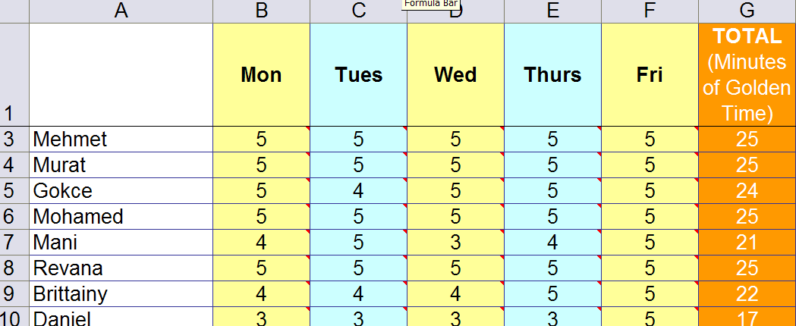
Behaviour Points

Slide 15
Daily Rewards
Verbal praise and smiles
Super Star Learner cards (if a child has a Super Star Learner card on their table at the end of the lesson, they can swap it for a house point as they leave).

Slide 16
Weekly Rewards
25 points= All golden time and text home.
22-24 points= All golden time.
11-21= Teacher to contact parents.
6-10 points= Mr Budge to send letter home to inform parents.
5 points or less= Mr Budge to have a meeting with parents.

Slide 17
Three Week Rewards
75 points= Letter home (emailed). Badge to wear.
3rd badge: RAPS lanyard
6th badge: Silver behaviour badge
12th badge: Gold behaviour badge

Slide 18
Class Rewards
Three week rewards
The class with the most points in each Key Stage gets a £3.00 RAPS Cheque to display in their classroom.
At the end of terms 2, 4 and 6 each class can ‘cash’ in their cheques to buy something for the class as a reward/treat. For example, an ice-cream each down the beach.

Slide 19
Home Learning
Love to Learns will be approximately every 3 weeks, but home reading should be happening regularly – preferably every night, but at least 3 times a week.
Spelling – this will be set weekly.
Rockstars – focusing on reinforcing times tables
Mathletics
Please check the website for any newsletters.

Slide 20
Home Reading
Children are expected to read at least 3x a week or a letter will be sent home.
Parents are to sign when the child has read inside the green reading records once these are sent home.
School reading bands and books will be assigned to every pupil in the class. The band is based on a combination of word reading and comprehension.
Children are encouraged to read books from the reading corner and library as well as banded books.
They should have their reading record with them in their bag, but especially on a Monday when it will be checked by myself.

Slide 21
Other information
PE kits, packed lunches, water bottles
Tucking in shirts is necessary.
Reading books can be changed whenever your child has finished their book. Correspondence will be completed in reading log book.
Class blogs (including spelling) will be uploaded 3x weekly.
Open door policy – come and chat with us!
If you need to contact me, my email address is kiki.amin@ramsgateartsprimaryschool.co.uk

Slide 22

Any Questions?

