Slide 1

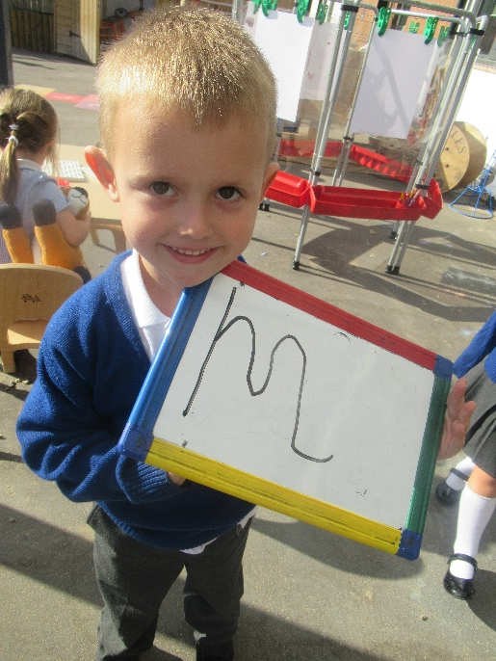
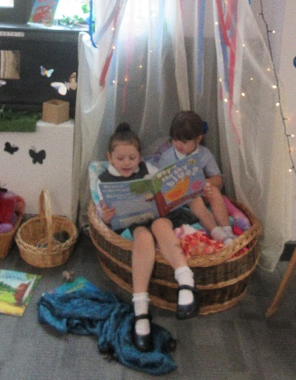
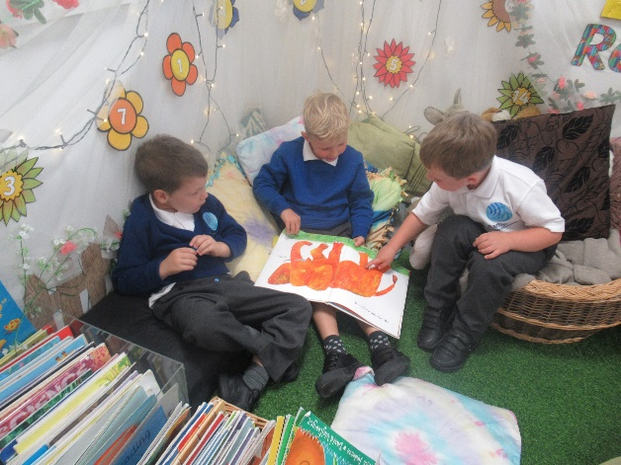
EYFS Reading and Writing

Slide 2
What is phonics?
Each word is made up of sounds and letters.
Cat, ship and sight all have 3 sounds but a different number of letters.
English language has 26 letters.
However, it has 44 sounds.
Therefore, we have different combinations of letters to make up the sounds within the English language.
http://www.ruthmiskin.com/en/resources/parent-information-understanding-phonics/

Slide 3

Read Write Inc in Year R
In reception we teach the children the set 1 sounds.
m a s d t i n p g o c k u b f e l h sh r j v y w th sh th ch qu x z ng nk ck kn
Followed by the set 2 sounds.
ay ee igh ow oo oo ar or air ir ou oy- special friends
http://www.ruthmiskin.com/en/resources/sound-pronunciation-guide/

Slide 4
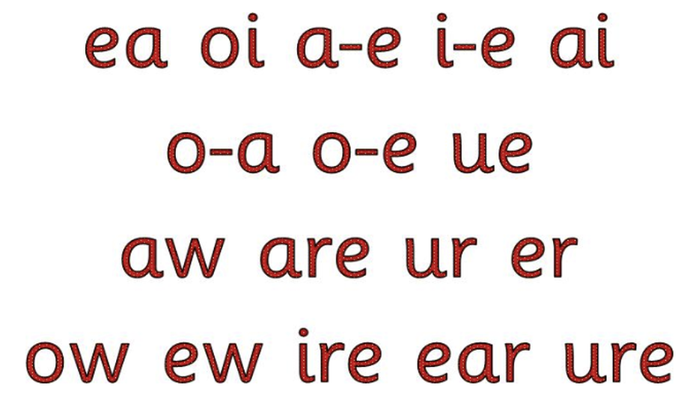
Read Write Inc in Year 1
In year 1 the children will have been assessed to find out how many sounds they can know from set one and two that were taught in reception.
The children will then be grouped and the groups will re-cap at set one, two or continue to set 3.
Set 3 sounds- special
friends and special friends
Who have been separated

Slide 5

Initial sound/Rhyming
The first stage of reading is hearing the initial sound in words. (ssssssnake).
You can encourage your child to hear it by exaggerating the first sound and then asking them to tell you what it was.
Rhyming is a very important step in reading. Can your child continue a rhyming string or spot the odd one out?

Slide 6
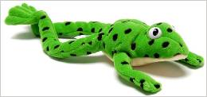
Blending – oral blending
In order to read using the sounds the children will also need to know how to blend.
This is when you say the sounds in a word and put them together to hear the whole word e.g. C-a-t, sh-ee-p, th-i-nk.
The first step in blending is known as oral blending. This is when you say the sounds in a word to the children and they tell you what the whole word is.
For this we use Fred the Frog
http://www.ruthmiskin.com/en/resources/parent-tutorial-preparing-teach-reading-fred-games/

Slide 7
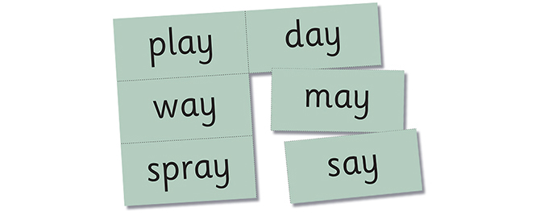
Blending
Once the children recognise some sounds confidently and can orally blend then they will begin to be able to read simple regular words (green words) by looking at the word, saying the sounds and blending the word together.

Slide 8
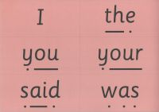
Red words
There are, annoyingly, many words in the English language that we cannot blend as they are irregular
E.g. Come, are, the, does.
These words are called red words.
The children have to memorise what these look like as a whole word. They will learn them by sight. They cannot blend these words.

Slide 9
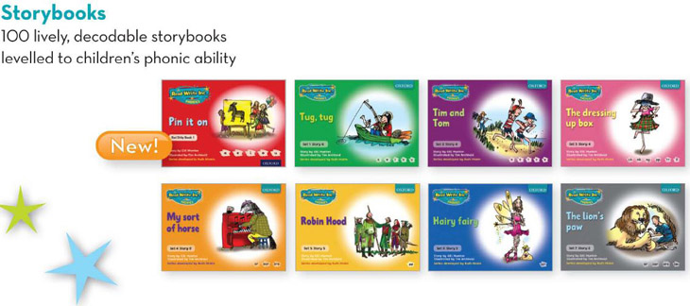
RWI books
When the children are ready they will start the reading and writing section of RWI.
The books are all banded and lower levels are on a one day cycle, middle levels on a 3 day cycle and higher levels on a 5 day cycle.
The activities include: reading green words, reading red words, taking turns to read the book, spelling, holding a sentence, comprehension, handwriting and writing about the book.

Slide 10
Helping at home
Sound books- New sounds added every Friday.
We will write each new sound your child has learned in the book. Your child can draw pictures of things that begin with that sound and they could practise writing the sound too.
It is hugely beneficial for you to go through your sound book every time you listen to your child read.
We will also send red and green words home on cards in order for you to play games with them to help your child to remember them as a whole.
Snap, matching pairs, hide the word, rhyming games, what sounds can you hear?
Please keep in the sound book in the plastic reading wallet so that we can keep it up to date.
We understand that some children may not wish to practice in the book- It can be completed on anything. Just let us know.

Slide 11
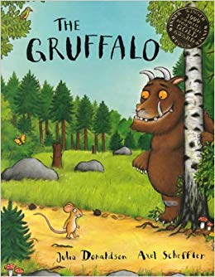
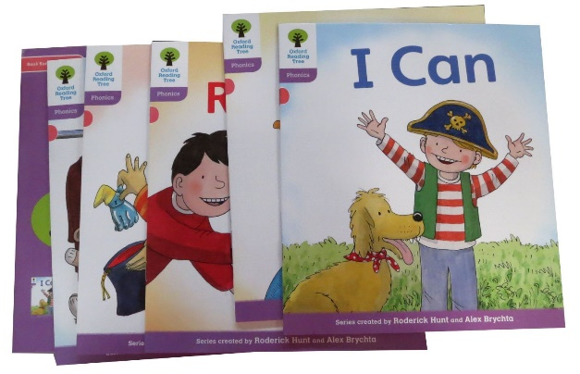
Reading books
Children can choose a book to take home from the class book corner to share with you. These can be changed as often as you wish.
These can be shared whenever is best for you!
We will also send home reading scheme books once your child is ready.

Slide 12

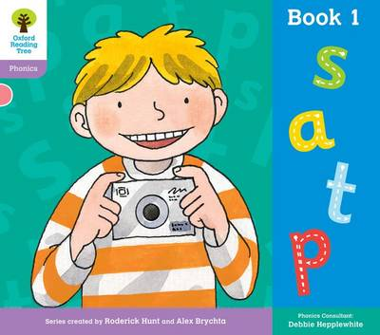
Phonics books
Phonic based book appropriate to stage of reading. Children will get his when they are ready.
Please try and complete this as often as possible.
Adults will sit and listen to child read to assess what level they should be on. This is a continuous process alongside RWI.
Please let us know if you think a level is too hard/too easy for your child by writing it in the reading record. Sometimes children have a real jump in their progress overnight.
Phonics based books go through the colour bands and every so often there will be a sounds book. Please don’t panic that your child has gone backwards. They are throughout every level.
If you would like more than one book at the weekends then please let us know.

Slide 13
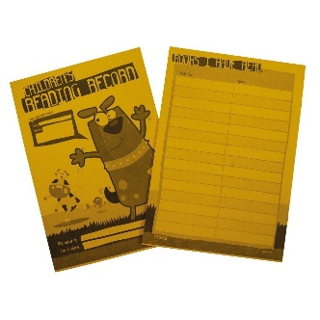
How to use the reading record:
When your child has completed the book please write the date and the title of the book.
There is no need to write a comment if you do not want to (a tick is enough).
The phonics book will not be changed if the reading record has not been written in.
The records are changed daily by the teaching assistants. They will pass on any comments/ actions to the class teacher.
Every Friday the reading records will be checked and commented in by the teacher.
When your child has read 100 books they will receive a book of their choice and a certificate from Mr Budge.

Slide 14
Things to discuss:
Discuss front cover: What might the book be about?
Look at the pictures.
Predict what might happen next.
Don’t expect your child to be able to sound out or recognise words we have not covered in class yet.
Did they like the story? What was their favourite part?
Can they retell the story in the correct sequence?

Slide 15
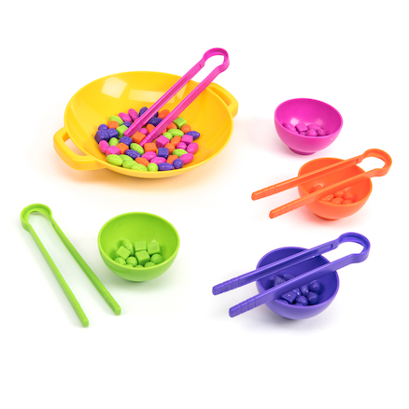
Writing – Pencil control
Your child may not be ready for writing letters yet. You can help them to prepare for this with different activities….
  Picking up small objects with tweezers
  Threading
  Playdough
  Buttons and zips
  Posting – coins, pasta, grains of rice etc
Once ready use variety of tools to make marks e.g. paint brushes, chunky felts/crayons, chalk, pencils.

Slide 16

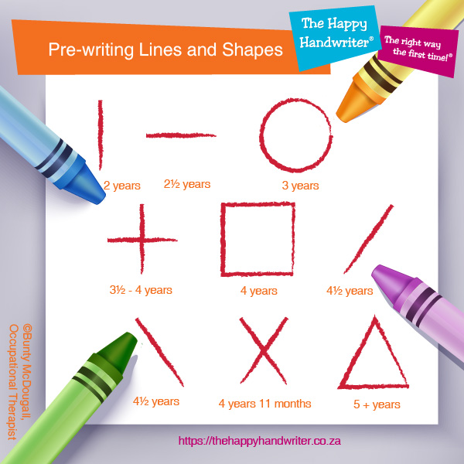
Writing – Pencil control
Begin with the pre writing shapes – including vertical lines and anti clockwise circles.
Once ready begin to help your child to form individual letters.
Please see handwriting ‘patter’ in child’s sound book.

Slide 17
Writing – for meaning
To begin with your child will ‘play’ at writing, making marks on paper. When your child does this, encourage them to tell you what it ‘says’, so that your child understands the purpose of writing is to communicate meaning.
The next step will involve your hearing and writing initial sounds in words.
After this children are taught to hear and write the sounds in 2 and 3 sound words – using the sounds they are familiar with.

Slide 18
Writing – for meaning
We do not worry at this stage if spelling is not accurate, it is more important that they are hearing and recording the main sounds in words e.g. we might expect your child to spell the word orange as orinj.
We teach your child to spell the high frequency words as a whole word and not to try and sound this out. However, this is not a focus until the latter stages of year R.

Slide 19

Most Importantly…
We want your child to LOVE reading as much as we do, not because they have to.
If your child is tired or not interested, take a break and come back to it or leave it for that evening.

