Slide 1

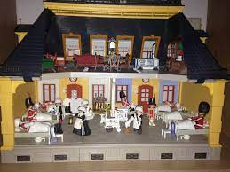
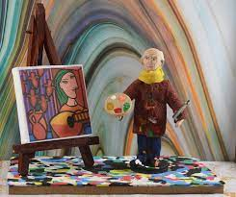
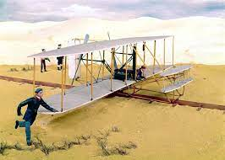
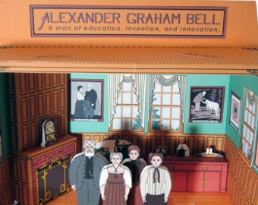
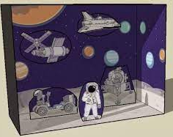
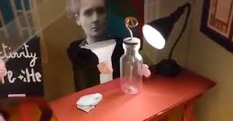
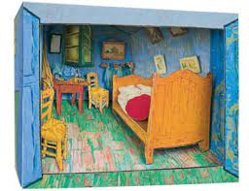
Love to Learn
This term our topic is all about Significant People: a history-based unit exploring historical figures who have had a major impact on the world as we know it today! This term's Love to Learn project is to create a diorama (3D model) of a significant person in action!
Due: w/b Monday 31st March

Slide 2
Love to Learn
This term our topic is all about Significant People: a history-based unit exploring historical figures who have had a major impact on the world as we know it today! This term's Love to Learn project is to create a diorama (3D model) of a significant person in action!
Due: w/b Monday 31st March
Love to Learn
This term our topic is all about Significant People: a history-based unit exploring historical figures who have had a major impact on the world as we know it today! This term's Love to Learn project is to create a diorama (3D model) of a significant person in action!
Due: w/b Monday 31st March

