Slide 1

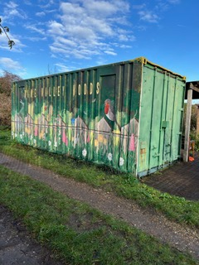
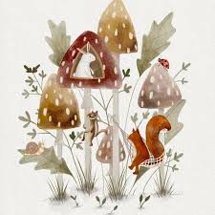
Term 5
Art Competition
Woodland Trust
Container design

Slide 2
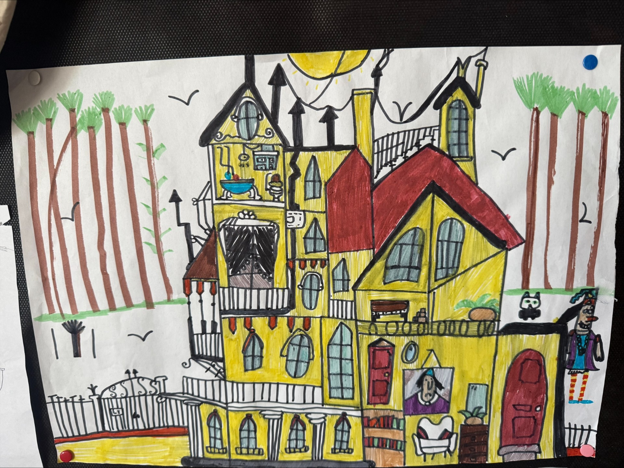
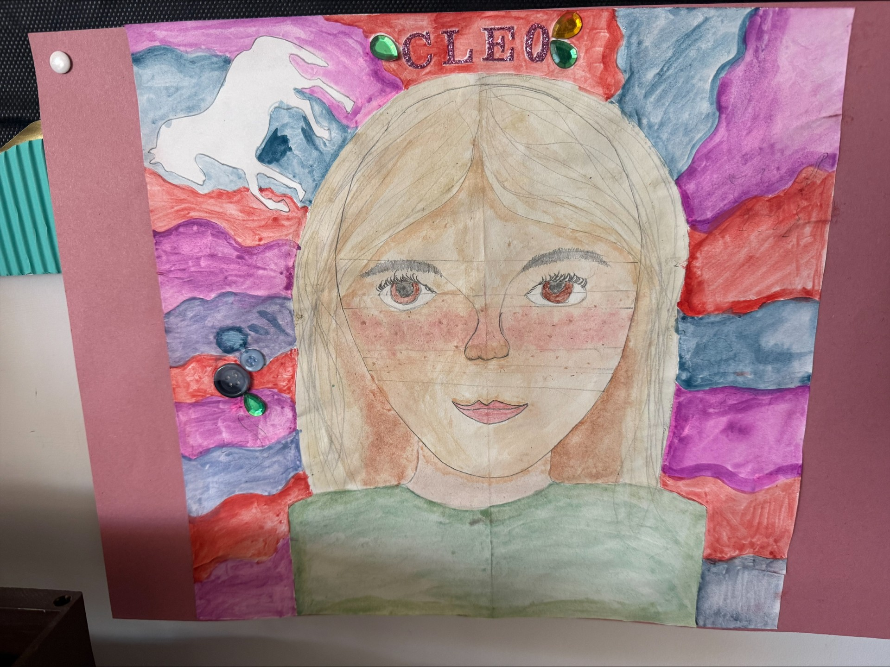
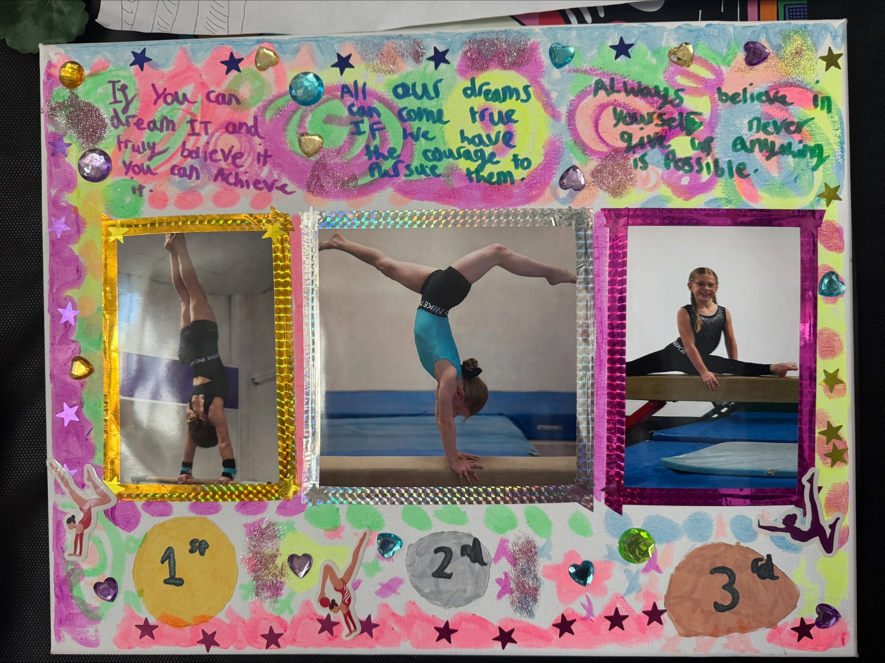
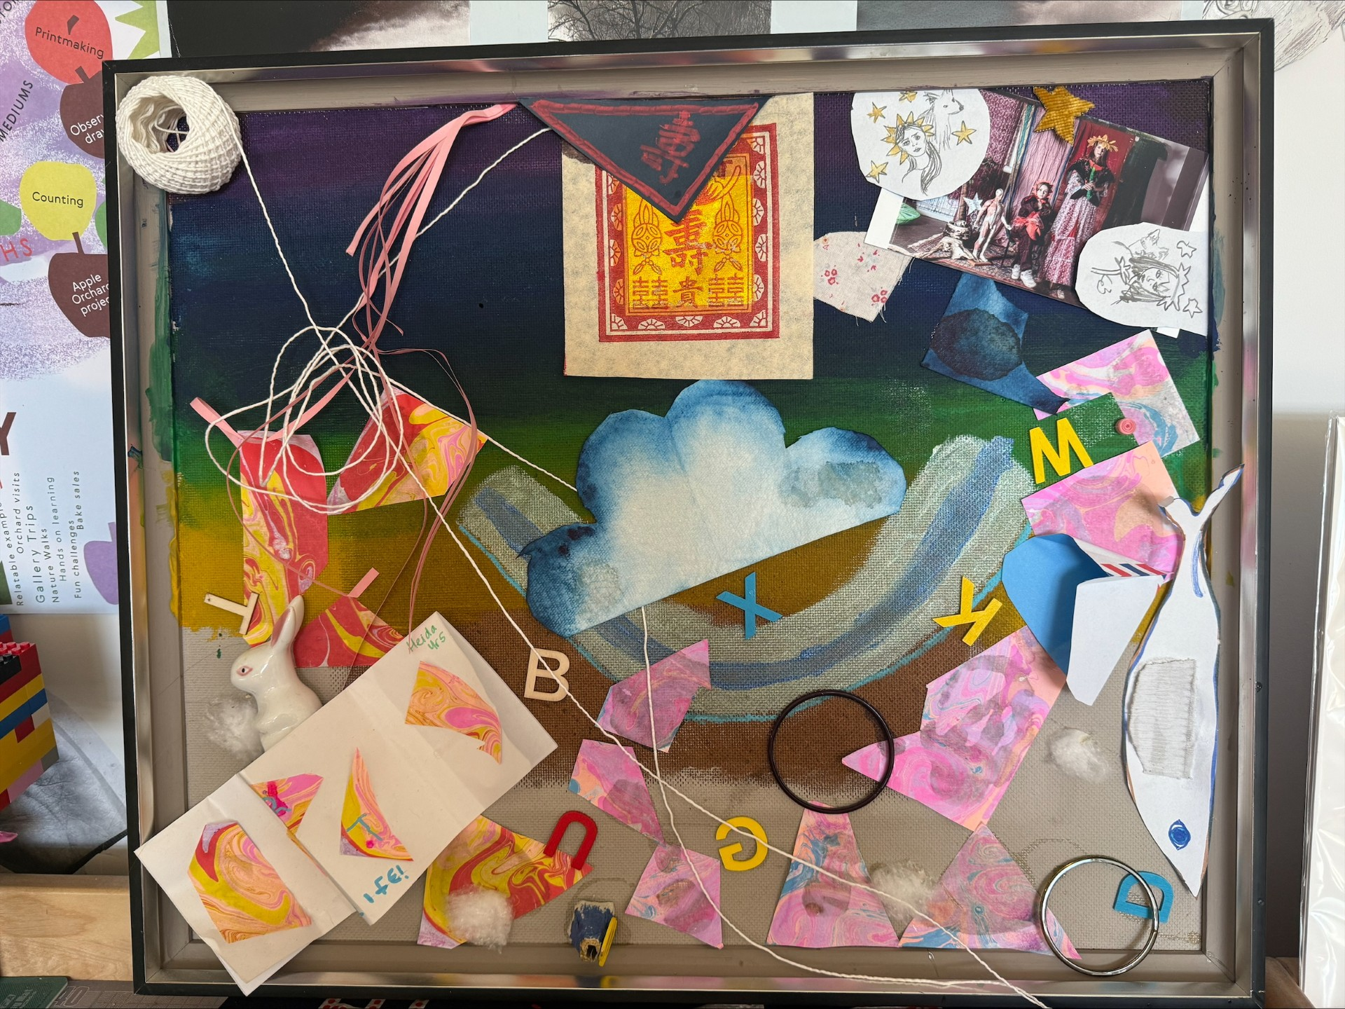
Highly commended
Wow! Such a fantastic effort on the theme 'Be Creative' such a variety of work from so many of you last term. All your work hangs proudly in the art room.
Well done to everyone who took part.
Good job guys!

Slide 3
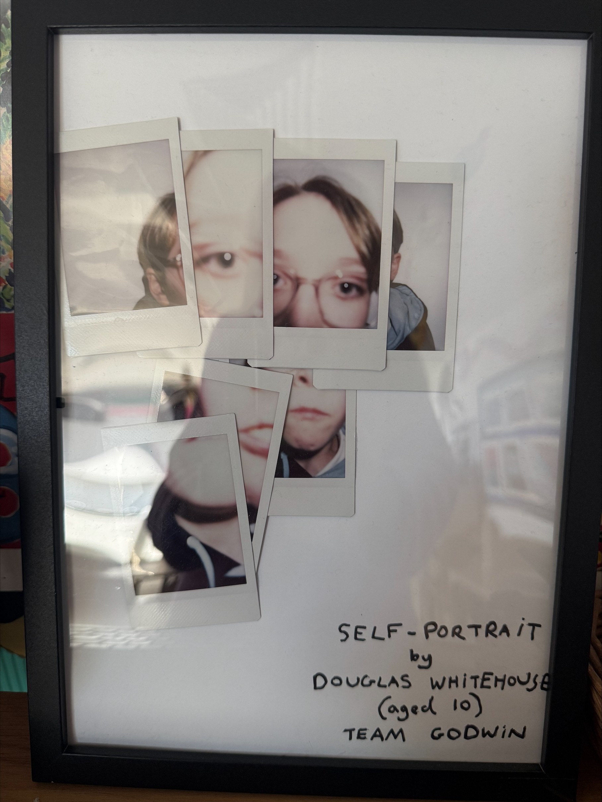
3rd place ​
Douglas

Slide 4
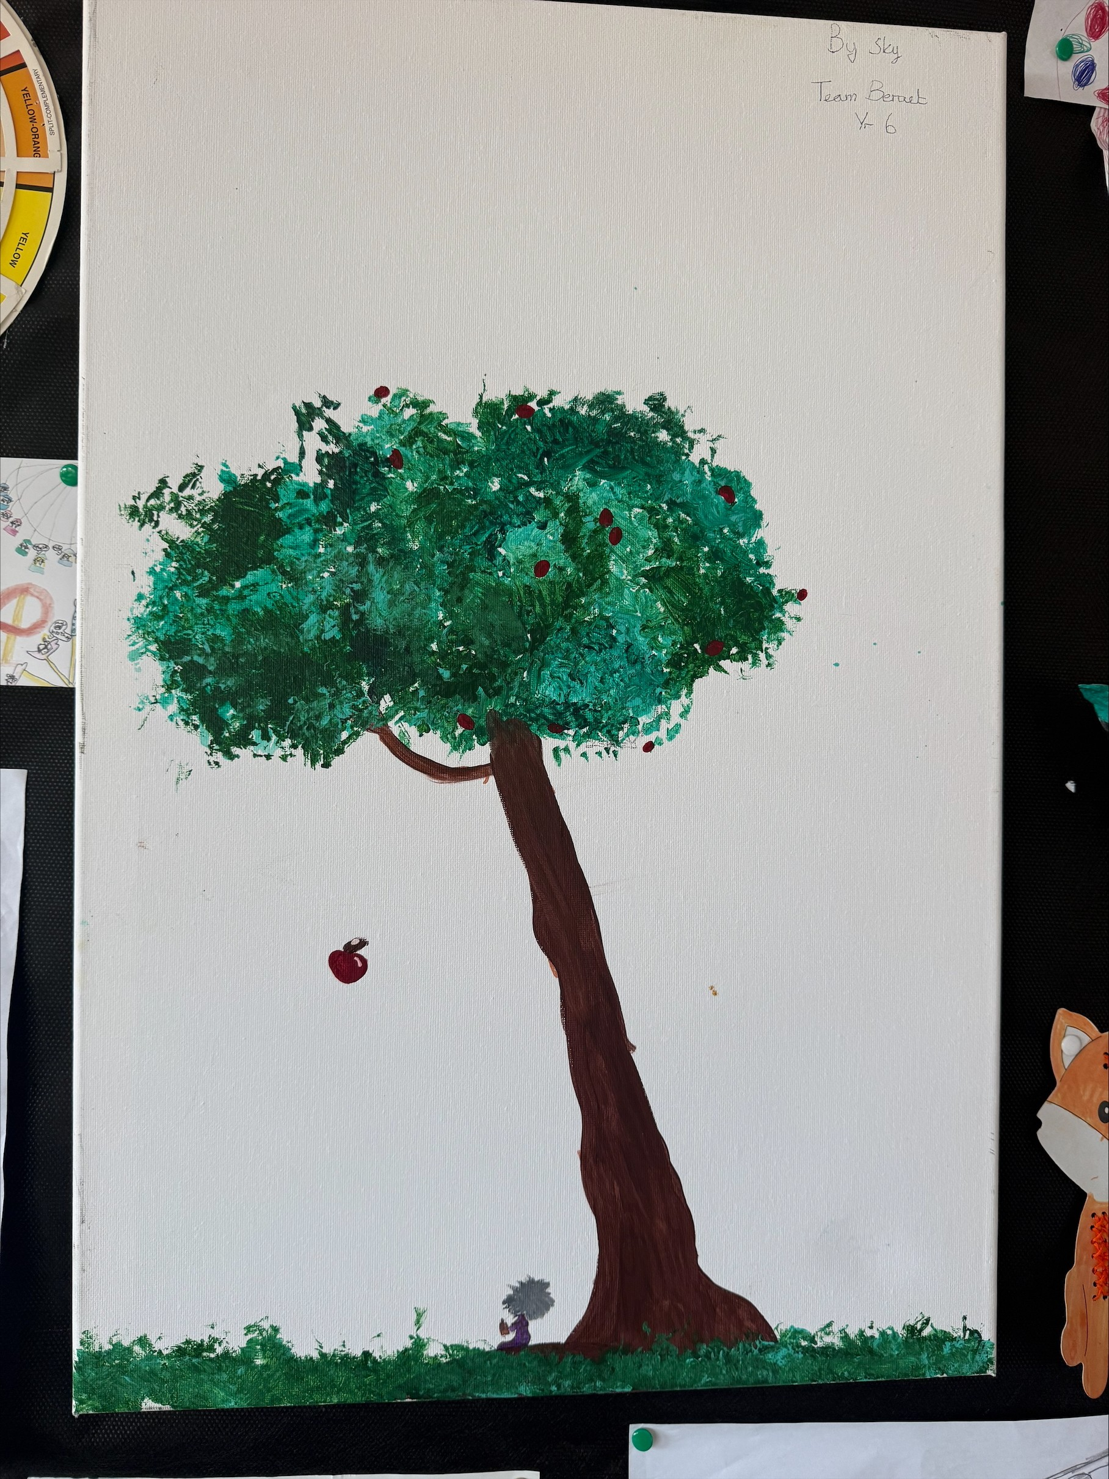
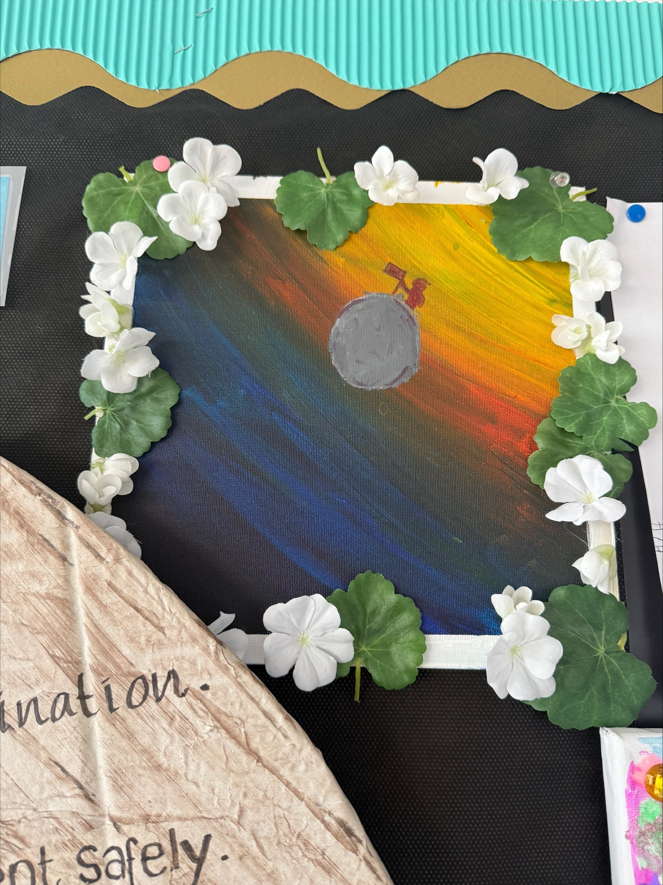
2nd place
Sky

Slide 5
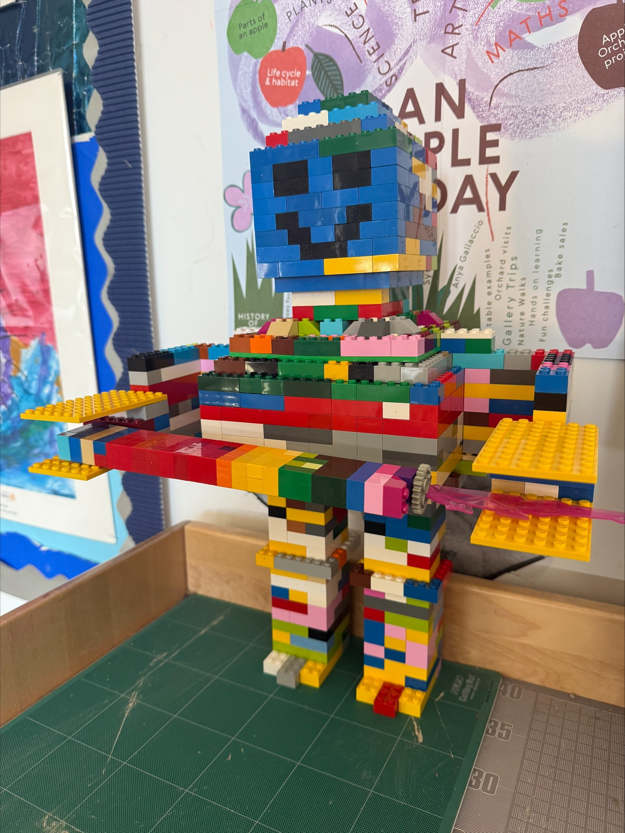
KS2 Winner
Ollie Year 5

Slide 6
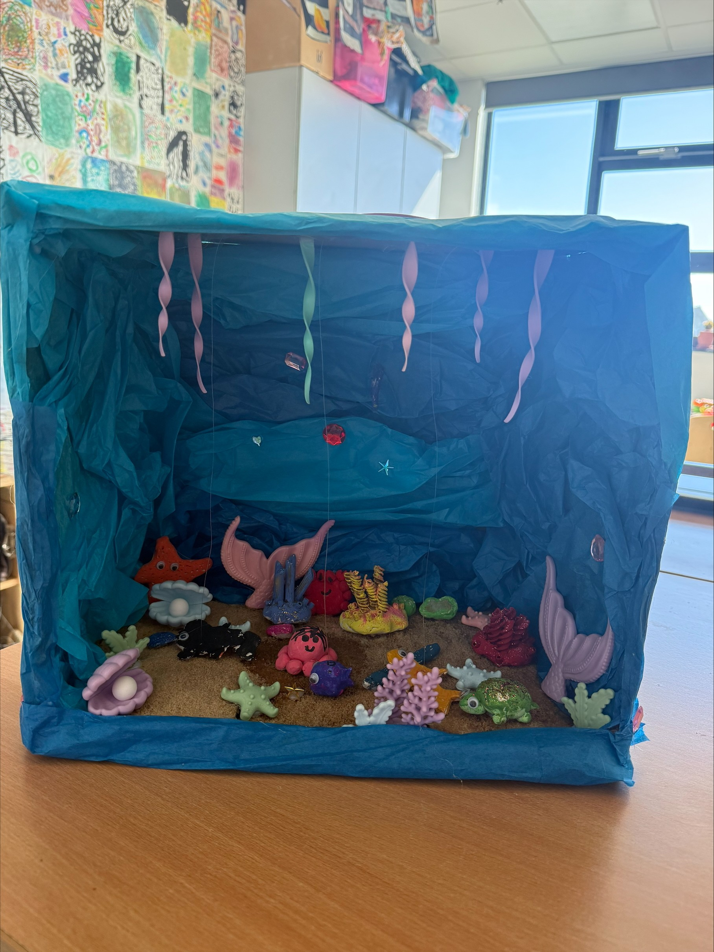
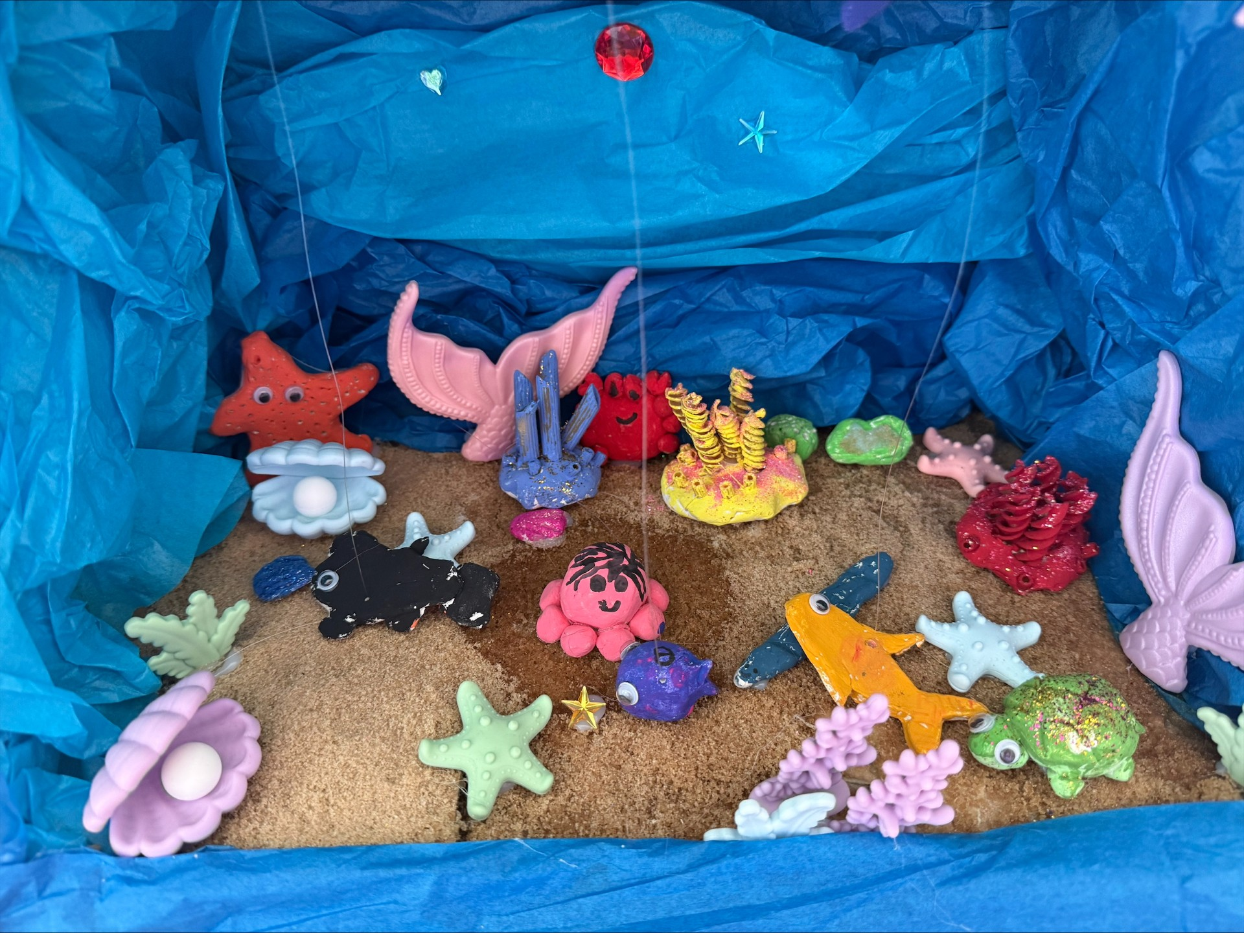
KS1 winner – Aurora Team Piper

Slide 7
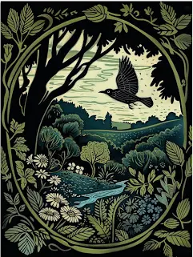
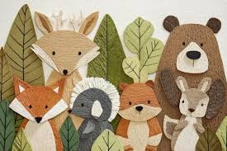
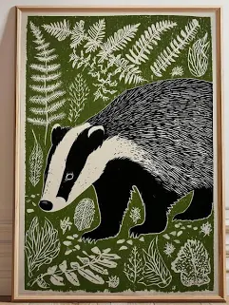
This term's art competition is extremely exciting as the design you create, you will get to paint on a container in the woods!
Aim: Create your own woodland themed design for the container.
Use the templates (from the art room) to create your design.
Design all 4 sides or just one side, (there could be up to 4 winners).

Slide 8

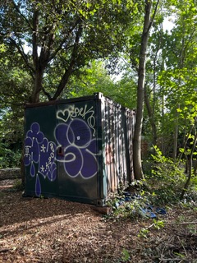
The Container
Your design will be painted on to this very container

Slide 9
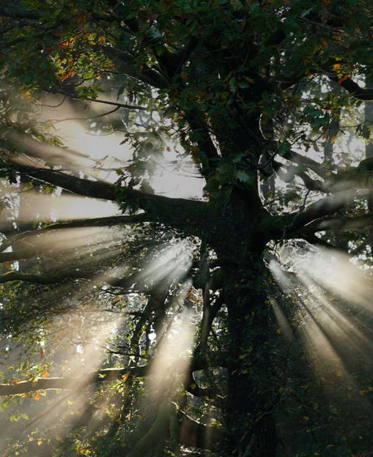
What we do
We are the UK's largest woodland conservation charity.
Our vision is a world where woods and trees thrive for people and nature. https://www.woodlandtrust.org.uk https://www.youtube.com/watch?v=cUK7YsPteLk
Woodland Trust

Slide 10
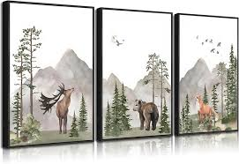
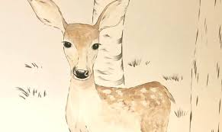
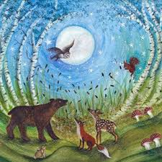
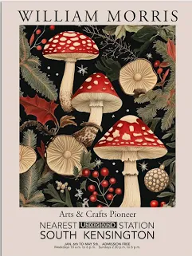
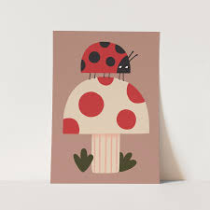
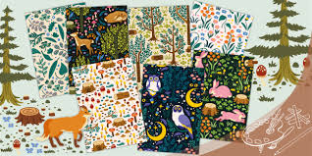
Some ideas to help you
🌲 Simple Woodland Scenes
Paint a forest with tall trees (just brown lines + green tops)
A sunset in the woods with orange/pink sky behind dark trees
A path through the forest leading into the distance
Wildflowers like bluebells, Frog Orchid, Sea Campion and Violets
🦊 Animal Paintings
Fox (orange triangle face + white chest)
Owl (big circles for eyes)
Hedgehog (oval body with spiky brush strokes)
Deer (basic shape + little antlers)
Insects – butterflies, moths, bee's
Mini Beasts – worms, spiders, ladybirds
🍄 Mushroom Art
Red mushrooms with white spots (classic and easy)
Rainbow or fantasy mushrooms for a magical twist
A whole “mushroom village” scene
🌙 Enchanted Forest Theme
Dark blue/purple background + white dots for stars
Add glowing fireflies with yellow paint
Sparkle/glitter for a magical effect

Slide 11

Resources you can use:
Templates from the art room
Drawing – Pens, pencils, markers, crayons
Paint – any different types of paint, acrylic, poster and water colour.
iPads - for inspiration
Collage ideas - create a mood board
Photographs
Images from books, magazines, newspapers

Slide 12

Rules
Keep your artwork appropriate and to the theme
Be original – use things you have at home
Try to think outside the box – This can be anything you want!
Use the inspiration from the slides and ideas page
Your design must be in school by with your full name, team name and age By Monday 22nd June
Workshops will be in the art room this term for the competition on Monday's 12pm-1pm.

Slide 13
Prizes
  There will be art-based prizes for KS1 and KS2
  Good Luck! Any questions then just ask :-)

