Slide 1
KENT TEST INFOMATION
2026

Slide 2
WE WILL COVER:
Registration
Preparation
Results and appeals.

Slide 3
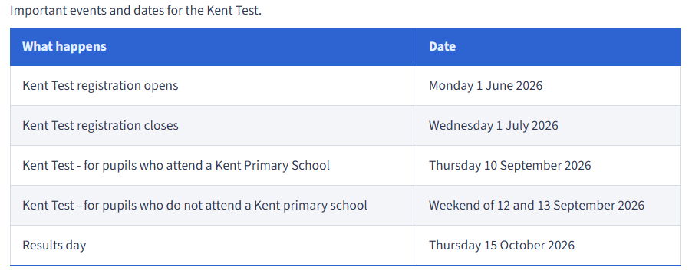
KEY DATES

Slide 4
REGISTRATION
Many children will find the test difficult. Grammar schools in Kent provide for children in about the top 25% of the ability range. You may want to discuss your child’s academic achievement with their primary school before you decide whether to register them for the Kent Test.
Make sure you know what the admissions criteria are for the school(s) you are interested in. Or search for Kent grammar schools in our Kent schools search.
https://www.kent.gov.uk/education-and-children/schools/school-places/admissions-criteria

Slide 5
What if my child has SEN
If your child has a disability or special educational needs which will affect their access to testing, you need to discuss this with the school SENCO before you register them for the test as the school will need to apply for any necessary access arrangements.
Requests will not be accepted after 1 July 2026.
The online registration form asks you to confirm you have discussed a request for access arrangements with your child’s school.
Email kent.admissions@kent.gov.uk if you would like more information about the special arrangements process.

Slide 6
WHAT DOES THE TEST ENTAIL?
  The Kent Test papers are multiple-choice questions with a separate answer sheet.
  The first test will be an English and maths paper and will take 1 hour.
  The English section will involve a comprehension exercise as well as some additional questions drawn from a set designed to test literacy skills.
  The second test will be a reasoning paper that will take about 1 hour. It will contain a verbal reasoning section and a non-verbal reasoning section of roughly the same length.
  The non-verbal reasoning will be split into short sections, administered and timed individually.
  There will also be a writing exercise which will not be marked but may be used by a local headteacher panel as part of the headteacher assessment stage of the process. 40 minutes will be allowed for the writing task, including 10 minutes planning time.

Slide 7
HOW TO PREPARE
  It is a good idea to do some familarisation papers with your child.
  This will give you a good indication as to how your child will perform in the test.
  If you are unsure whether to put them in for the test, doing the familiarisation might help you decide.
https://www.kent.gov.uk/__data/assets/pdf_file/0006/196314/Kent-Test-familiarisation-booklet.pdf
https://11plus.gl-assessment.co.uk/pages/free-materials

Slide 8
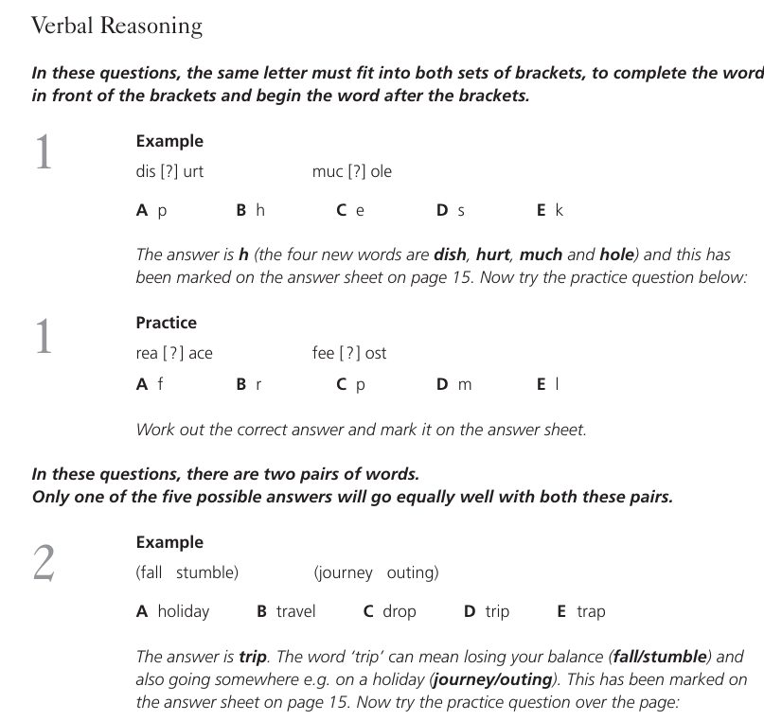
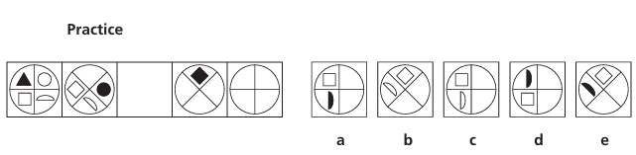
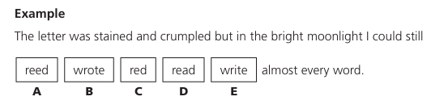
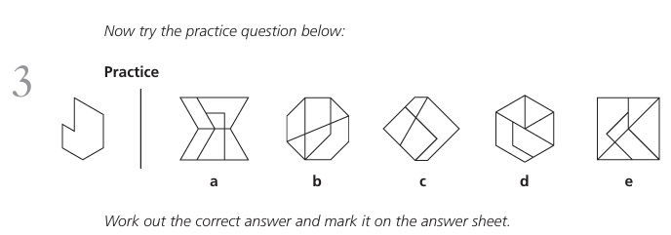
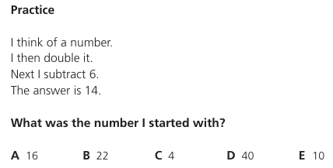

Slide 9
RESULTS
If you gave an email address when you registered, your Kent Test result will be emailed to you on Thursday 15 October 2026. They can only send the results to the email address used to register your child.
If you did not give an email address, they will post your child’s result to you on results day by first class post. If you have not received it, you can ask your child’s primary school for their test scores the day after results go out.

Slide 10
SCORES
Your child will get 3 standardised scores, one for English, one for maths and one for reasoning, and a total (aggregate) score.
Standardisation is a statistical process which compares your child's performance with the average performance of other children in each test. A slight adjustment is made to take account of each child's age so that the youngest are not at a disadvantage.
Last year, to be given a grammar school assessment, children needed a total score of 332 or more, with no single score lower than 108. Test scores range from 69 to 141. The highest possible total score is 423.
The grammar school threshold for 2026 will be available in October 2026.

Slide 11
WHAT IF MY CHILD DOESN’T PASS?
If your child was not tested or was not assessed as suitable for a Kent grammar school, you can still apply for a Kent grammar school but your application to that school will be refused when school places are offered on 1 March 2027.
You will then have the right to appeal to explain why you think it is a suitable option for your child.

Slide 12
APPEALS
It is recommended you still accept the place your child has been offered. This will not affect your appeal and will guarantee your child has a school place if your appeal is unsuccessful.
The school may have already completed a headteacher appeal if your child was close to passing.
For parent appeals, the school may not support an appeal to a grammar school if we do not feel there is sufficient evidence to do so. This includes work in books and previous results from assessments.

Slide 13
Applying to a grammar school
You will be able to name up to 4 secondary school preferences. Read more about how to apply for a secondary school place.
  Any Kent grammar school you apply for will consider your application, but this does not guarantee your child will be offered a place.
  Grammar schools are often oversubscribed, meaning they receive more applications than there are available places. Schools use their admissions criteria to rank all applicants in priority order, so it’s important to read the admissions criteria for schools you are interested in.
  A Kent grammar school can only consider your child for a place if you have named it on your application and your child has been tested and assessed suitable for admission.
  If your child is not offered a place at the school, you will be able to appeal to an independent appeal panel and may be able to join the school’s waiting list.

Slide 14
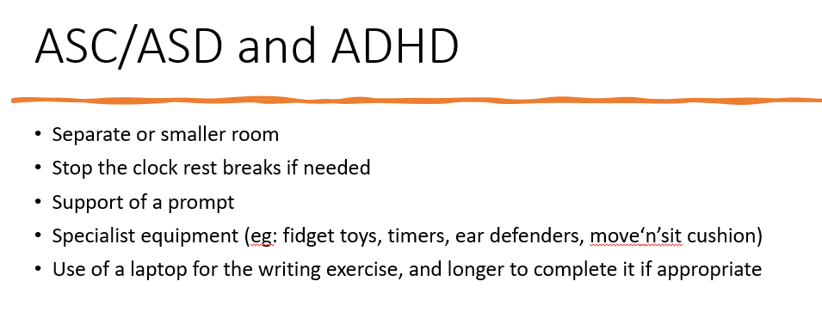
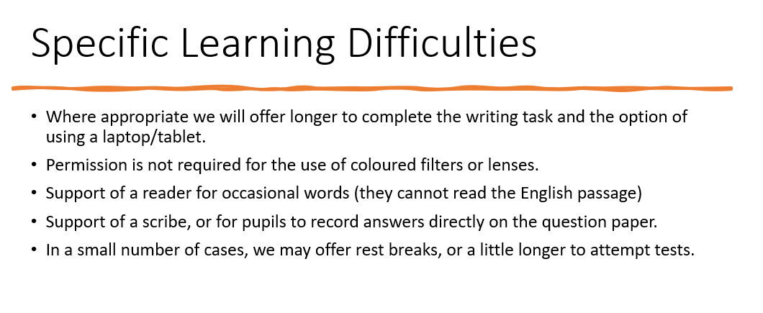
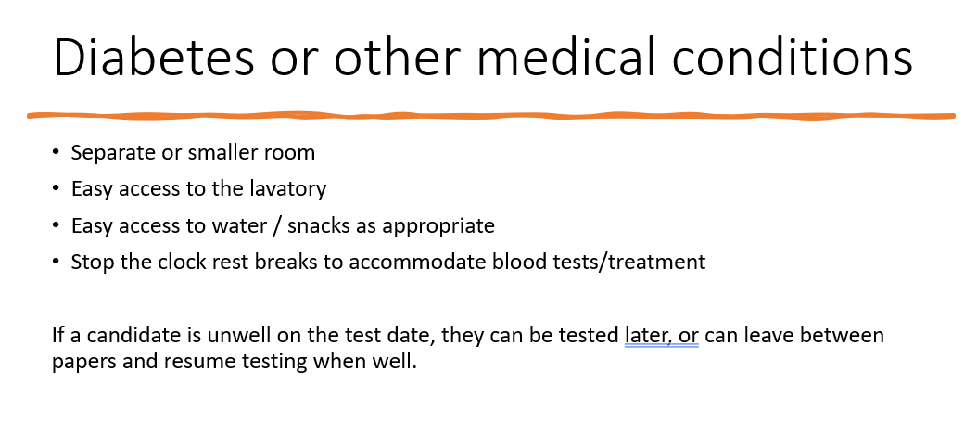
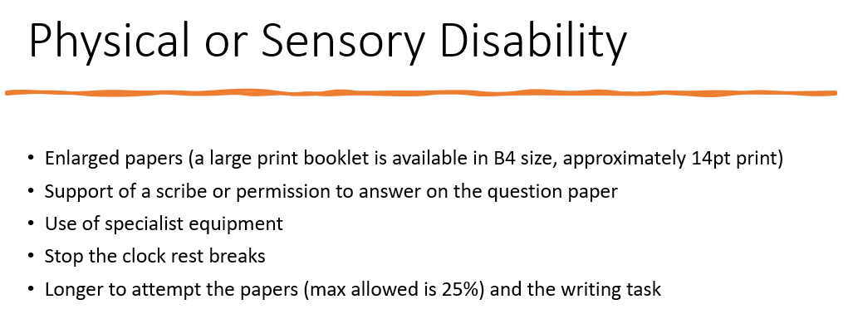
Access Arrangements

