Slide 1


Welcome to Year ?
Team CHANGE and
Team CHANGE
RAPS Open Classes 2026-2027
Welcome to Year 2
One Childhood, One Chance
Together we make a difference

Slide 2
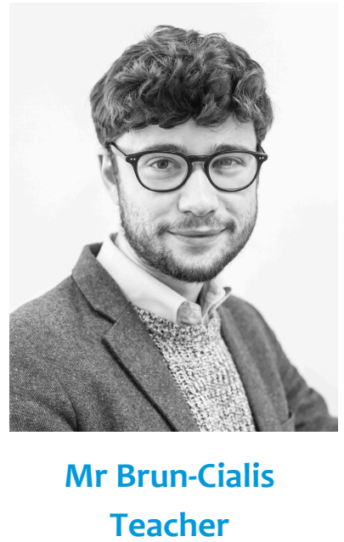
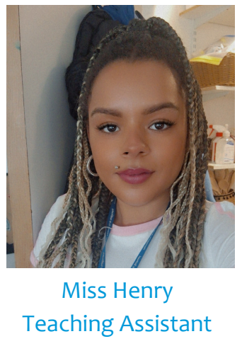
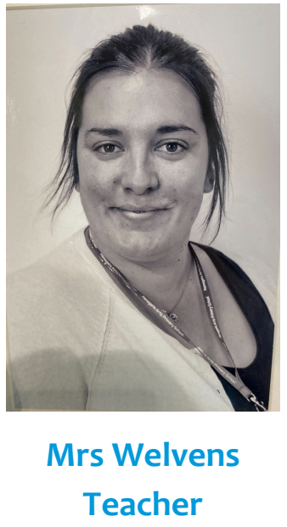
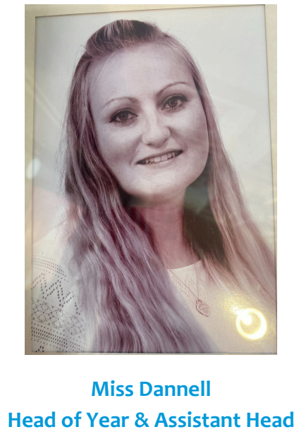
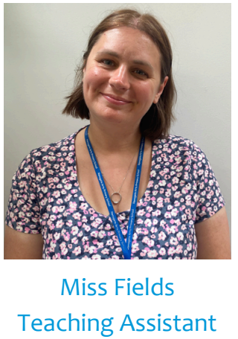
The team

Slide 3
We will cover:
Core Values
Behaviour for learning
Attendance
The School day
Curriculum
Home Learning/Reading/TTRS
Social Media
Communication
Questions

Slide 4

Our Core Values…
These are at the heart of everything we do at Ramsgate Arts Primary School.
Kindness
Resilience
Collaboration
Creativity
Kindness, Resilience, Collaboration, Creativity

Slide 5
Behaviour for Learning
At RAPS, we want our children to be ready to learn.
Our golden rules:
Be Ready Be Respectful Be Safe
Kindness, Resilience, Collaboration, Creativity

Slide 6


Behaviour Points
Each child starts off with 5 points at the beginning of every day.
Possible total of 25 points a week. Expected to keep all 25 points!
If your child keeps all their points for the week, you will receive a text home and they will receive 'Golden Time' on Friday afternoon.
If a child has a yellow card on their desk at the end of the lesson, they lose 1 point.
If a child has a red card on their desk at the end of the lesson, they lose 2 points.

Slide 7
Weekly Rewards
25 points= All golden time and text home.
“Your child has kept all of their behaviour points this week and has been rewarded with Golden Time.”
22-24 points = Restorative conversations will be had with the children.
11-21 = All golden time will be missed.
6-10 points= Mr Budge to send letter home to inform parents.
5 points or less= Mr Budge to have a meeting with parents.

Slide 8
Termly Rewards
If children have kept all their behaviour points for the term, they will receive a behaviour badge.
After 4 terms of keeping all their behaviour points the children will receive a Bronze badge, the fifth one is a Silver badge.
If a child keeps their behaviour points for the entire year, they will receive a Gold badge.

Slide 9
Restorative Conversation
When unpicking behaviours after a yellow/red card is given, a conversation will take place based around a restorative approach:
What happened?
I’m wondering why you did that?
Who's been affected?
What needs to happen next to put things right?
What can we do next time?
I notice that…
This conversation will ensure the child is in right place to continue their learning/day positively.

Slide 10
Attendance
Good school attendance is crucial for a child’s academic, social, and emotional development. It ensures consistent learning, builds positive habits, and provides access to crucial support systems.
If a child’s attendance drops below 90%, parents will be contacted by SLT to find out if there is anything we can do to help improve attendance.
If attendance does not improve the next term, a warning letter may be sent.
If attendance still does not improve, parents may receive a fine.
The registers close at 8.30am and repeated lates will count towards poor attendance.
Evidence shows that the students with the highest attendance throughout their time in school gain the best GCSE and A Level results. Attendance is important!

Slide 11
The School Day
8.15am- Doors open, early morning work *Register completed by 8:30am
8:15 –Mindfulness
8.30-10am – English/RWI
10:00 – Break
10:15 - Maths
11:00-11:30– Child Initiated
Handwriting/Spelling either before/after lunch
11:30-12:30/12:00-1:00 – Lunch
1:00 – Topic
2:00 – Break/Toilet/Drink
2:15 – Child Initiated
3:00 End of the day

Slide 12
Personal Development
Personal Development is taught in the first week of each term.
This includes learning about: our school values, oracy, citizenship, religious education, emotional literacy, British values and RSHE.
In RSHE, children learn about relationships and physical and mental health.
The aim of these weeks is to develop children into well-rounded, kind and responsible members of our school and of society.
By devoting a whole week to personal development every term, the children get plenty of opportunities to have class discussions and learn how to be tolerant and respectful.

Slide 13
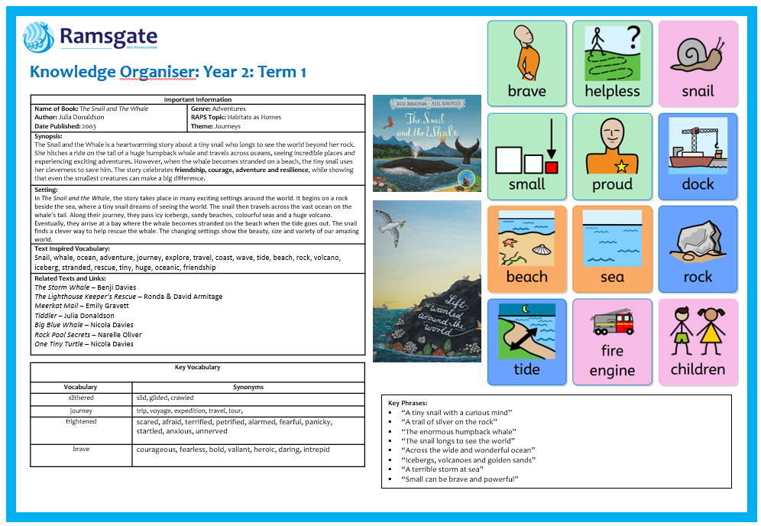
What will we be learning?
English- Term 1
Website, blogs and curriculum letter will show termly updates

Slide 14
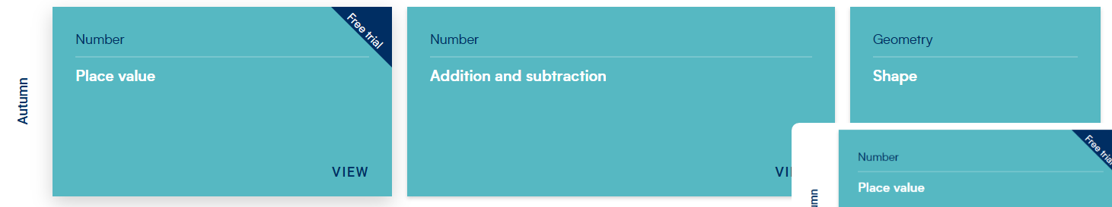
What will we be learning?
Maths- Term 1
Website, blogs and newsletters will show termly updates

Slide 15
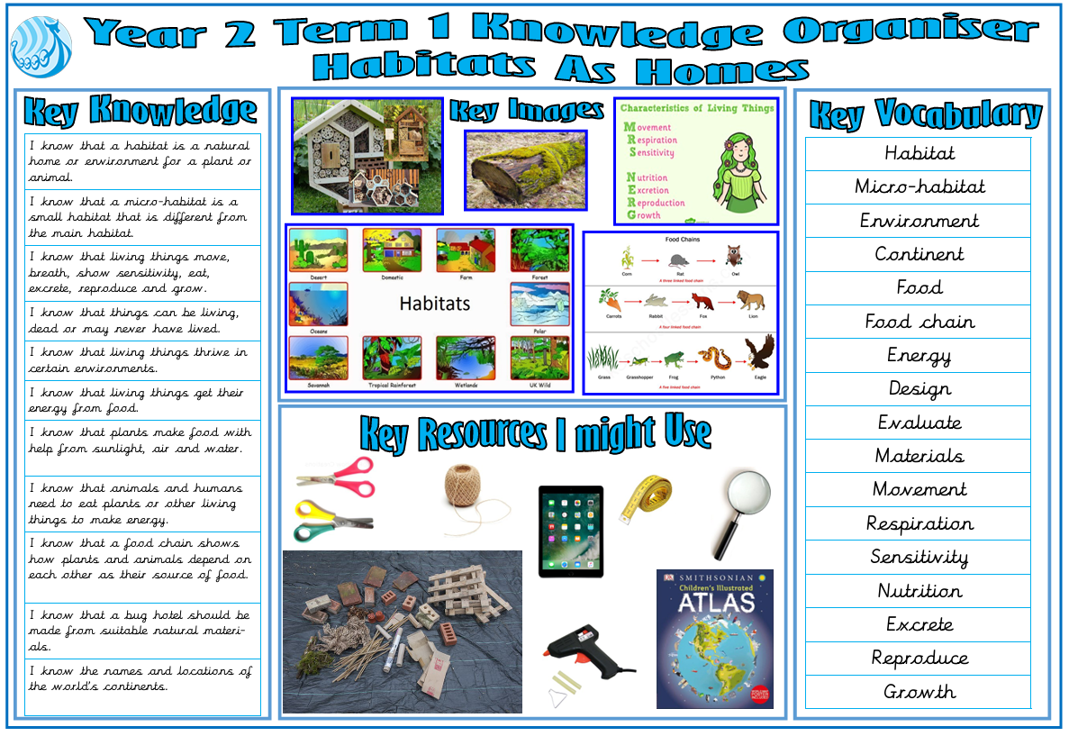
What will we be learning?
Topic- Term 1
Website, blogs and curriculum letters will show termly updates

Slide 16
Home Learning
Love 2 learn will be assigned once or twice per term
Home reading should be happening regularly – preferably every night, but at least 4 times a week
Spellings once a term – spelling test termly
Please continue to practise times tables at home – Time Tables Rock Stars, TTRS, logins to go home

Slide 17
Home Reading
School reading books will be assigned to every pupil in the class. The band is based on a combination of word reading and comprehension.
These will be changed depending on the RWI timetable, every 3/5 days.
If you feel it is too easy or too difficult, please speak to a member of staff.

Slide 18
Times Tables Rockstars
Pupils will be given a TTRS log in this term.
You can download the app.
They can practise as they so wish.
We will practise in class, just not yet.

Slide 19
General Communication
School Website
Blog three times per week (for updates about learning)
Termly Curriculum letters on blog
MCAS (for info about dates, admin etc)
Next Week At RAPS.
RAPS Instagram and Facebook page
Parents' Evenings
End of year report

Slide 20
Communication
A member of the Team will be on the door every morning
Each phase has a member of the senior leadership team-the SLT member for Year 2 is Miss Dannell.
If you wish to discuss anything related to your child, please email: enquiries@ramsgateartsprimaryschool.co.uk

Slide 21
Social Media
The minimum age to open an account on nearly every social media platform—TikTok, Instagram, Twitter, Pinterest, Kik, YouTube, Snapchat, Facebook, and more— is 13. WhatsApp is 16.
We ask that if using social media, such as ‘WhatsApp’, children behave appropriately using respectful language and refrain from sending images/videos of themselves or others
Where parents’ social media groups are created for classes, refrain from discussing pupils, staff or other parents
The school is not responsible for monitoring parents’ WhatsApp groups and recommend they are only used for event and timetable reminders

Slide 22

We are a ‘no phone zone’ for parents/carers
We kindly ask you put your phone away when on the school site.

Slide 23
Trips and adult ratios
We rely on parent and family volunteers to help us meet the required adult-to-child ratios on our school trips. Without enough adult helpers, we are unable to run many of our trips, so we would really appreciate any support you can give.
If you are able to volunteer for a trip, please let us know- your help makes a huge difference and allows our children to enjoy these experiences!

Slide 24
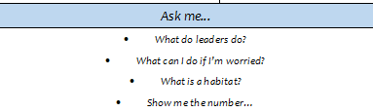
Communicating with your child
Sometimes engaging your child about school can be hard!
Ask open questions: What was your favourite part of the day? Why? What did you learn in topic? Tell me about your day.
Keep up to date with the blog- often there are prompts for parents e.g: ‘Ask us about our science experiment on friction!’
Use the questions at the bottom of the curriculum letter

Slide 25

Any Questions?

