Slide 1

Aims
I can identify the features of an instruction text.
I can write instructions.

Slide 2


Instructions
Play me!
Instructions tell us how do to something.
There are many different types of instructions. Some examples include:
recipes;
directions;
how to play a game;
how to make or build something;
how to repair something;
or how to look after/care for something.
Can you think of any more examples?

Slide 3
Features of Instruction Writing
Play me!
Regardless of their purpose, instructions share many of the same features:
An introduction to explain what the end result will be (what the instructions will help the reader to do). This will usually include questions to engage the reader.
A list of things the reader will need, such as ingredients for a recipe, materials for a building project or equipment for a craft activity.
An outline of the method needed to complete the task (usually in chronological order).

Slide 4
Features of Instruction Writing
Imperative verbs are usually used within the method to ‘boss’ the reader around!
Play me!
Conjunctions, prepositions and adverbs to show time, place and cause should be used throughout, e.g. After that, Inside the box, As soon as it has melted, etc.
Extra tips and advice may be given to the reader for especially tricky parts of a task.
Pictures or diagrams can be used to provide clarification, e.g. a series of pictures or diagrams corresponding to each step of the method, a single picture or diagram of a tricky part of the process or an illustration of the final product.

Slide 5

Features of Instruction Writing
A conclusion to sum up the task and help the reader check that they have achieved the correct outcome.
Play me!
Layout devices will also be used to structure and organise the text. These may include headings and subheadings, underlining, bold or italic text, bullet points and numbers.

Slide 6
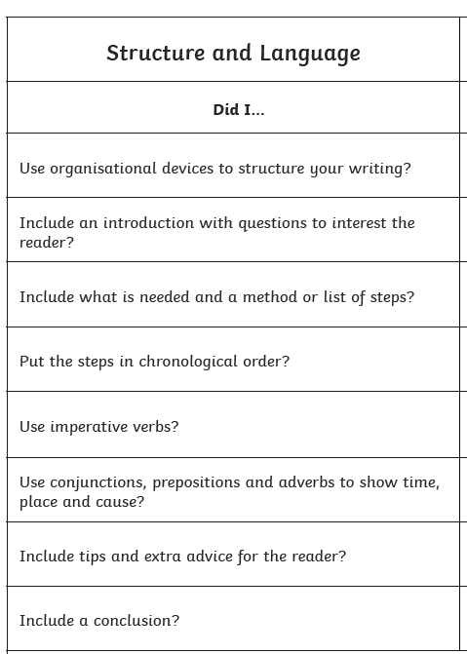
Your task!
Play me!
Title:
How to make a cup of tea
Safety Warning: Do not use the kettle without asking an adult first.

Slide 7
Check!
How specific were you?
Listen to the recording AFTER you have written your instructions to see if you included all these instructions.
Play me!

