Slide 2
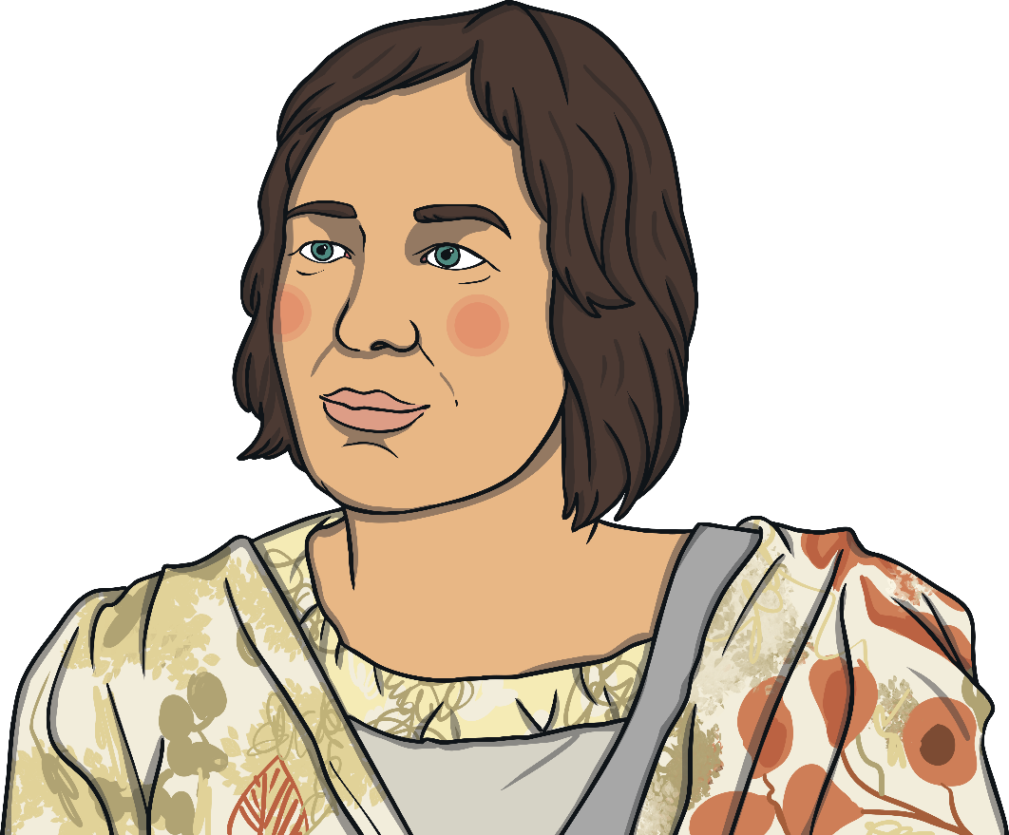
Who Is India Flint?
India Flint is a textile artist and writer from Australia.
She experiments with natural dyes, such as plants, to colour wool
and textiles.

Slide 3
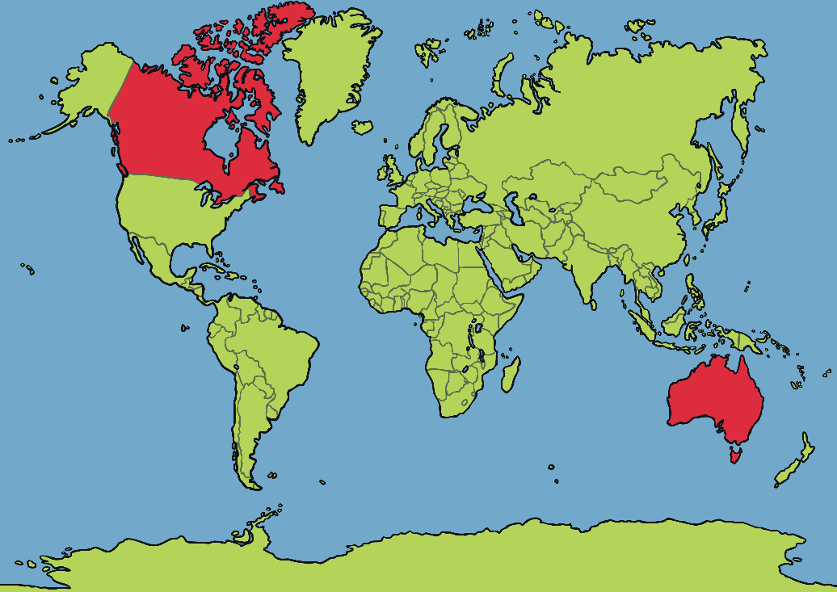
Early Life
India Flint was born in Canada in 1958.
At the age of three, she moved to Australia with her family. As a child she enjoyed sewing, and watching her grandmother dye cloth with tea leaves and onion skins.

Slide 4
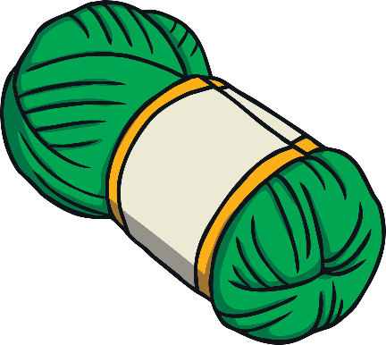
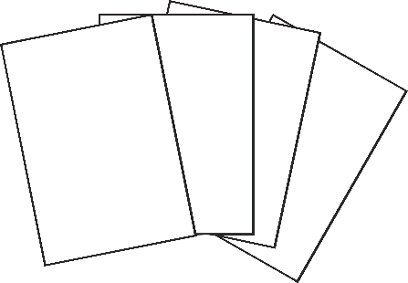
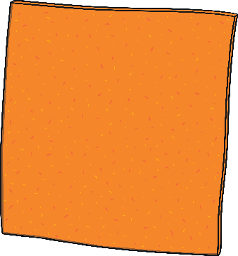
Textiles
India Flint uses wool, felt and paper in her work. She says ‘weaving is a meditation’ and it helps her relax. She weaves cloth and then dyes
it afterwards.

Slide 5
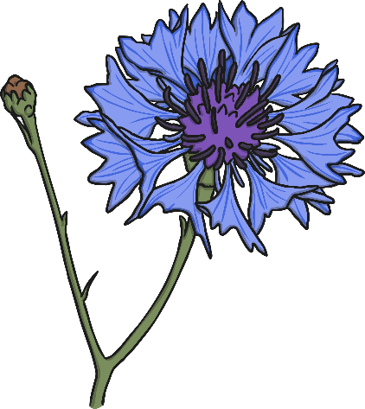
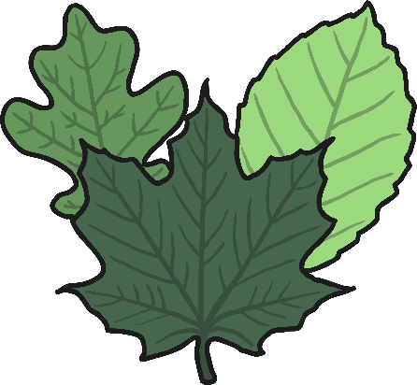
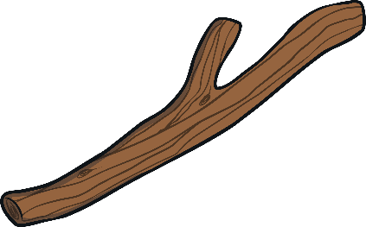
Printing
For printing patterns onto cloth, India uses leaves, sticks and flowers.

Slide 6
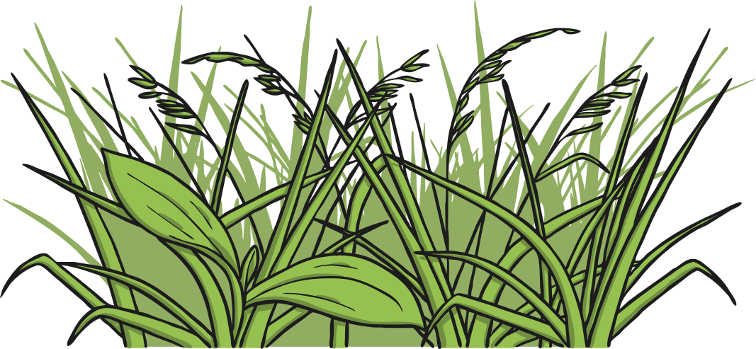
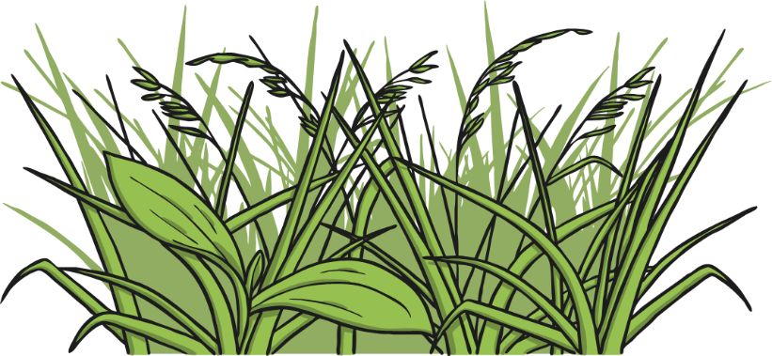
Dyeing
India is known for using natural dyes in her work:
Leaves
Ochre (a type of earth)
Sticks
Plants

