Slide 1



Slide 2

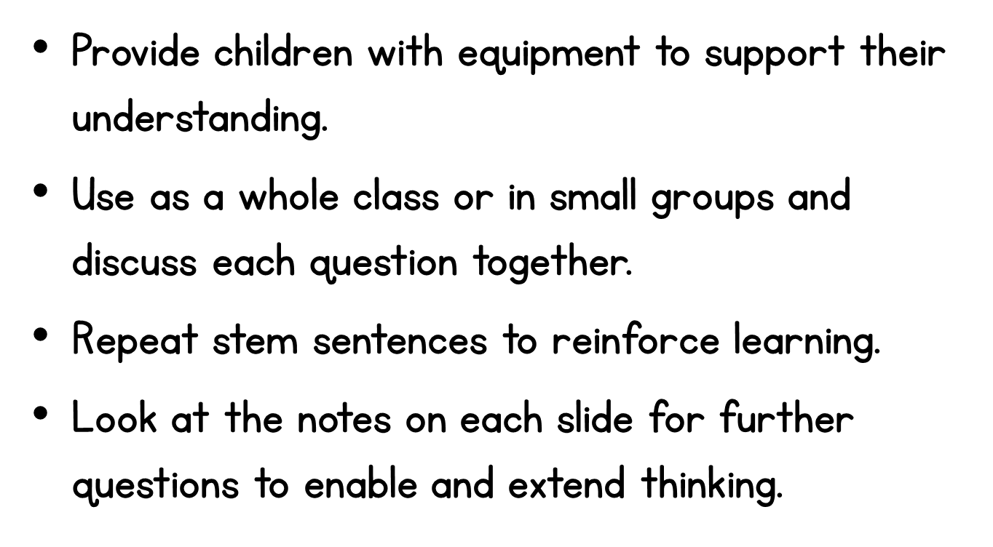

Slide 3

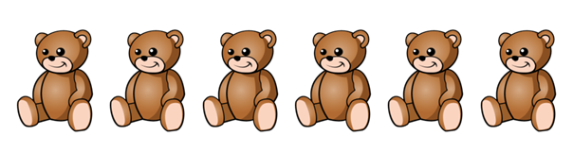


Notes:
Children can use counters to represent the teddy bears, to support them in counting out the objects.
What number do we start counting from?
What does each teddy bear represent?
What is the last number we count? What does the last number represent?
Encourage children to count the objects in a line to make links to bar models later on.

Slide 4



Notes:
Children might want to use counters or cubes to count a group of 7, or place 10 counters on a ten frame and count 7 of them.
How can counting on a ten frame help us count 7 apples?
Can we circle any 7 apples? Is there more than one way we can circle 7 apples?
The example shown may support the children with recognising 5 and two more, from when they have used a ten frame.

Slide 5

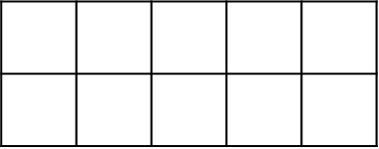



Notes:
How can we use a ten frame to help us count or see how many counters there are?
What number do we start counting from?
Children might see that they need 1 more counter to make 10, and 9 is one less than 10.

Slide 6




Circle the number four.
Notes:
For the second question, you could ask ‘how do we know that 2 is the smallest number?’
By representing each of the numbers using manipulatives, such as towers of cubes, the children can see that the number 2 looks the smallest.
You could also talk about counting from zero, which of the four numbers do we count first? 0, 1, 2..

Slide 7

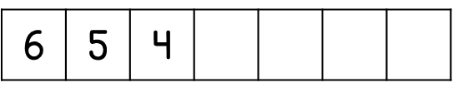
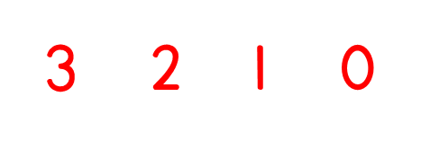
Notes:
Children could use a number line to count backwards to support them with this question.
What is happening to the number each time?
Can we count backwards from 4? What number comes before 4?
It is important that children understand that zero comes before 1. If children don’t understand this, they may leave the 4th missing number out and just write 3,2 and 1.
This could be modelled by starting with 6 counters, and taking one away each time, to show now we have no counters left. We have 0 counters left.

Slide 8

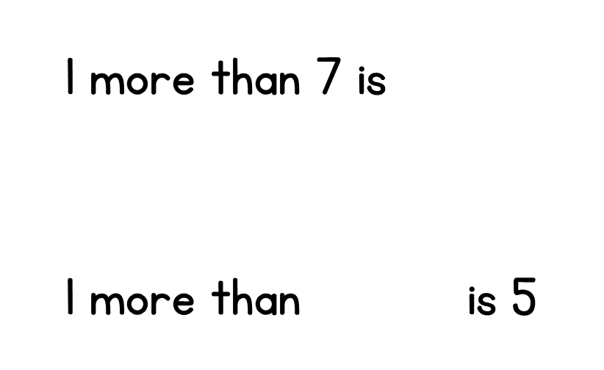




Notes:
Children can use a number line to support them to count on one.
What number comes after 7 when we are counting in 1s?
Some children may count from 7, one more to 8. Others may start counting from 1 all the way to 7, to then count one more to 8.
For the second question you could use a number line, or model taking away one from 5 counters. You could ask these questions,
5 is 1 more than which number?
Which number is 1 less than 5?
Which number comes before 5?

Slide 9

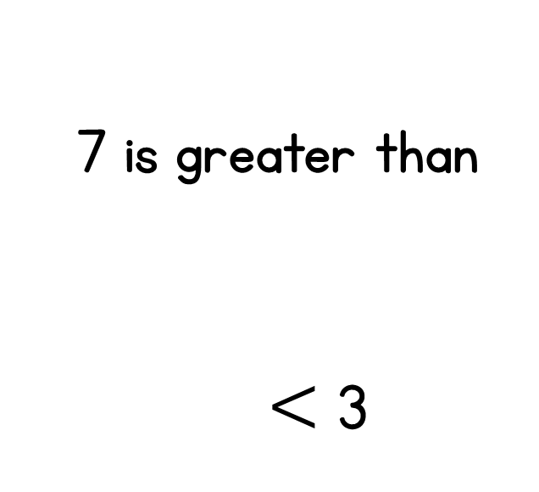




1
3
5
1
Notes:
Use cubes or Numicon to help to compare the numbers.
Is there more than one number that could fill the box?
What's the highest number we could choose? What's the lowest number we could choose?
What words could we use instead of this symbol (<)?
Is there more than one number that could complete the number sentence?

Slide 10






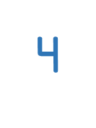







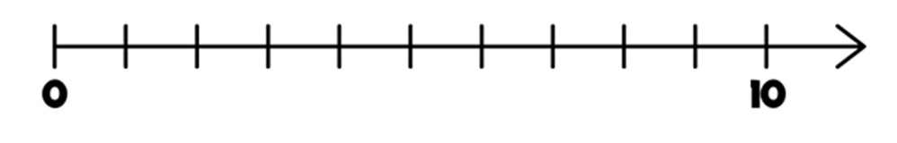


Notes:
The children could use a blank number line and label the numbers 1, 2 and reach number 3.
What number comes after zero? How can we check the number line is counting up in 1s?
The children must have an understanding that the blank number line is counting in intervals of 1, up to 10. This will support them with the second question.
What is the number line counting up in? Can we label the number line first? Which numbers is the arrow half way between?
What number is between 4 and 6?

