Slide 1




Slide 2

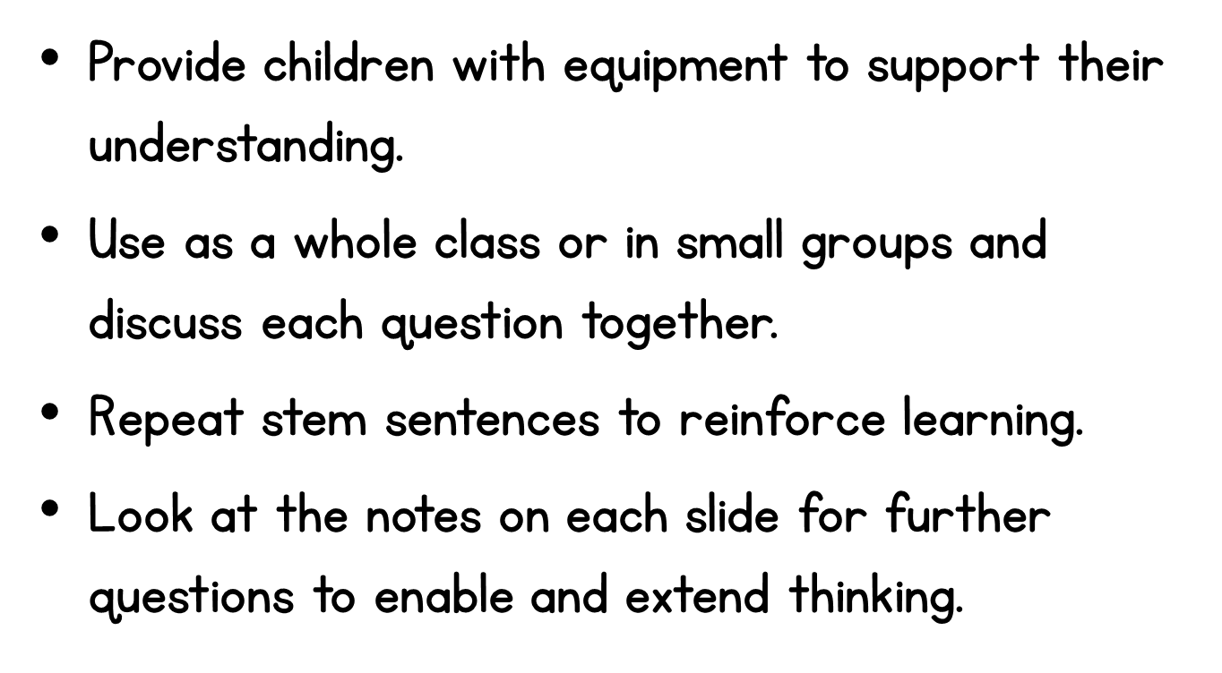

Slide 3
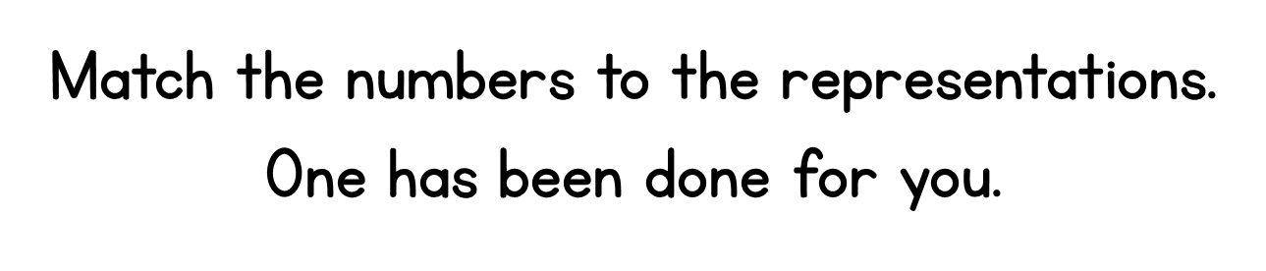
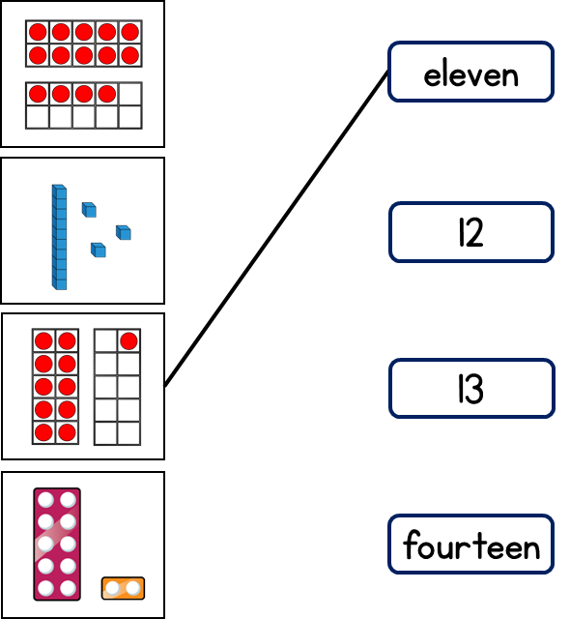
Notes:
How do we know that the first number that has been matched up is 11?
Can we use the same strategy to match the other numbers?
What is the same about all the numbers?
What is different about all the numbers?
Can we just look at the ones to help us match the numbers?
How can we write eleven and fourteen in digits?

Slide 4

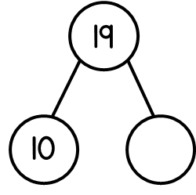
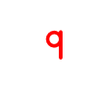
Notes:
What is the whole?
What is the part?
How do we know the missing part?
Children might want to make the number 19 using concrete resources to represent it, and physically split the ten and 9 ones to find the missing part.

Slide 5


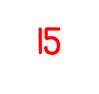
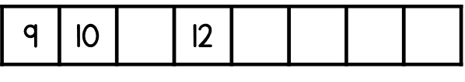
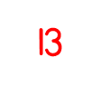
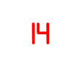
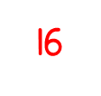
Notes:
What number are we starting on?
What are we counting up in?
What is one more than 10? What is one more/less than 12?
What number would come next after 16?

Slide 6

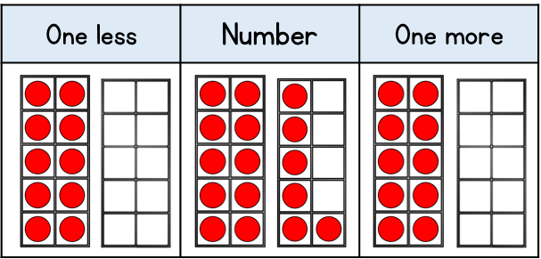




Notes:
What number is represented on the 10 frame?
What is 1 less than this number? Can you show me how we take one away to show one less?
How many more do we need to add to 10 to make this number?
What is one more than the number?
What do we need to add to the 10 to make this number?
Can we add a column of 5 to count quicker?

Slide 7

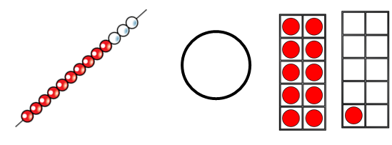

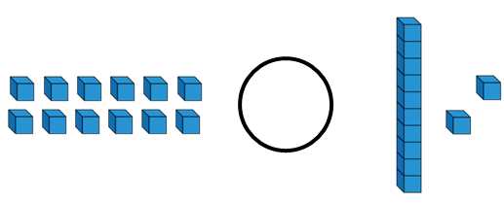
Notes:
How many tens do each of the numbers have?
How many ones do each of the number haves?
Is 1 ten and 3 ones bugger or smaller than 1 ten and 1 one? How do we know?
Which symbol represents more than?
Can we group and ones to exchange them for 1 ten?
Is it easier to see that 12 ones is equal to 1 ten and 2 ones now?
What does equal mean?

Slide 8





Notes:
Children may want to use a number track or number – line to help them to count on one more or count one less.
What number comes after 17 when we are counting up in ones?
What number is 12 one more than?
Is 11 one less than 12?

Slide 9
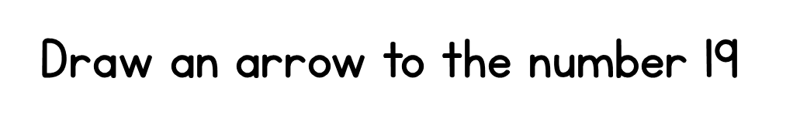
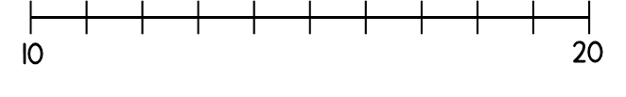
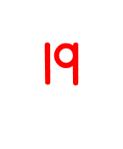
Notes:
What are we counting up in?
What number could you start counting up or down from?
What do we know about the number 19 that can help us?
Is 19 (1 ten and 9 ones) one less than 20?

Slide 10

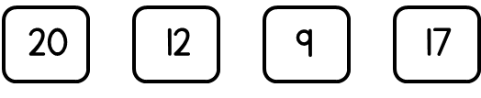
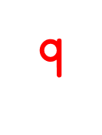


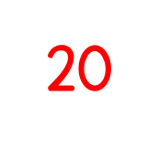

Notes:
What is the same/different about the numbers?
How can we identify the smallest number? Explain how you know
How can we compare 12 and 17 if they both have 1 ten?
How do we know 20 is the greatest number? Is it still the greatest number even though it has 0 ones?

Slide 11
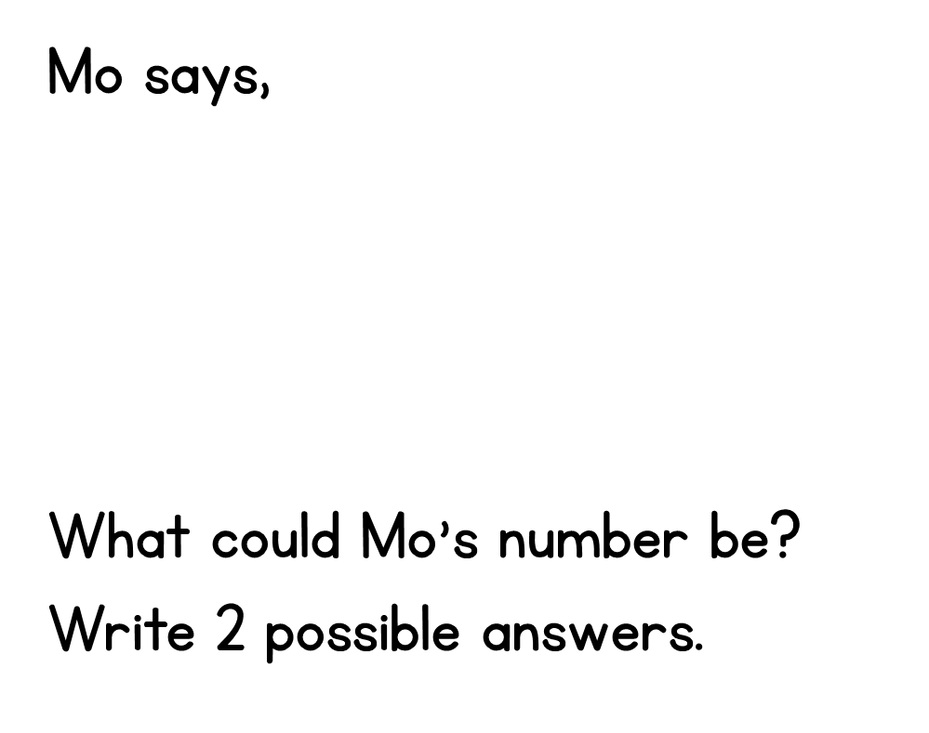
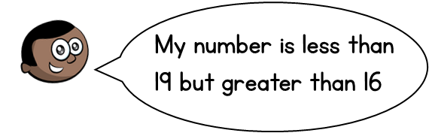

Notes:
What numbers are less than 19?
Which of these numbers are more than 16?
Are there only two possible numbers in between 16 and 19?
Could Mo’s number be 16 or 19? Explain why not.
Children may need to use a number-line to see the possible numbers inbetween 16 and 19.

