Slide 1



Slide 2

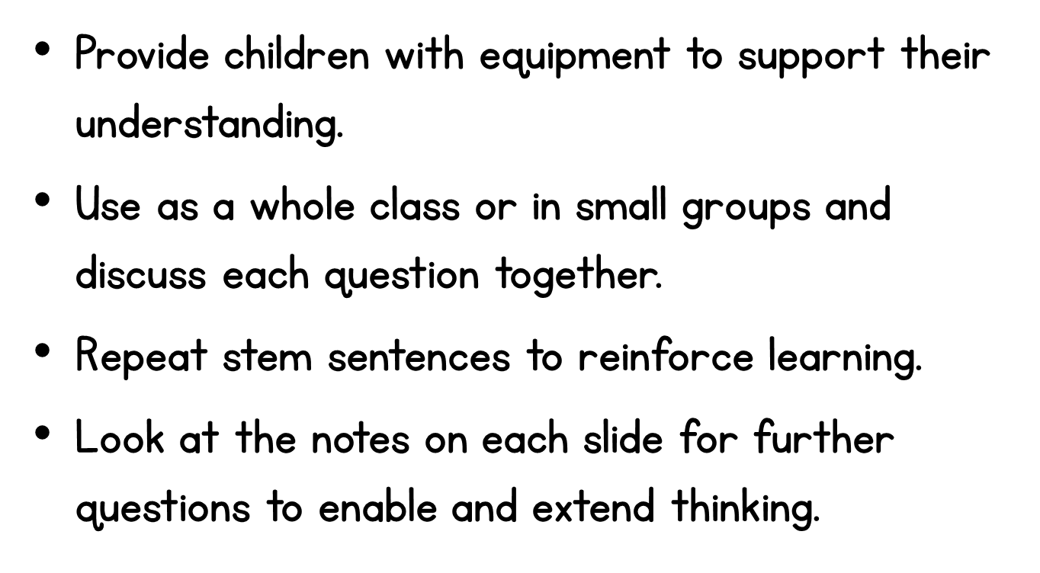

Slide 3

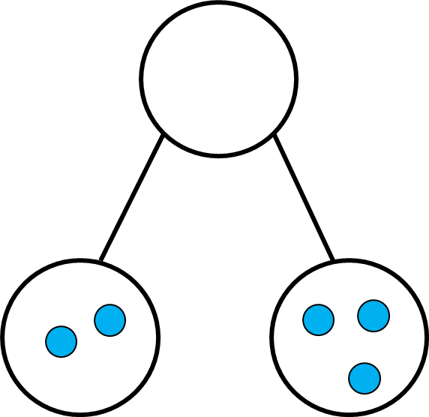

Notes:
The children could use counters to represent the two parts. They can the count how many counters there are altogether to make the whole.
How many are in each part?
How many are there altogether?
How can we check?

Slide 4

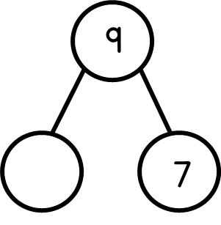
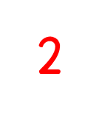
Notes:
Children can use counters to represent the whole. They can then partition the counters into two parts, counting a group of seven, to see how many are in the missing part.
How can we work out a missing part?
What do we need to add to 7 to make the whole?
How can we check that the two parts make the whole?

Slide 5

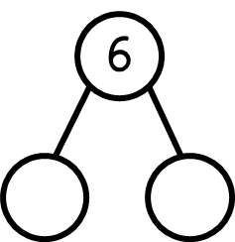
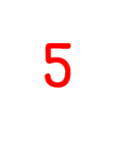

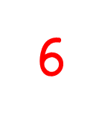
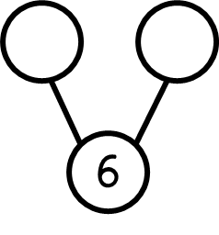

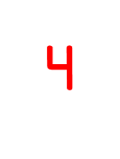
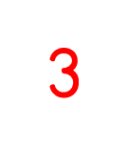

Notes:
Children could use counters or cubes to partition 6 into two groups in different ways to explore how we can make the total of 6.
What numbers can go in our parts?
Can you find two different numbers that add up to 6?
How many different ways can you find?

Slide 6

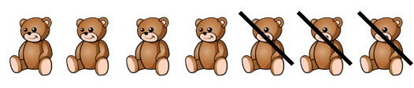
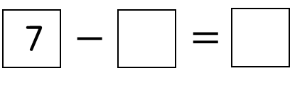
Notes:
Children can use a concrete resource to represent the teddies.
e.g One counter represents one teddy.
How many teddies have we started with?
How many teddies have been taken away?
How many teddies are left?

Slide 7

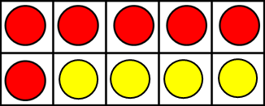
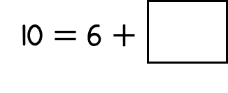
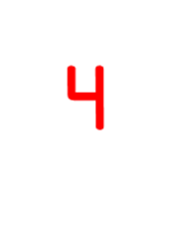
Notes:
How many counters are there altogether?
How many red counters are there?
How many yellow counters are there?
Which colour counters is the 6 representing?
Which colour counters is the missing number representing?

Slide 8
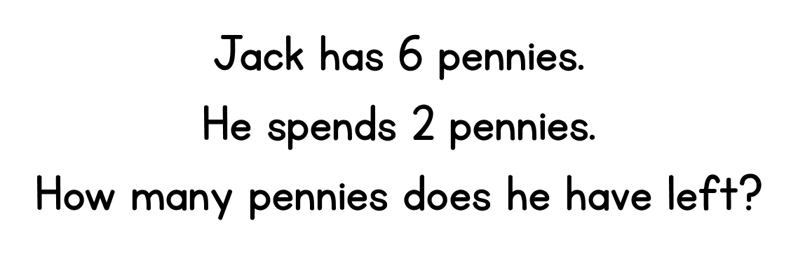




Notes:
Children can represent the problem using concrete resources or pictorially.
e.g They could use double sided counters and turn two over, or they could draw 6 circles and cross two out.
How many pennies does Jack start with?
How can we show the pennies that Jack has spent?
How many pennies are left?

Slide 9

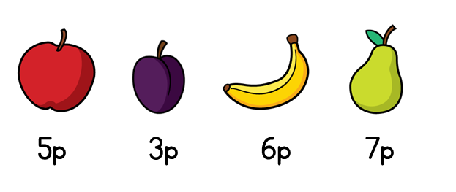

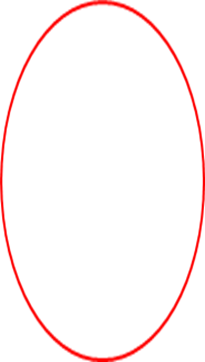
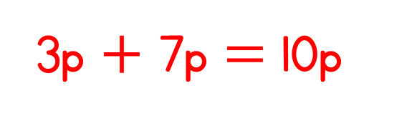
Notes:
The children could use pennies our a concrete manipulative to represent 5p, 3p, 6p and 7p for each of the items.
The children can then explore the different totals they make when adding two different amounts together.
What is the total amount Ted spends?
Which amount goes with 5p to make 10p?
Which amount goes with 3p to make 10p?
Is there only one way Ted could have spend 10p?
How do you know?

Slide 10


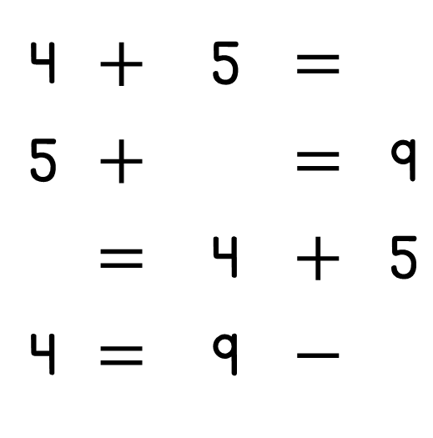
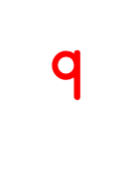


Notes:
The children could use pencils or a pictorial drawing to represent the pencils in each pout.
They could also represent the problem in a part- part – whole model, to show whether it is the part or the whole that is the missing value.
How many pencils are there altogether?
How many more do we add on to 5 to get to 9? (Children could use a numberline here to count on or count back for the subtraction)

Slide 11
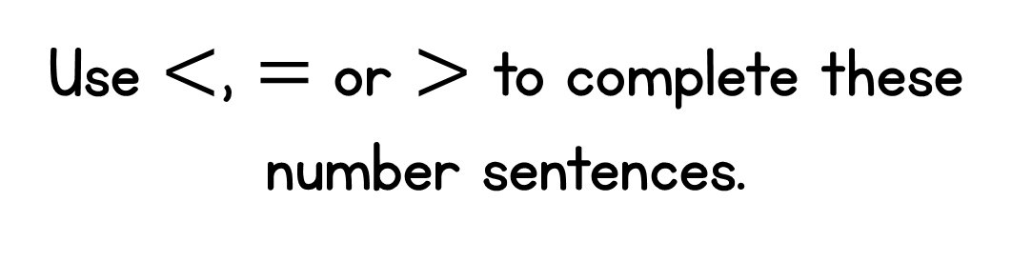
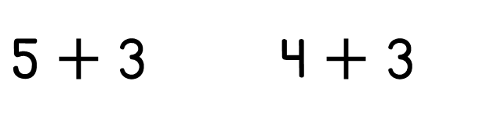



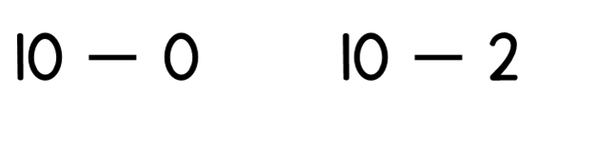
Notes:
Children could use counters to represent the totoal amount on each side of the symbol.
They can make a group of 5 and add 3 more, and a group of 4 and add 3 more.
They can explore which side has more, fewer or equal to.
Ask the children What’s the same? What different? This will encourage them to recognize that they are adding three both times, so if they are starting on 4, this must be smaller than starting at 5.
Repeat with the second example. What’s the same? What’s different?

