Slide 1



Slide 2

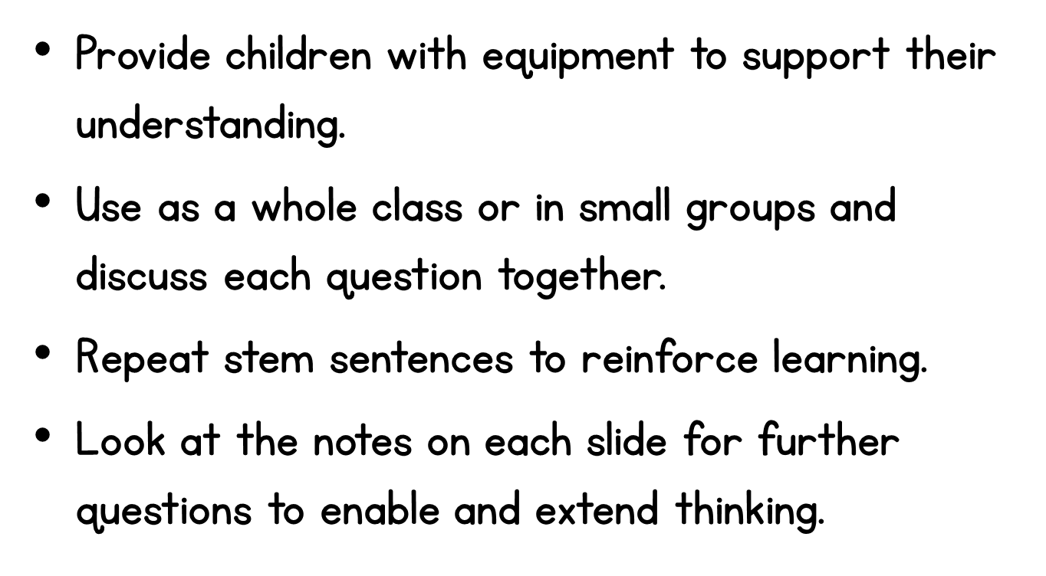

Slide 3






cuboid
cylinder
cube
cone
Notes:
The children should have access to the 3d shapes in front of them, to support them to recognise the shapes from a 2d image.
Extend the children’s reasoning by asking them ‘How do you know?’ Encourage them to use key vocabulary to talk about the properties of 3d shapes that they can use to identify a shape.
What shape am I? would be a great extension activity.
What is the difference between a cube and a cuboid?
What do we know about all the sides on a cylinder?

Slide 4

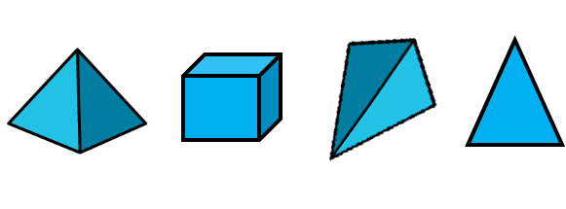
Notes:
Again, the children should have access to the 3d shapes in front of them, to support them when identifying which shapes are pyramids, from a 2d image.
Extend the children’s reasoning by asking them ‘How do you know?’ Encourage them to use key vocabulary to talk about the properties of pyramids that they can use to identify if a shape is or isn’t.
What shape faces can a pyramid have?

Slide 5


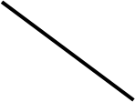

Notes:
The children should have access to the 2d shapes in front of them, to support them to recognise the shapes from a 2d image.
Children who find it difficult to identify the triangle and square because of the non-standard orientation, could use shapes to turn and place over the images.
Is an upside down triangle still a triangle? How do we know that the red shape is a square?
Extend the children’s reasoning by asking them ‘How do you know?’ Encourage them to use key vocabulary to talk about the properties of 2d shapes that they can use to identify a shape.
What shape am I? would be a great extension activity.

Slide 6
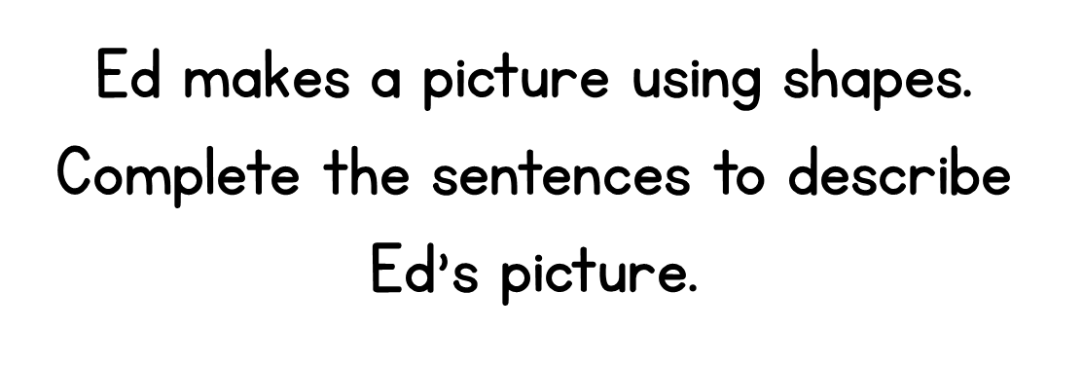
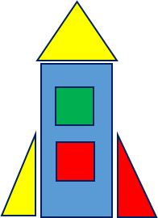
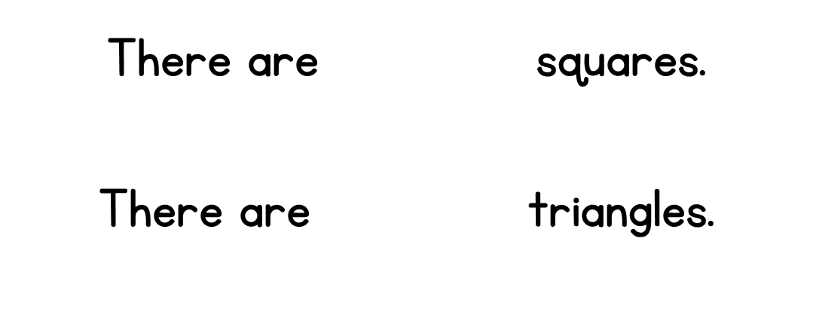


Notes:
The children could make the picture of the rocket themselves using the 2d shapes, and explore the shapes they need to use. They can then count the number or squares and triangles.
Are there any other shapes you can see in the rocket picture?
How many triangles are there? Do all triangles have to look the same?

Slide 7
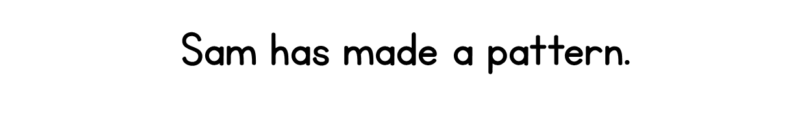

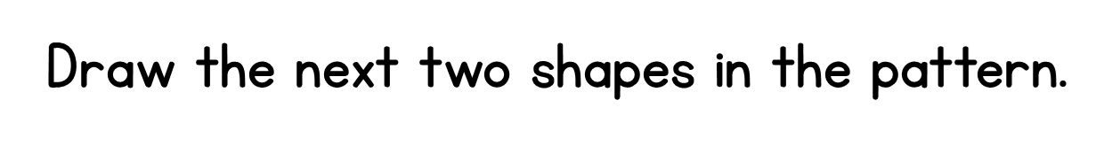
Notes:
Encourage the children to spot patterns by putting this pattern together themselves, using 2d shapes.
What shape comes first in the pattern?
How many different shapes are there in the pattern?
What shape always comes after the triangle?
What shape always comes after a circle?
What shape would come next?

Slide 8
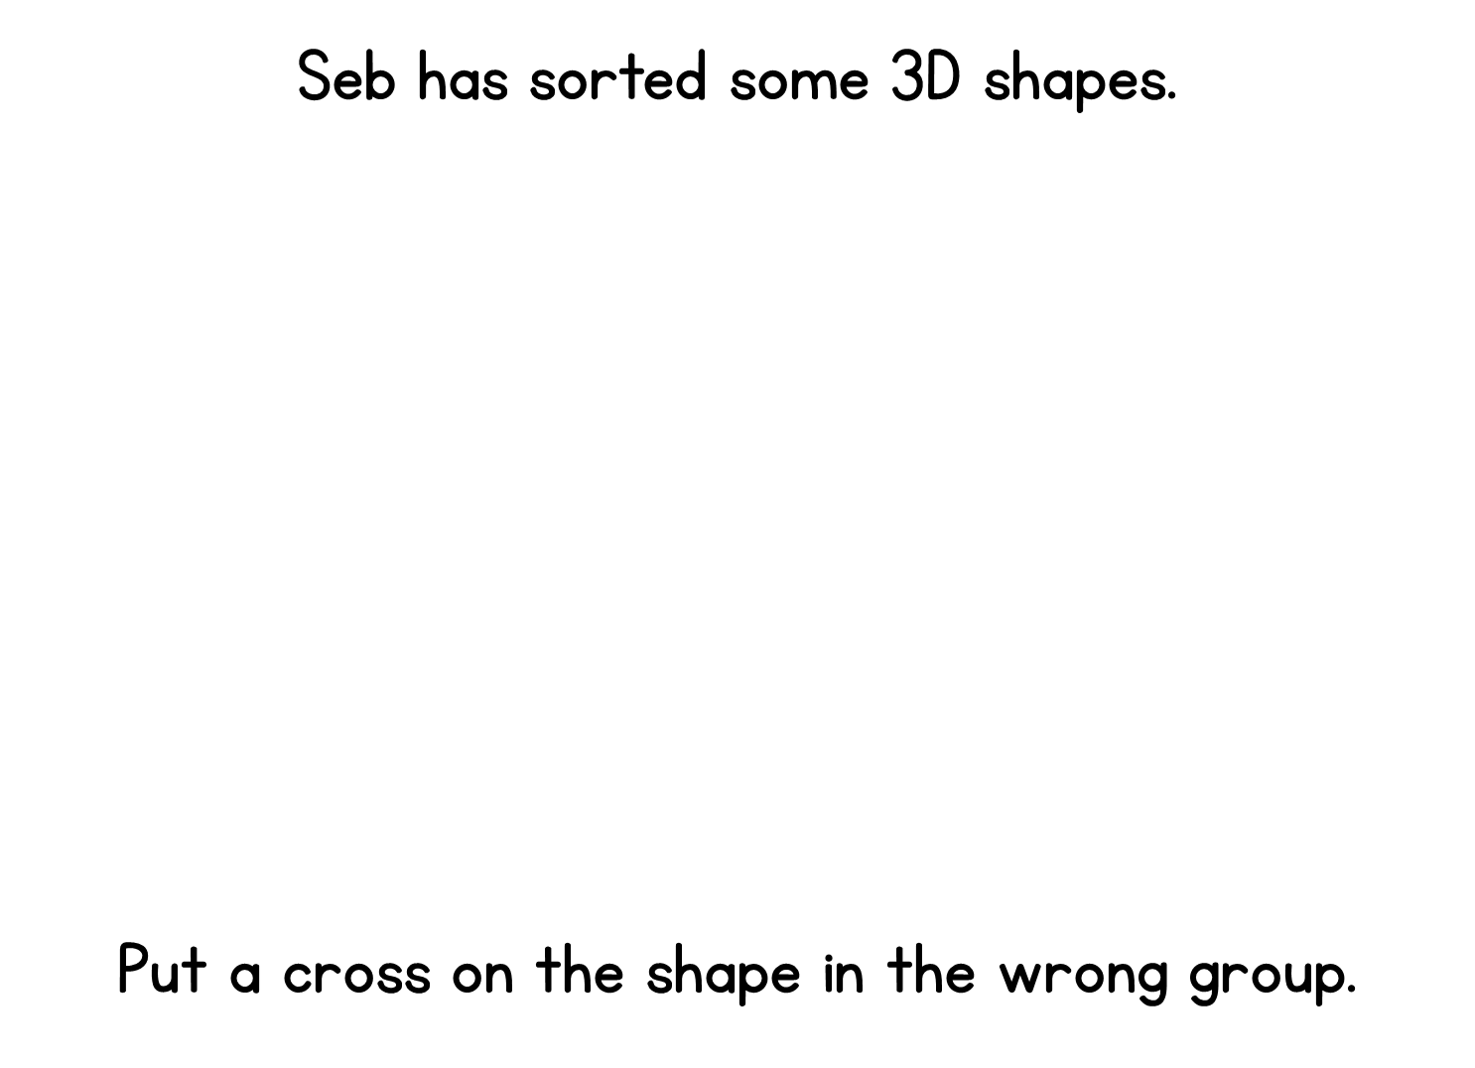
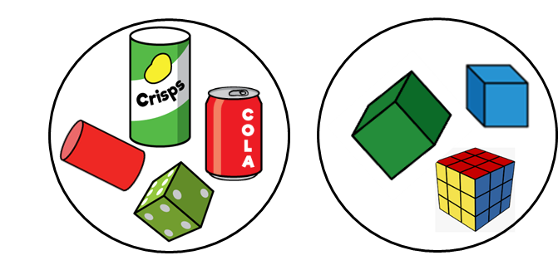
Notes:
Ask the children what shapes they can see in the two groups.
How do we know if a shape is a cylinder?
How do we know if a shape is a cube?
Which shape do you need to move so all the shapes are the same in each group? How do you know?

Slide 9

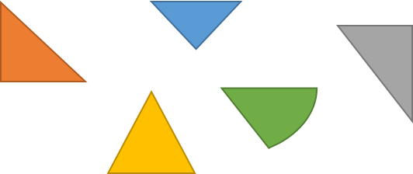
Notes:
Explore the properties of a triangle with the children.
What do we know about a triangle?
How many sides does a triangle have? Do any of the shapes have more than 3 sides?
What do we know about the sides of a triangle? Do any of the shapes not have straight sides?

Slide 10
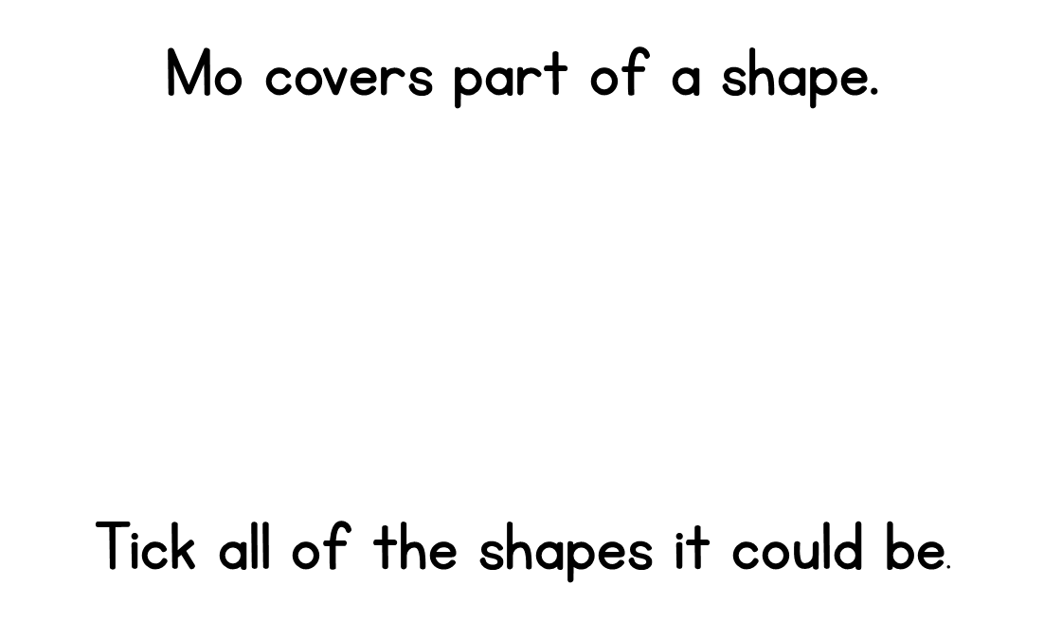


Notes:
The children could explore all 4 shapes, to ensure they have found all of the possible solutions that the shape could be.
Can it be a circle? How do we know it can’t be a circle? Does a circle have any straight sides?
Can it be a triangle? How many sides does a triangle have? We can see 3 sides, but will they ever make a complete shape?
Is it possible that it could be a square or a rectangle?

