Slide 1
We are learning to write a recount

Slide 2
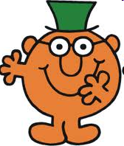
We are learning to write a recount
We are going to use time words to say what happened
in order.

Slide 3
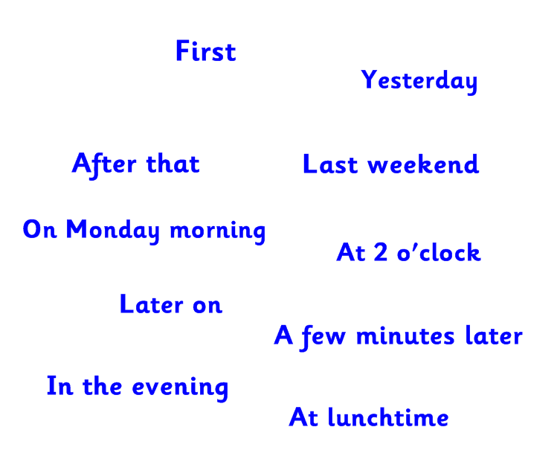

Slide 4
Spot the time words...
My Easter Recount
Last Sunday was Easter Sunday!
First I woke up really early because I was excited to find my Easter eggs!
My grown ups had hidden them in the garden.
A few minutes later, I grabbed my Easter basket and ran into the garden. I looked everywhere! I spotted some sparkly pink foil under a plant it was an egg! Then I saw another and another. I kept looking and I found some in the shed and behind the flower pots! I found 6 eggs all for me! Yum!
Soon, I was tired so I had a drink and some lunch and then I had some delicious chocolate eggs!
Afterwards, I went to the park with my family. The sun was shining and it was great. We walked around and looked at the flowers and birds and bees.
Finally, I was tired and I snuggled up on the sofa with my sister to watch an Easter film.

Slide 5
How to write a brilliant recount…

Slide 6
How to write a brilliant recount…
Introduction

Slide 7
How to write a brilliant recount…
When ?
Introduction
Who ?
Where ?

Slide 8
How to write a brilliant recount…
When ?
Introduction
Who ?
Where ?
Time words

Slide 9
How to write a brilliant recount…
When ?
Introduction
Who ?
Where ?
First
Time words
Then
After that
Finally

Slide 10
How to write a brilliant recount…
When ?
Introduction
Who ?
Where ?
First
Time words
Then
After that
Finally

Slide 11
How to write a brilliant recount…
When ?
Introduction
Who ?
Where ?
First
Time words
Then
After that
Finally

