Slide 1


Year 3 – Summer Block 2 – Time – Hours in a Day
About This Resource:
This PowerPoint has been designed to support your teaching of this small step. It includes a starter activity and an example of each question from the Varied Fluency and Reasoning and Problem Solving resources also provided in this pack. You can choose to work through all examples provided or a selection of them depending on the needs of your class.
National Curriculum Objectives:
Mathematics Year 3: (3M4d) Estimate and read time with increasing accuracy to the nearest minute; record and compare time in terms of seconds, minutes and hours; use vocabulary such as o'clock/a.m./p.m., morning, afternoon, noon and midnight
Mathematics Year 3: (3M4e) Know the number of seconds in a minute and the number of days in each month, year and leap year
Mathematics Year 3: (3M4f) Compare durations of events, [e.g. to calculate the time taken by particular events or tasks]
More resources which follow the same small steps as White Rose.
Did you like this resource? Don’t forget to review it on our website.
© Classroom Secrets Limited 2018

Slide 2
Year 3 – Summer Block 2 – Time
Step 2: Hours in a Day
© Classroom Secrets Limited 2018

Slide 3
Introduction
Sort the months.
There are ______ days in a year.
There are ______ days in a leap year.
There are ______ months in a year.
30 days | 31 days | 28 or 29 days
January
February
March
April
May
July
June
August
September
October
November
December
© Classroom Secrets Limited 2018

Slide 4
Introduction
Sort the months.
There are 365 days in a year.
There are 366 days in a leap year.
There are 12 months in a year.
30 days | 31 days | 28 or 29 days
April
January
March
February
June
May
July
September
August
October
November
December
© Classroom Secrets Limited 2018

Slide 5
Varied Fluency 1
Match the statements to the correct number.
days in April |  | 4
hours in 3 days |  | 30
days in two weekends |  | 72
© Classroom Secrets Limited 2018

Slide 6
Varied Fluency 1
Match the statements to the correct number.
days in April |  | 4
hours in 3 days |  | 30
days in two weekends |  | 72
© Classroom Secrets Limited 2018

Slide 7
Varied Fluency 2
Put these events in the correct order from earliest to latest.
home time |  | morning registration
afternoon playtime |  | noon
© Classroom Secrets Limited 2018

Slide 8
Varied Fluency 2
Put these events in the correct order from earliest to latest.
morning registration
noon
afternoon playtime
home time
home time |  | morning registration
afternoon Playtime |  | noon
© Classroom Secrets Limited 2018

Slide 9
Varied Fluency 3
Fill in the blanks:
There are _________ days in five weeks.
There are 12 ___________ in half a day.
© Classroom Secrets Limited 2018

Slide 10
Varied Fluency 3
Fill in the blanks:
There are _________ days in five weeks.
There are 12 ___________ in half a day.
35
hours
© Classroom Secrets Limited 2018

Slide 11
Varied Fluency 4
True or false?
Lunch is served at midday.
© Classroom Secrets Limited 2018

Slide 12
Varied Fluency 4
True or false?
Lunch is served at midday.
True because...
© Classroom Secrets Limited 2018

Slide 13
Varied Fluency 4
True or false?
Lunch is served at midday.
True because lunch is served in the ‘middle’ of the day – usually 12 o’clock.
© Classroom Secrets Limited 2018

Slide 14
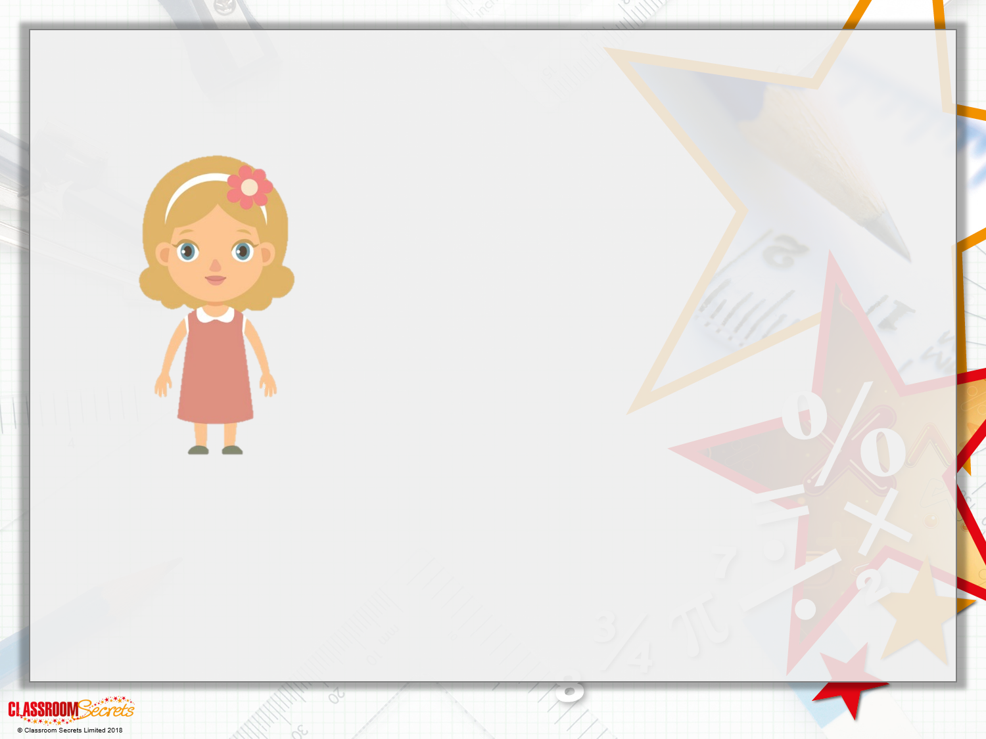
Reasoning 1
Ellie says:
Is that possible? Explain how you know.
Lunchtime is at 12 o’clock. So, whenever a clock shows 12 o’clock it has to be lunchtime.

Slide 15
Reasoning 1
Ellie says:
Is that possible? Explain how you know.
Ellie is incorrect because...
Lunchtime is at 12 o’clock. So, whenever a clock shows 12 o’clock it has to be lunchtime.

Slide 16
Reasoning 1
Ellie says:
Is that possible? Explain how you know.
Ellie is incorrect because a clock can say 12 o’clock in the middle of the night and in the middle of the day. Only one of those is lunchtime.
Lunchtime is at 12 o’clock. So, whenever a clock shows 12 o’clock it has to be lunchtime.

Slide 17
Reasoning 2
“Today the sunset was at 8 o’clock. That means every day must finish at 8 o’clock.”
True or false? Explain how you know.
© Classroom Secrets Limited 2018

Slide 18
Reasoning 2
“Today the sunset was at 8 o’clock. That means every day must finish at 8 o’clock.”
True or false? Explain how you know.
False because...
© Classroom Secrets Limited 2018

Slide 19
Reasoning 2
“Today the sunset was at 8 o’clock. That means every day must finish at 8 o’clock.”
True or false? Explain how you know.
False because the sun sets at different times (depending on the season) and this doesn’t always mean the day has ended.
© Classroom Secrets Limited 2018

Slide 20
Problem Solving 1
How many days in this month are not weekend days?
Mo | Tu | We | Thu | Fri | Sa | Su
 |  |  | 1 | 2 | 3 | 4
5 | 6 | 7 | 8 | 9 | 10 | 11
12 | 13 | 14 | 15 | 16 | 17 | 18
19 | 20 | 21 | 22 | 23 | 24 | 25
26 | 27 | 28
© Classroom Secrets Limited 2018

Slide 21
Problem Solving 1
How many days in this month are not weekend days?
20 days are not weekend days
Mo | Tu | We | Thu | Fri | Sa | Su
 |  |  | 1 | 2 | 3 | 4
5 | 6 | 7 | 8 | 9 | 10 | 11
12 | 13 | 14 | 15 | 16 | 17 | 18
19 | 20 | 21 | 22 | 23 | 24 | 25
26 | 27 | 28
© Classroom Secrets Limited 2018

