Slide 1

Geography
Rainforests
Year One

Slide 2
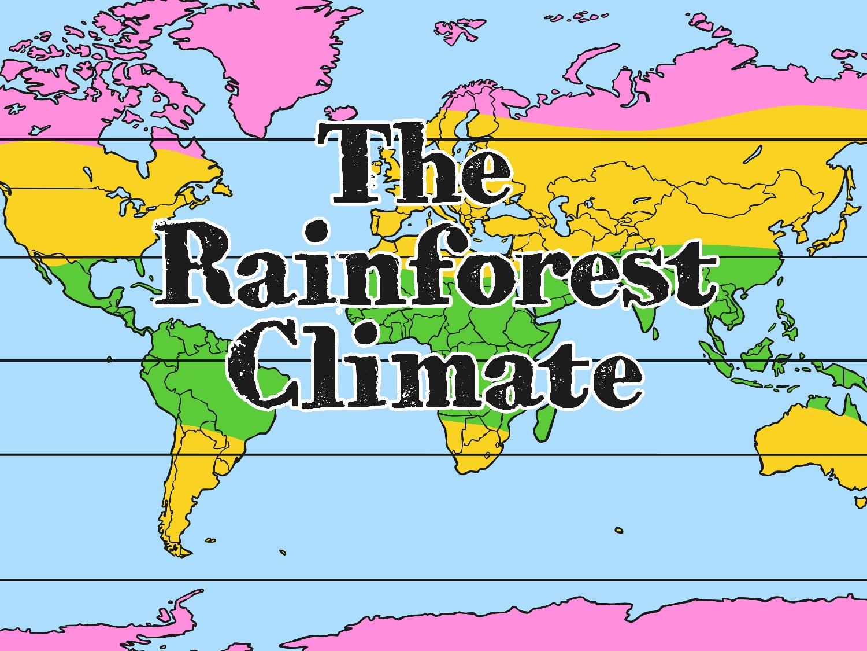

Slide 3
Aim
IALT identify areas of the world containing rainforests.
IALT explain the key aspects of a rainforest climate.
Success Criteria
I can find the Equator on a map.
I can tell you that rainforests are found near the Equator.
I can find the tropics of Cancer and Capricorn on a map.
I can tell you that rainforests are found between the tropics of Cancer and Capricorn.
I can tell you the difference between weather and climate.
I can describe what the weather is usually like in a tropical climate.

Slide 4

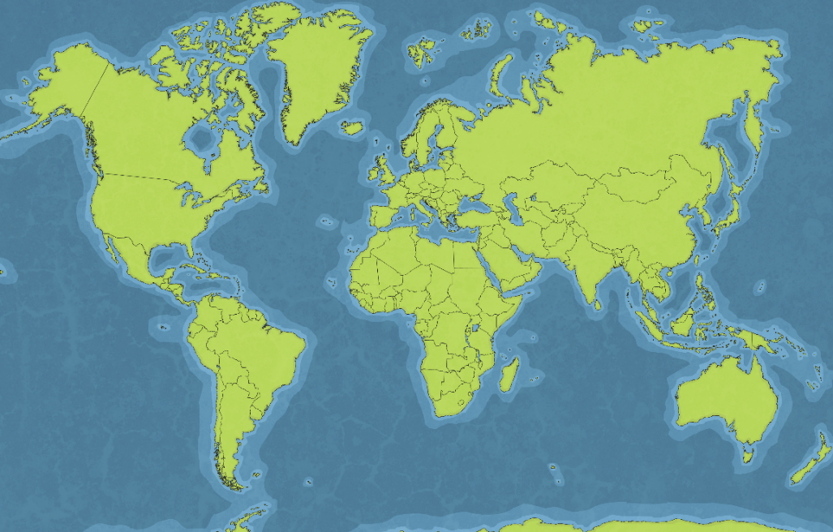
Can You Remember
Where Rainforests Are Found?
Can you find each country?
1
Brazil
Peru
Indonesia
Bolivia
Ecuador
Guyana
India
Malaysia
Mexico
Venezuela
Australia
2
3
4
5
6
9
7
10
4
6
8
7
5
8
1
3
2
9
11
10
11

Slide 5
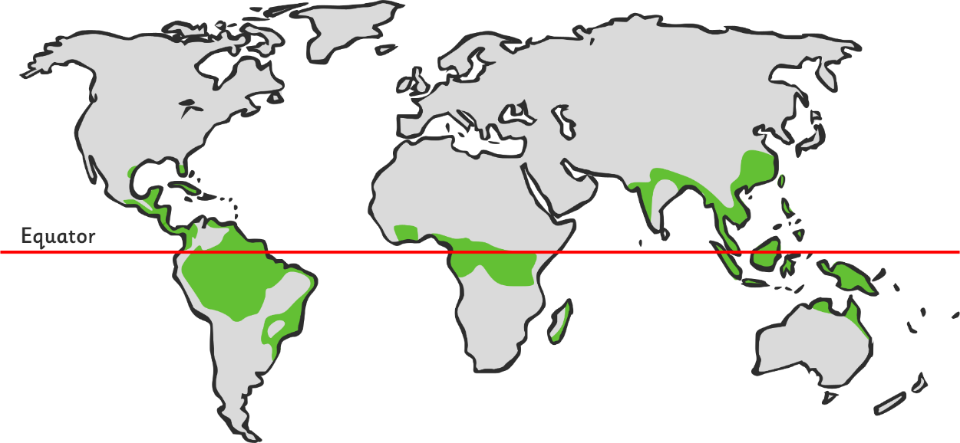
What Do You Notice?
What do you notice about the location of most rainforests?
What’s this line called?
Rainforests are found near to the equator.

Slide 6
What Do You Notice?
What do you notice about the location of most rainforests now? Can you describe their location even more precisely?
tropics of cancer
tropics of capricorn
Rainforests are found between the Tropics of Cancer and Capricorn.

Slide 7

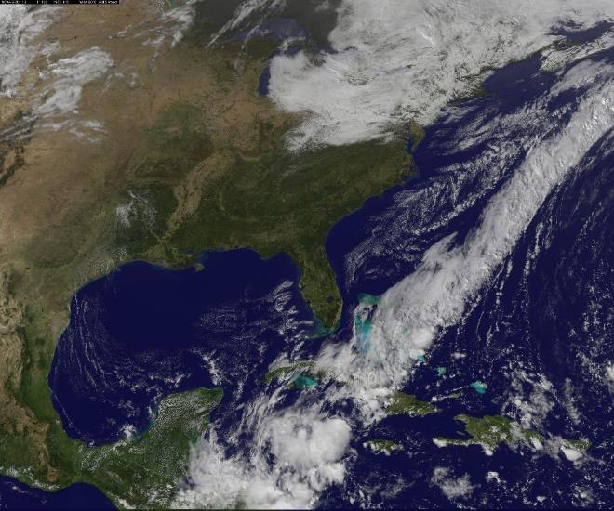
Climate and Weather
What is the difference between weather and climate?
Climate is the usual or average weather conditions over a long period of time.
Weather is the specific condition on a given day (which may or may not be typical for a climate).
Photo courtesy of gsfc @flickr.com - granted under creative commons licence - attribution

Slide 8
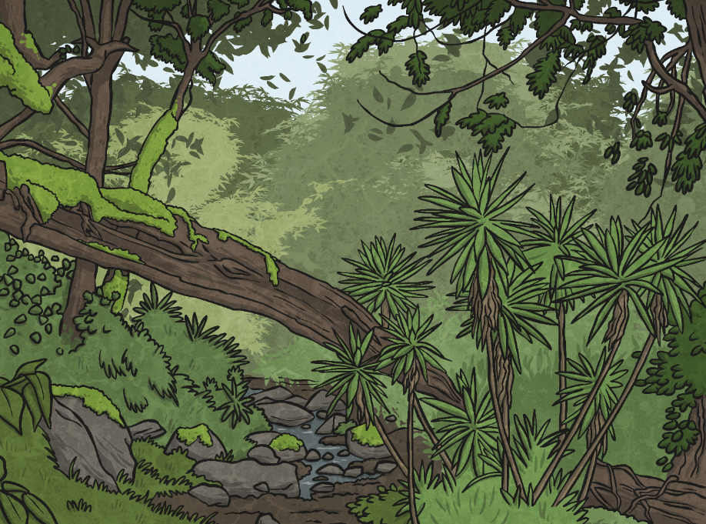
What Is the Climate of a Rainforest?
There are no seasons – the climate is the same all year round.
Every month has an average rainfall of at least 6cm.
It usually rains every day.
Temperatures are hot all year round.
It is very humid.

Slide 9

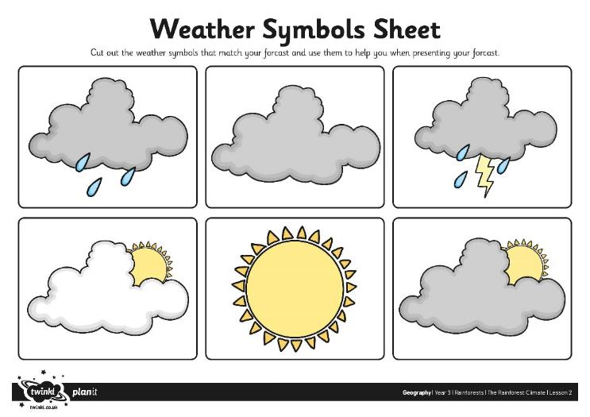
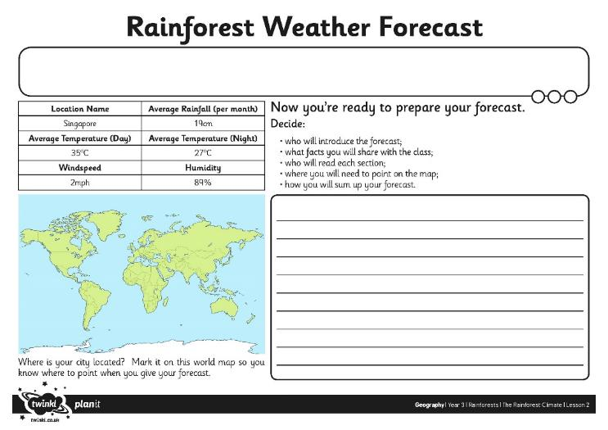
What’s the Weather Like?
Read through the information about the climate of a rainforest area.
Make notes about what the weather might be like there today.
Cut out the symbols you will need.
Practise reading your weather report.

Slide 10
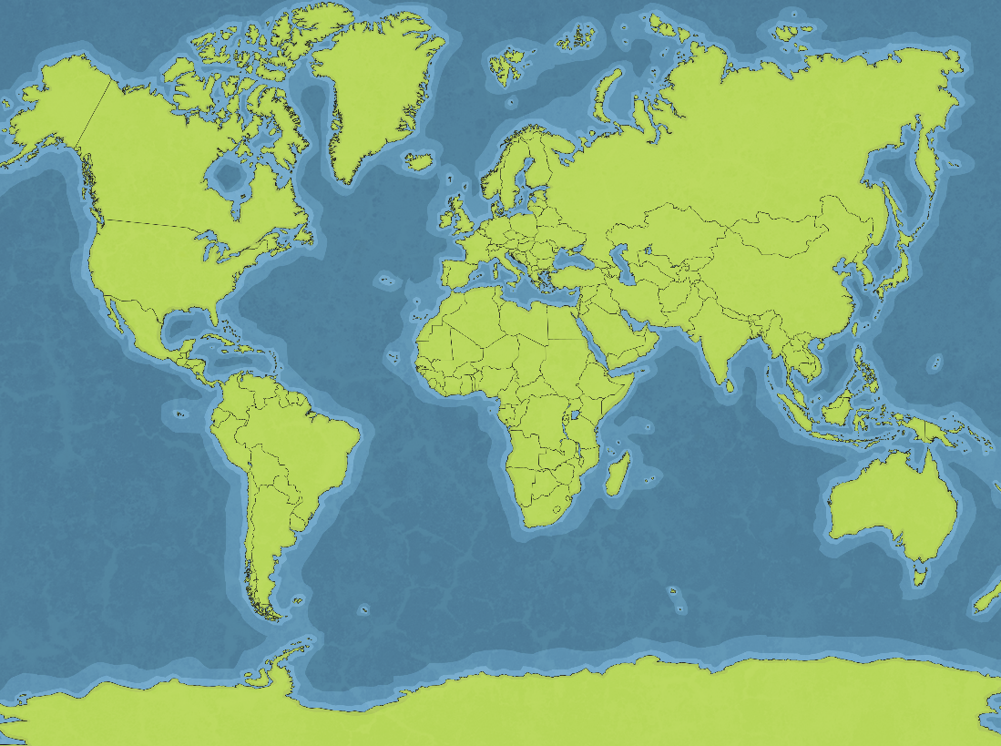
Today’s Weather…

