Slide 2
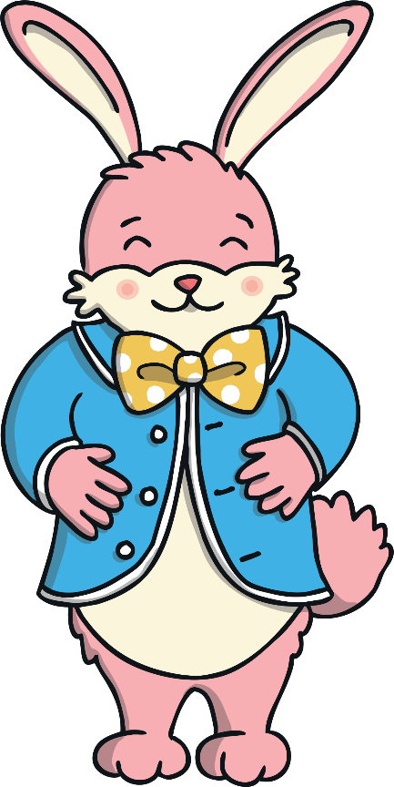




Can You Help the Easter Bunny to Tell the Time?
The Easter Bunny must not be late! There’s lots to do to get ready for Easter but the Easter Bunny is not very good at checking the clock. Can you keep an eye on the clock and press the alarm when the Easter Bunny needs to stop.
Click to change the time on the clock. Then, when the clock shows the correct time, press the alarm.
start

Slide 3
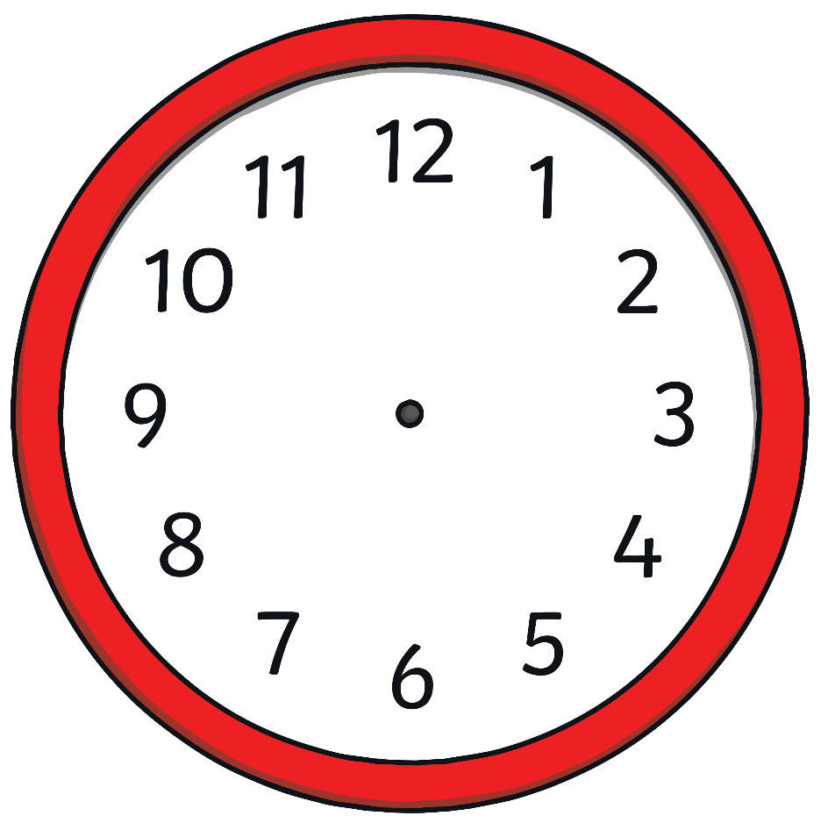
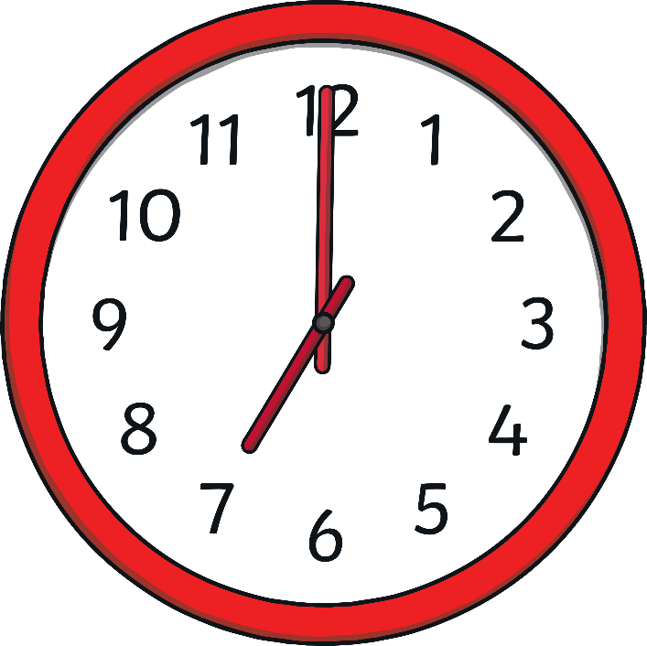
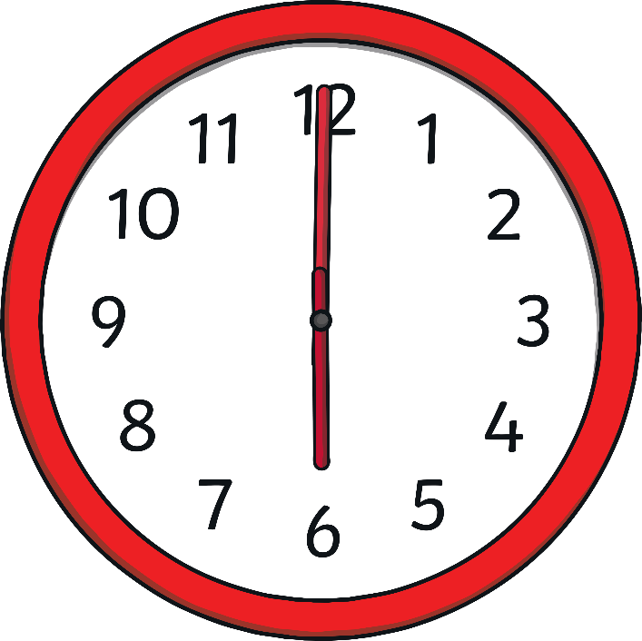
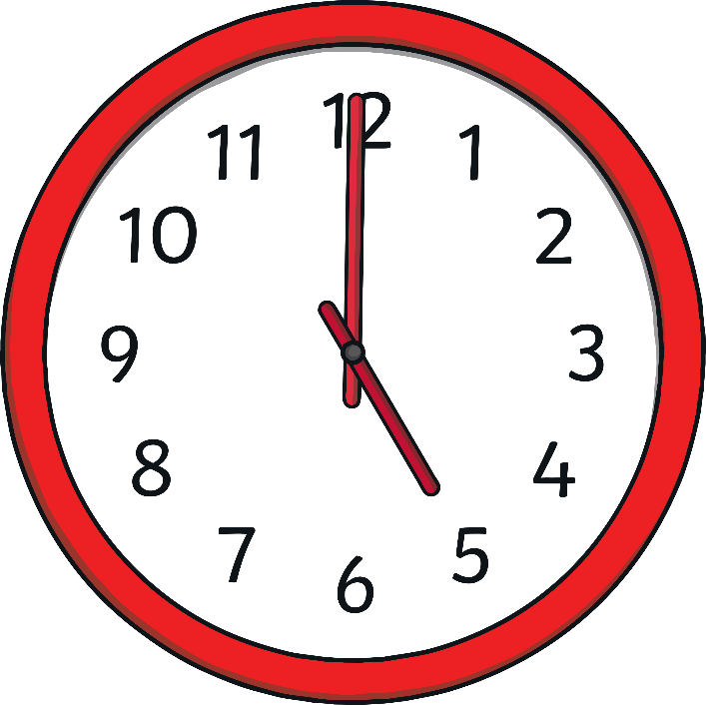


The Easter Bunny is making some chocolate eggs.
He must be finished by 7 o’clock.
Alarm
back
next

Slide 4
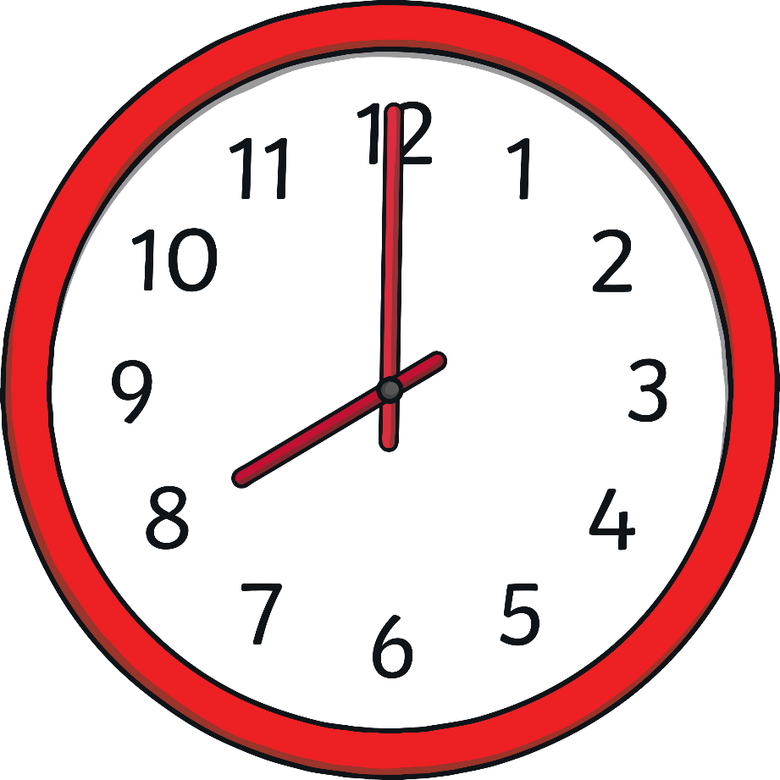
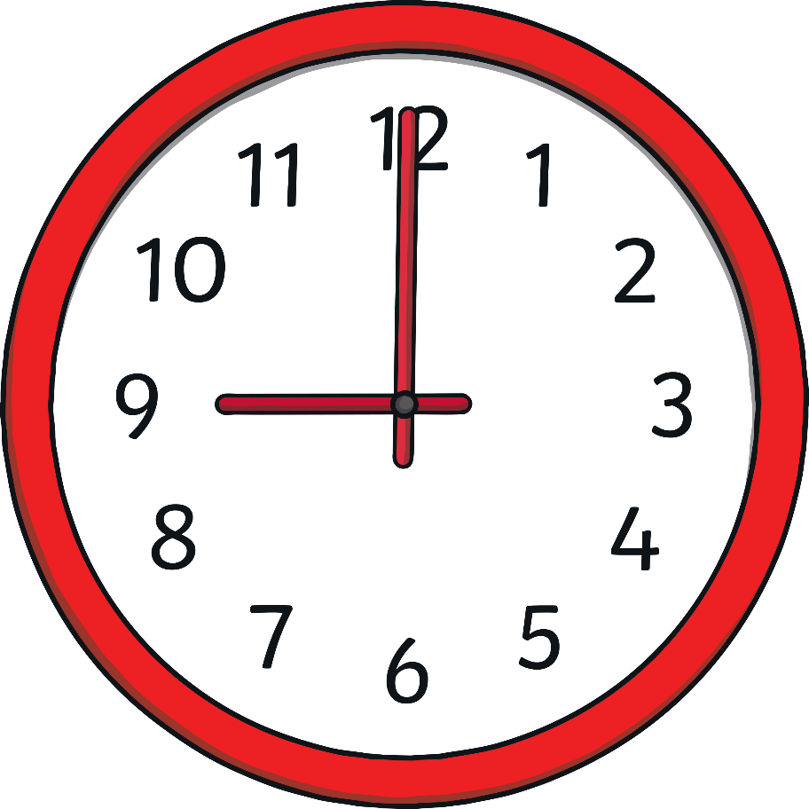




The Easter Bunny needs to wrap the eggs.
He must be finished by 9 o’clock.
Alarm
back
next

Slide 5
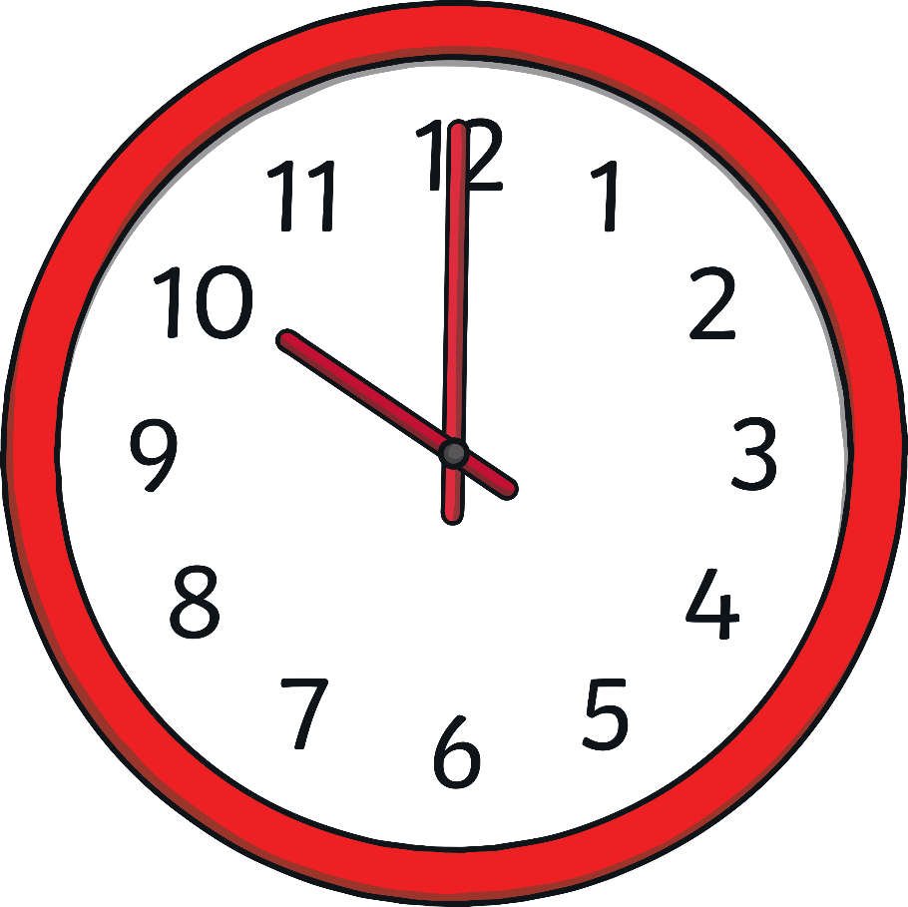
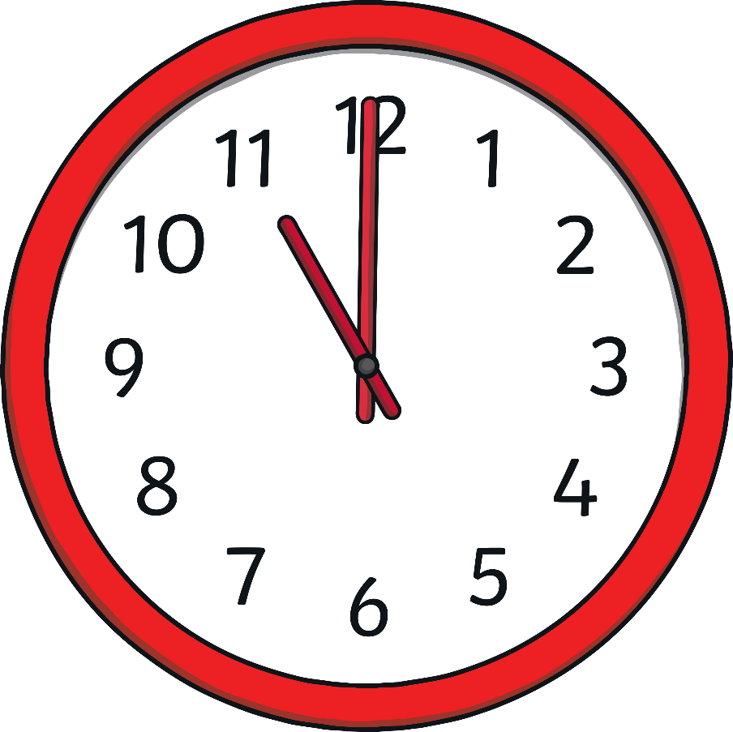
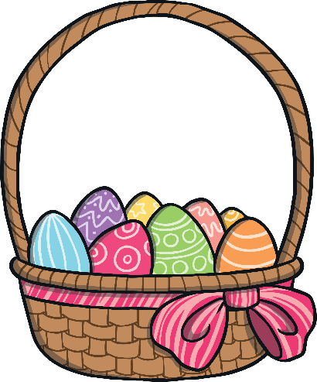
The Easter Bunny must put all of the Easter eggs into his basket.
He must be finished by 11 o’clock.
Alarm
back
next

Slide 6
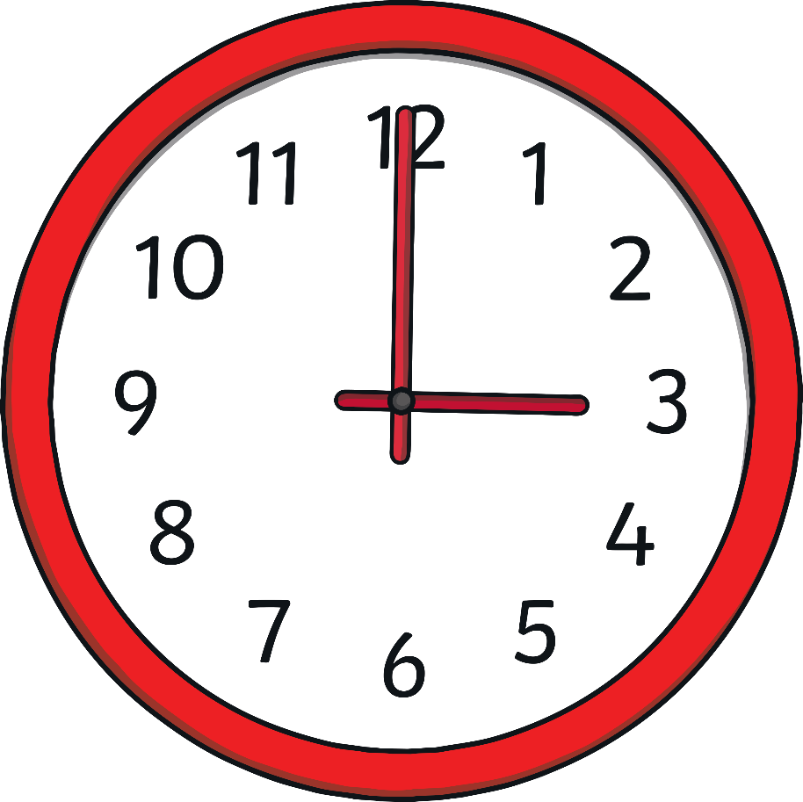
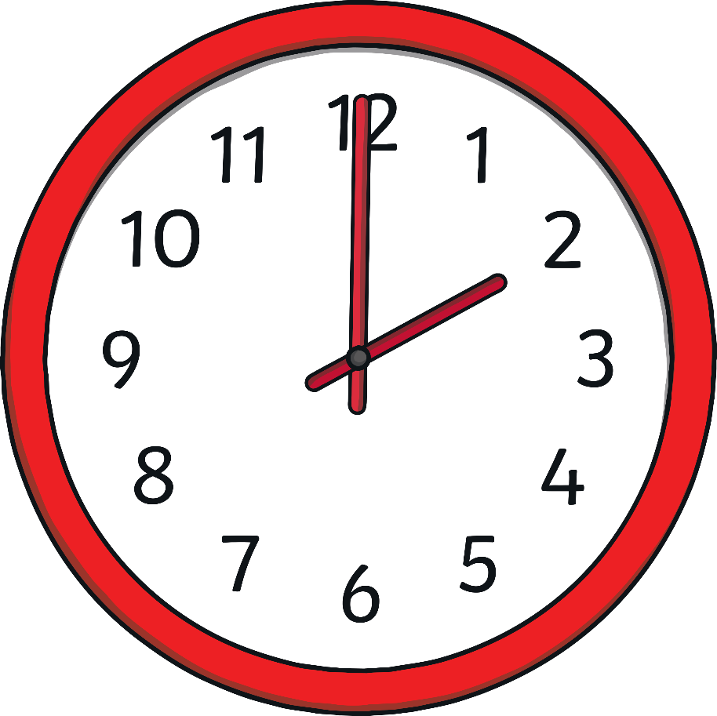
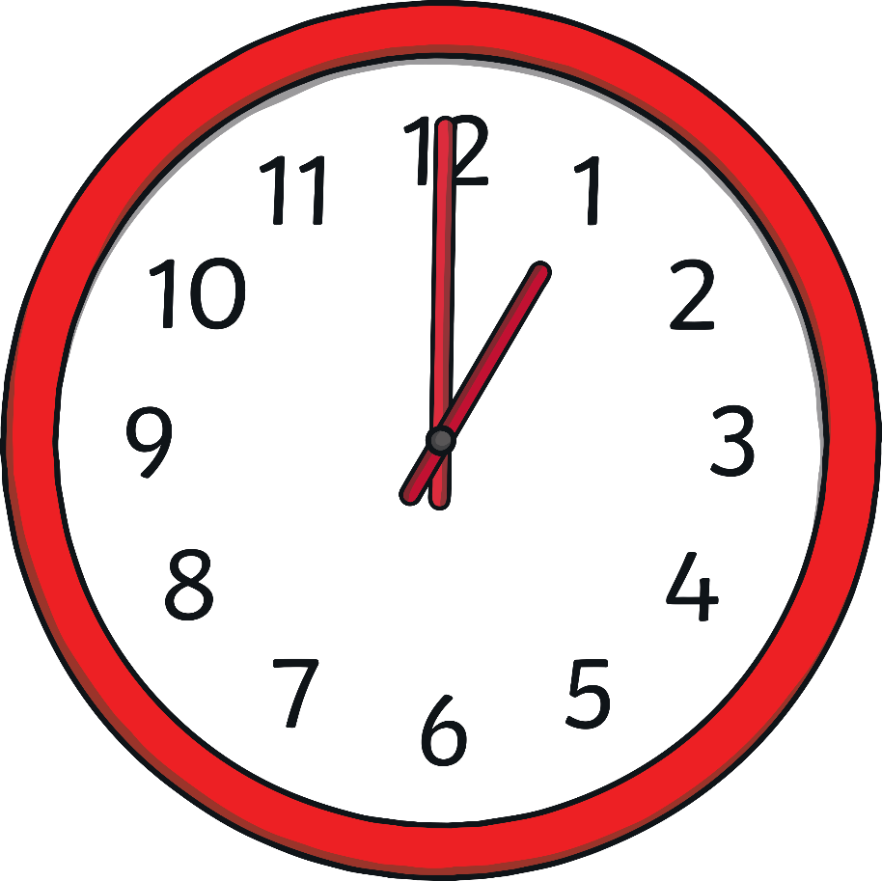
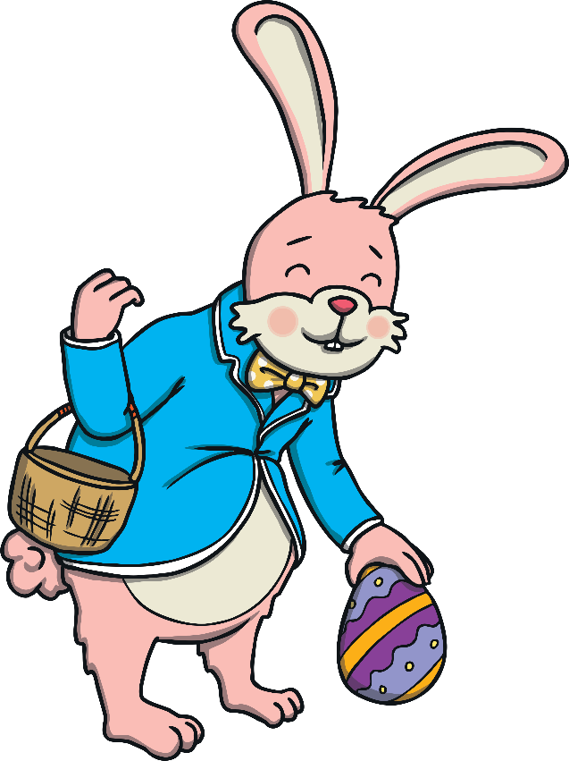

The Easter Bunny needs to hide all of the Easter eggs.
He must be finished by 3 o’clock.
Alarm
back
next

Slide 7


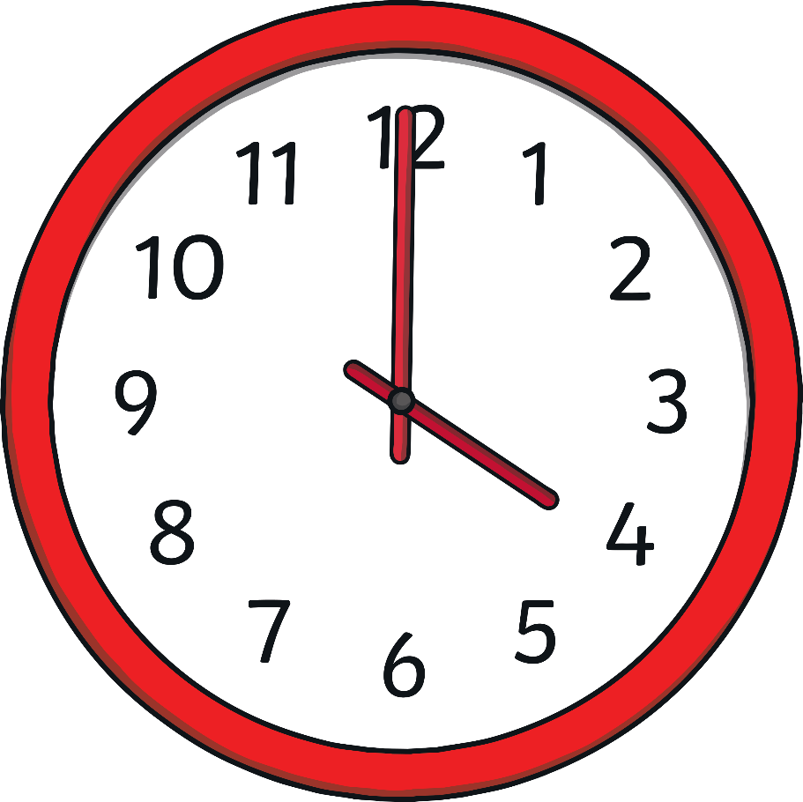
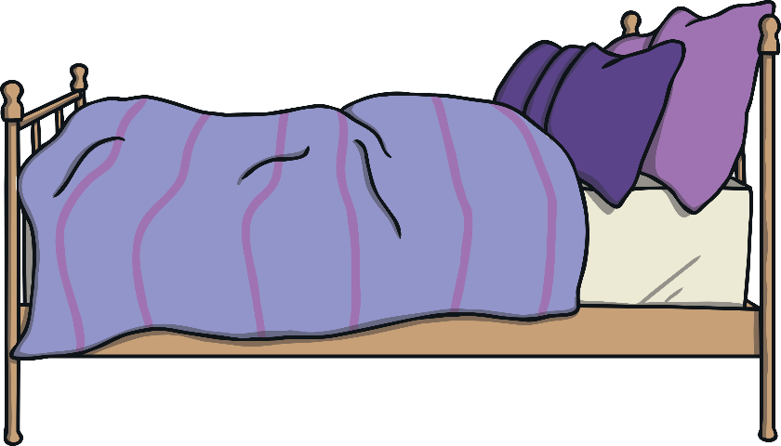

Well done Easter Bunny! You were not late.
Now you need to be in bed at 6 o’clock.
Alarm
back

