Slide 1


Welcome to Ramsgate Arts Primary School
One Childhood: One Chance

Slide 2


Executive Headteacher
Michaela Lewis
‘One Childhood One Chance’

Slide 3
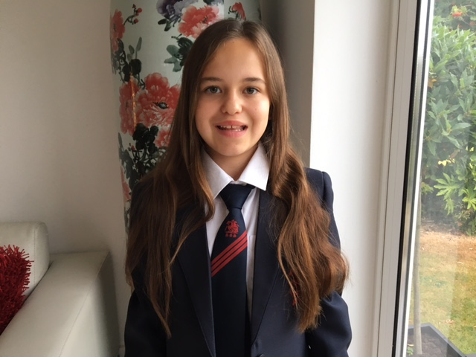
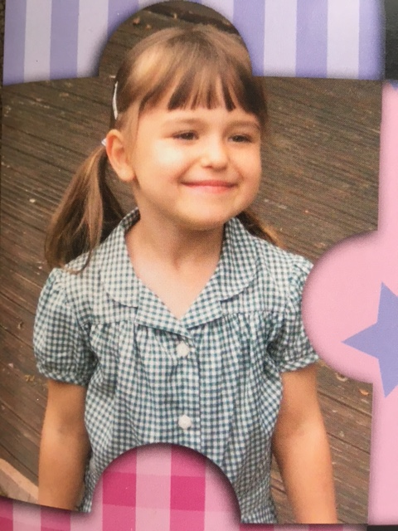
What I know To Be True…

Slide 4
Who’s Who?
Michaela Lewis – Executive Headteacher
Nick Budge – Head of School
Emily Hughes-Trust SENCO
Michelle Richards– Reception Teacher
Andrew Beraet –Year 3 Teacher
Mary Brown - Admin Assistant
Barbara Smith –Finance Assistant

Slide 5
Together we make a difference...
The key factor in determining a child’s success in school life is to forge a longstanding and strong partnership with parents.

Slide 6
From us you can expect:
High quality education
To be welcomed in to school on a regular basis: reading sessions, stay and play sessions, workshops, celebration events, sports and arts events
A partnership! Children come first.

Slide 7
‘Open Door’ policy
Teachers and Teaching Assistants at arrival and pick up times
Appointments
Letters
Telephone
Website
Leadership Team
We want to hear from you!

Slide 8
What we ask from you:
Children arrive on time – 8:15 doors open – doors closed by 8:30
Correct school uniform and PE kit
Attend parent-teacher consultation appointments
Support home learning activities – high priority on regular reading and phonics activities / book sharing
Keep us informed!
Talk to us about any concerns you have – we are the ones to help... We can’t help with things we don’t know about

Slide 9
Attendance
Regular and punctual attendance – 97%
We reward good attendance
Consistently poor attendance is addressed in a robust manner
Attendance matters – for the good of your children.

Slide 10
Reception | Year 3 | IYA 1,2,4,5
 | Thursday 6th July - Transition Day 9.00-3.00
Friday 1st September - Summer Picnic 12 - 2pm | Friday 1st September - Summer Picnic 12 - 2pm
 |  | Tuesday 5th Sep Visit 11.00-12.00
Week beginning 4th Sep - Home Visits | Wednesday 6th Sep - Start school 8.30-3.00 | Wednesday 6th Sep - Start school 8.30-3.00
Week Beginning 11th Sep – a.m 8.30 -11.00 0R p.m 12.30 - 3.00 | Monday 11th Sep - Arts Curriculum starts (8.30 - 4.15)
Week beginning 18th Sep – 8.30 - 1.30 (stay for lunch)
Thurs 2^{1st} /Fri 22nd Sep - 8.30 - 3.00 (Stay all day)

Slide 11
For September
NAMED uniform:
grey skirt / shorts / trousers, white shirt / polo shirt, royal blue jumper / cardigan
Black shoes (no trainers)
No sandals / open-toed shoes
Summer – blue gingham dresses
Can your child put it on?
PE kit (named)
Book Bags (named)
Wellies
Coat
Water bottle (named)

Slide 12
A Typical School Day
Reception |  | KS2
8.15-8.30 | Self Registration | 8.15 - 8.30 | Registration
8.40-9.00 | Guided Reading | 8.30 - 9.00 | Phonics/Spelling/ Grammar
9.00 - 9.35 | Phonics | 9.00 - 9.15 | Assembly
9.35 - 9.40 | Smart Bodies | 9.15 - 10.15 | English
9.40 - 10.00 | Lesson | 10.15 - 10.30 | Break
10.00 -10.15 | Snack | 10.30 - 11.30 | Maths
10.15 - 11.15 | Child Initiated | 11.30 - 12.00 | Reading
11.15 - 11.45 | Lesson | 12.00 - 12.55 | Lunch
12.00 - 1.00 | Lunch | 1.00 - 2.00 | IPC
1.15 - 1.30 | Fine Motor Fun | 2.00 – 3.00 | Arts Curriculum
1.30 -2.00 | Lesson | 3.00 - 3.15 | Break
2.00-2.45 | Child Initiated | 3.15 - 4.15 | Arts Curriculum
2.45 - 3.00 | Story

Slide 13
Food and Drink
Reception | Year 3
Snack-milk/water and fruit/vegetables Water bottles - named Lunch | To bring own snack Water bottles - named Packed/School Lunch
Aspiration – Challenge – Collaboration – Diversity – Engagement – Enquiry – Autonomy

Slide 14
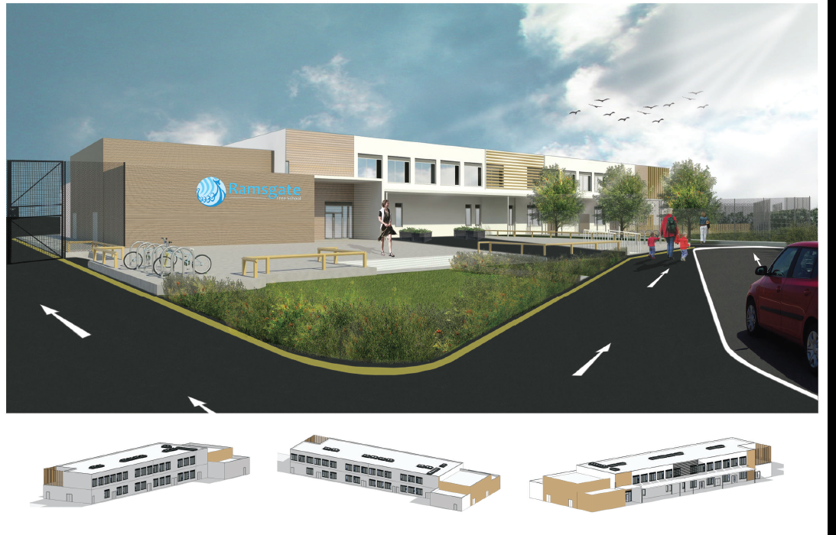
Our new building!

Slide 15
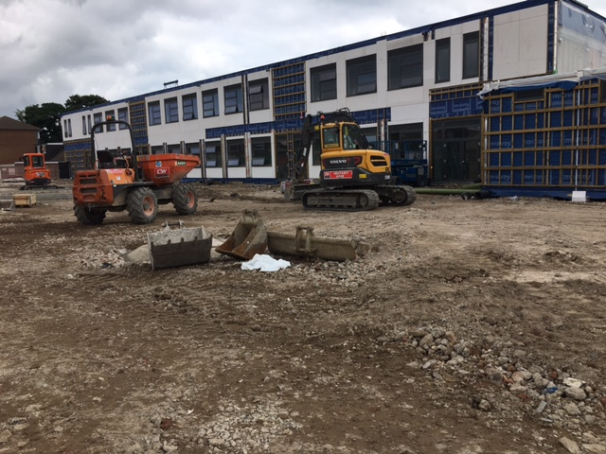

Slide 16

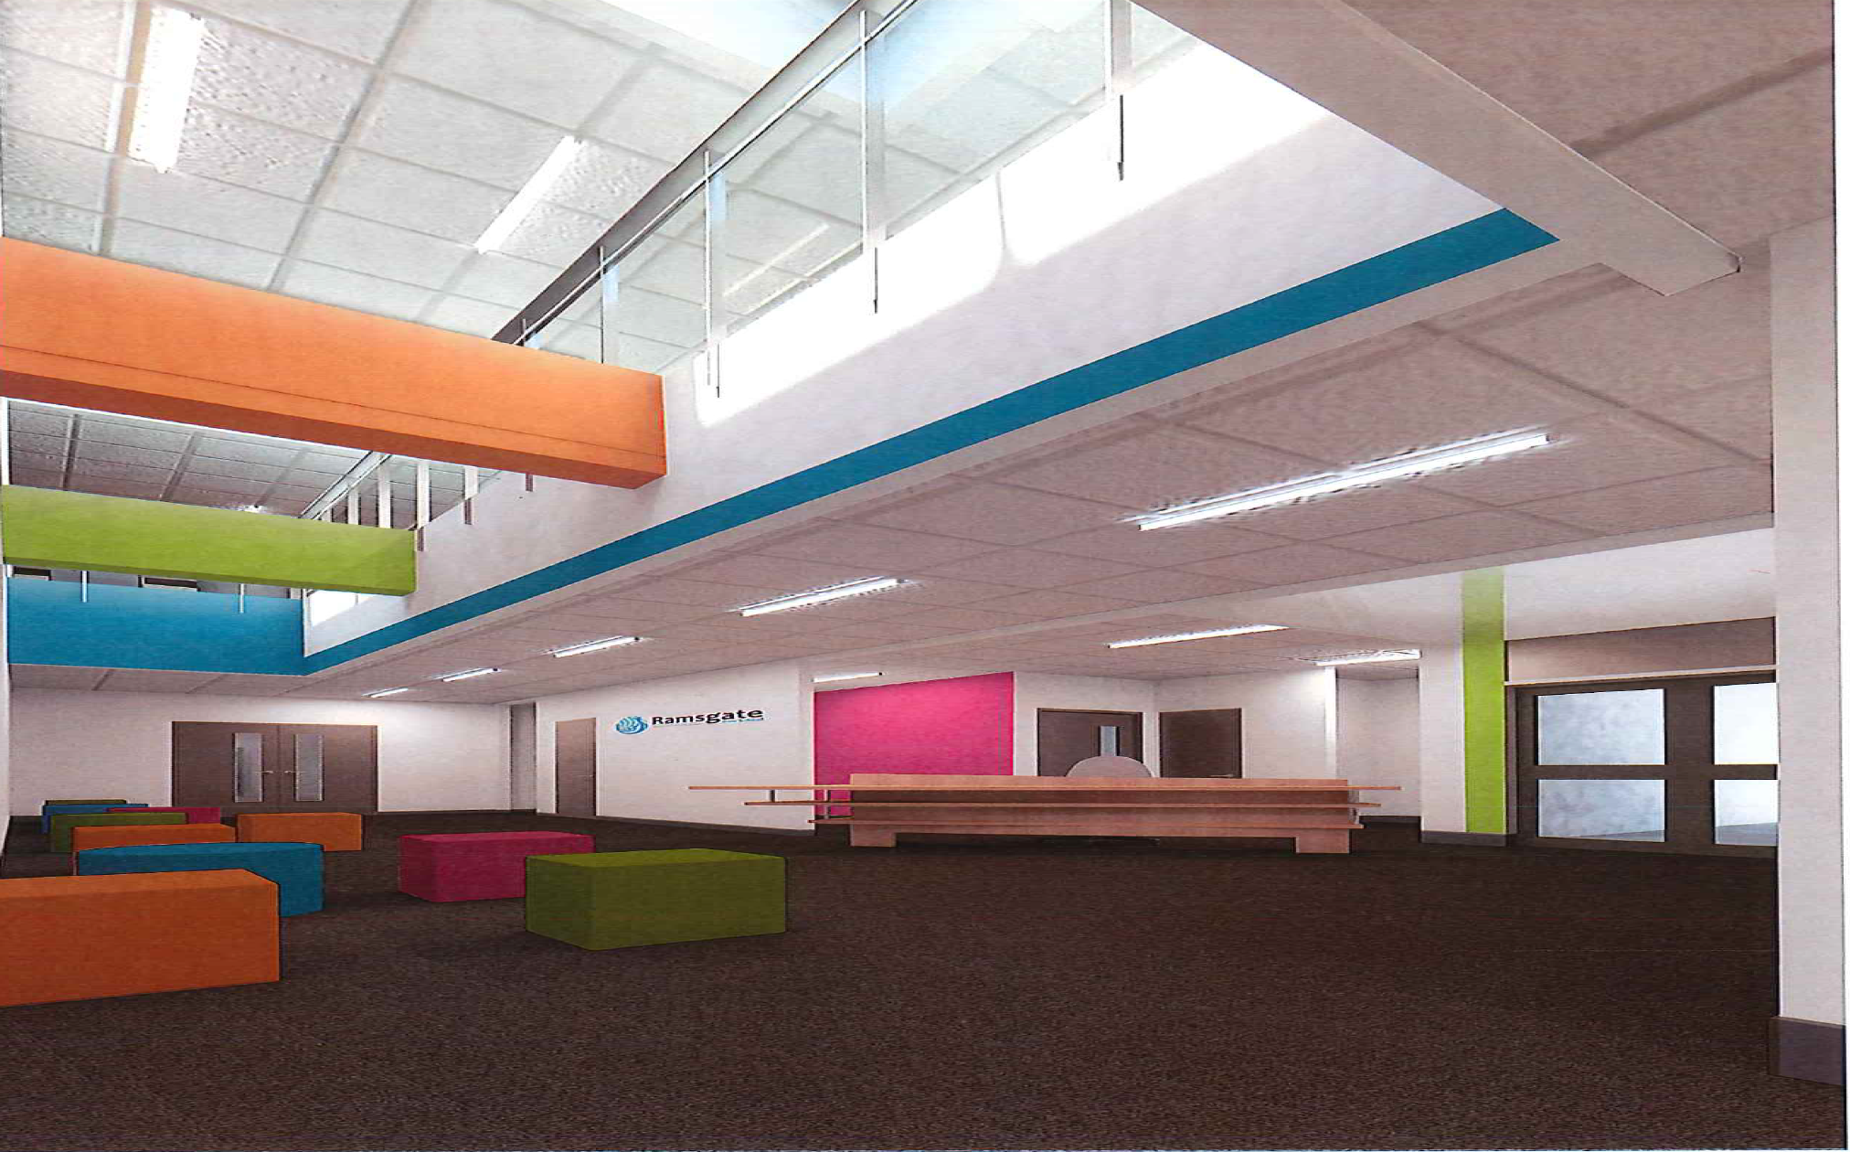
Our new building

Slide 17
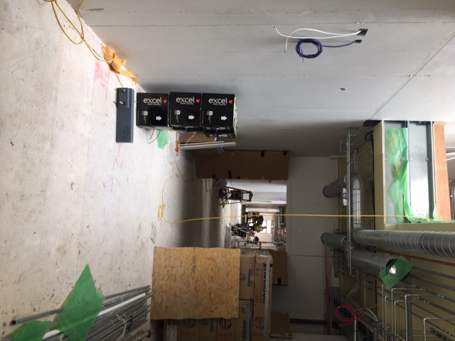

Slide 18
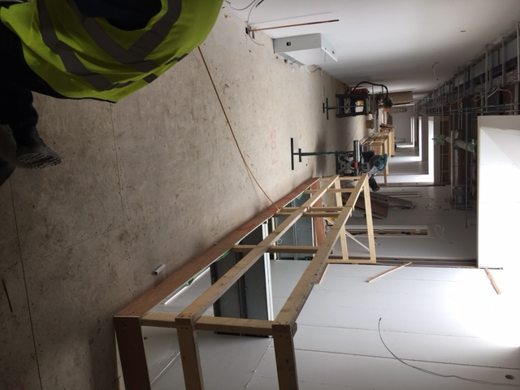

Slide 19
And Finally
We don’t always get it right... But we never, ever set out to get it wrong!
Please talk to us!

Slide 20
Classroom Visits
Team Richards
Team Beraet

Slide 21



