Slide 1
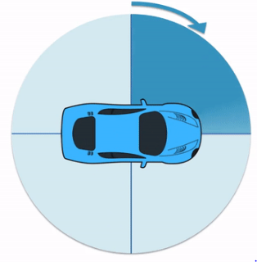
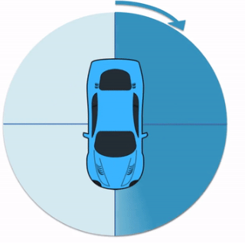
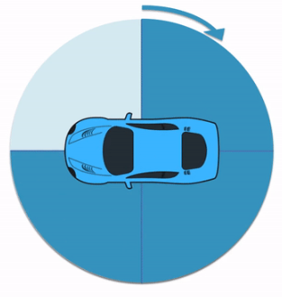
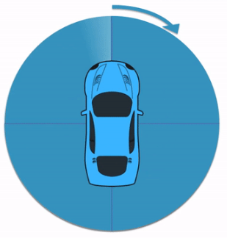
I am learning to describe turns.
¼
¼
¼
¼
½
½
¼
¼
¼
¼
quarter turn (¼)
three-quarter turn (¾)
full turn (whole)
half turn (½)

Slide 2
I recognise quarter turns.
Start
quarter turn

Slide 3
I recognise half turns.
Start
half turn

Slide 4
I recognise three-quarter turns.
Start
three-quarter turn

Slide 5
I recognise full turns.
Start
full turn

Slide 6


I am learning to make turns in both directions
Turn left
Turn right

Slide 7
I am learning to make turns in both directions
Start
Turn left

Slide 8
I am learning to make turns in both directions
Start
Turn right

