Slide 2
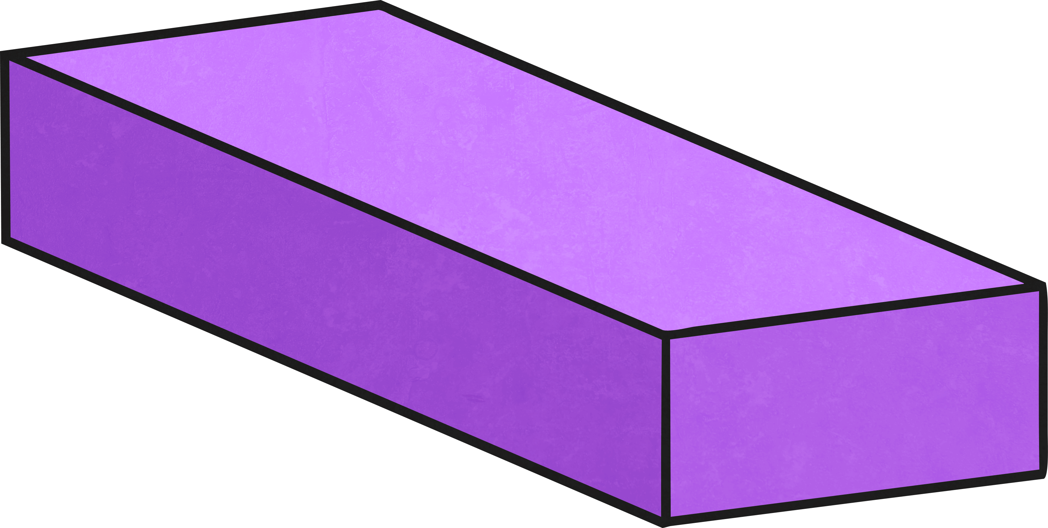
What is the name of this shape?
cuboid

Slide 3
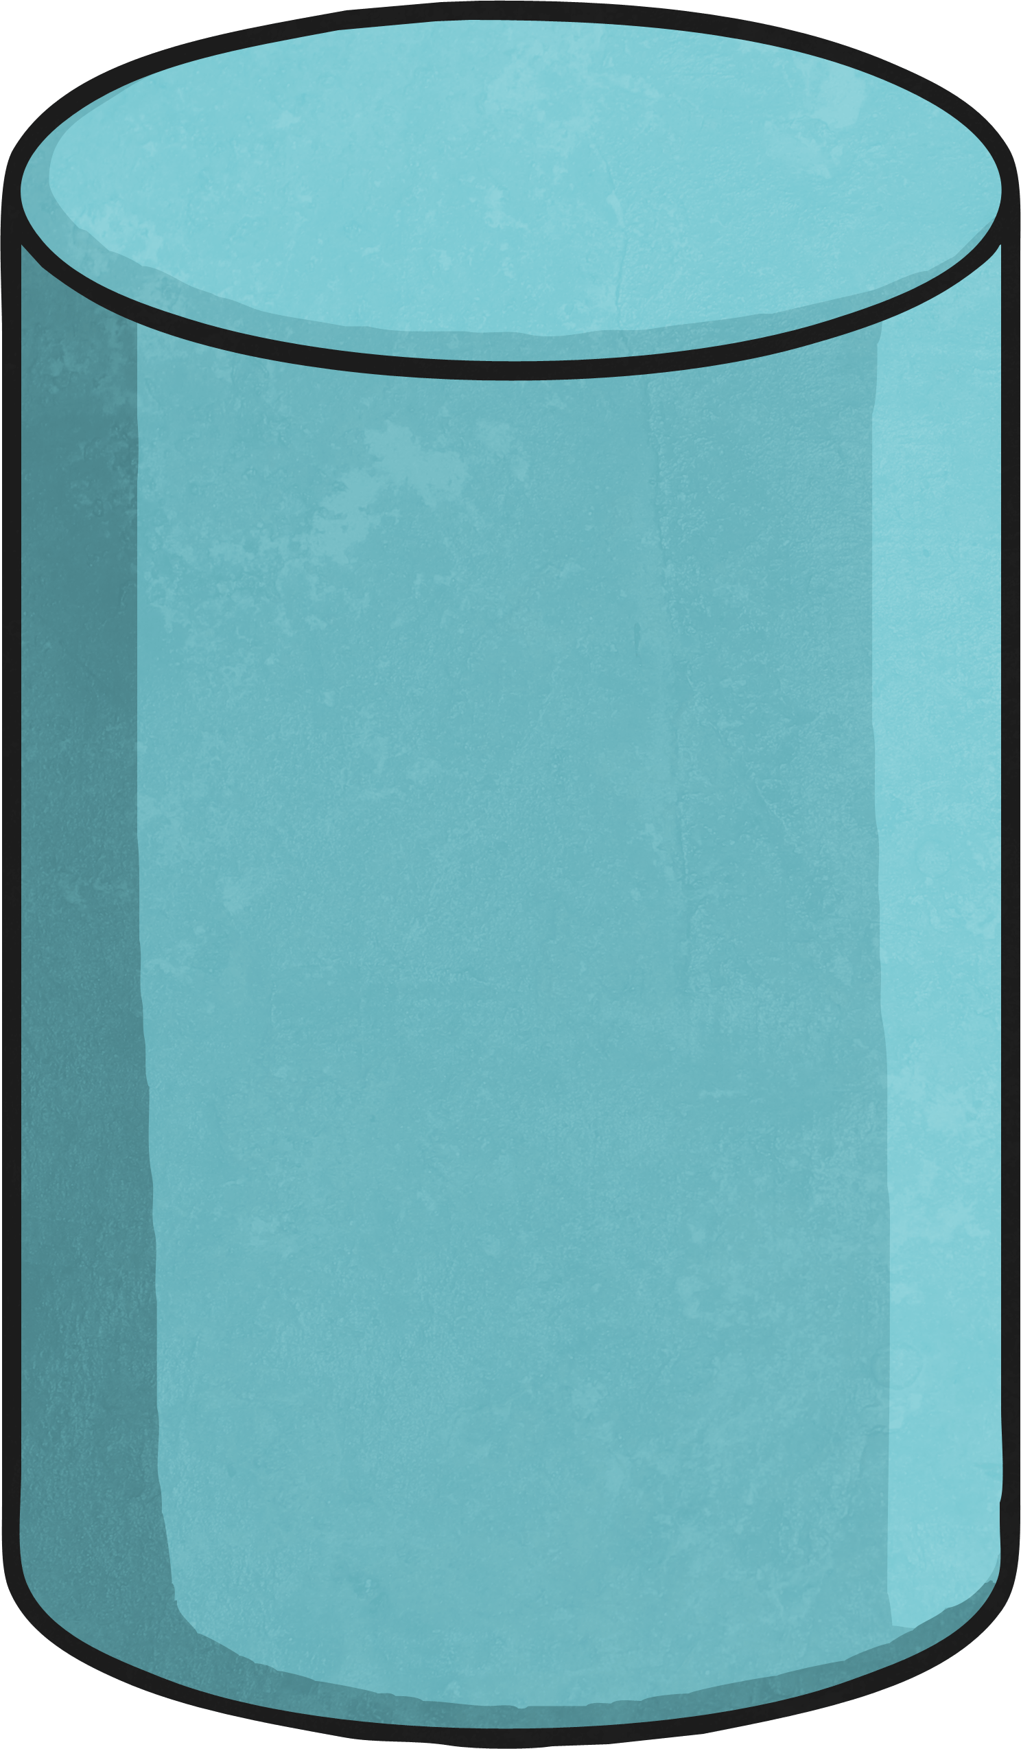
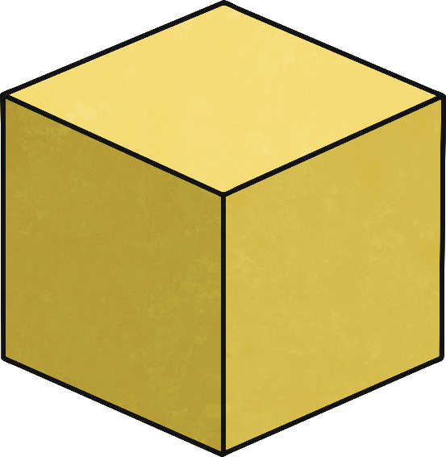
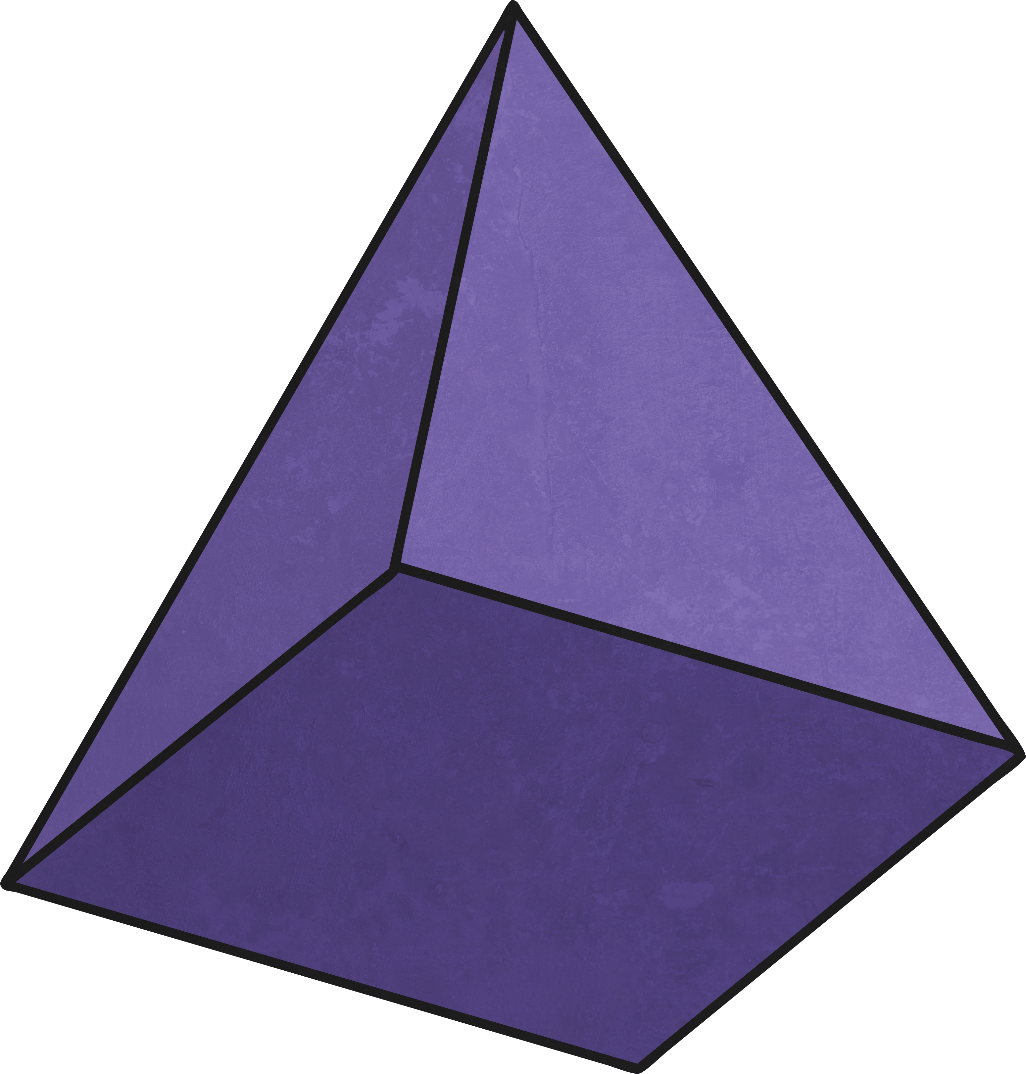
Which shape is the odd one out and why?
cylinder – It’s the only shape with a curved surface and curved edges.
Can you think of any other answers?

Slide 4
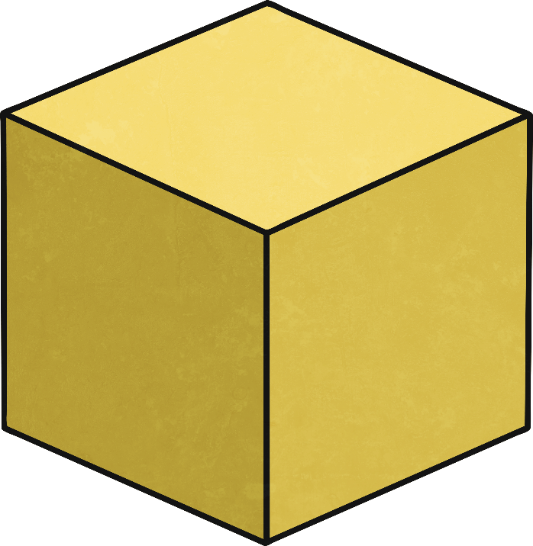
How many vertices does this shape have?
eight

Slide 5

These two shapes have the same amount of vertices. True or false?
true

Slide 6
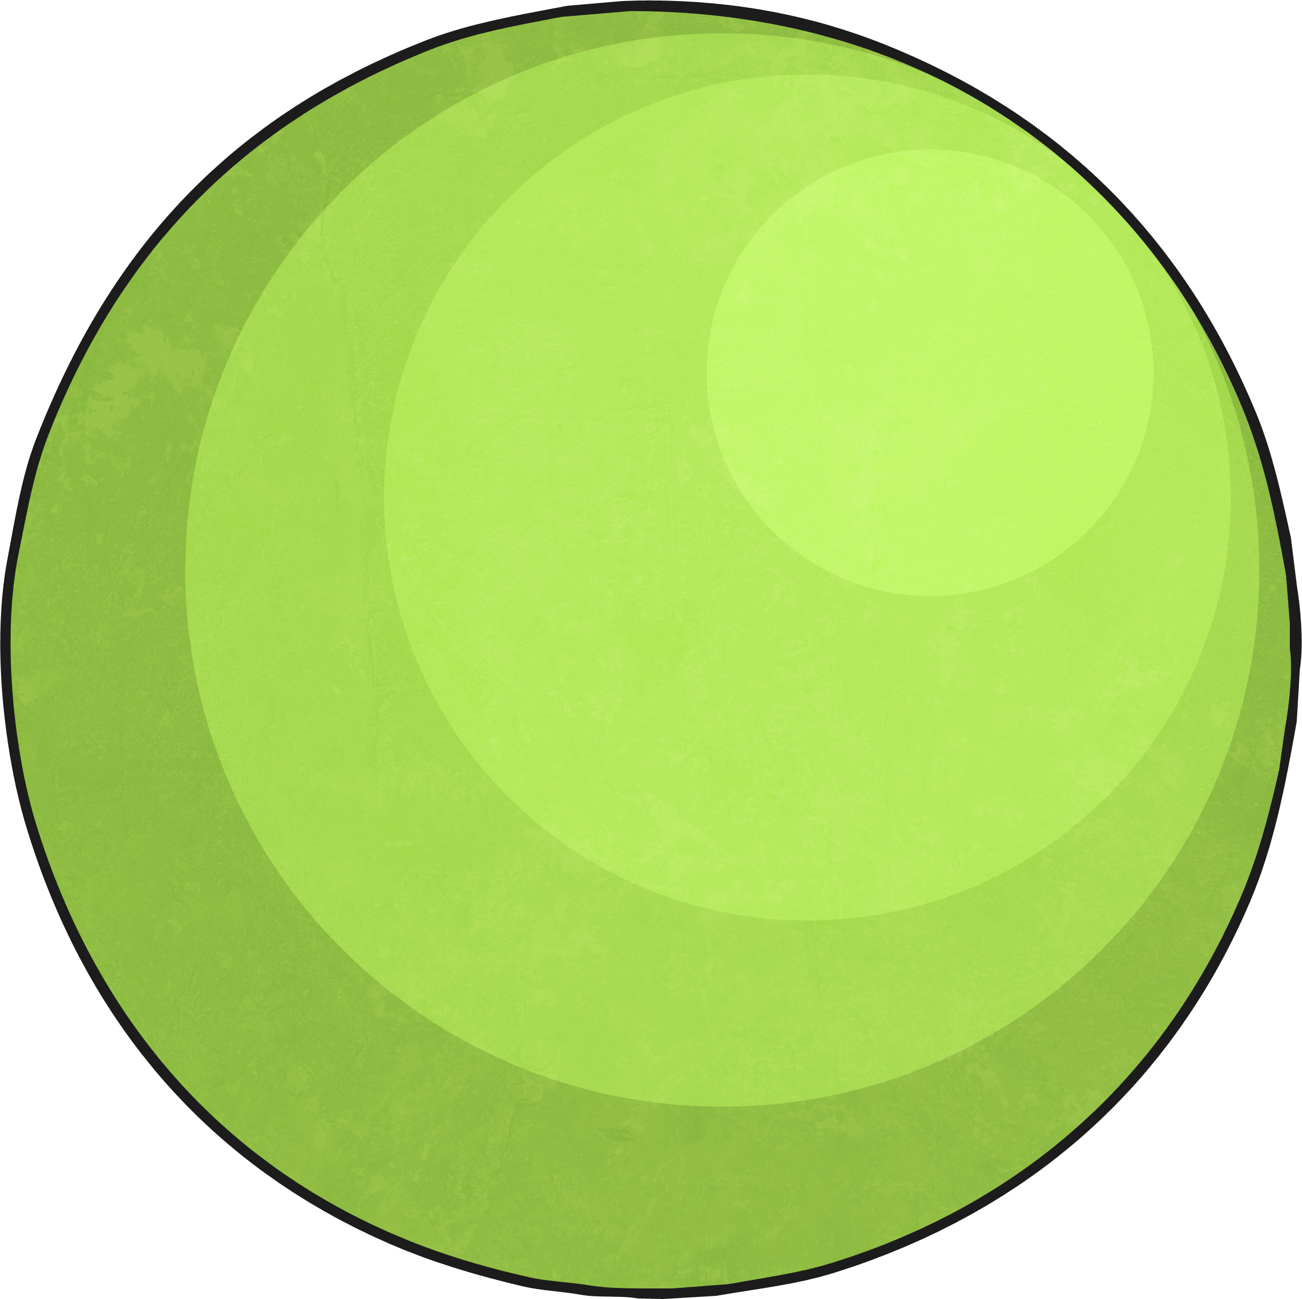
How many surfaces does this shape have?
one

Slide 7
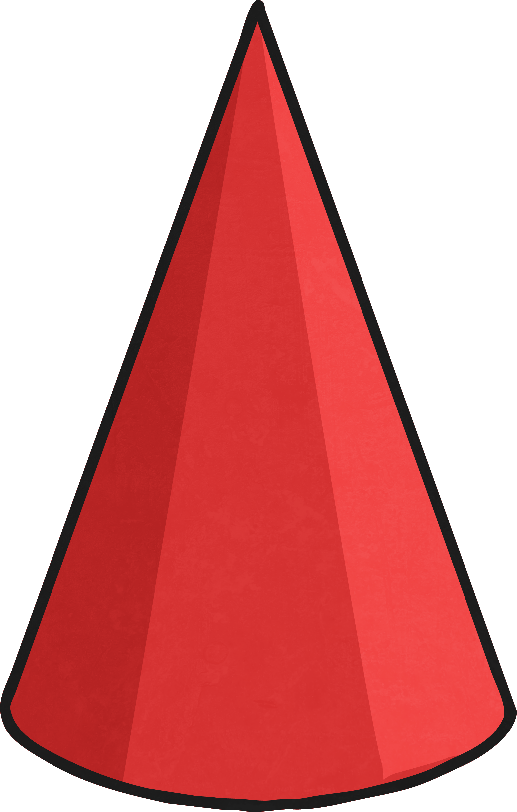
This shape has two surfaces.
True or false?
true

Slide 8
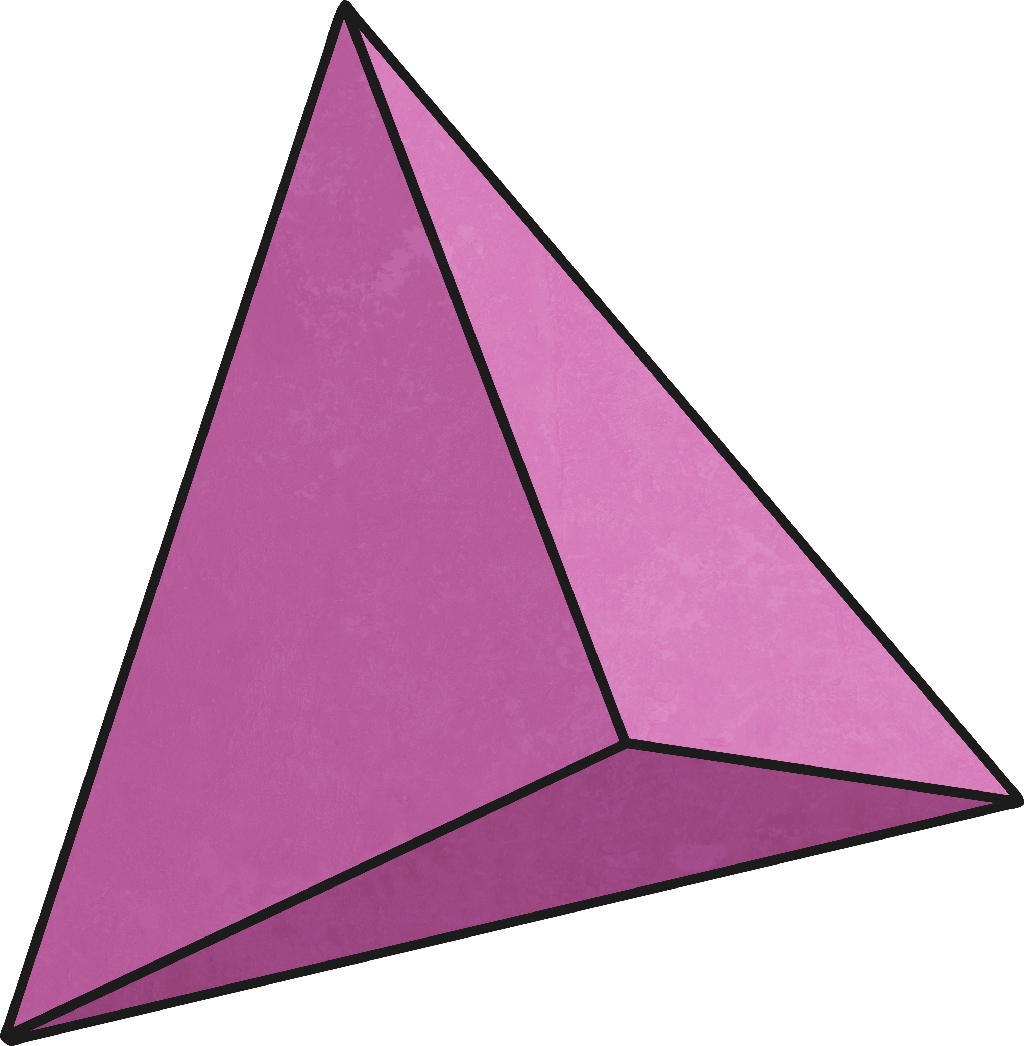
What is the name of this shape?
triangular-based pyramid

Slide 9
How many edges does this shape have?
eight

Slide 10
How many edges does this shape have?
zero

Slide 11
Which shape has the most surfaces?
cylinder

Slide 12
What is the name of this shape?
sphere

Slide 13
How many surfaces does this shape have?
six

Slide 14
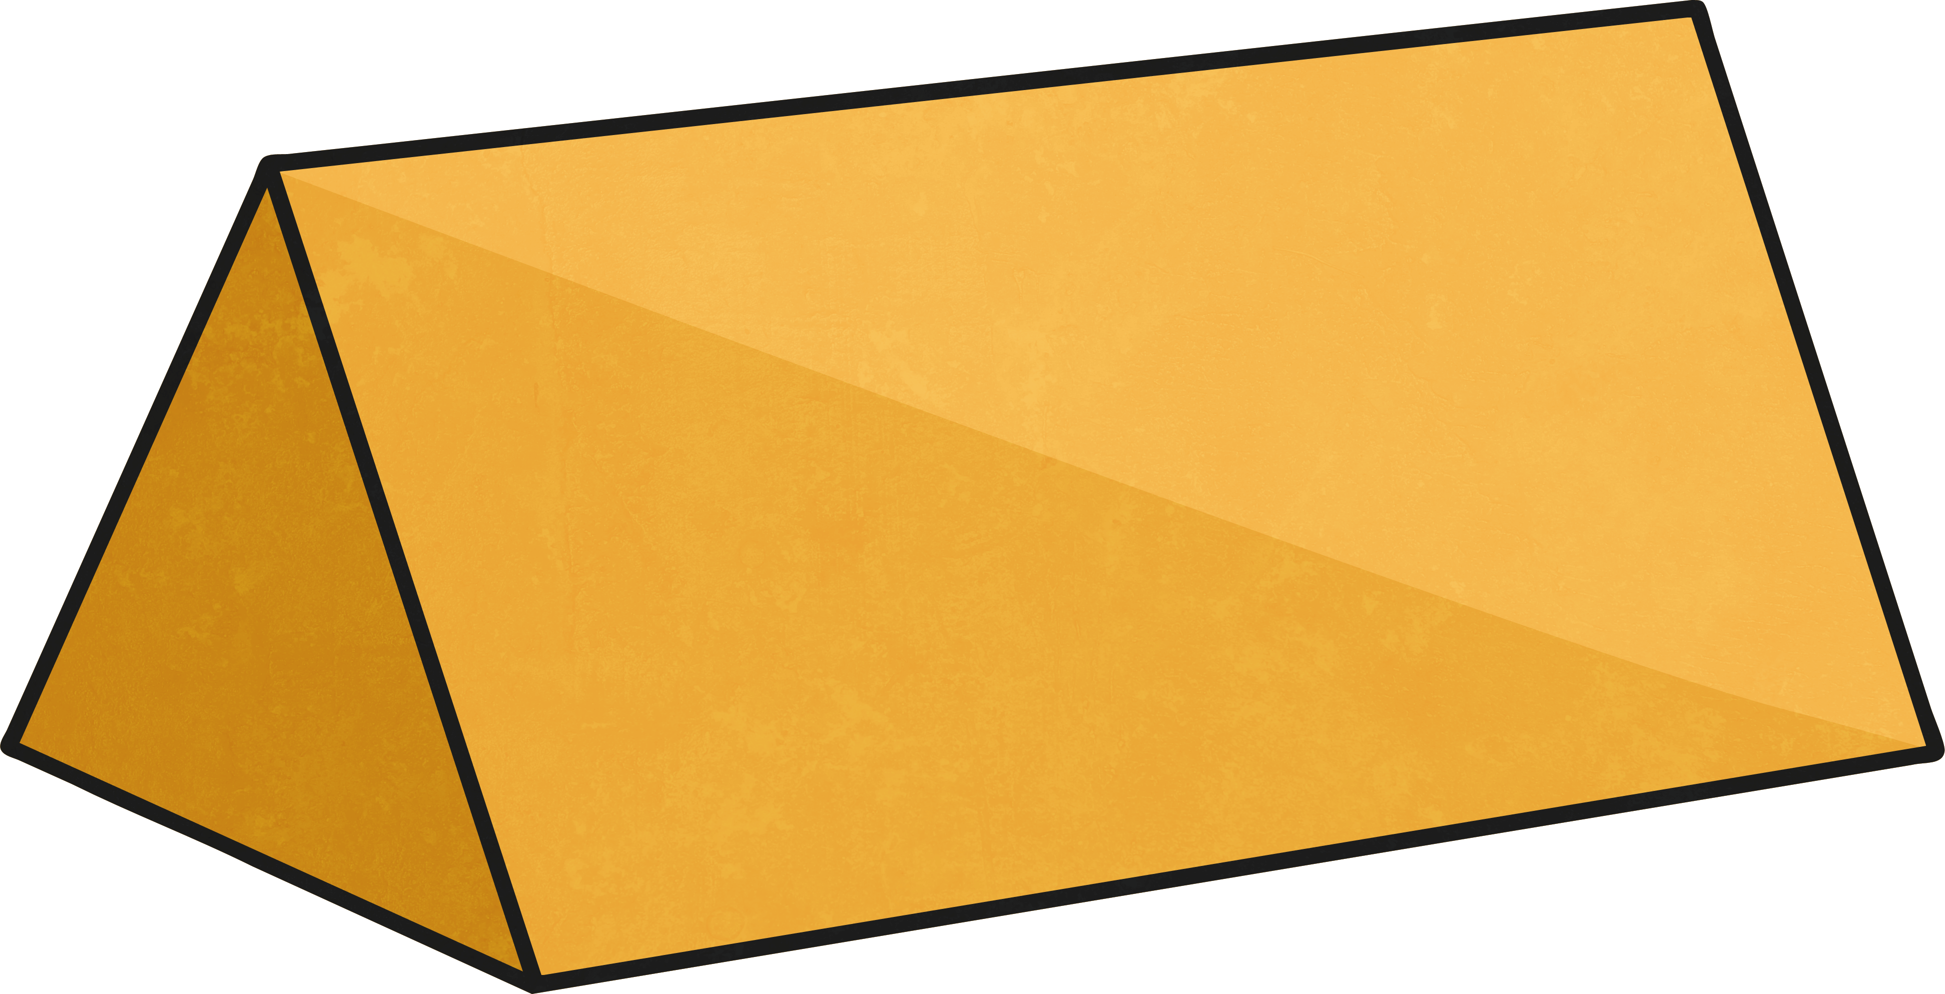
Which shape has the most edges?
triangular prism

Slide 15
How many surfaces do these two shapes have in total?
five

Slide 16
This shape has seven faces.
True or false?
false

Slide 17
What is the name of this shape?
cylinder

Slide 18
what is the name of this shape?
triangular prism

Slide 19
How many more surfaces does the cylinder have than the sphere?
two

Slide 20

How many more faces does a cube have than a square-based pyramid?
one

Slide 21
Which shape is the odd one out and why?
triangular prism – It’s the only shape without a curved surface.
Can you think of any other answers?

Slide 22
How many more edges has a square-based pyramid than a cylinder?
six

Slide 23
How many surfaces does this shape have?
five

Slide 24

How many vertices do these three shapes have in total?
seventeen

Slide 25
Which shape has the least amount of faces?
sphere

Slide 26

Which shape has the least amount of surfaces?
triangular-based pyramid

Slide 27
Which shape has the least amount of faces?
triangular-based pyramid

Slide 28
How many edges does a triangular-based pyramid have?
six

Slide 29
How many edges in total do these two shapes have?
three

Slide 30
Which shape has the least amount of edges?
cone

Slide 31

Which shape is the odd one out and why?
cube – It’s the only shape without a triangular surface.
Can you think of any other answers?

