Slide 1
Instructions

Slide 2
What are Instructions?
Why do we need them?

Slide 3
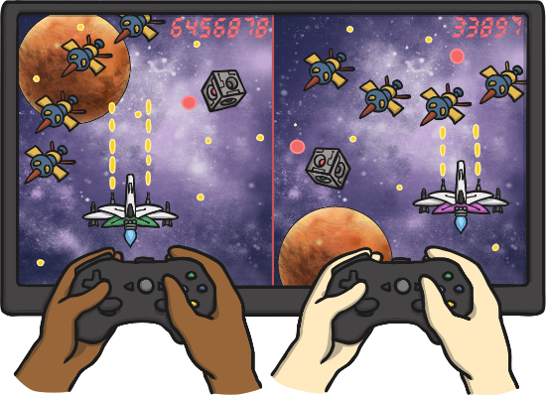
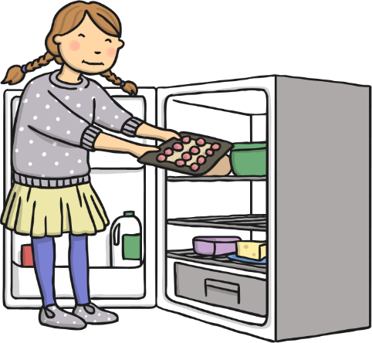
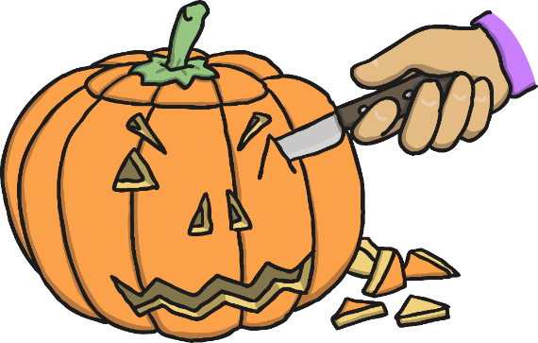
Instructions tell us how to do something.
How to play games
How to make things
Recipes

Slide 4



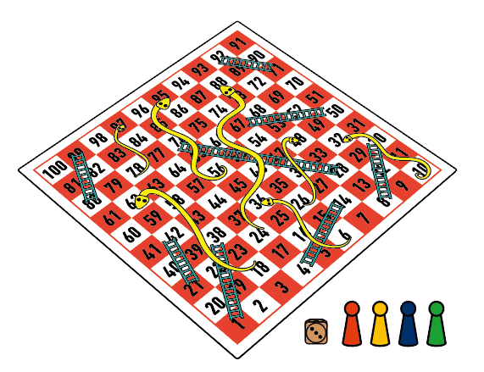
How to grow a sunflower
How to make a pepperoni pizza
How to play Snakes and Ladders
How to play snakes and ladders

Slide 5
Features of Instructions
Title (what are you giving instructions on)
Things you need (a list of what you need)
Method:
  Numbered instructions
  Time words in order (First, then, next, finally)
  Bossy words (put, take, add)

Slide 6

Can you spot all the features in these instructions:
How to make a Halloween Mask [Title]

Slide 7



You will need: [List of what you need]
Card
Felt tips
Scissors
Lollipop stick
Tape

Slide 8
How to make [Method using numbers, time words and bossy words]
1. First draw the design on the card
2. Then colour the mask with felt tips.
3. Next cut out the mask outline.
4. After cut eye holes.
5. Finally stick the lollipop stick to the back with
the tape.

