Slide 1


Secondary Transfer Meeting
Thursday 4th October
One Childhood, One Chance
Together we make a difference

Slide 11
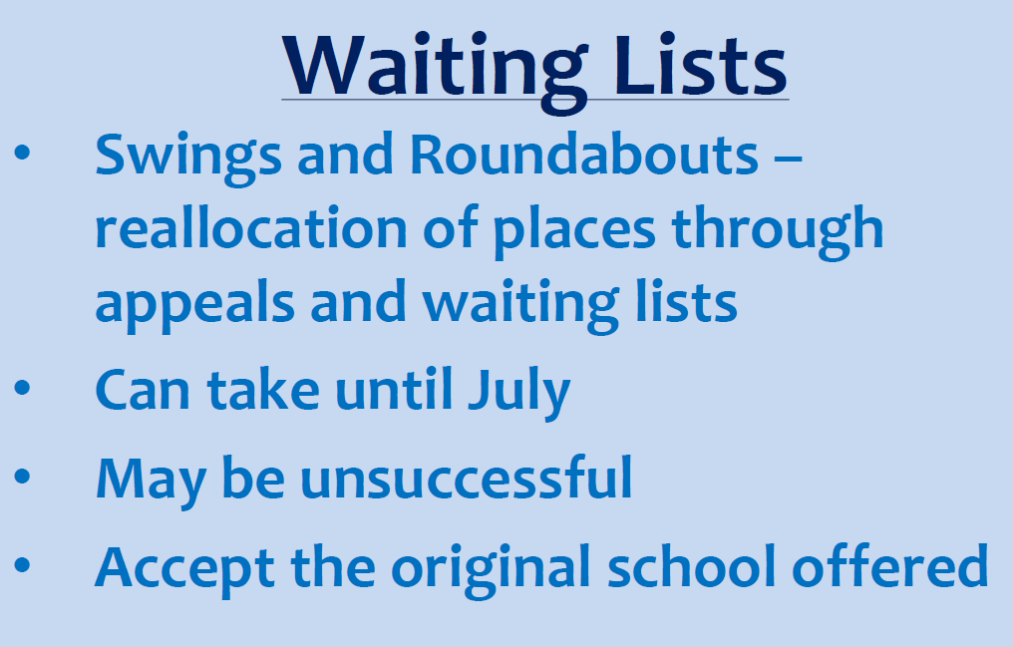

Slide 14


