Slide 1


Year 3 – Summer Block 3 – Geometry
Step 5: Horizontal and Vertical
© Classroom Secrets Limited 2018

Slide 2
Introduction
How many horizontal lines do you see?
How many vertical lines do you see?
Can you write a definition for both?
© Classroom Secrets Limited 2018

Slide 3
Introduction
There are 5 horizontal lines.
Horizontal lines run left to right or right to left.
© Classroom Secrets Limited 2018

Slide 4
Introduction
There are 6 vertical lines.
Vertical lines run up and down.
© Classroom Secrets Limited 2018

Slide 5
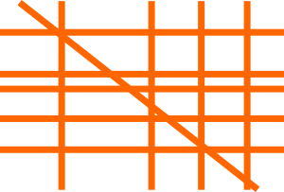
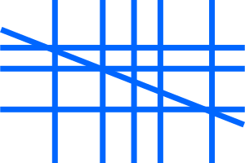
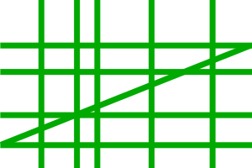
Varied Fluency 1
Which of the images below has the most horizontal lines?
© Classroom Secrets Limited 2018

Slide 6
Varied Fluency 1
Which of the images below has the most horizontal lines?
5
3
4
© Classroom Secrets Limited 2018

Slide 7
Varied Fluency 3
Which of these shapes has a vertical line of symmetry?
F
© Classroom Secrets Limited 2018

Slide 8
Varied Fluency 3
Which of these shapes has a vertical line of symmetry?
F
© Classroom Secrets Limited 2018

Slide 9

Reasoning 1
Justine is waiting for the hour hand of the clock to make a horizontal line. This is the time now:
Explain how long she will have to wait for a horizontal hour hand.
© Classroom Secrets Limited 2018

Slide 10
Reasoning 1
Justine is waiting for the hour hand of the clock to make a horizontal line. This is the time now:
Explain how long she will have to wait for a horizontal hour hand.
The next time the hour hand will be horizontal is at… so she will have to wait…
© Classroom Secrets Limited 2018

Slide 11
Reasoning 1
Justine is waiting for the hour hand of the clock to make a horizontal line. This is the time now:
Explain how long she will have to wait for a horizontal hour hand.
The next time the hour hand will be horizontal is at 9:00 so she will have to wait 1 hour and 50 minutes after the time shown.
© Classroom Secrets Limited 2018

Slide 12
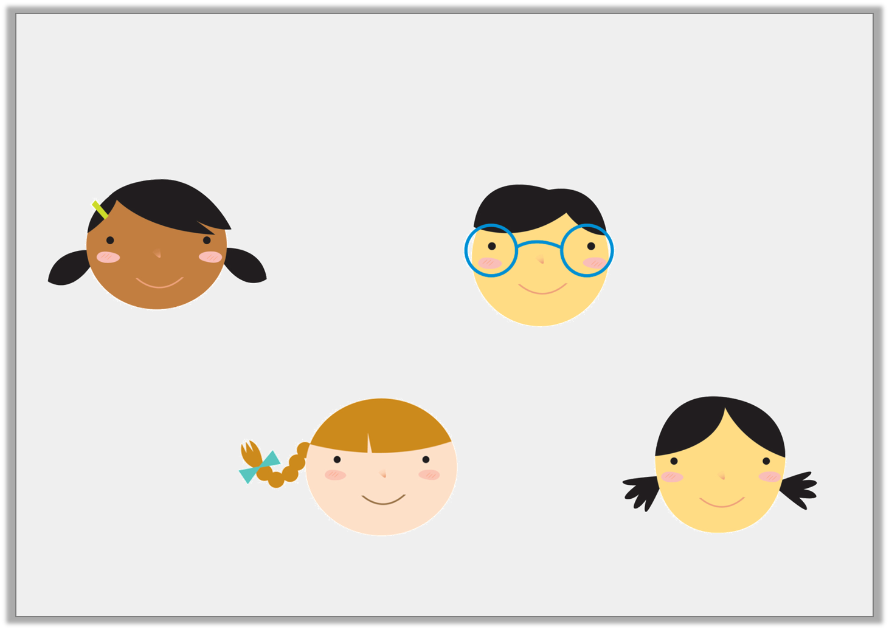
Problem Solving 1
Anna and her friends are writing their names in capital letters. Which friend has more vertical lines in the letters of their name than Anna?
ANNA
BILL
TANYA
KYLIE
© Classroom Secrets Limited 2018

Slide 13
Problem Solving 1
Anna and her friends are writing their names in capital letters. Which friend has more vertical lines in the letters of their name than Anna?
ANNA
BILL
4
4
TANYA
KYLIE
4
5
© Classroom Secrets Limited 2018

Slide 14
Reasoning 2
Which of these shapes is the odd one out when it comes to lines of symmetry? Explain your answer.
T
+
© Classroom Secrets Limited 2018

Slide 15
Reasoning 2
Which of these shapes is the odd one out when it comes to lines of symmetry? Explain your answer.
The addition sign is the odd one out. It is the only shape with both a horizontal and a vertical line of symmetry.
T
+
© Classroom Secrets Limited 2018

