Slide 1


Slide 2
Aim
I can compare the Amazon Rainforest and Sherwood Forest.
Success Criteria
I can tell you some similarities between the Amazon Rainforest and Sherwood Forest.
I can tell you some differences between the Amazon Rainforest and Sherwood Forest.

Slide 3


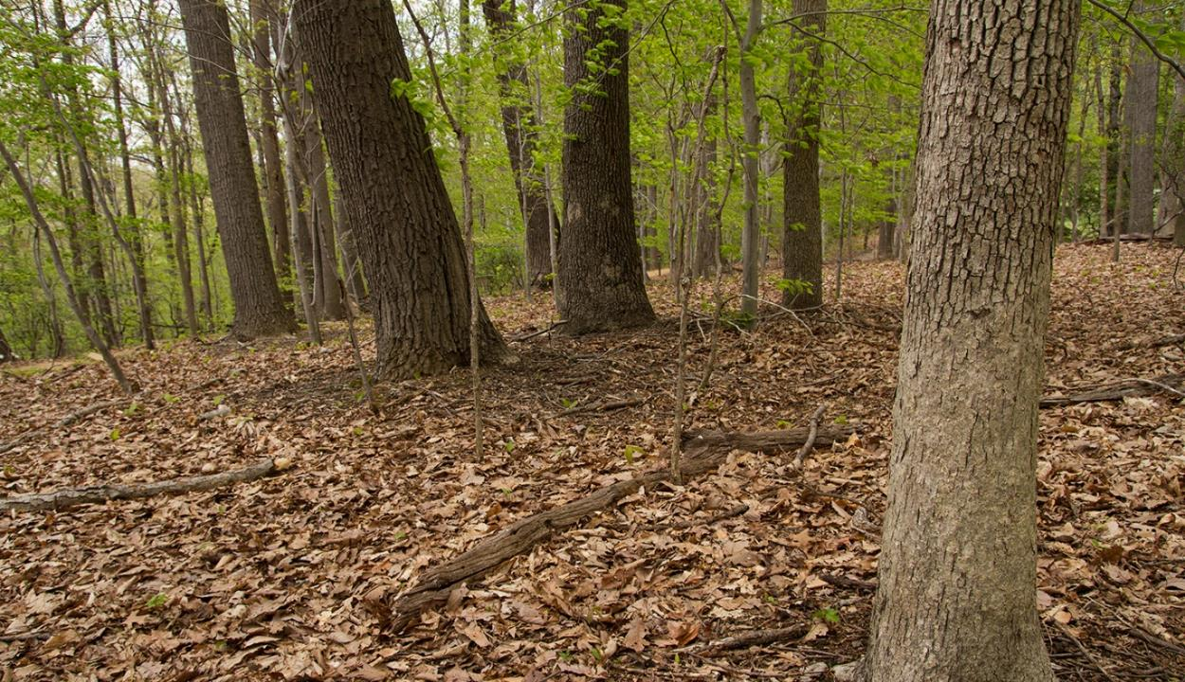
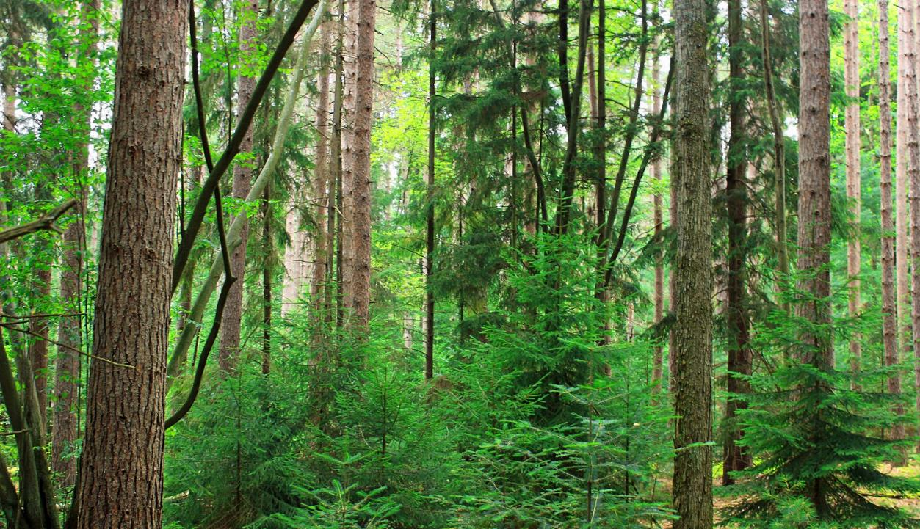
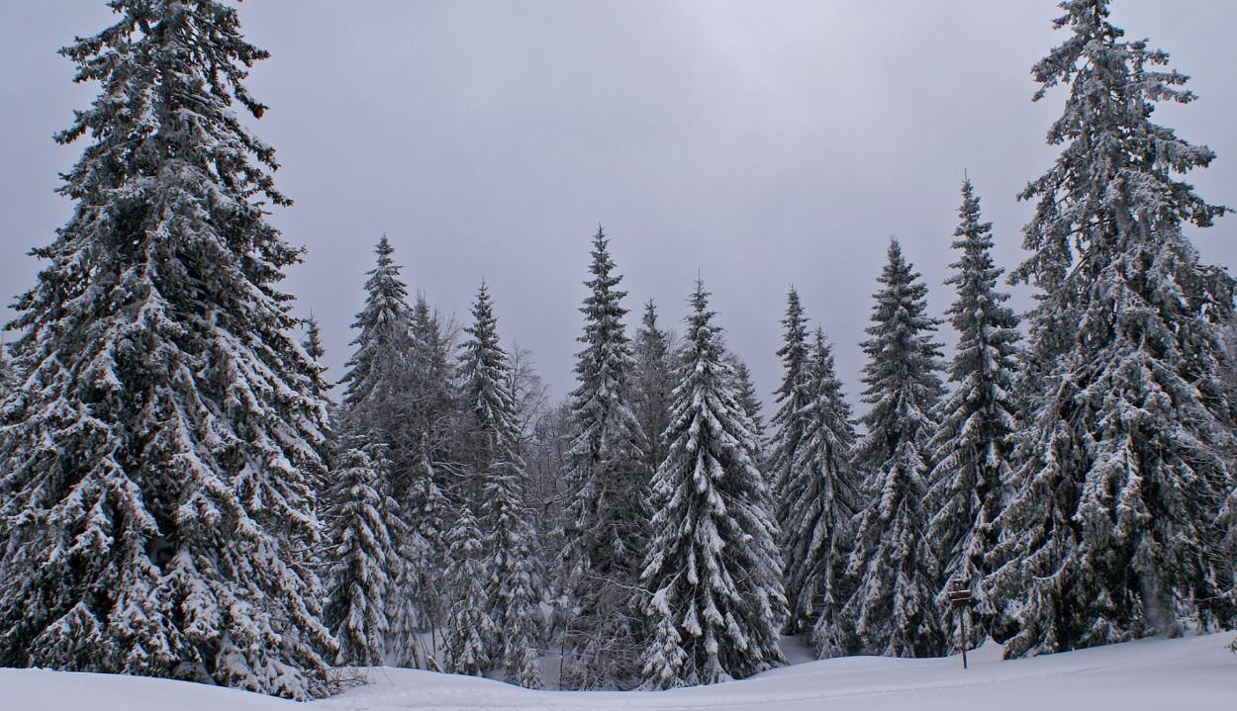
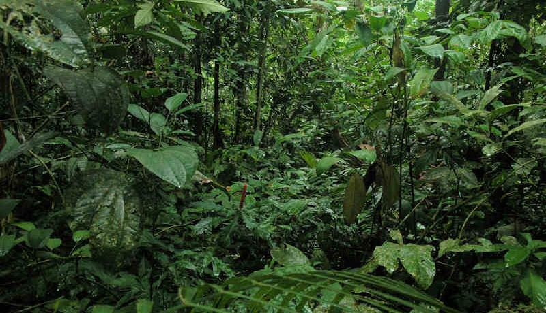
Types of Forests
There are four main types of forests around the world:
temperate coniferous forest
temperate deciduous forest
boreal forest
tropical rainforest

Slide 4

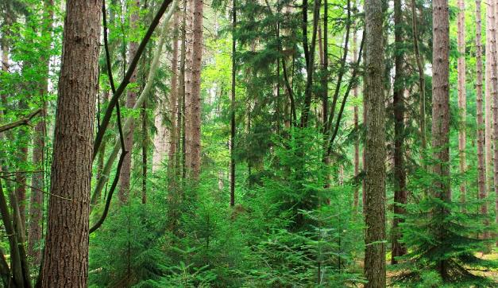

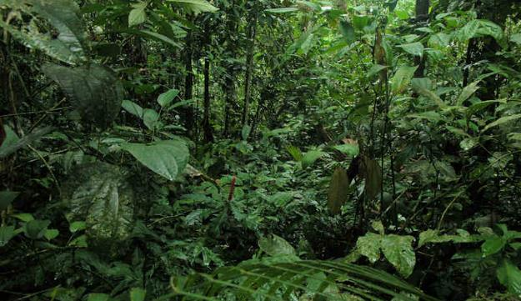
Types of Forests
Which kinds of forest do we find in the UK? Which ones are not found in the UK?
temperate deciduous forest
temperate coniferous forest
boreal forest
tropical rainforest

Slide 5
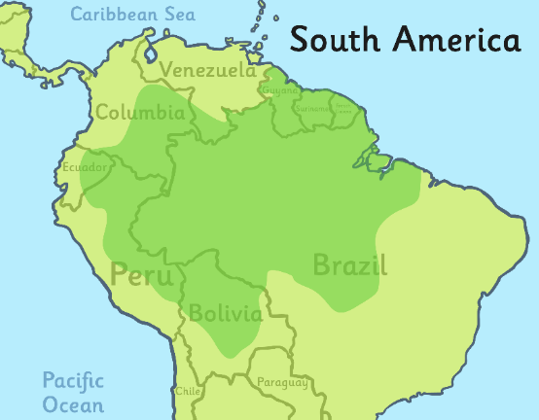

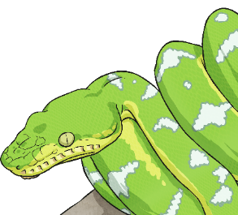
The Amazon Rainforest
The Amazon is 5,500,000 square kilometres of rainforest, with parts in Brazil, Peru , Colombia , Venezuela, Ecuador, Bolivia, Guyana, Suriname and French Guiana.
It previously covered a much larger area and was densely populated.
Home to about 2.5 million insect species, tens of thousands
of plant species, and
over 2,000 species
of birds and
mammals.
Around 2 million tourists visit each year.
Watch this video showing scenes and sounds from the Amazon Rainforest.

Slide 6
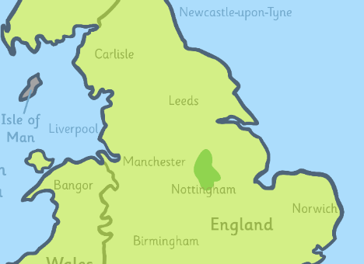
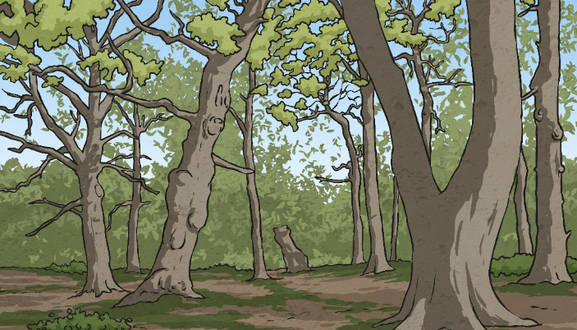
Sherwood Forest
Sherwood forest is 4.23 square kilometres of forest in Nottinghamshire, UK. It previously covered a much larger area, including some of Derbyshire. Its now designated a Special Area of Conservation and is a Country park run by Nottinghamshire County Council. The River Idle passes through it, before joining the River Trent. Sherwood Forest attracts over 500,000 visitors every year.
Home to the Major Oak, a tree between 800 and 1000 years old and thought to be Robin Hood’s hideout.
This video shows you Clumber Park (part of Sherwood Forest) from the air.

Slide 7

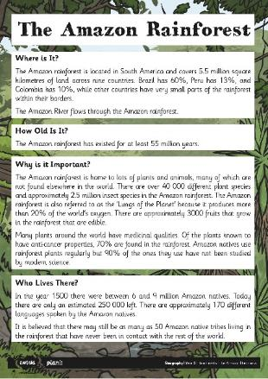
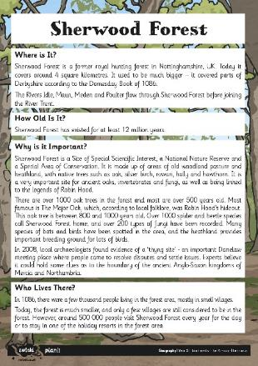
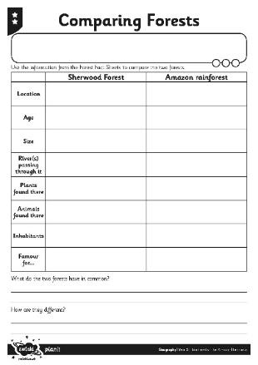
Comparing Forests
How are Sherwood Forest and the Amazon Rainforest similar?
How are they different?
Sherwood forest is 4.23 square kilometres of forest in Nottinghamshire, UK. It previously covered a much larger area, including some of Derbyshire. Its now designated a Special Area of Conservation and is a Country park run by Nottinghamshire County Council. Rive Idle passes through it, before joining the River Trent. Sherwood Forest attracts over 500,000 visitors every year.

Slide 8


Comparing Forests
Look at your work. What things did you notice that the two forests have in common?
Sherwood forest is 4.23 square kilometres of forest in Nottinghamshire, UK. It previously covered a much larger area, including some of Derbyshire. Its now designated a Special Area of Conservation and is a Country park run by Nottinghamshire County Council. Rive Idle passes through it, before joining the River Trent. Sherwood Forest attracts over 500,000 visitors every year.
Do you think all forests would have these features?
Explain to a parent / guardian which features you think all forests would have.

