Slide 2
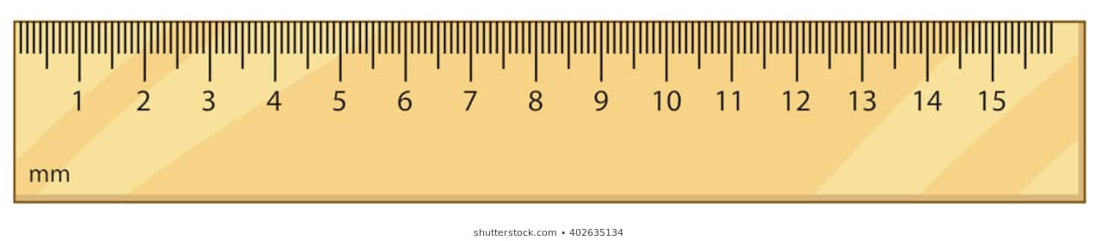
Look at a ruler
This is 1 millimetre (mm)
There are 10 millimetres (mm) in a centimetre (cm)
This is 1 centimetre (cm)

Slide 3
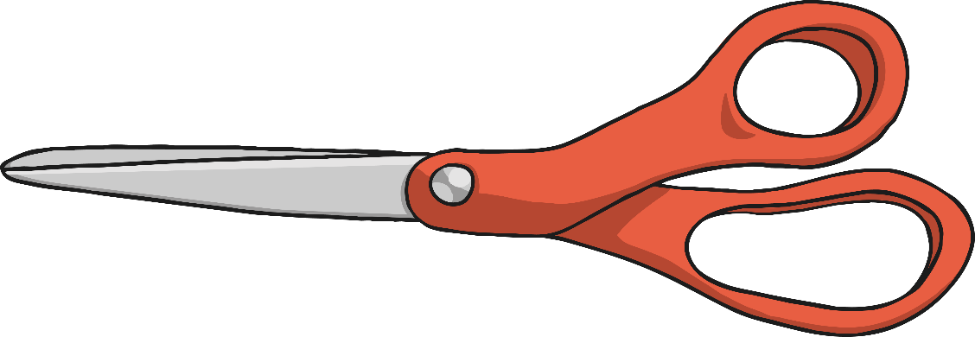
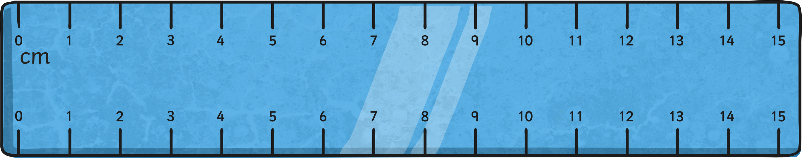
Step 1
Place the 0cm mark on the ruler at one end of the object you are measuring. Make sure you are using the centimetre scale (some rulers have inches too). Do not measure from the end of the ruler.

Slide 4
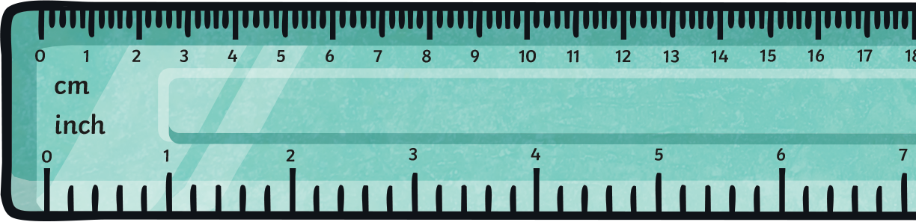
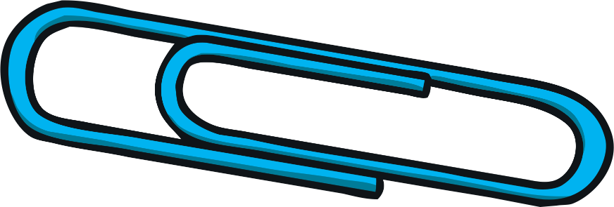
Step 2
To find the length of the object to the nearest centimetre, round the length up or down to the nearest number on the ruler.

Slide 5
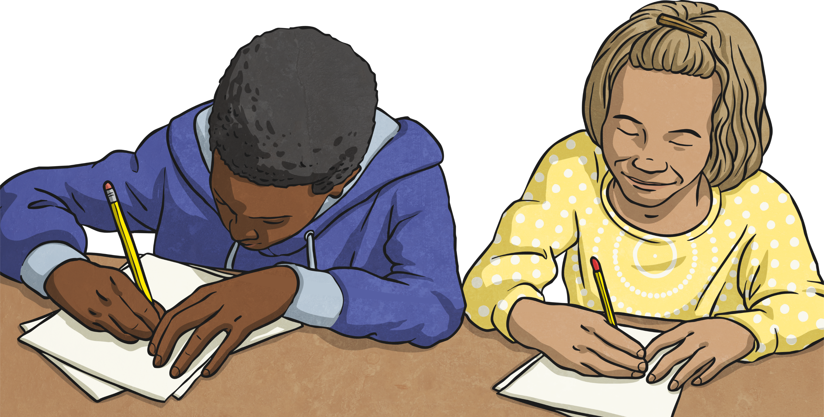
Step 3
Write down the length of the object in centimetres.

