Slide 1
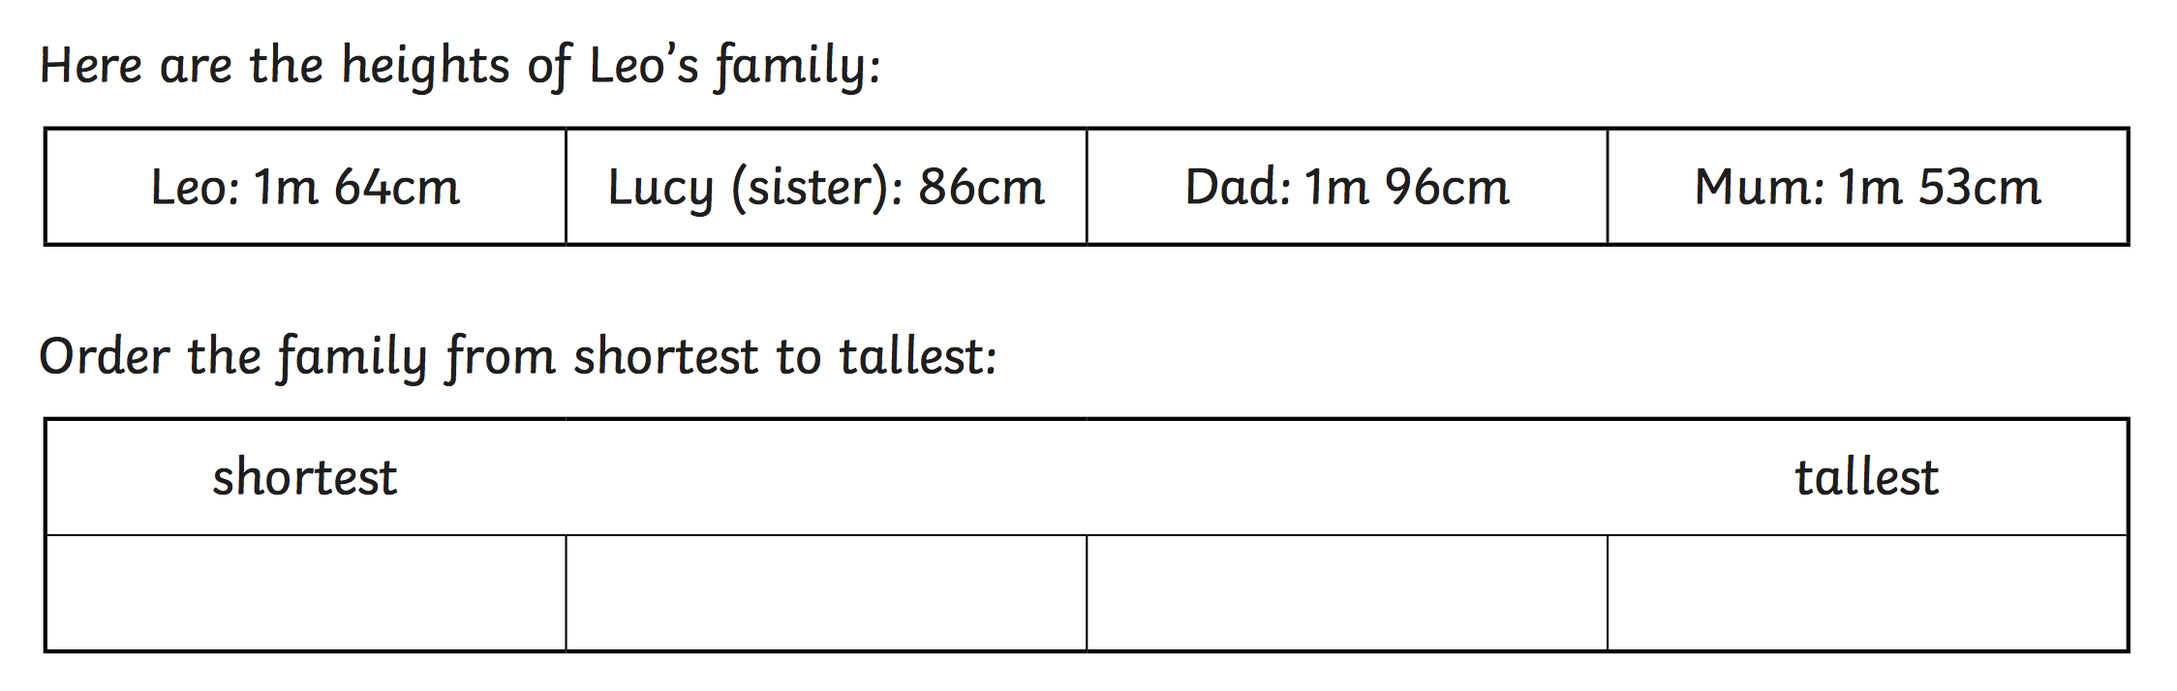
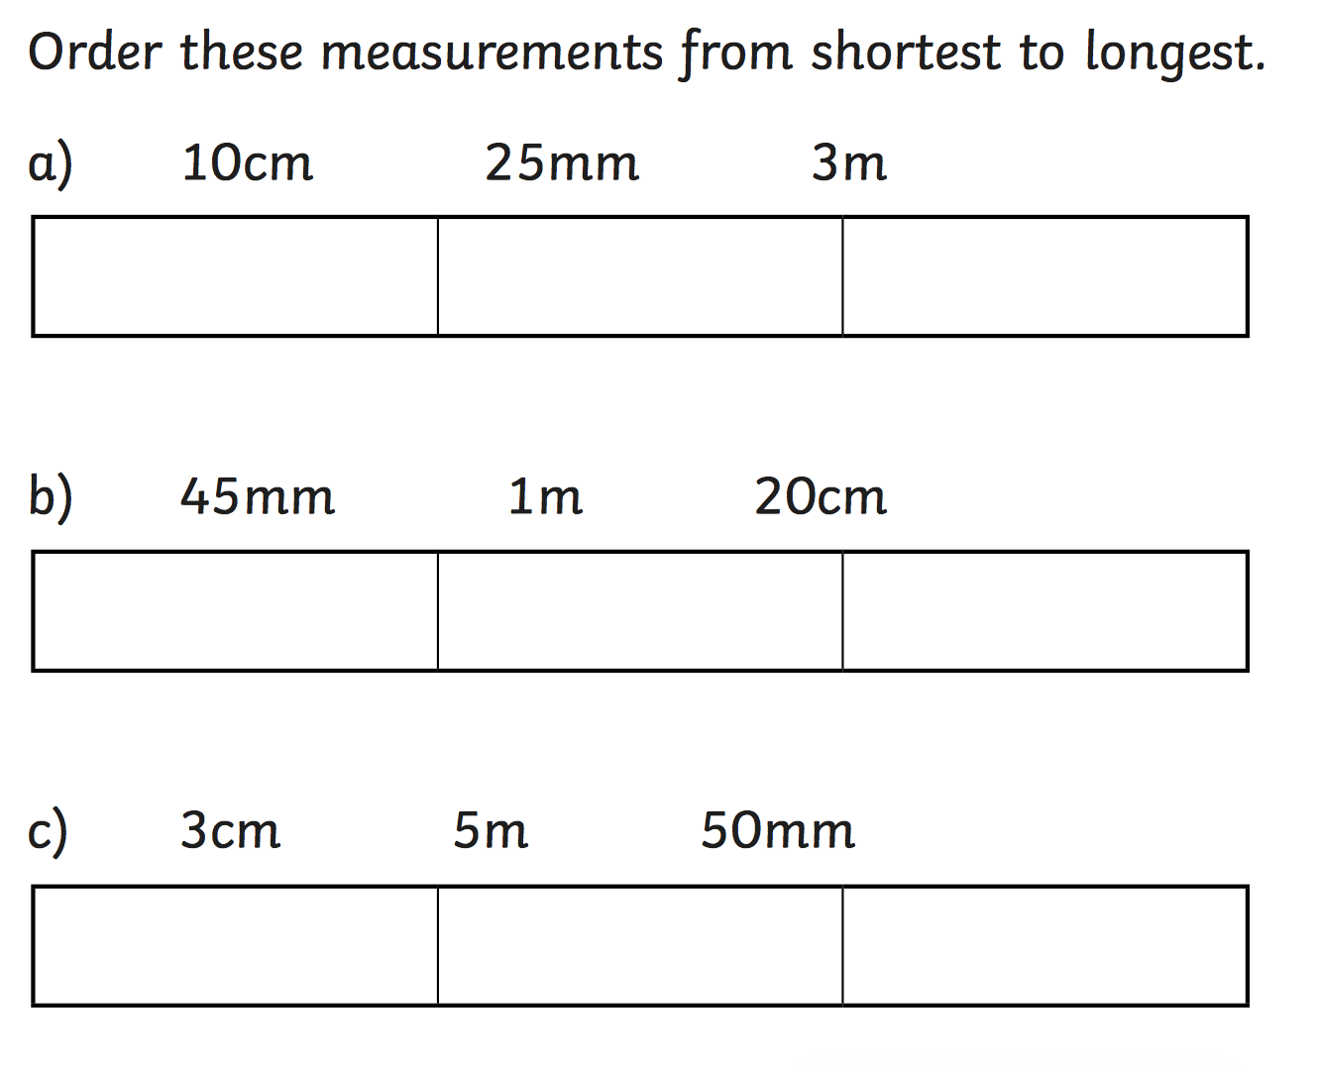
`
Lesson Continuation: IALT: Compare and order lengths.
Write in measurements that would make the <, > and = signs correct.
cm | < | cm
cm | > | cm
cm | = | mm
mm | < | cm
m | > | m
m | = | cm
m | > | cm

Slide 2
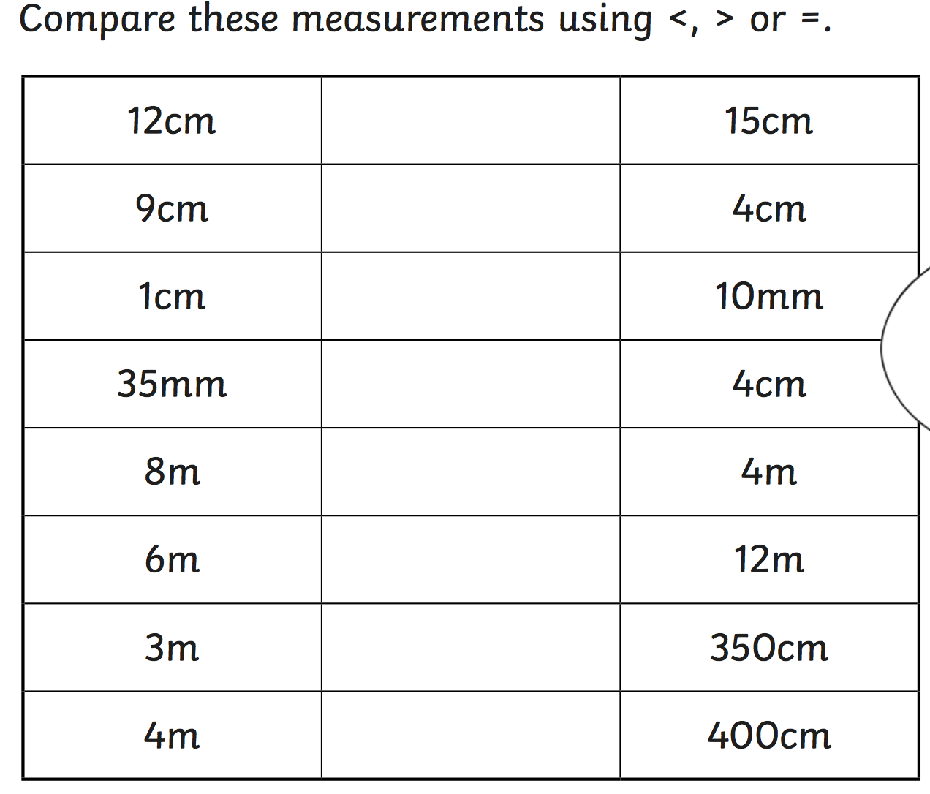
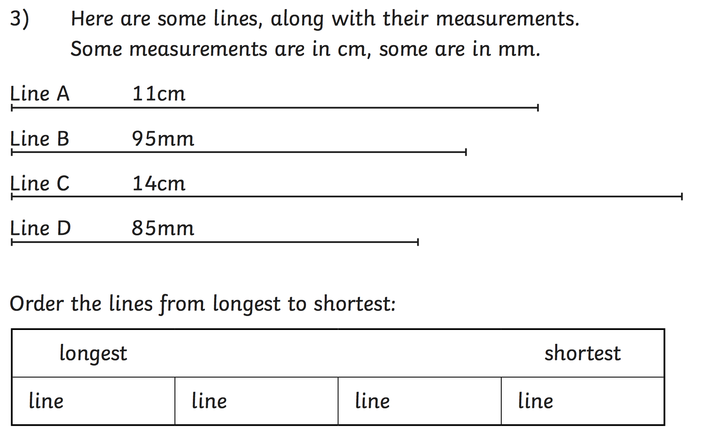
`
Lesson Continuation: IALT: Compare and order lengths.
Order these measurements from the shortest to the longest.
A. 12 cm 70 mm 4 m
B. 10 mm 15m 100cm

Slide 3
`
Lesson Continuation: IALT: Compare and order lengths.
Write in measurements that would make the <, > and = signs correct.
5cm |  | 10 cm
15cm |  | 45cm
3mm |  | 30mm
83mm |  | 32mm
4m |  | 54cm
100mm |  | 3cm
9m |  | 900cm
Order these measurements from the shortest to the longest.
A. 15 cm 15 mm 15 m
B. 1 mm 1m 1cm

