Slide 1


I can locate numbers
on a number line
© Classroom Secrets Limited 2018

Slide 2
Introduction
Put the digit cards in order from zero to ten.
5
9
1
4
0
3
7
10
8
6
2
© Classroom Secrets Limited 2018

Slide 3
Introduction
Put the digit cards in order from zero to ten.
Now it is a number line.
0
1
2
3
4
5
6
7
8
9
10
© Classroom Secrets Limited 2018

Slide 4
Varied Fluency 1
Circle the number seven on the number line below.
Circle the number two on the number line below.
0
1
2
3
4
5
6
7
8
9
10
0
1
2
3
4
5
6
7
8
9
10
© Classroom Secrets Limited 2018

Slide 5
Varied Fluency 2
Circle the smallest number on the number line.
0
1
2
3
4
5
6
7
8
9
10
© Classroom Secrets Limited 2018

Slide 6
Varied Fluency 3
Circle the number that is one more than nine.
0
1
2
3
4
5
6
7
8
9
10
© Classroom Secrets Limited 2018

Slide 7
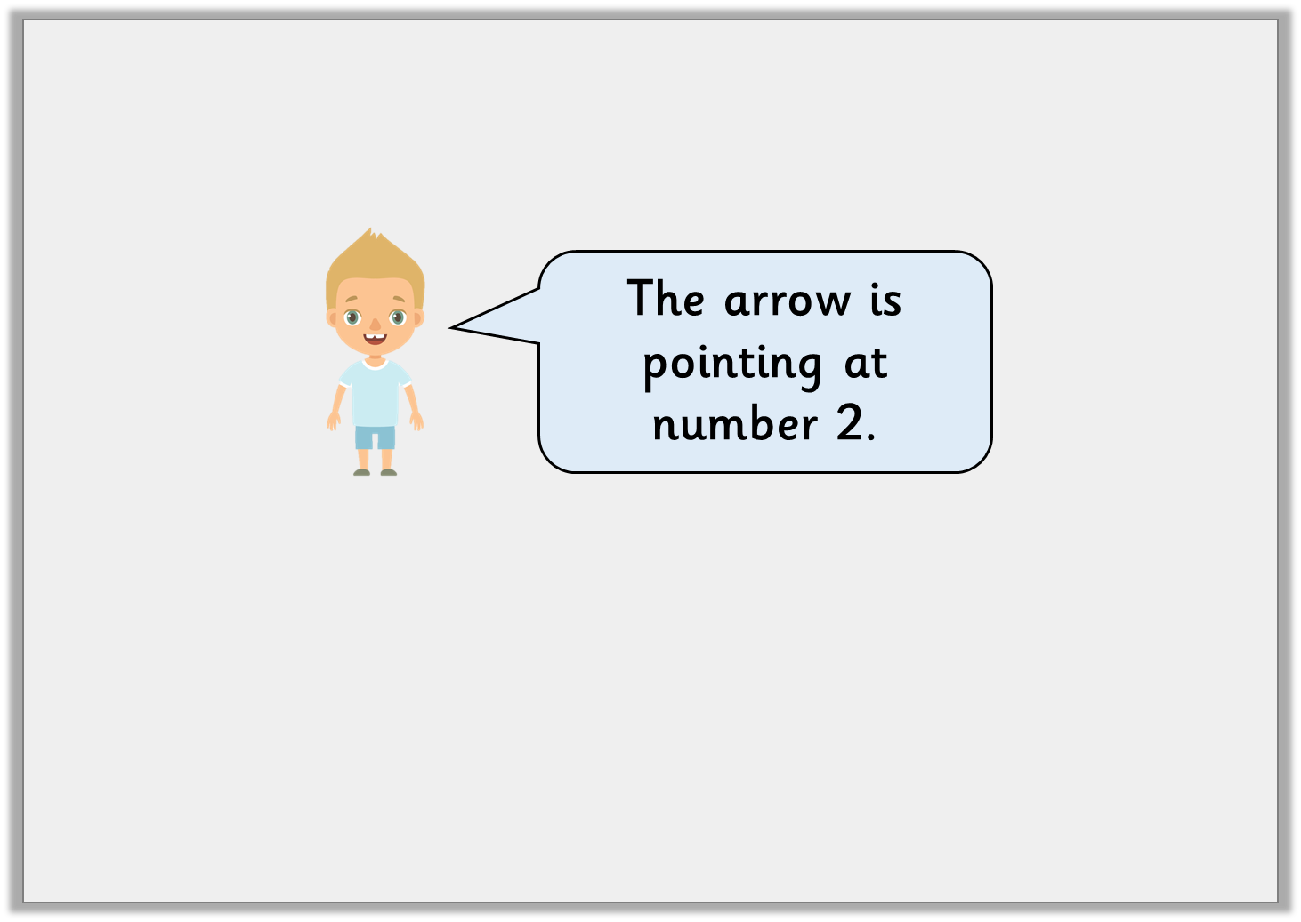

Reasoning 1
Joseph says:
Is he correct? Explain why.
The arrow is pointing at number 2.
0
© Classroom Secrets Limited 2018

Slide 8
Reasoning 1
Joseph says:
Is he correct? Explain why.
Joseph is correct as the number line goes 0, 1, 2.
The arrow is pointing at number 2.
0
© Classroom Secrets Limited 2018

Slide 9

Reasoning 2
Michael draws a number line and shows it to Rick. Rick notices that Michael has made a mistake. What has Michael done wrong on his number line?
0
1
8
3
4
5
6
7
2
9
10
© Classroom Secrets Limited 2018

Slide 10
Reasoning 2
Michael draws a number line and shows it to Rick. Rick notices that Michael has made a mistake. What has Michael done wrong on his number line?
Michael has put the numbers 2 and 8 the wrong way round on his number line.
0
1
8
3
4
5
6
7
2
9
10
© Classroom Secrets Limited 2018

