Slide 1


Year 1 – Autumn Block 4 – Place Value – Numbers from 11 to 20
About This Resource:
This PowerPoint has been designed to support your teaching of this small step. It includes a starter activity and an example of each question from the Varied Fluency and Reasoning and Problem Solving resources also provided in this pack. You can choose to work through all examples provided or a selection of them depending on the needs of your class.
National Curriculum Objectives:
Mathematics Year 1: (1N2c) Read and write numbers from 1 to 20 in numerals and words
More Year 1 Place Value resources.
Did you like this resource? Don’t forget to review it on our website.
© Classroom Secrets Limited 2018

Slide 2
Year 1 – Autumn Block 4 – Place Value
Step 2: Numbers from
11 to 20
© Classroom Secrets Limited 2018

Slide 3
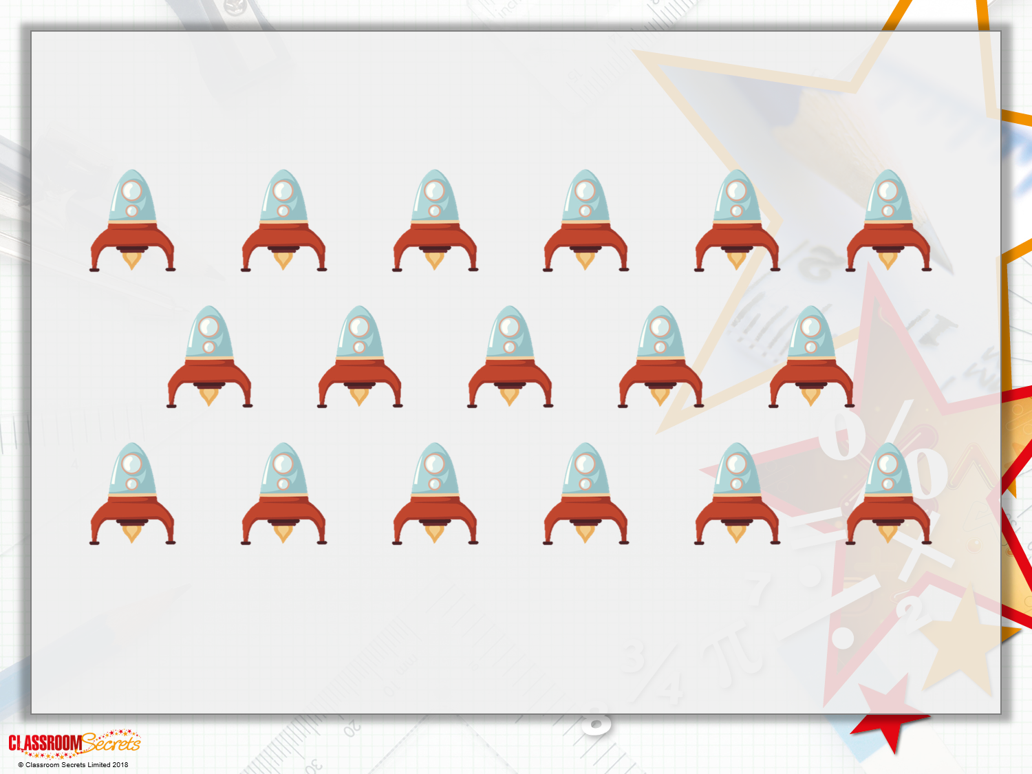
Introduction
How many rockets are there? Circle the correct number below.
14 | 15 | 16 | 17

Slide 4
Introduction
How many rockets are there? Circle the correct number below.
14 | 15 | 16 | 17

Slide 5



Varied Fluency 1
When put together, which two pieces of
Numicon make thirteen?
A
B
C
© Classroom Secrets Limited 2018

Slide 6
Varied Fluency 1
When put together, which two pieces of
Numicon make thirteen?
A and B
A
B
C
© Classroom Secrets Limited 2018

Slide 7
Varied Fluency 2
Write the following numbers in words:
14
17
11
© Classroom Secrets Limited 2018

Slide 8
Varied Fluency 2
Write the following numbers in words:
14 | fourteen
17 | seventeen
11 | eleven
© Classroom Secrets Limited 2018

Slide 9
Varied Fluency 3
Complete the number sequence.
15, 14, 13, ____ , ____
© Classroom Secrets Limited 2018

Slide 10
Varied Fluency 3
Complete the number sequence.
15, 14, 13, ____ , ____
12
11
© Classroom Secrets Limited 2018

Slide 11
Varied Fluency 4
Match the pairs.
19
eighteen
11
nineteen
16
18
fourteen
15
fifteen
© Classroom Secrets Limited 2018

Slide 12
Varied Fluency 4
Match the pairs.
19
eighteen
11
nineteen
16
18
fourteen
15
fifteen
© Classroom Secrets Limited 2018

Slide 13

Reasoning 1
Alice is thinking of a number.
She says the number is between 16 and 19.
Who is correct? Explain why.
The number might be 18.
The number must be 17.
Talissa
Robb

Slide 14
Reasoning 1
Alice is thinking of a number.
She says the number is between 16 and 19.
Who is correct? Explain why.
Talissa is correct because…
Robb is incorrect because…
The number might be 18.
The number must be 17.
Talissa
Robb

Slide 15
Reasoning 1
Alice is thinking of a number.
She says the number is between 16 and 19.
Who is correct? Explain why.
Talissa is correct because the number could be 17 or 18. She has recognised that there are other possibilities. Robb is incorrect because he thinks the only possibility is 17.
The number might be 18.
The number must be 17.
Talissa
Robb

Slide 16
Reasoning 2
Carla puts some number cards in order so
that they count backwards.
Is Carla correct? How do you know?
19
17
18
16
© Classroom Secrets Limited 2018

Slide 17
Reasoning 2
Carla puts some number cards in order so
that they count backwards.
Is Carla correct? How do you know?
Carla is not correct because…
19
17
18
16
© Classroom Secrets Limited 2018

Slide 18
Reasoning 2
Carla puts some number cards in order so
that they count backwards.
Is Carla correct? How do you know?
Carla is not correct because she has put 17 and 18 in the wrong order.
The numbers should be 19, 18, 17, 16.
19
17
18
16
© Classroom Secrets Limited 2018

Slide 19
Problem Solving 1
Tywin is guessing the code to unlock the elevator door.
He knows the first two numbers.
The last number is more than eleven and less than fifteen.
What could the missing number be? Give your answer as a number and a word.
18
11
?
© Classroom Secrets Limited 2018

Slide 20
Problem Solving 1
Tywin is guessing the code to unlock the elevator door.
He knows the first two numbers.
The last number is more than eleven and less than fifteen.
What could the missing number be? Give your answer as a number and a word.
12, twelve; 13, thirteen; 14, fourteen
18
11
?
© Classroom Secrets Limited 2018

